Slide 1
BrainSafe AI
A BBB-gated, multi-endpoint
predictor of small-molecule
action in the human brain
47 deployed endpoints across 16 conditions. What the system computes, what is known about it, and what is not.
Every figure in this deck is read from an artefact at build time.
Notes:
This is the long-form explanation. The four thesis figures embedded here are the same files the chapters cite, so nothing shown can drift from the repository.

Slide 2
1
The problem is a coupling, not a prediction
Two questions that are usually answered by two different tools, and must be answered together
Does it reach the brain?
An exposure question. Answered by barrier models, physicochemical rules, and PK.
1
Does it do anything there?
An engagement question. Answered by target-activity models, one per protein.
2
Neither answer is useful alone
A potent ligand that does not cross is not a CNS drug. A permeant molecule with no mechanism is not either. The product is what a project needs, and it is what almost no server returns.
3
BrainSafe computes the product explicitly: an engagement signal per target, routed to the conditions that mechanism touches, then multiplied by a predicted barrier probability. The multiplication is the design claim, and Chapter 7 tests it.
Chapters 1 and 7
Notes:
Resist the urge to call this novel. The claim is that the coupling is made explicit and then tested, not that nobody has multiplied two numbers before.

Slide 3
2
What the system is, in numbers
Counted from models_rf/ and the panel registry at build time, not restated
47
16
8
6
deployed endpoints, of 52 trained. Five withdrawn on evidence
conditions, reached from 51 targets through a curated pathway graph
core classifiers with the full uncertainty stack
deployed endpoints fail the reliability gate and say so on every result
One prediction is assembled from many estimators trained on different data under different label rules. There is no single model, and describing the system by a panel mean is the one summary guaranteed to mislead: the endpoints are not interchangeable and their sensitivities run from 0.303 to 0.993.
Endpoints failing the gate: COX2, GABA_A, GluN2B, P2X7, SIRT1, TAAR1.
models_rf/binder_modes.json; results/tables/rf_cv_summary.csv
Notes:
If asked why five were withdrawn, the answer is on the falsification slide: they fired on glucose, urea and lactate.

Slide 4
I
How a prediction is made
Features, forests, and the five operations that turn a probability into a reported condition
Notes:
Four slides. The two figures carry most of it; the words between them are the parts a figure cannot say.

Slide 5
3
One representation, one estimator family
A fixed 1,036-column vector per compound, and a random forest per endpoint
The feature vector
The estimator
1,024
ECFP-4 bits, folded
300
trees per forest
12
physicochemical descriptors
2 / 4
minimum samples per leaf, core / binder
1,036
columns, identical for every endpoint
balanced
class weights, and a fixed seed
Computed on the desalted, neutralised parent
Chosen by benchmark, not by preference
Five model families were compared on the same folds. The forest was not the best on every task, and the thesis says so.
It wins 7 of 8 classification endpoints and 0 of 5 regression endpoints, where gradient boosting is ahead. Against the deployed panel it is statistically indistinguishable from both boosting methods pooled (p = 0.735 and 0.893, Wilcoxon signed-rank paired by endpoint). The forest is kept for its calibration behaviour and its out-of-bag structure, not because it is measurably more accurate.
results/tables/model_comparison.csv; results/tables/model_family_significance.csv
Notes:
Volunteer the 0 of 5. A referee who finds it unaided will discount the 7 of 8.

Slide 6
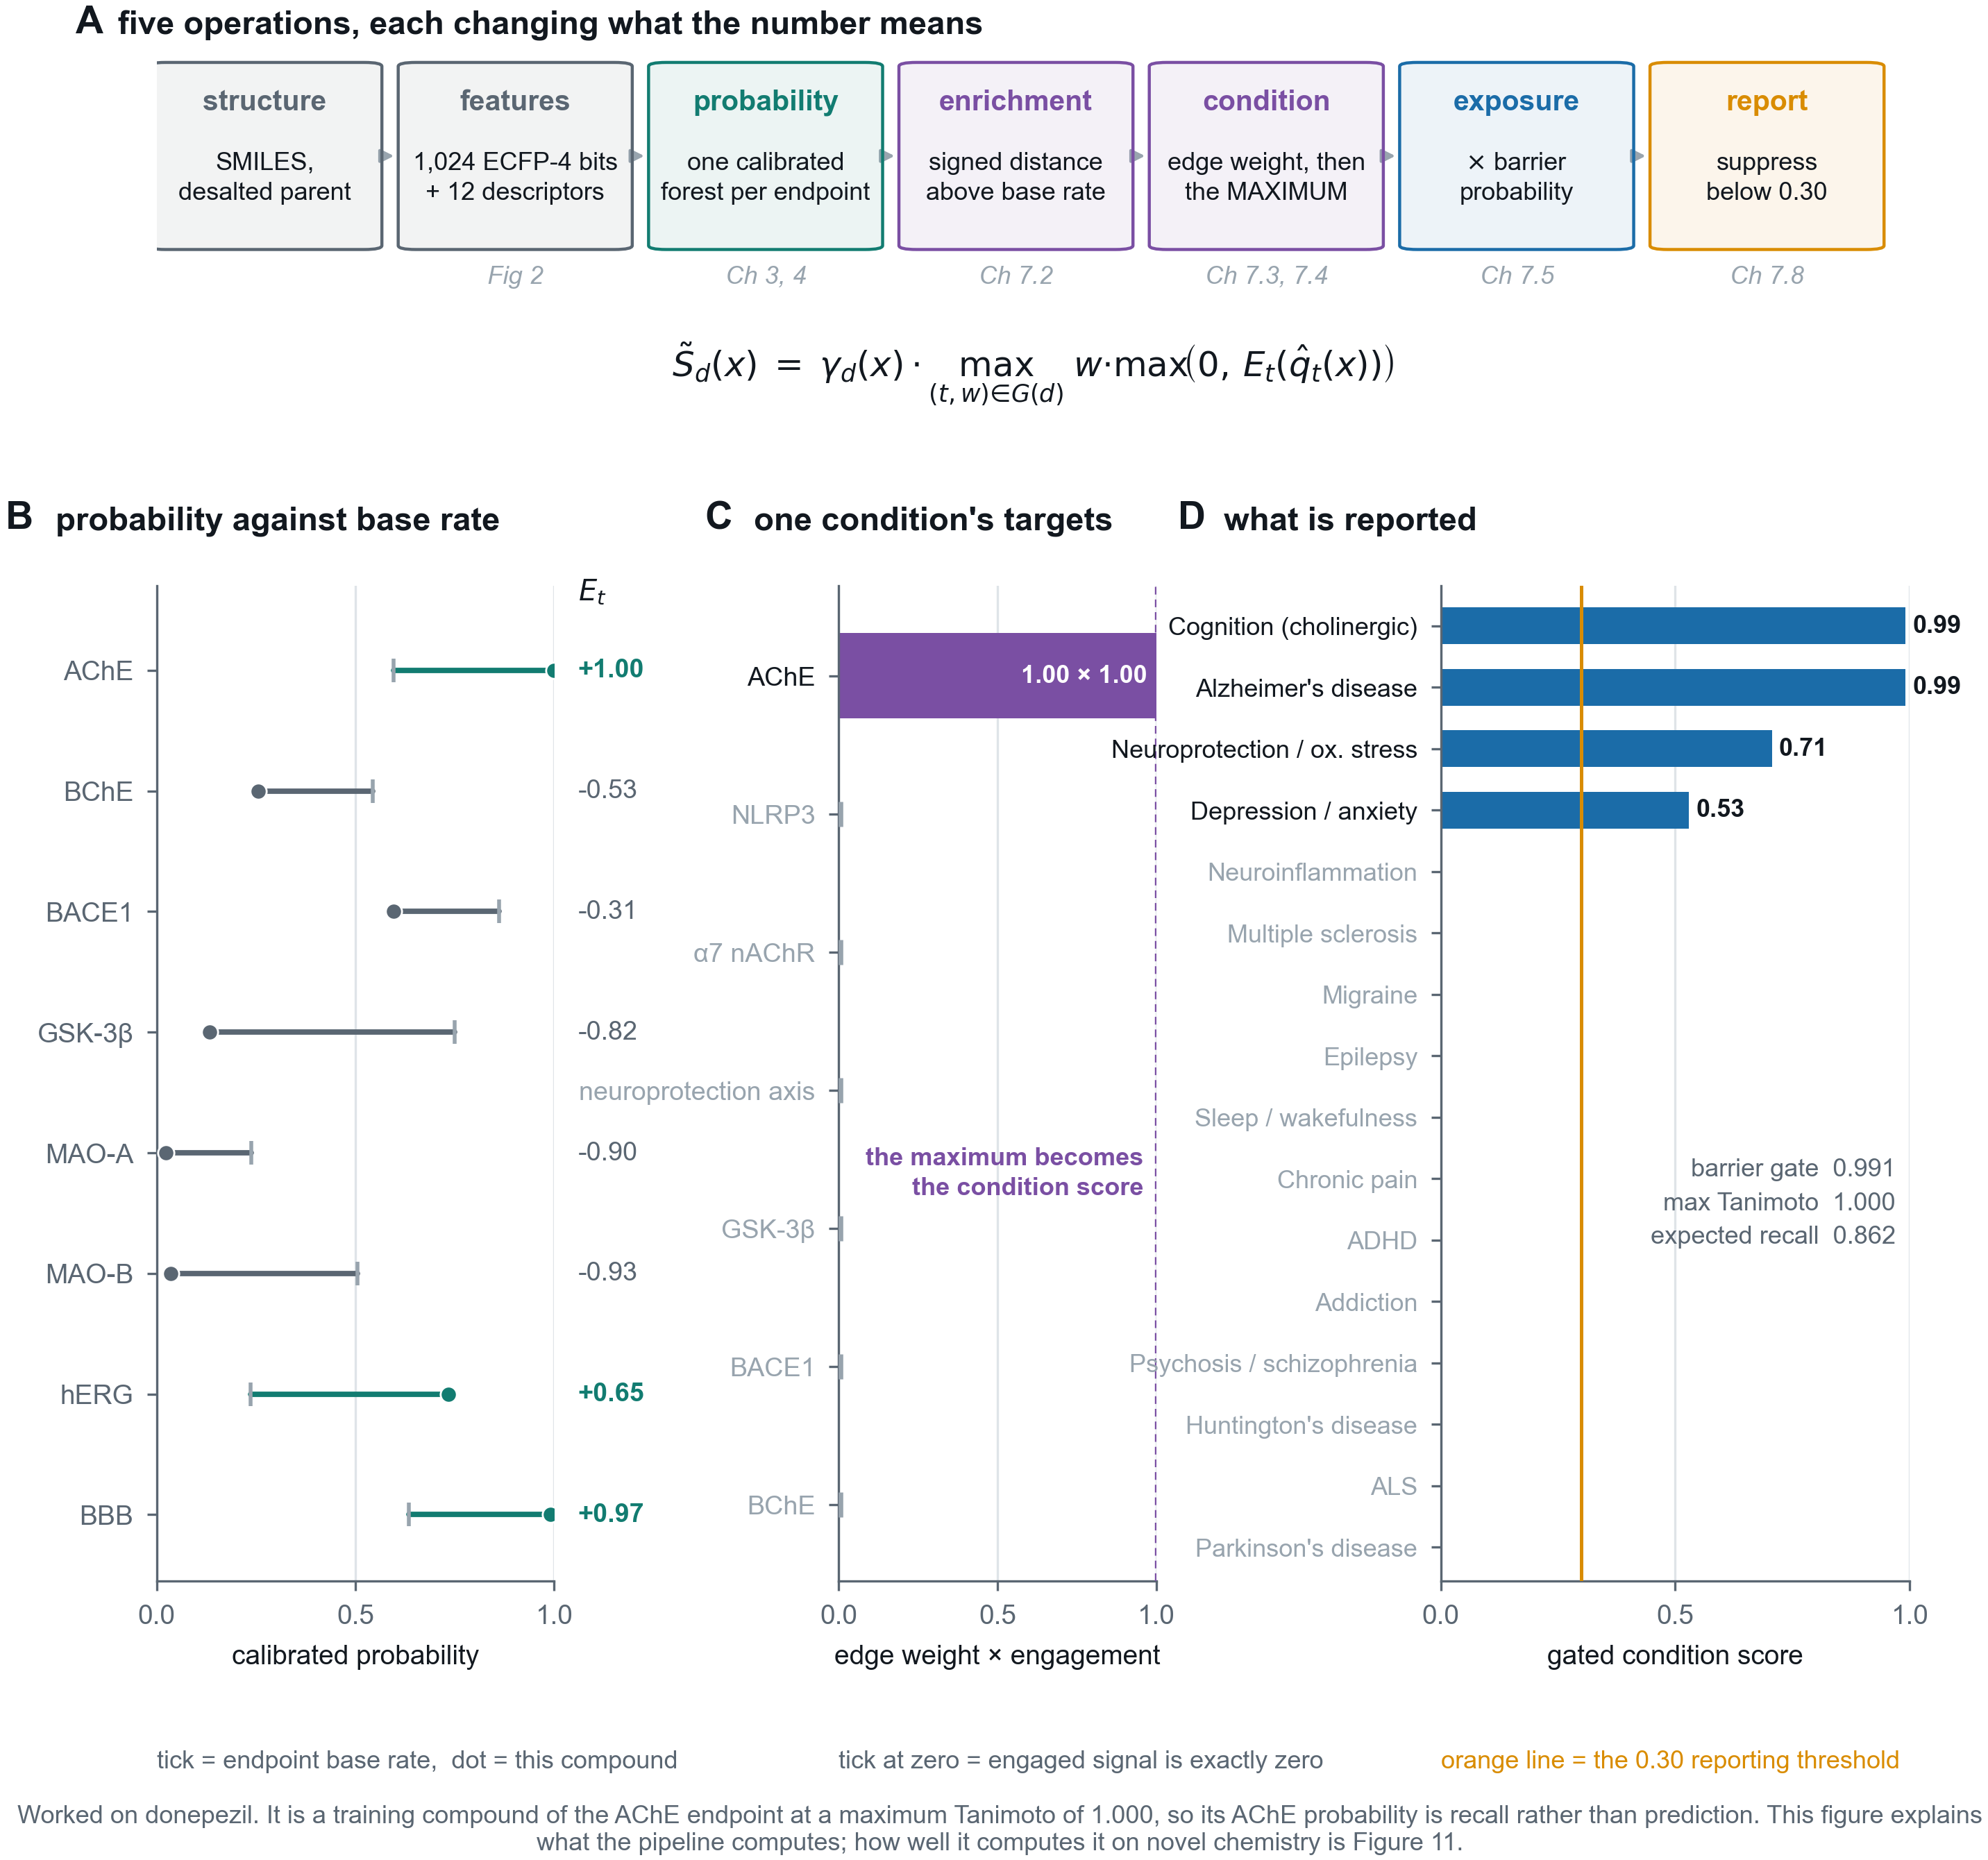
4
What the system computes, end to end
Five operations, each of which changes what the number means
1
A probability is not a score
Panel B. The same 0.60 means opposite things at an endpoint where a quarter of compounds are active and one where six sevenths are. Enrichment fixes the reference point.
2
One mechanism, not a tally
Panel C. Only the strongest engaged target contributes to a condition, because homologous targets are not independent observations.
3
The gate decides whether to speak
Panel D. Twelve of the sixteen conditions fall below the reporting threshold here, and the expected recall at this compound's distance is printed beside the answer.
Figure T1. Worked on donepezil, scored through the served pipeline.
Notes:
Walk the top row left to right, then say that panel B is the step people miss: a probability is not comparable across endpoints, which is why enrichment exists.

Slide 7
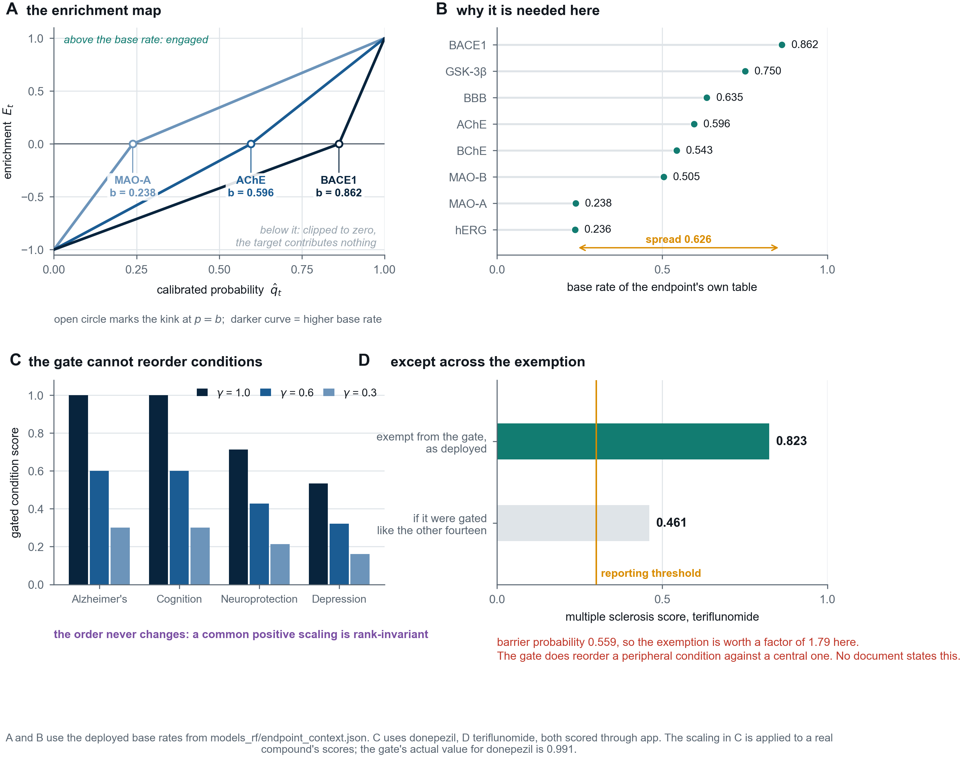
5
The two transforms that are easiest to misread
Enrichment over base rate, and an exposure gate that cannot reorder conditions
1
The base rates span 0.626
Panels A and B. A single probability threshold applied across the panel would be asking a different question at every endpoint.
2
The gate is a filter, not a discriminator
Panel C. Multiplying fourteen conditions by the same number is rank-invariant, so gating cannot sharpen a disease call. It decides whether anything is reported at all.
3
With one exception nobody had stated
Panel D. Migraine and multiple sclerosis are gate-exempt, so the gate does reorder them against the central conditions. Worth a factor of 1.79 on teriflunomide.
Figure T2. Base rates from the deployed context; C donepezil, D teriflunomide.
Notes:
Panel D is the one to dwell on. H3 is refuted for the fourteen central conditions, and the exemption for migraine and multiple sclerosis is a qualification no document in the project states.

Slide 8
6
Why a maximum and not a sum
The aggregation rule, and the evidence that made it defensible
If engaged targets were independent
They are not independent
summing them would be the right thing to do: three separate observations of activity are stronger evidence than one, and a sum would say so.
Across 400 approved drugs, 37 targets fire at least once but span only 16 independent directions. Five homologous pairs co-fire above φ = 0.5: μ and κ opioid at 0.798, SERT and NET at 0.732, D2 and D3 at 0.720.
So a sum would count the same pharmacology two or three times. The maximum takes the strongest engaged mechanism and nothing else, which understates the evidence rather than overstating it. That is the safer direction for a tool whose purpose is to avoid a wasted experiment.
The interface now groups engaged targets by homology family and quotes the measured correlation wherever two members fire, because reporting three engaged targets as three findings is the error, not the co-firing itself.
inversion/results/H8_panel_independence.csv, H8_family_correlation.csv
Notes:
This is the one design choice whose stated justification survived testing, and it survived because H8 supplied the evidence for it.

Slide 9
II
What is known about it
Cross-validation, calibration, thresholds, and three external tests
Notes:
This is the evidence section. Lead with the scaffold split and the permutation null, because together they answer the leakage question a referee asks first.

Slide 10
7
Two cross-validation regimes, and why both are reported
A single AUROC is the number most easily overstated in this field
regime
mean
lowest
highest
Random 10-fold
0.9575
0.8990
0.9764
Scaffold-grouped 10-fold
0.9252
0.8777
0.9648
The scaffold figure is the one to quote. A random split of medicinal-chemistry data holds out close analogues of its own training set, because the published record is series, so it answers a question no user ever asks.
And neither figure is obtainable without the labels. With labels permuted, the same pipeline on the same folds returns 0.4959 and 0.5026, every one of the sixteen values within 0.0200 of chance.
results/tables/rf_cv_summary.csv; results/tables/permutation_null.csv
Notes:
The permutation null closes the leakage question. It also shows scaffold grouping alone confers nothing, which is the specific route a referee will ask about.

Slide 11
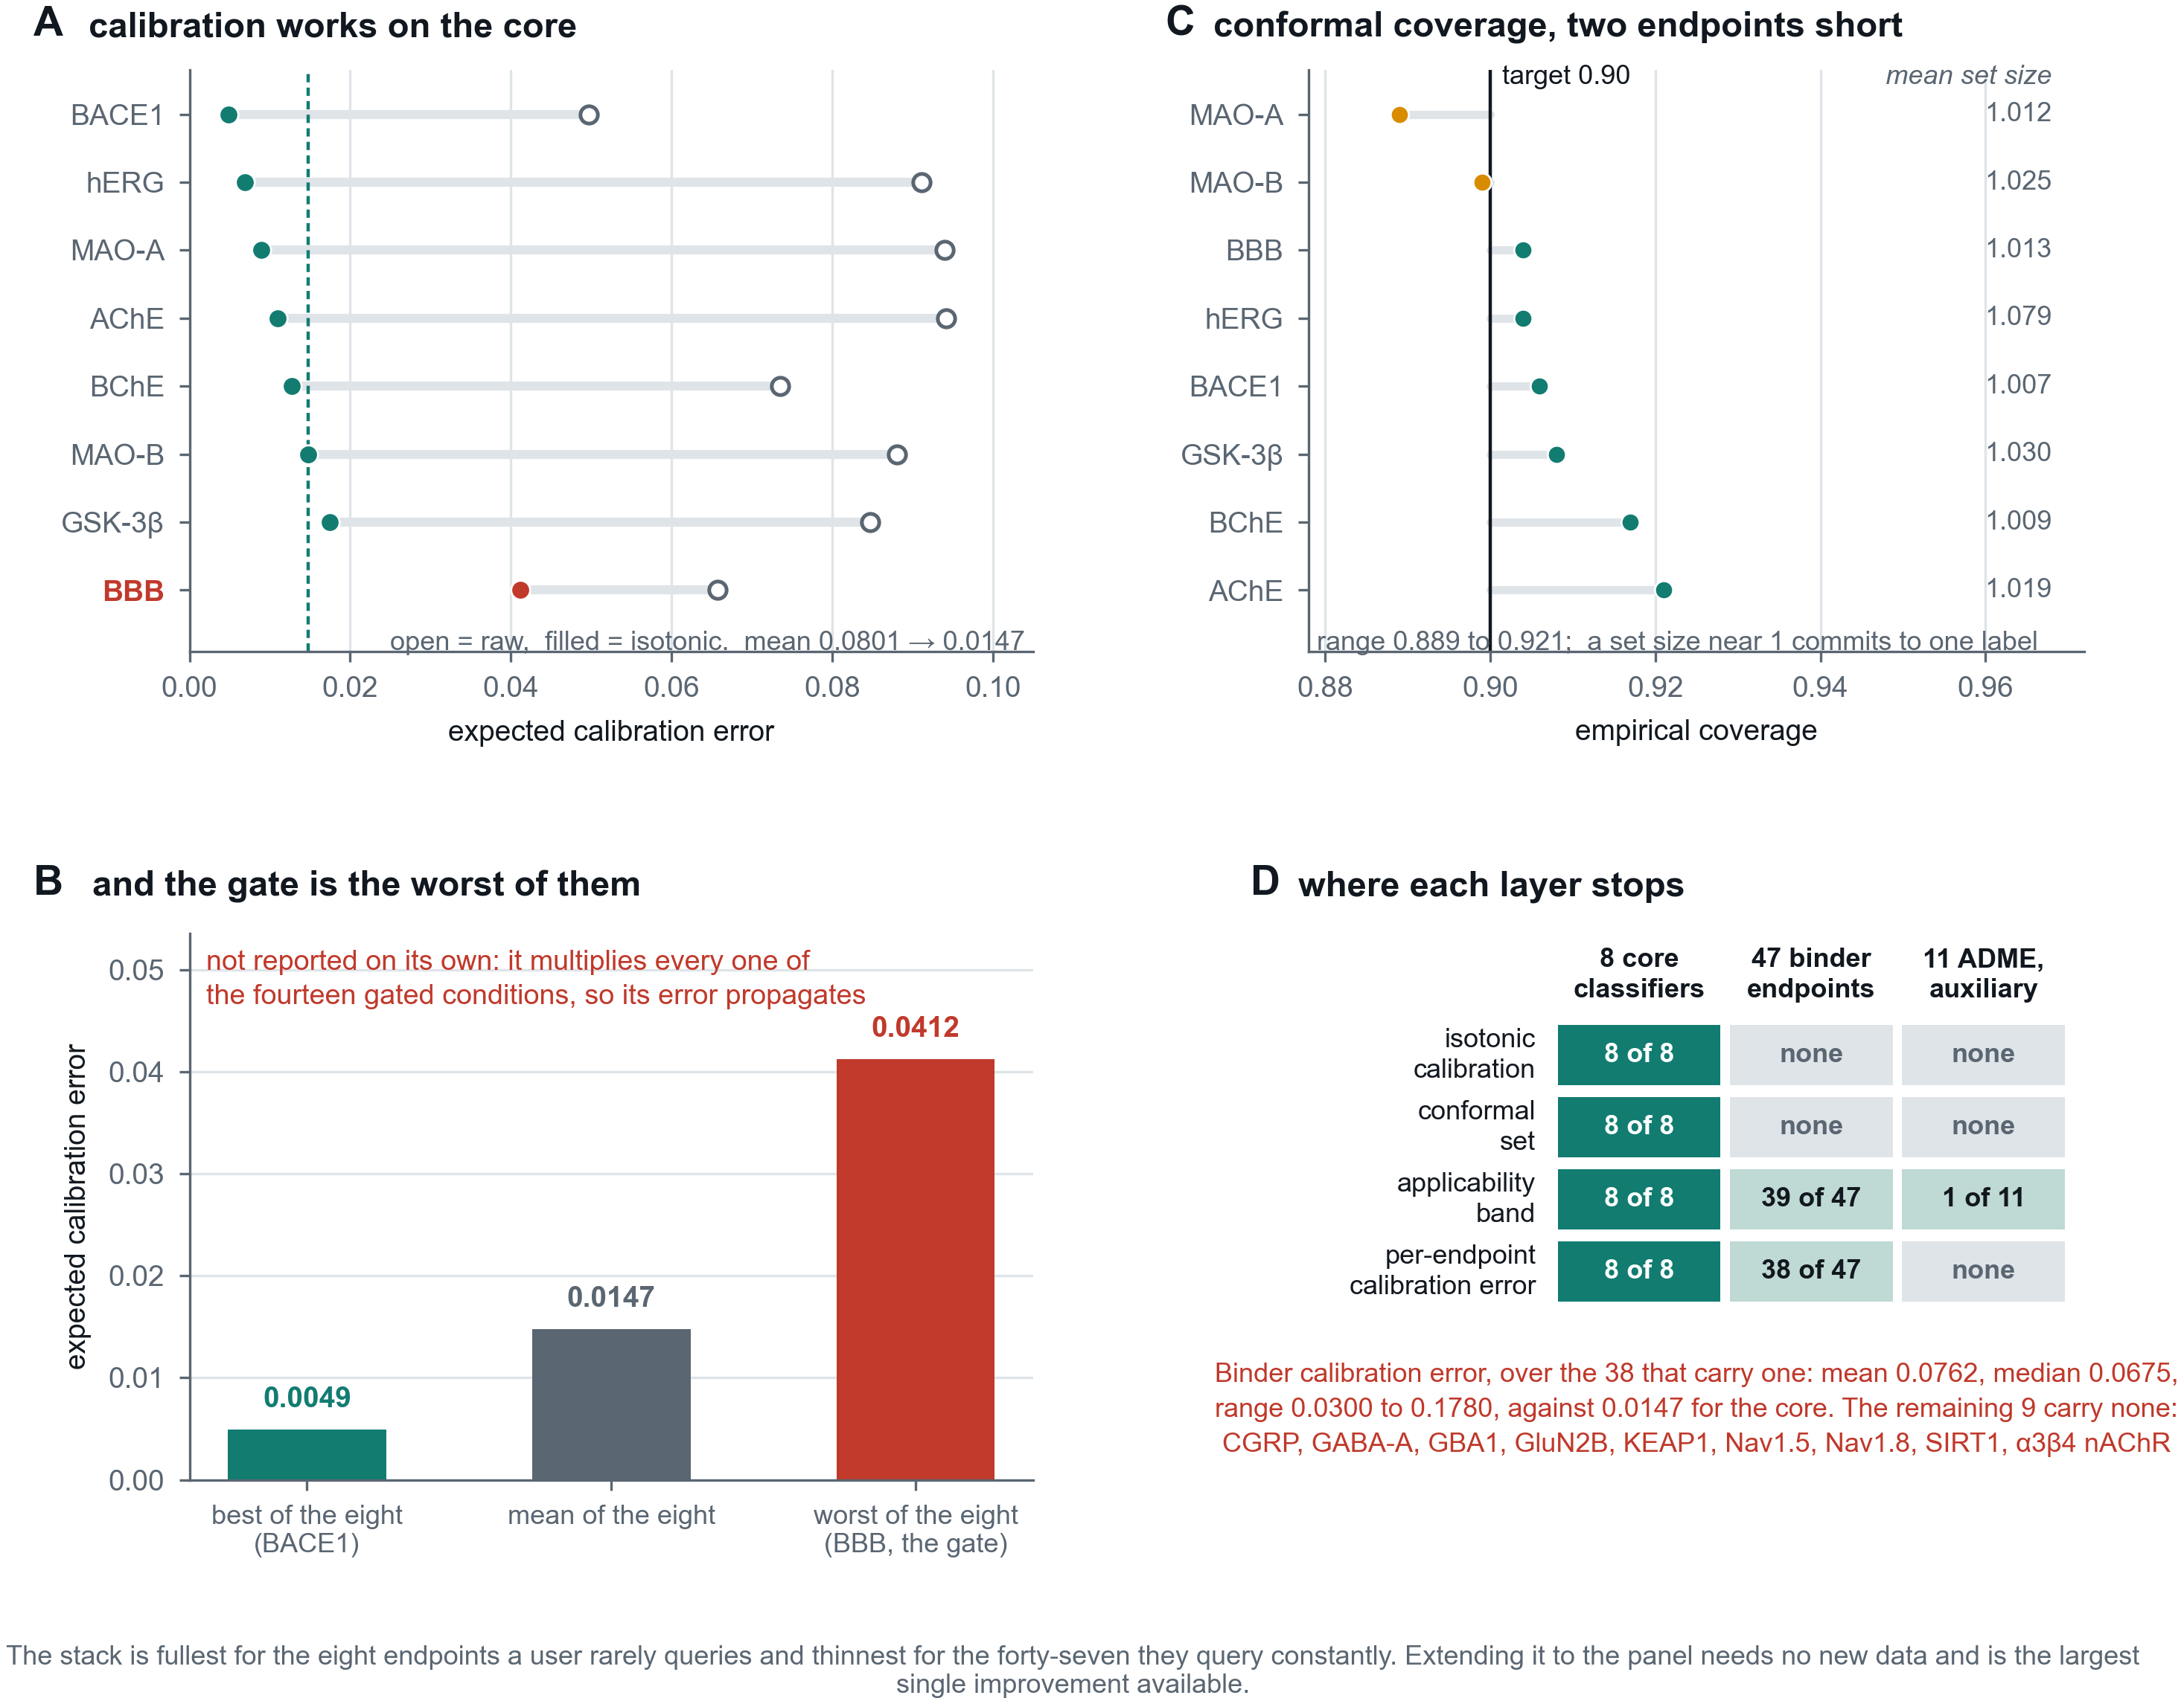
8
The uncertainty stack, and where it stops
Calibration, conformal coverage, an applicability band, and an asymmetry worth stating
1
Calibration works where it is applied
Panel A. Expected calibration error falls from 0.0801 to 0.0147 across the eight core classifiers.
2
And the gate is the worst of the eight
Panel B. 0.0412, nearly three times the mean, on the one model whose output multiplies every disease score rather than being reported alone.
3
The stack is thinnest where it is used most
Panel D. None of the 47 deployed binder endpoints carries a conformal statement. The 38 with a measured calibration error average 0.0762; the other 9 carry none.
Figure T3. calibration.csv, rf_conformal.csv, integrity_calibration_per_target.csv.
Notes:
Panel B is the uncomfortable one and should be said aloud: the barrier model is the worst-calibrated of the eight, and it multiplies every disease score.

Slide 12
9
Thresholds are a separate problem from probabilities
Three disjoint background pools, and two constraints of which the harder binds
Decoy pool, 60%
Threshold pool, 20%
Evaluation pool, 20%
trains the binder classifiers against chemistry presumed inactive
sets each operating point
measures the false-positive rate at that point
Assignment by blake2b(salt + canonical SMILES) mod 100, so a compound's pool is a property of the compound and never of the run.
Each threshold is then set by the harder of two constraints
1
separation from background
a false-positive rate at or under 5 per cent on random chemistry
2
separation from measured inactives
compounds tested at that same target and reported as non-binders
The second is usually the harder, and it is the reason several endpoints have low sensitivity: relaxing them would mean calling compounds an experiment has already reported as non-binders.
Chapter 5; results/tables/final_thresholds.csv
Notes:
Higher sensitivity is available at any time. It would make the server less truthful.

Slide 13
10
What a silence is worth
The number that makes a negative result interpretable, and the correction it required
0.7638
0.835
0.303
0.993
panel mean sensitivity at the deployed threshold, on held-out actives
median
lowest, GABA-A
highest, CGRP
For most of this project's life the published figure was 0.8983, under a label reading "held out by scaffold". It was not held out: the last of four scripts writing that field scored every active in each endpoint table, roughly four fifths of which the model had been fitted on. The held-out mean is 0.7638, and six endpoints fire for fewer than half their own actives where the published figure had none.
A silence is therefore not evidence of inactivity, and the server reports the expected recall at that compound's distance from training chemistry beside every negative result. The falsification suite had recorded the correct figure three weeks before anything compared it with the registry.
models_rf/binder_modes.json; results/tables/sensitivity_reconciliation.csv
Notes:
Tell this as a defect found and fixed. It is the strongest evidence that the project's checking works, and hiding it would waste that.

Slide 14
III
Does it hold outside the training set?
One genuine external set, a prospective simulation, and a different curator
Notes:
The composition finding is the payload here: an apparent temporal decay that is a property of what each split holds out, not of time.

Slide 15
11
The one genuine external set
FDA-curated approved drugs absent from the barrier model's training database
set
n
AUROC
sensitivity
specificity
FDA-curated, not in B3DB by InChIKey
306
0.7645
0.7734
0.6505
FDA-curated, also distinguishable from training in feature s…
241
0.7934
0.7661
0.6571
of which: feature-identical to a training compound
65
0.7102
0.8125
0.6364
The middle row is the claim. Excluding overlap by InChIKey is not enough to call a compound unseen, because the InChIKey separates stereoisomers and salts and the featuriser does not. The third row is the memorisation the first row contains.
For the target panel no external set of this kind exists, and the reason is structural: for most of these proteins the public record is the training set.
results/tables/external_bbb_validation.csv
Notes:
The gap between rows one and two, 0.7645 against 0.7934, is the memorisation. Quote the second and explain why.

Slide 16
An apparent temporal decay that is a composition effect
Models refitted before a date cutoff, thresholds frozen, then scored on 15,854 actives measured afterwards across 39 of 47 endpoints.
Read in aggregate the time split looks like decay: sensitivity 0.4886 against 0.8715 for a size-matched random control.
It is not decay. 83.3 per cent of the random split's test compounds are close analogues of its own training set, against 16.3 per cent for the time split. The two splits are not testing comparable populations.
Read band by band the AUROC gap of 0.128 falls to at most 0.081, and three test sets built by unrelated rules trace one curve.
results/tables/external_prospective.csv, external_novelty_strata.csv
Notes:
The residual is not attributed: the random split yields only 212 novel actives across 39 endpoints, too few for a paired within-band comparison. Say so.

Slide 17
12
Accuracy is a function of chemical distance
The limitation that bounds every other number in this deck
nearest-training Tanimoto
actives
AUROC
recall
below 0.40, a different chemotype
4,366
0.6711
0.1612
0.40 to 0.55, a related series
5,228
0.7645
0.5532
0.55 to 0.70, the same series
3,674
0.7871
0.7403
0.70 and above, a close analogue
2,586
0.8617
0.8616
Recall runs 0.1612 to 0.8616, a factor of five. Across a database boundary the lowest band falls to 0.0494. On genuinely novel chemistry the tool finds roughly one true activity in six.
No analysis in this thesis improves that. What is established is that the figure is predictable, which is why it is reported beside every negative result.
results/tables/external_novelty_strata.csv
Notes:
If the audience takes one slide away, this is the one. AUROC moves far less than recall because ranking survives what a fixed threshold does not.

Slide 18
13
What it does when there is nothing to find
The behaviour a triage tool is used for most often
0.925
0.0717
0.515
6 of 47
specificity on 1,000 non-CNS compounds, interval 0.907 to 0.9397
of random PubChem structures receive any user-visible finding
of approved drugs receive one, a set active somewhere by construction
endpoints carry a reliability flag on every result
The specificity figure is an upper bound and the artefact labels it as one: the compounds are presumed inactive because nothing is recorded about them, not proven inactive. They are also drawn from within the applicability reference, so the figure does not bound behaviour on genuinely distant chemistry.
H4 tested exactly that and is the suite's weakest supported verdict: on 61 compounds distant from training chemistry the false-positive rate is 0.0164, but with one false positive the 95 per cent interval runs 0.0029 to 0.0872 and contains the 0.0750 comparator. Specificity does not degrade with distance; that it improves is not established.
results/tables/noncns_specificity_summary.csv; inversion/results/H4_*.csv
Notes:
Distinguish the two claims carefully. The null predicted degradation and did not get it, which is a real negative result worth having.

Slide 19
IV
Trying to break it
Ten hypotheses stated so that they could fail, and what the four refutations cost
Notes:
The strongest section. A suite is worth what the project paid for it, and every payment here is a commit rather than a claim.

Slide 20
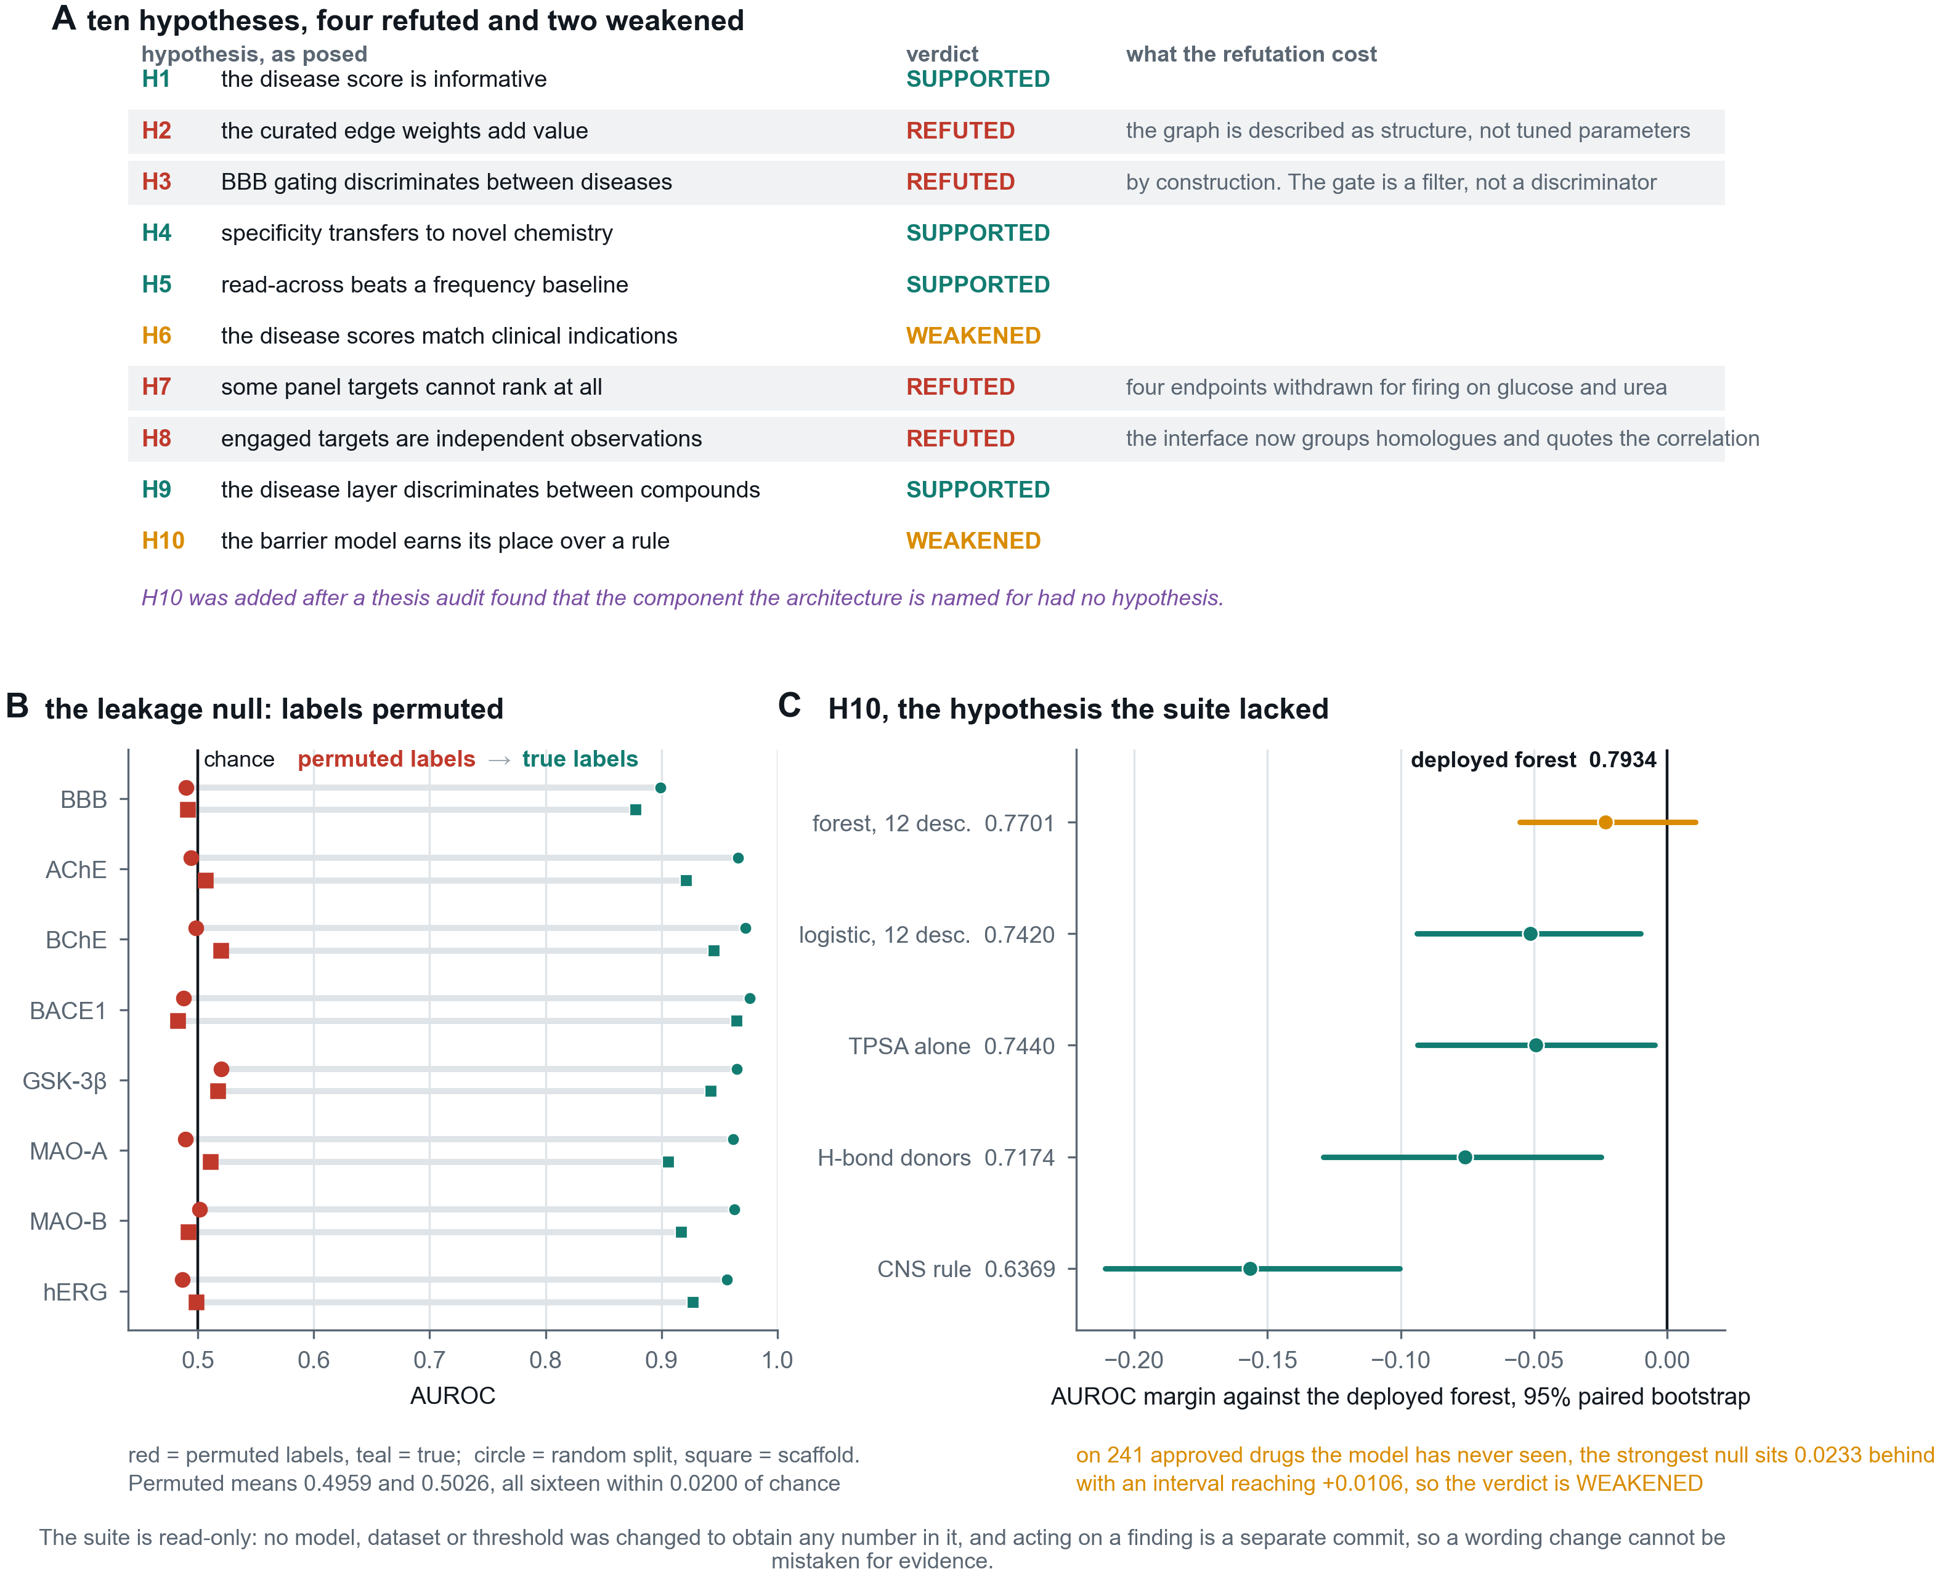
14
The falsification suite
4 of 10 hypotheses refuted, 2 weakened
1
Every hypothesis has a null that could win
Panel A. A test that cannot fail is not evidence, so each claim is paired with a model capable of producing the same apparent success by accident.
2
The cross-validation is not leakage
Panel B. Under permuted labels the same folds return 0.4959 and 0.5026, and scaffold grouping alone confers nothing.
3
The newest hypothesis weakened a claim
Panel C. H10 tests the barrier model against descriptor rules, and its interval on unseen drugs crosses zero.
Figure T4. VERDICTS.csv, permutation_null.csv, H10_barrier_necessity.csv.
Notes:
The suite is worth what the project paid for it, and every payment is a commit rather than a claim: the graph re-described, the gate re-described, the interface changed, four endpoints withdrawn.

Slide 21
15
What the disease layer does and does not establish
Three hypotheses, answering three different questions
against the project's own map
Top-3 accuracy 0.7901 on 7,008 held-out compounds, against a permutation null of 0.1625 and a frequency null of 0.5508. The layer carries real information about mechanism.
H1
against real clinical indications
On 162 drugs whose structure appears nowhere in training, top-3 accuracy is 0.3519 against a frequency null of 0.6543. It beats the permutation null decisively and does not beat a constant answer naming the three commonest CNS indications.
H6
on metrics a constant answer cannot pass
Mean per-indication AUROC 0.6158 against 0.500, beating chance on 7 of 9 indications, from 0.7981 for depression down to 0.4898 for epilepsy.
H9
The honest description: the layer ranks mechanisms and the conditions they touch. It does not predict indication, and two of the nine conditions are not being predicted at all.
inversion/results/H1_disease_layer.csv, H6_clinical_indication.csv, H9_disease_discrimination.csv
Notes:
Epilepsy at 0.4898 is the informative failure: most approved antiepileptics are small, simple and low-affinity, which is the chemistry that sits under a strict cut.

Slide 22
16
The hypothesis the suite lacked
The component the architecture is named for had no test until a thesis audit named the gap
Null: permeability is a bulk property, the twelve descriptors already in the feature vector encode it, and the fingerprint adds nothing.
scaffold hold-out
241 unseen approved drugs
Deployed forest, 1,036 features
0.8779
0.7934
Random forest, 12 descriptors only
0.8441
0.7701
Read as point estimates the fingerprint wins on both. Read with a paired bootstrap of 2,000 resamples, the external interval runs -0.0553 to +0.0106, p = 0.083. It crosses zero.
VERDICT WEAKENED. On the training distribution the fingerprint demonstrably earns its place; on chemistry the model has never seen, its advantage over twelve descriptors is not established. Under a point-estimate rule this would read SUPPORTED, and the suite's own criticism of H4 is why it does not.
inversion/results/H10_barrier_necessity.csv
Notes:
What the barrier model does clearly beat, on both populations and by a wide margin, is the published CNS heuristic: 0.7934 against 0.6369. Say that second, not first.

Slide 23
What the system cannot do
Properties of the science rather than of the housekeeping, and none of them is fixed by tidying.
1
Novel chemistry
Recall 0.1612 on a different chemotype and 0.0494 across a database boundary. A silence there is close to uninformative.
2
Uncertainty coverage
The full stack reaches 8 core classifiers. None of the 47 deployed binder endpoints has a conformal statement; the 38 with a measured calibration error average 0.0762, about five times the core figure, and 9 carry no calibration measurement at all.
3
Natural products
Median fraction sp3 of the library is 0.3448 and only 9.23 per cent of it is sp3-rich and largely non-aromatic. Three endpoints could be scored externally, with two to five actives each.
4
Nothing prospective
Every result here is retrospective. The dates are real, but no compound was predicted before it was measured.
Stated because the alternative is a referee finding them unaided.
Notes:
Do not soften these. The thesis's credibility rests on them being said first.

Slide 24
What this establishes
With the spread rather than the mean wherever one exists.
0.8777 to 0.9648
scaffold-grouped AUROC across the 8 core classifiers, against permuted-label nulls of 0.4959 and 0.5026
0.1612 to 0.8616
recall across four novelty bands, the same curve traced by three independently built test sets
0.7638
panel sensitivity on held-out actives, median 0.835, from 0.303 to 0.993
0.925
specificity on presumed-inactive non-CNS chemistry, an upper bound rather than an estimate
4 of 10
falsification hypotheses refuted, 2 weakened, at the cost of two claims, one interface change and four withdrawn endpoints
Not established: anything prospective, anything about natural-product chemistry, and any advantage for the barrier model over twelve descriptors on chemistry it has not seen.
Notes:
End on the last line. Naming the boundary of the work is stronger than any figure above it, and all three items have a measurement behind them.

