Slide 1
BRAINSAFE AI
Supplementary Material
Figures and supplementary tables. Every value is read directly from the released validation artifacts (supplementary/*.csv); figures are regenerated from out-of-fold predictions. Nothing is hand-entered.
8 figures · 14 supplementary tables (S0–S13)

Slide 2
Part A: Figures
fig1–fig7 + graphical abstract

Slide 3
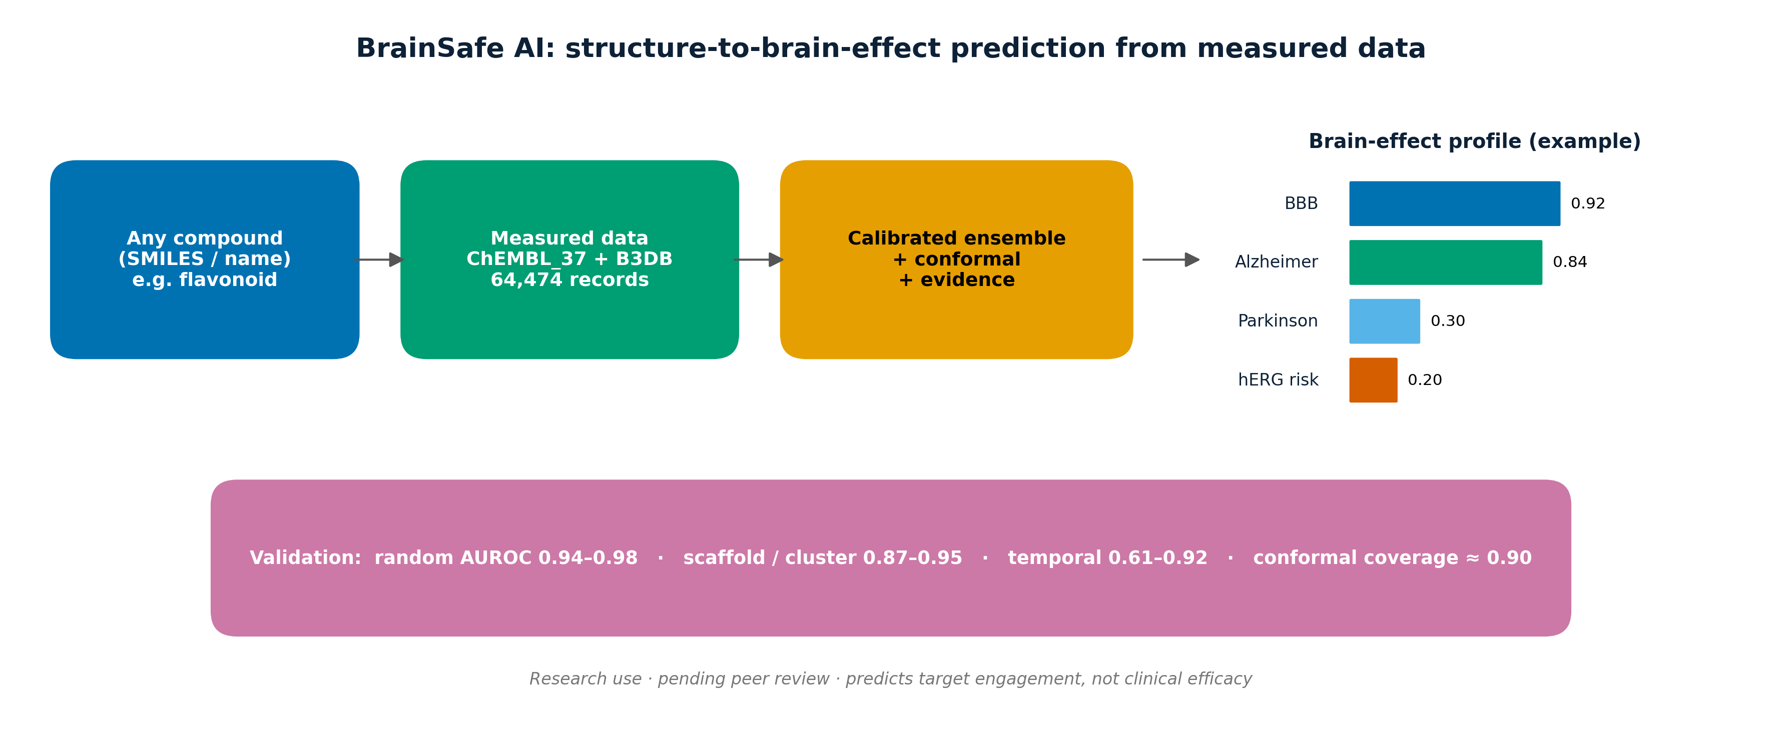
SUPPLEMENTARY · GRAPHICAL ABSTRACT
Graphical abstract. Structure-to-brain-effect prediction from measured data; validation and coverage summarised. The per-compound profile shown is illustrative.

Slide 4
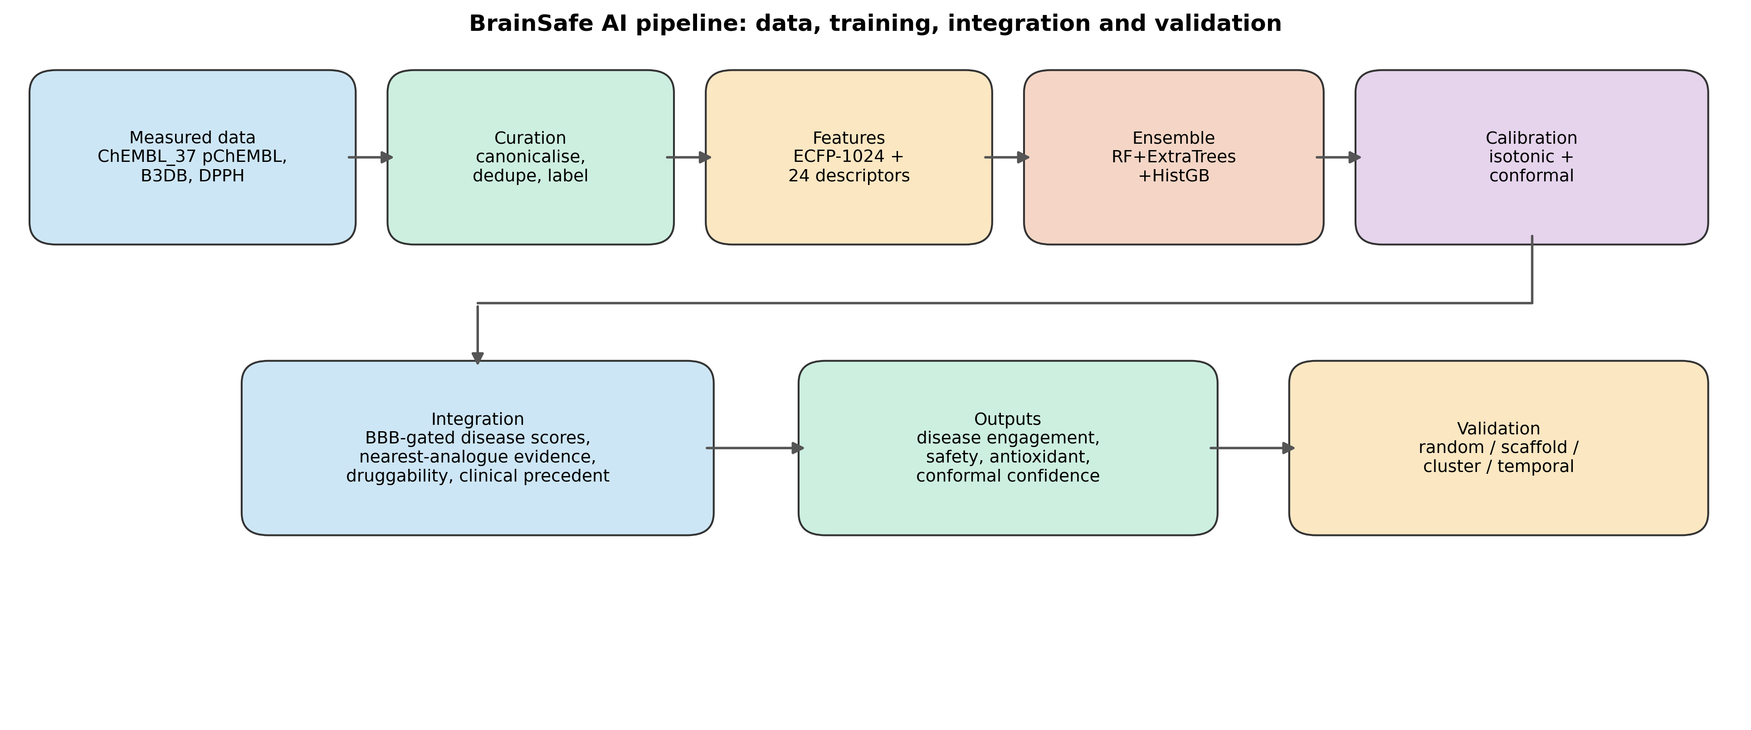
SUPPLEMENTARY · FIGURE 1
Figure 1. BrainSafe AI pipeline: measured data sources -> curation -> ECFP+descriptor featurisation -> ensemble training -> calibration/conformal -> integrated outputs, with the four validation regimes.

Slide 5
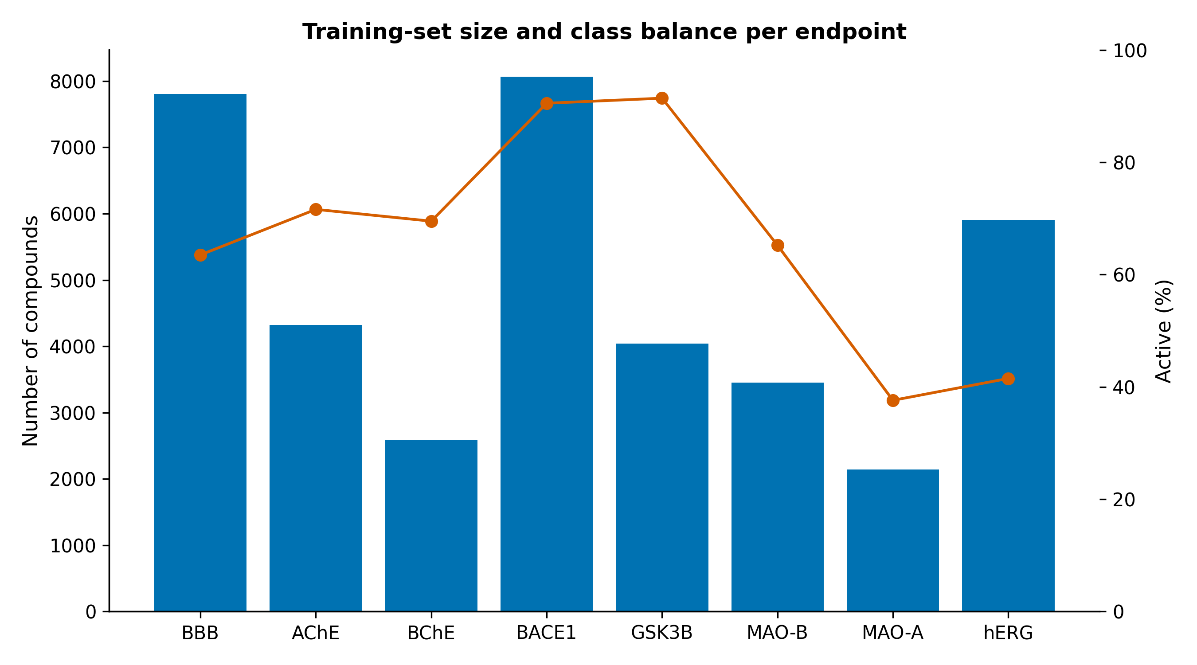
SUPPLEMENTARY · FIGURE 2
Figure 2. Training-set size and class balance for each endpoint (measured records).

Slide 6
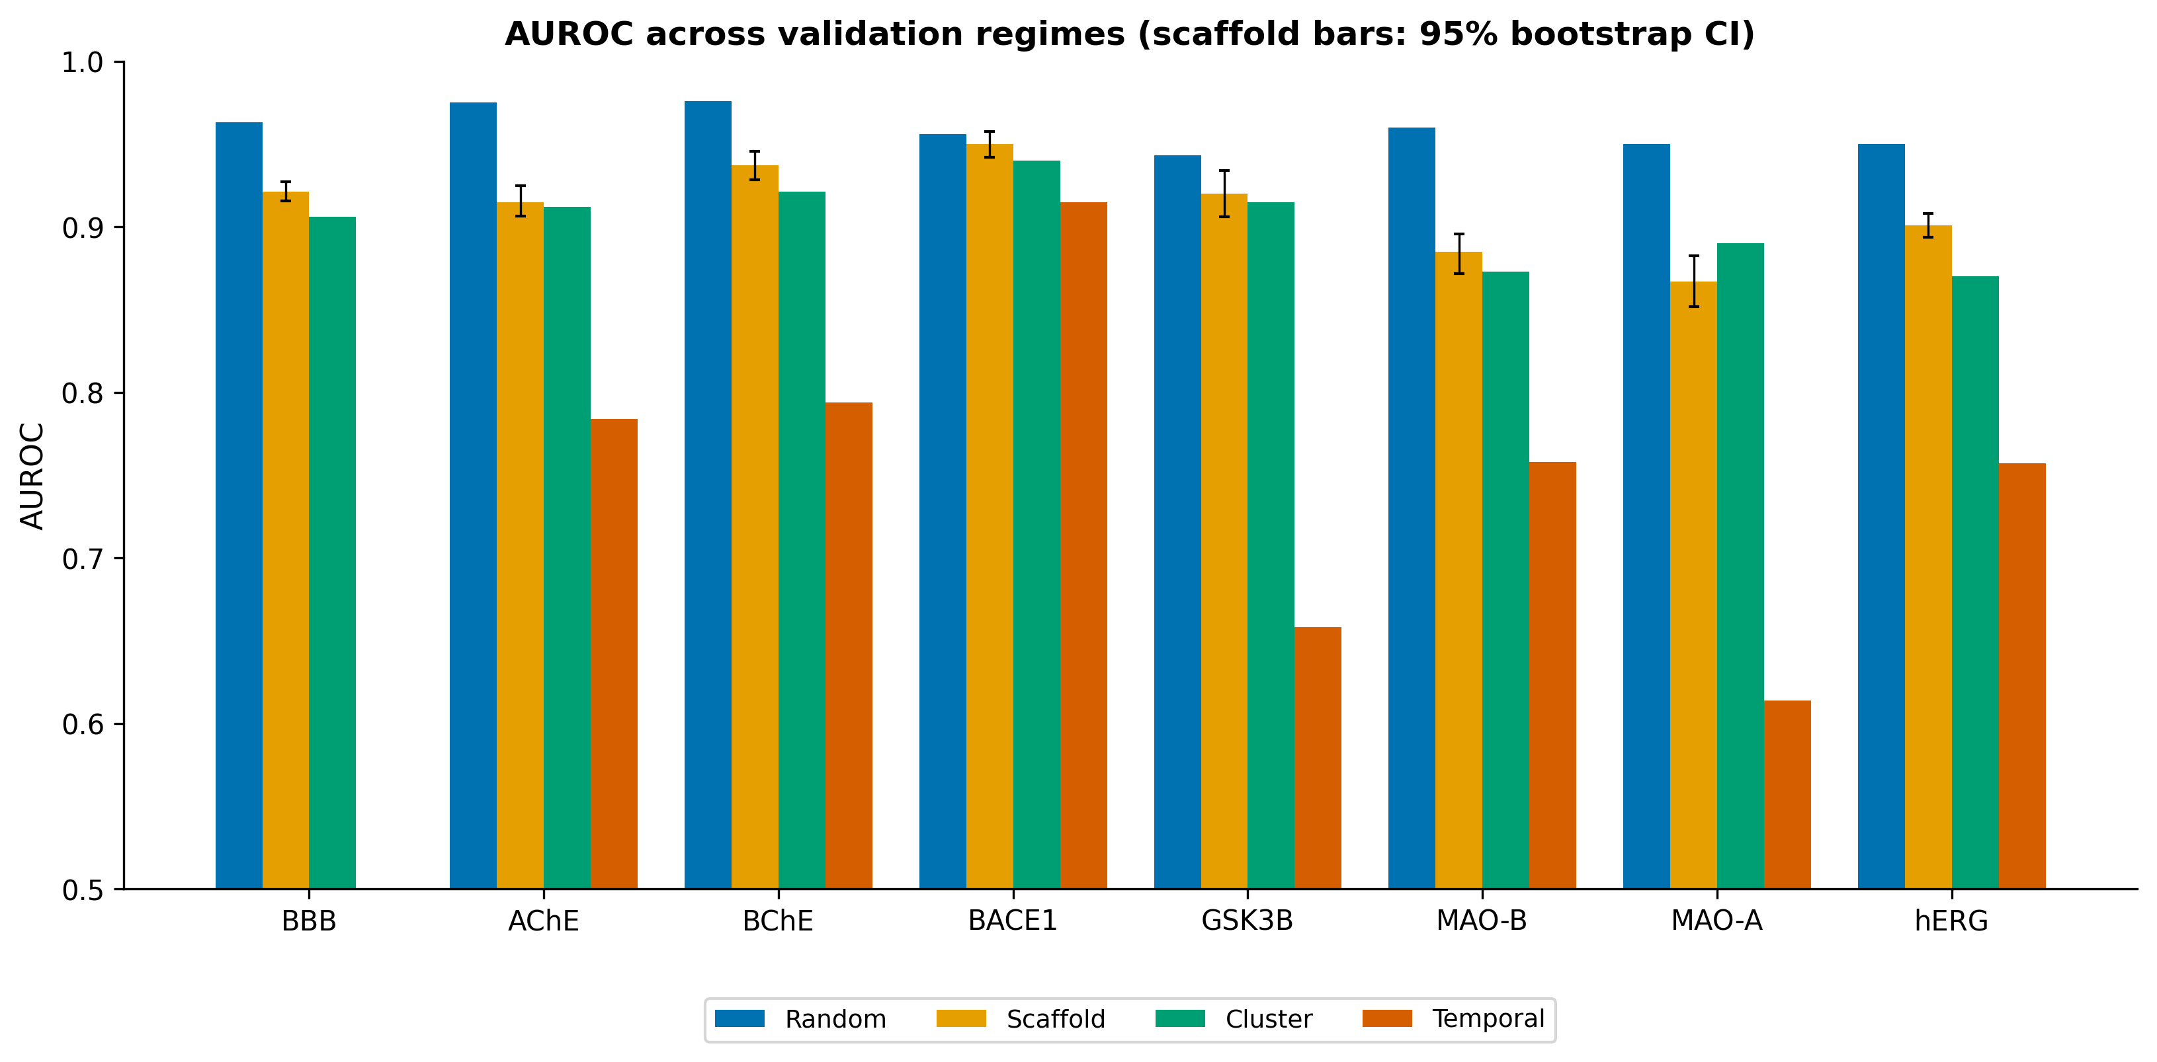
SUPPLEMENTARY · FIGURE 3
Figure 3. AUROC across the four validation regimes (random, scaffold, leave-cluster-out, temporal). Error bars on scaffold bars are 95% bootstrap CIs. BBB has no temporal split (no document year).

Slide 7
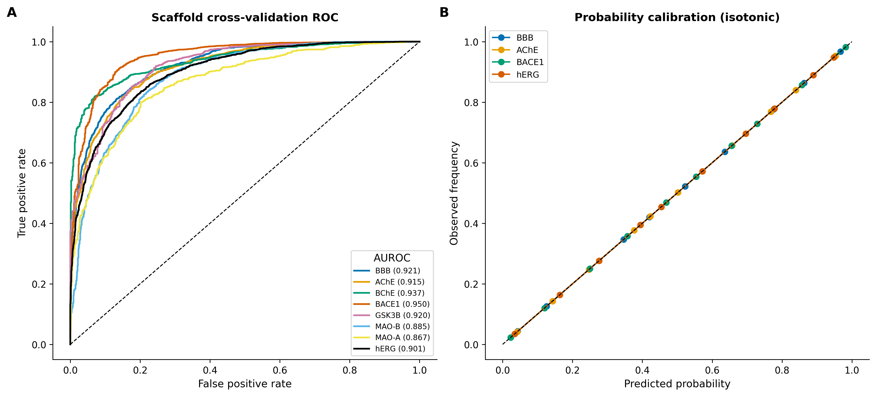
SUPPLEMENTARY · FIGURE 4
Figure 4. (A) Scaffold cross-validation ROC curves (out-of-fold). (B) Reliability diagrams after isotonic calibration.

Slide 8
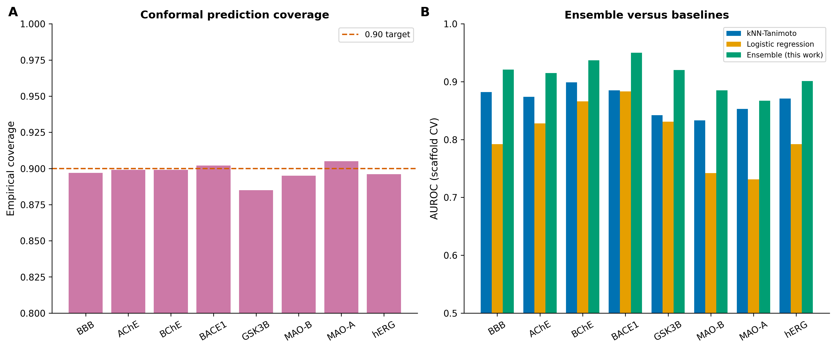
SUPPLEMENTARY · FIGURE 5
Figure 5. (A) Empirical coverage of 90%-level conformal prediction sets (target 0.90). (B) Scaffold-CV AUROC of the deployed ensemble versus kNN-Tanimoto and logistic-regression baselines.

Slide 9
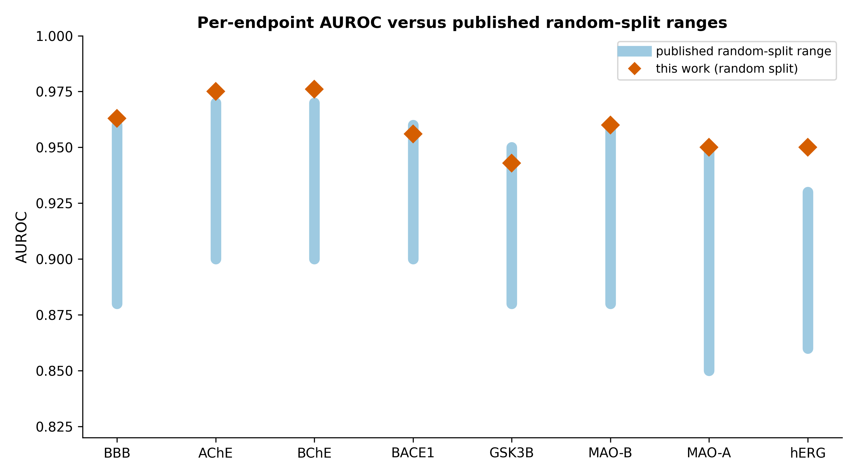
SUPPLEMENTARY · FIGURE 6
Figure 6. Per-endpoint random-split AUROC (this work) relative to published random-split ranges.

Slide 10
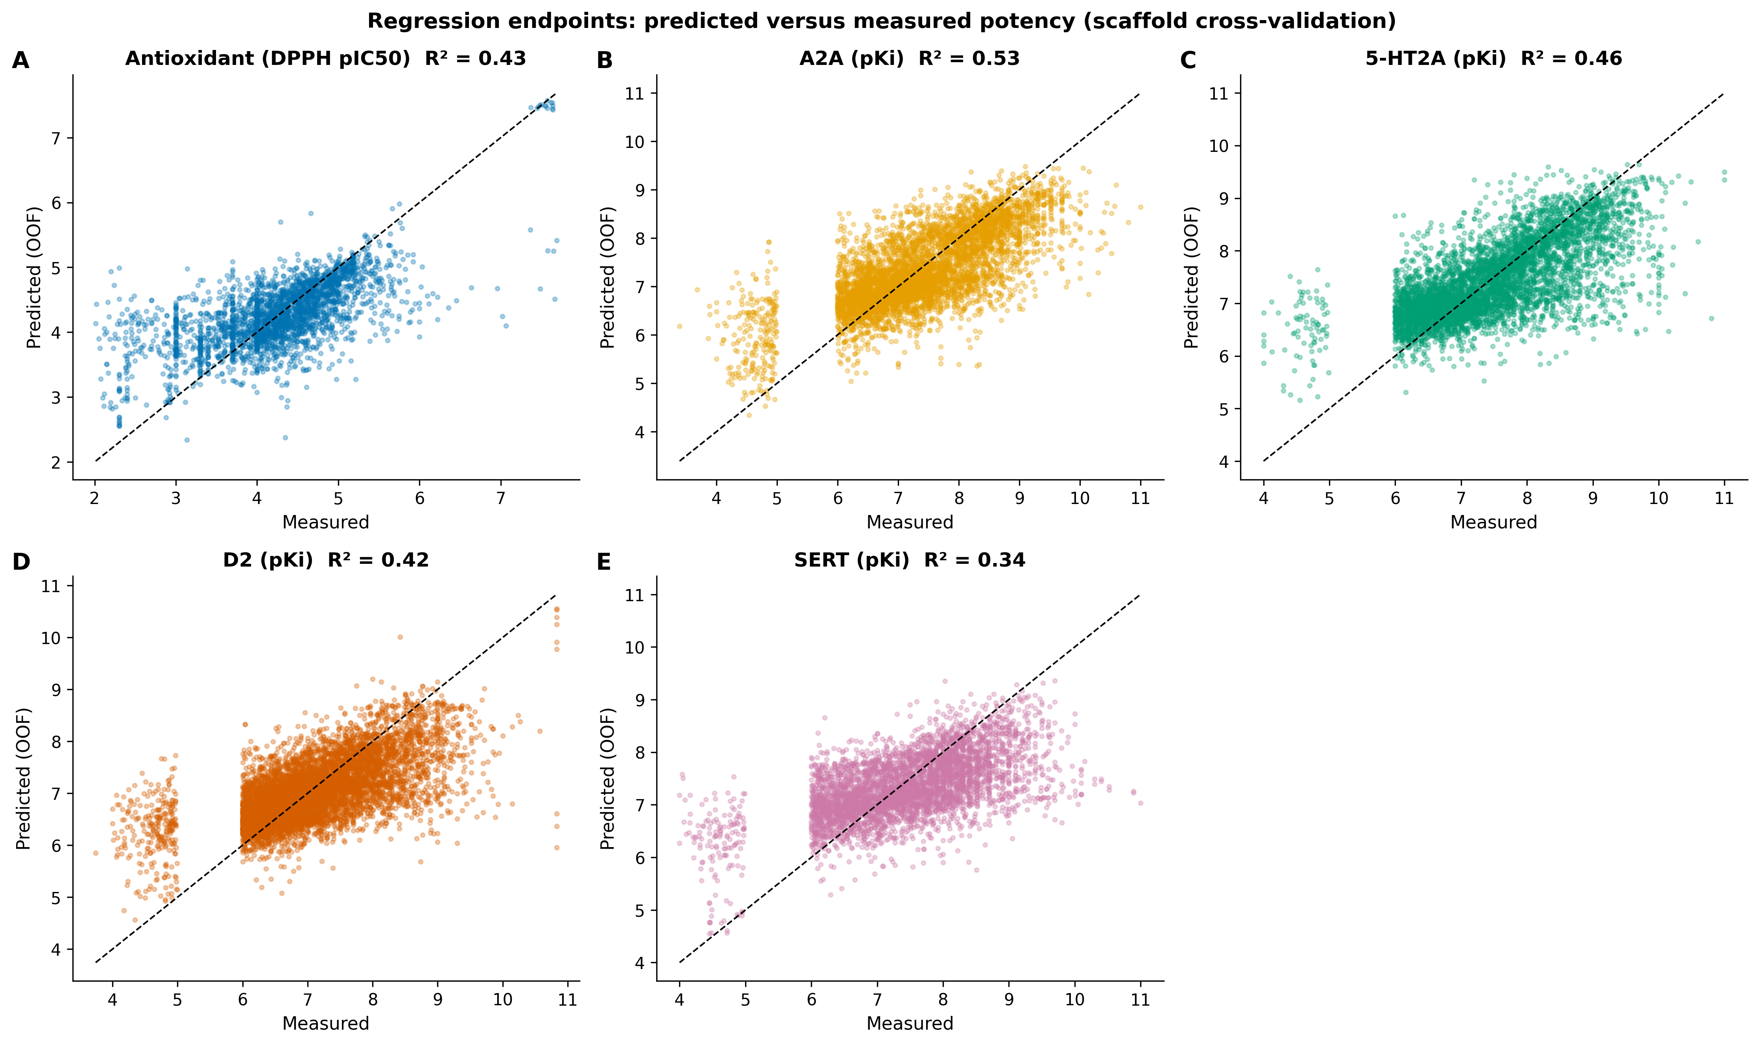
SUPPLEMENTARY · FIGURE 7
Figure 7. Predicted versus measured potency (scaffold CV): measured antioxidant (DPPH) model and four receptor potency-regression endpoints (A2A, 5-HT2A, D2, SERT).

Slide 11
Part B: Supplementary Tables
S0–S13, read from the released CSVs

Slide 12
SUPPLEMENTARY TABLE
STable S0: Data provenance
Endpoint | Role | Modality | Source | Identifier | Measurement | n | Year range
BBB | BBB gate | Classification | B3DB (measured) | B3DB | BBB+/- permeability | 7807 | curated
AChE | Alzheimer's | Classification | ChEMBL (measured) | CHEMBL220 | pChEMBL (IC50/Ki/Kd/EC50) | 4324 | 1986-2025
BChE | Alzheimer's | Classification | ChEMBL (measured) | CHEMBL1914 | pChEMBL (IC50/Ki/Kd/EC50) | 2580 | 1976-2025
BACE1 | Alzheimer's | Classification | ChEMBL (measured) | CHEMBL4822 | pChEMBL (IC50/Ki/Kd/EC50) | 8067 | 2001-2025
GSK3B | Neuroprotection (tau) | Classification | ChEMBL (measured) | CHEMBL262 | pChEMBL (IC50/Ki/Kd/EC50) | 4044 | 2000-2025
MAO-B | Parkinson's | Classification | ChEMBL (measured) | CHEMBL2039 | pChEMBL (IC50/Ki/Kd/EC50) | 3455 | 1990-2025
MAO-A | Depression | Classification | ChEMBL (measured) | CHEMBL1951 | pChEMBL (IC50/Ki/Kd/EC50) | 2141 | 1990-2025
D2 | Parkinson's/psychosis | Regression | ChEMBL (measured) | CHEMBL217 | pChEMBL (IC50/Ki/Kd/EC50) | 7511 | 1987-2025
A2A | Parkinson's | Regression | ChEMBL (measured) | CHEMBL251 | pChEMBL (IC50/Ki/Kd/EC50) | 5547 | 1992-2025
HT2A | Mood/psychosis | Regression | ChEMBL (measured) | CHEMBL224 | pChEMBL (IC50/Ki/Kd/EC50) | 5256 | 1994-2025
SERT | Depression | Regression | ChEMBL (measured) | CHEMBL228 | pChEMBL (IC50/Ki/Kd/EC50) | 4471 | 1980-2025
hERG | Safety (cardiotox) | Classification | ChEMBL (measured) | CHEMBL240 | pChEMBL (IC50/Ki/Kd/EC50) | 5905 | 1995-2025
Antioxidant | Oxidative stress | Regression | ChEMBL DPPH (measured) | DPPH assays | pIC50 (radical scavenging) | 2862 | curated
Clinical precedent | Translational | Reference (k-NN) | ChEMBL ATC-N (measured) | ATC level-1 N | max clinical phase 1-4 | 504 | curated
STable S0. Provenance of every endpoint: role, modality, source database, identifier, measurement type, n, and year range. All measured experimental data.

Slide 13
SUPPLEMENTARY TABLE
STable S1: Classification metrics
endpoint | n | pos_rate | AUROC_random | AUROC_scaffold | AUROC_cluster | AUROC_temporal | PR_AUC | MCC | Brier | conformal_coverage
AChE | 4324 | 0.716 | 0.975 | 0.915 | 0.912 | 0.784 | 0.963 | 0.633 | 0.099 | 0.899
BACE1 | 8067 | 0.905 | 0.956 | 0.95 | 0.94 | 0.915 | 0.994 | 0.614 | 0.039 | 0.902
BBB | 7805 | 0.635 | 0.963 | 0.921 | 0.906 | nan | 0.952 | 0.659 | 0.105 | 0.897
BChE | 2580 | 0.695 | 0.976 | 0.937 | 0.921 | 0.794 | 0.974 | 0.701 | 0.09 | 0.899
GSK3B | 4044 | 0.914 | 0.943 | 0.92 | 0.915 | 0.658 | 0.991 | 0.468 | 0.044 | 0.885
MAO_A | 2141 | 0.376 | 0.95 | 0.867 | 0.89 | 0.614 | 0.815 | 0.586 | 0.136 | 0.905
MAO_B | 3455 | 0.652 | 0.96 | 0.885 | 0.873 | 0.758 | 0.925 | 0.606 | 0.122 | 0.895
hERG | 5905 | 0.415 | 0.95 | 0.901 | 0.87 | 0.757 | 0.874 | 0.626 | 0.123 | 0.896
STable S1. Full classification metrics across regimes (key columns shown; complete 16-column table in the CSV).

Slide 14
SUPPLEMENTARY TABLE
STable S2: Receptor regression
receptor | n | scaffold_cv_R2 | RMSE | Spearman | temporal_R2 | y_range | task
D2 | 7511 | 0.425 | 0.713 | 0.652 | -0.007 | 3.74-10.83 | regression (pChEMBL)
A2A | 5547 | 0.526 | 0.738 | 0.706 | 0.326 | 3.39-11.0 | regression (pChEMBL)
HT2A | 5256 | 0.46 | 0.757 | 0.684 | 0.085 | 4.0-11.0 | regression (pChEMBL)
SERT | 4471 | 0.338 | 0.841 | 0.573 | 0.171 | 4.0-11.0 | regression (pChEMBL)
STable S2. Receptor potency-regression performance (scaffold CV and temporal split).

Slide 15
SUPPLEMENTARY TABLE
STable S3: Antioxidant (measured DPPH)
endpoint | n | scaffold_cv_R2 | RMSE | Spearman | temporal_R2 | crosscheck_curated_vs_measured_Spearman | prior_curated_R2 | source
antioxidant_DPPH_measured | 2862 | 0.43 | 0.597 | 0.636 | -0.021 | 0.387 | 0.25 | ChEMBL DPPH radical-scavenging assays (measured IC50/EC50 -> pIC50)
STable S3. Measured-DPPH antioxidant regression, including cross-check against the prior curated proxy.

Slide 16
SUPPLEMENTARY TABLE
STable S4: Threshold sensitivity
endpoint | split | threshold | precision | recall | f1 | AUROC | PR_AUC | n_test | pos_rate_test
A2A | temporal | @0.3 | 0.981 | 1.0 | 0.99 | 0.92 | 0.996 | 1057 | 0.977
A2A | temporal | @0.5 | 0.986 | 0.999 | 0.992 | 0.92 | 0.996 | 1057 | 0.977
A2A | temporal | @0.7 | 0.987 | 0.997 | 0.992 | 0.92 | 0.996 | 1057 | 0.977
A2A | temporal | @youden | 0.997 | 0.973 | 0.985 | 0.92 | 0.996 | 1057 | 0.977
A2A | scaffold_holdout | @0.3 | 0.98 | 0.999 | 0.989 | 0.931 | 0.998 | 1696 | 0.973
A2A | scaffold_holdout | @0.5 | 0.981 | 0.996 | 0.989 | 0.931 | 0.998 | 1696 | 0.973
A2A | scaffold_holdout | @0.7 | 0.984 | 0.99 | 0.987 | 0.931 | 0.998 | 1696 | 0.973
A2A | scaffold_holdout | @youden | 0.994 | 0.925 | 0.959 | 0.931 | 0.998 | 1696 | 0.973
AChE | temporal | @0.3 | 0.742 | 0.963 | 0.838 | 0.784 | 0.897 | 848 | 0.699
AChE | temporal | @0.5 | 0.806 | 0.86 | 0.832 | 0.784 | 0.897 | 848 | 0.699
AChE | temporal | @0.7 | 0.862 | 0.568 | 0.685 | 0.784 | 0.897 | 848 | 0.699
AChE | temporal | @youden | 0.835 | 0.74 | 0.785 | 0.784 | 0.897 | 848 | 0.699
AChE | scaffold_holdout | @0.3 | 0.8 | 0.981 | 0.881 | 0.884 | 0.944 | 1183 | 0.71
AChE | scaffold_holdout | @0.5 | 0.878 | 0.887 | 0.882 | 0.884 | 0.944 | 1183 | 0.71
AChE | scaffold_holdout | @0.7 | 0.934 | 0.676 | 0.785 | 0.884 | 0.944 | 1183 | 0.71
AChE | scaffold_holdout | @youden | 0.909 | 0.833 | 0.87 | 0.884 | 0.944 | 1183 | 0.71
BACE1 | temporal | @0.3 | 0.949 | 0.967 | 0.958 | 0.915 | 0.991 | 1604 | 0.933
BACE1 | temporal | @0.5 | 0.966 | 0.945 | 0.955 | 0.915 | 0.991 | 1604 | 0.933
BACE1 | temporal | @0.7 | 0.982 | 0.926 | 0.954 | 0.915 | 0.991 | 1604 | 0.933
BACE1 | temporal | @youden | 0.993 | 0.886 | 0.936 | 0.915 | 0.991 | 1604 | 0.933
BACE1 | scaffold_holdout | @0.3 | 0.947 | 0.992 | 0.969 | 0.924 | 0.991 | 2334 | 0.907
BACE1 | scaffold_holdout | @0.5 | 0.958 | 0.981 | 0.969 | 0.924 | 0.991 | 2334 | 0.907
STable S4. Per-operating-threshold precision/recall/F1 by endpoint and split (temporal, scaffold-holdout).

Slide 17
SUPPLEMENTARY TABLE
STable S4: Threshold sensitivity (continued)
endpoint | split | threshold | precision | recall | f1 | AUROC | PR_AUC | n_test | pos_rate_test
BACE1 | scaffold_holdout | @0.7 | 0.97 | 0.94 | 0.955 | 0.924 | 0.991 | 2334 | 0.907
BACE1 | scaffold_holdout | @youden | 0.98 | 0.894 | 0.935 | 0.924 | 0.991 | 2334 | 0.907
BBB | scaffold_holdout | @0.3 | 0.799 | 0.941 | 0.865 | 0.944 | 0.955 | 1529 | 0.545
BBB | scaffold_holdout | @0.5 | 0.87 | 0.898 | 0.884 | 0.944 | 0.955 | 1529 | 0.545
BBB | scaffold_holdout | @0.7 | 0.937 | 0.788 | 0.856 | 0.944 | 0.955 | 1529 | 0.545
BBB | scaffold_holdout | @youden | 0.87 | 0.902 | 0.886 | 0.944 | 0.955 | 1529 | 0.545
BChE | temporal | @0.3 | 0.888 | 0.892 | 0.89 | 0.794 | 0.946 | 527 | 0.827
BChE | temporal | @0.5 | 0.912 | 0.739 | 0.816 | 0.794 | 0.946 | 527 | 0.827
BChE | temporal | @0.7 | 0.955 | 0.482 | 0.64 | 0.794 | 0.946 | 527 | 0.827
BChE | temporal | @youden | 0.917 | 0.789 | 0.848 | 0.794 | 0.946 | 527 | 0.827
BChE | scaffold_holdout | @0.3 | 0.914 | 0.969 | 0.941 | 0.965 | 0.988 | 602 | 0.746
BChE | scaffold_holdout | @0.5 | 0.946 | 0.904 | 0.925 | 0.965 | 0.988 | 602 | 0.746
BChE | scaffold_holdout | @0.7 | 0.986 | 0.804 | 0.886 | 0.965 | 0.988 | 602 | 0.746
BChE | scaffold_holdout | @youden | 0.964 | 0.891 | 0.926 | 0.965 | 0.988 | 602 | 0.746
D2 | temporal | @0.3 | 0.962 | 1.0 | 0.981 | 0.727 | 0.983 | 1397 | 0.96
D2 | temporal | @0.5 | 0.962 | 1.0 | 0.981 | 0.727 | 0.983 | 1397 | 0.96
D2 | temporal | @0.7 | 0.962 | 0.993 | 0.977 | 0.727 | 0.983 | 1397 | 0.96
D2 | temporal | @youden | 0.98 | 0.704 | 0.819 | 0.727 | 0.983 | 1397 | 0.96
D2 | scaffold_holdout | @0.3 | 0.964 | 0.998 | 0.981 | 0.883 | 0.994 | 2015 | 0.962
D2 | scaffold_holdout | @0.5 | 0.966 | 0.995 | 0.98 | 0.883 | 0.994 | 2015 | 0.962
D2 | scaffold_holdout | @0.7 | 0.968 | 0.987 | 0.977 | 0.883 | 0.994 | 2015 | 0.962
D2 | scaffold_holdout | @youden | 0.989 | 0.847 | 0.912 | 0.883 | 0.994 | 2015 | 0.962
STable S4. Per-operating-threshold precision/recall/F1 by endpoint and split (temporal, scaffold-holdout).

Slide 18
SUPPLEMENTARY TABLE
STable S4: Threshold sensitivity (continued)
endpoint | split | threshold | precision | recall | f1 | AUROC | PR_AUC | n_test | pos_rate_test
GSK3B | temporal | @0.3 | 0.933 | 0.997 | 0.964 | 0.658 | 0.96 | 418 | 0.928
GSK3B | temporal | @0.5 | 0.937 | 0.992 | 0.964 | 0.658 | 0.96 | 418 | 0.928
GSK3B | temporal | @0.7 | 0.935 | 0.972 | 0.953 | 0.658 | 0.96 | 418 | 0.928
GSK3B | temporal | @youden | 0.957 | 0.74 | 0.834 | 0.658 | 0.96 | 418 | 0.928
GSK3B | scaffold_holdout | @0.3 | 0.943 | 0.995 | 0.968 | 0.918 | 0.991 | 1037 | 0.916
GSK3B | scaffold_holdout | @0.5 | 0.948 | 0.988 | 0.968 | 0.918 | 0.991 | 1037 | 0.916
GSK3B | scaffold_holdout | @0.7 | 0.959 | 0.951 | 0.955 | 0.918 | 0.991 | 1037 | 0.916
GSK3B | scaffold_holdout | @youden | 0.989 | 0.791 | 0.879 | 0.918 | 0.991 | 1037 | 0.916
HT2A | temporal | @0.3 | 0.968 | 1.0 | 0.984 | 0.736 | 0.986 | 901 | 0.968
HT2A | temporal | @0.5 | 0.968 | 1.0 | 0.984 | 0.736 | 0.986 | 901 | 0.968
HT2A | temporal | @0.7 | 0.968 | 1.0 | 0.984 | 0.736 | 0.986 | 901 | 0.968
HT2A | temporal | @youden | 0.99 | 0.69 | 0.814 | 0.736 | 0.986 | 901 | 0.968
HT2A | scaffold_holdout | @0.3 | 0.985 | 1.0 | 0.992 | 0.894 | 0.998 | 928 | 0.985
HT2A | scaffold_holdout | @0.5 | 0.986 | 1.0 | 0.993 | 0.894 | 0.998 | 928 | 0.985
HT2A | scaffold_holdout | @0.7 | 0.986 | 0.999 | 0.992 | 0.894 | 0.998 | 928 | 0.985
HT2A | scaffold_holdout | @youden | 1.0 | 0.698 | 0.822 | 0.894 | 0.998 | 928 | 0.985
MAO_A | temporal | @0.3 | 0.523 | 0.619 | 0.567 | 0.614 | 0.549 | 449 | 0.45
MAO_A | temporal | @0.5 | 0.556 | 0.322 | 0.408 | 0.614 | 0.549 | 449 | 0.45
MAO_A | temporal | @0.7 | 0.619 | 0.064 | 0.117 | 0.614 | 0.549 | 449 | 0.45
MAO_A | temporal | @youden | 0.523 | 0.777 | 0.625 | 0.614 | 0.549 | 449 | 0.45
MAO_A | scaffold_holdout | @0.3 | 0.664 | 0.79 | 0.722 | 0.867 | 0.823 | 638 | 0.365
MAO_A | scaffold_holdout | @0.5 | 0.802 | 0.627 | 0.704 | 0.867 | 0.823 | 638 | 0.365
STable S4. Per-operating-threshold precision/recall/F1 by endpoint and split (temporal, scaffold-holdout).

Slide 19
SUPPLEMENTARY TABLE
STable S4: Threshold sensitivity (continued)
endpoint | split | threshold | precision | recall | f1 | AUROC | PR_AUC | n_test | pos_rate_test
MAO_A | scaffold_holdout | @0.7 | 0.957 | 0.382 | 0.546 | 0.867 | 0.823 | 638 | 0.365
MAO_A | scaffold_holdout | @youden | 0.667 | 0.815 | 0.734 | 0.867 | 0.823 | 638 | 0.365
MAO_B | temporal | @0.3 | 0.754 | 0.92 | 0.829 | 0.758 | 0.887 | 756 | 0.709
MAO_B | temporal | @0.5 | 0.82 | 0.784 | 0.802 | 0.758 | 0.887 | 756 | 0.709
MAO_B | temporal | @0.7 | 0.883 | 0.547 | 0.675 | 0.758 | 0.887 | 756 | 0.709
MAO_B | temporal | @youden | 0.872 | 0.634 | 0.734 | 0.758 | 0.887 | 756 | 0.709
MAO_B | scaffold_holdout | @0.3 | 0.78 | 0.955 | 0.858 | 0.888 | 0.916 | 686 | 0.611
MAO_B | scaffold_holdout | @0.5 | 0.844 | 0.866 | 0.855 | 0.888 | 0.916 | 686 | 0.611
MAO_B | scaffold_holdout | @0.7 | 0.908 | 0.611 | 0.73 | 0.888 | 0.916 | 686 | 0.611
MAO_B | scaffold_holdout | @youden | 0.843 | 0.883 | 0.862 | 0.888 | 0.916 | 686 | 0.611
SERT | temporal | @0.3 | 0.947 | 1.0 | 0.973 | 0.731 | 0.979 | 998 | 0.947
SERT | temporal | @0.5 | 0.947 | 0.997 | 0.971 | 0.731 | 0.979 | 998 | 0.947
SERT | temporal | @0.7 | 0.951 | 0.997 | 0.973 | 0.731 | 0.979 | 998 | 0.947
SERT | temporal | @youden | 0.973 | 0.753 | 0.849 | 0.731 | 0.979 | 998 | 0.947
SERT | scaffold_holdout | @0.3 | 0.98 | 0.999 | 0.989 | 0.873 | 0.995 | 1279 | 0.977
SERT | scaffold_holdout | @0.5 | 0.98 | 0.998 | 0.989 | 0.873 | 0.995 | 1279 | 0.977
SERT | scaffold_holdout | @0.7 | 0.981 | 0.998 | 0.99 | 0.873 | 0.995 | 1279 | 0.977
SERT | scaffold_holdout | @youden | 0.997 | 0.77 | 0.869 | 0.873 | 0.995 | 1279 | 0.977
hERG | temporal | @0.3 | 0.472 | 0.767 | 0.584 | 0.757 | 0.665 | 1263 | 0.313
hERG | temporal | @0.5 | 0.649 | 0.539 | 0.589 | 0.757 | 0.665 | 1263 | 0.313
hERG | temporal | @0.7 | 0.811 | 0.271 | 0.406 | 0.757 | 0.665 | 1263 | 0.313
hERG | temporal | @youden | 0.565 | 0.686 | 0.619 | 0.757 | 0.665 | 1263 | 0.313
STable S4. Per-operating-threshold precision/recall/F1 by endpoint and split (temporal, scaffold-holdout).

Slide 20
SUPPLEMENTARY TABLE
STable S4: Threshold sensitivity (continued)
endpoint | split | threshold | precision | recall | f1 | AUROC | PR_AUC | n_test | pos_rate_test
hERG | scaffold_holdout | @0.3 | 0.668 | 0.901 | 0.767 | 0.908 | 0.868 | 1610 | 0.389
hERG | scaffold_holdout | @0.5 | 0.861 | 0.665 | 0.75 | 0.908 | 0.868 | 1610 | 0.389
hERG | scaffold_holdout | @0.7 | 0.942 | 0.391 | 0.553 | 0.908 | 0.868 | 1610 | 0.389
hERG | scaffold_holdout | @youden | 0.764 | 0.824 | 0.793 | 0.908 | 0.868 | 1610 | 0.389
STable S4. Per-operating-threshold precision/recall/F1 by endpoint and split (temporal, scaffold-holdout).

Slide 21
SUPPLEMENTARY TABLE
STable S5: Similarity-binned AUROC
endpoint | tanimoto_bin | n | AUROC
A2A | T[0.0-0.4) | 180 | 0.836
A2A | T[0.4-0.6) | 950 | 0.893
A2A | T[0.6-0.8) | 3399 | 0.965
A2A | T[0.8-1.0) | 1018 | 0.958
AChE | T[0.0-0.4) | 538 | 0.687
AChE | T[0.4-0.6) | 1044 | 0.827
AChE | T[0.6-0.8) | 1569 | 0.94
AChE | T[0.8-1.0) | 1173 | 0.974
BACE1 | T[0.0-0.4) | 218 | 0.652
BACE1 | T[0.4-0.6) | 1043 | 0.919
BACE1 | T[0.6-0.8) | 5244 | 0.937
BACE1 | T[0.8-1.0) | 1562 | 0.966
BBB | T[0.0-0.4) | 2587 | 0.846
BBB | T[0.4-0.6) | 2851 | 0.918
BBB | T[0.6-0.8) | 1953 | 0.968
BBB | T[0.8-1.0) | 414 | 0.951
BChE | T[0.0-0.4) | 250 | 0.6
BChE | T[0.4-0.6) | 485 | 0.842
BChE | T[0.6-0.8) | 986 | 0.949
BChE | T[0.8-1.0) | 859 | 0.986
D2 | T[0.0-0.4) | 281 | 0.577
D2 | T[0.4-0.6) | 1568 | 0.809
STable S5. AUROC binned by nearest-training Tanimoto similarity, the empirical basis of the applicability-domain flag.

Slide 22
SUPPLEMENTARY TABLE
STable S5: Similarity-binned AUROC (continued)
endpoint | tanimoto_bin | n | AUROC
D2 | T[0.6-0.8) | 3880 | 0.885
D2 | T[0.8-1.0) | 1782 | 0.935
GSK3B | T[0.0-0.4) | 576 | 0.814
GSK3B | T[0.4-0.6) | 968 | 0.865
GSK3B | T[0.6-0.8) | 1954 | 0.95
GSK3B | T[0.8-1.0) | 546 | 0.986
HT2A | T[0.0-0.4) | 469 | 0.821
HT2A | T[0.4-0.6) | 1260 | 0.787
HT2A | T[0.6-0.8) | 2341 | 0.966
HT2A | T[0.8-1.0) | 1186 | 0.976
MAO_A | T[0.0-0.4) | 376 | 0.63
MAO_A | T[0.4-0.6) | 817 | 0.851
MAO_A | T[0.6-0.8) | 705 | 0.916
MAO_A | T[0.8-1.0) | 243 | 0.948
MAO_B | T[0.0-0.4) | 450 | 0.755
MAO_B | T[0.4-0.6) | 1345 | 0.831
MAO_B | T[0.6-0.8) | 1172 | 0.91
MAO_B | T[0.8-1.0) | 488 | 0.983
SERT | T[0.0-0.4) | 354 | 0.768
SERT | T[0.4-0.6) | 1318 | 0.927
SERT | T[0.6-0.8) | 2126 | 0.939
SERT | T[0.8-1.0) | 673 | 0.857
STable S5. AUROC binned by nearest-training Tanimoto similarity, the empirical basis of the applicability-domain flag.

Slide 23
SUPPLEMENTARY TABLE
STable S5: Similarity-binned AUROC (continued)
endpoint | tanimoto_bin | n | AUROC
hERG | T[0.0-0.4) | 1222 | 0.748
hERG | T[0.4-0.6) | 1643 | 0.862
hERG | T[0.6-0.8) | 2539 | 0.946
hERG | T[0.8-1.0) | 501 | 0.975
STable S5. AUROC binned by nearest-training Tanimoto similarity, the empirical basis of the applicability-domain flag.

Slide 24
SUPPLEMENTARY TABLE
STable S6: Clinical reference composition
disease | n_compounds
CNS (other) | 178
Depression | 66
Psychosis | 66
Other CNS | 44
Epilepsy | 44
Cognition/ADHD | 34
Anxiety | 34
Parkinson's | 32
Alzheimer's / dementia | 6
STable S6. Composition of the 504-compound clinical-precedent reference set by disease class.

Slide 25
SUPPLEMENTARY TABLE
STable S7: Benchmark vs literature
endpoint | BrainSafe_random_AUROC | published_random_AUROC_range
BBB | 0.963 | 0.88-0.96
AChE | 0.975 | ~0.90-0.97
BChE | 0.976 | ~0.90-0.97
BACE1 | 0.956 | ~0.90-0.96
GSK3B | 0.943 | ~0.88-0.95
MAO_B | 0.96 | ~0.88-0.96
MAO_A | 0.95 | ~0.85-0.95
hERG | 0.95 | 0.86-0.93
STable S7. BrainSafe random-split AUROC versus published random-split ranges per endpoint.

Slide 26
SUPPLEMENTARY TABLE
STable S8: Capability vs LLM
dimension | BrainSafe_AI | General_LLM
Input | Chemical structure (SMILES; name/inchi resolved to structure) | Natural-language text prompt
Molecular representation | ECFP-4 (1024-bit) + 24 computed RDKit physicochemical descriptors | Sub-word text tokens; no explicit molecular graph/descriptors
Training signal | 64,474 measured ChEMBL/B3DB bioactivity records (structure->measured value) | Web/text corpus; bioactivity not learned as a measured regression target
Primary output | Calibrated probability / potency per endpoint | Free-text assertion
Uncertainty quantification | Isotonic calibration + Mondrian conformal sets (empirical 88.5-90.5% coverage) | None, or verbal and uncalibrated
Provenance / grounding | Returns nearest MEASURED analogue(s) + measured pChEMBL for every call | Not grounded in specific measurements; hallucination documented
Applicability domain | Explicit Tanimoto AD flag; performance shown to degrade with distance (STable5) | No domain boundary; equally fluent in- and out-of-domain
Reproducibility | Deterministic (fixed seed 42); identical output on re-run | Stochastic; version- and prompt-dependent
Benchmarked property-prediction accuracy | AUROC 0.87-0.98 (scaffold/random, this work) | Underperforms specialised ML on molecular property prediction (Guo 2023; Zhong 2024)
Behaviour on a novel compound | Grounded, calibrated prediction or explicit out-of-domain flag | May confabulate plausible but unverifiable values
STable S8. Capability comparison: BrainSafe AI versus a general-purpose large language model.

Slide 27
SUPPLEMENTARY TABLE
STable S9: Ablation vs baselines
endpoint | Ensemble_AUROC | kNN_Tanimoto_AUROC | LogisticRegression_AUROC | delta_vs_kNN | delta_vs_LR | ensemble_best
AChE | 0.915 | 0.874 | 0.828 | 0.041 | 0.087 | True
BACE1 | 0.95 | 0.885 | 0.883 | 0.065 | 0.067 | True
BBB | 0.921 | 0.882 | 0.792 | 0.039 | 0.129 | True
BChE | 0.937 | 0.899 | 0.866 | 0.038 | 0.071 | True
GSK3B | 0.92 | 0.842 | 0.831 | 0.078 | 0.089 | True
MAO_A | 0.867 | 0.853 | 0.731 | 0.014 | 0.136 | True
MAO_B | 0.885 | 0.833 | 0.742 | 0.052 | 0.143 | True
hERG | 0.901 | 0.871 | 0.792 | 0.03 | 0.109 | True
STable S9. Scaffold-split AUROC: deployed ensemble versus kNN-Tanimoto and logistic-regression baselines (ensemble best on all 8 endpoints).

Slide 28
SUPPLEMENTARY TABLE
STable S10: Label-definition robustness
endpoint | label_definition | n | pos | pos_rate | scaffold_AUROC | MCC | balanced_acc
AChE | deployed (>=6 / <5) | 4324 | 3098 | 0.716 | 0.915 | 0.624 | 0.835
AChE | strict (>=6.5 / <5.5) | 4533 | 2297 | 0.507 | 0.927 | 0.687 | 0.843
AChE | sharp boundary (>=6 / <6) | 6194 | 3098 | 0.5 | 0.865 | 0.553 | 0.775
AChE | high-potency (>=7 / <5) | 2833 | 1607 | 0.567 | 0.947 | 0.75 | 0.878
MAO_B | deployed (>=6 / <5) | 3455 | 2254 | 0.652 | 0.884 | 0.602 | 0.807
MAO_B | strict (>=6.5 / <5.5) | 3575 | 1574 | 0.44 | 0.883 | 0.607 | 0.805
MAO_B | sharp boundary (>=6 / <6) | 4933 | 2254 | 0.457 | 0.825 | 0.479 | 0.74
MAO_B | high-potency (>=7 / <5) | 2218 | 1017 | 0.459 | 0.914 | 0.67 | 0.835
hERG | deployed (>=6 / <5) | 5905 | 2451 | 0.415 | 0.901 | 0.626 | 0.817
hERG | strict (>=6.5 / <5.5) | 7895 | 1302 | 0.165 | 0.907 | 0.55 | 0.822
hERG | sharp boundary (>=6 / <6) | 11093 | 2451 | 0.221 | 0.827 | 0.424 | 0.75
hERG | high-potency (>=7 / <5) | 4181 | 727 | 0.174 | 0.936 | 0.68 | 0.865
BACE1 | deployed (>=6 / <5) | 8067 | 7303 | 0.905 | 0.95 | 0.607 | 0.888
BACE1 | strict (>=6.5 / <5.5) | 7693 | 6126 | 0.796 | 0.938 | 0.678 | 0.87
BACE1 | sharp boundary (>=6 / <6) | 10022 | 7303 | 0.729 | 0.887 | 0.573 | 0.806
BACE1 | high-potency (>=7 / <5) | 5500 | 4736 | 0.861 | 0.969 | 0.738 | 0.917
STable S10. Scaffold-CV AUROC under alternative pChEMBL label cut-offs (deployed / strict / sharp-boundary / high-potency).

Slide 29
SUPPLEMENTARY TABLE
STable S11: Assay-type composition
endpoint | standard_type | n_activities | fraction
AChE | IC50 | 7274 | 0.888
AChE | Ki | 665 | 0.081
AChE | Kd | 204 | 0.025
AChE | EC50 | 46 | 0.006
BChE | IC50 | 4270 | 0.925
BChE | Ki | 337 | 0.073
BChE | Kd | 6 | 0.001
BChE | EC50 | 3 | 0.001
BACE1 | IC50 | 12721 | 0.814
BACE1 | Ki | 2534 | 0.162
BACE1 | EC50 | 299 | 0.019
BACE1 | Kd | 72 | 0.005
GSK3B | IC50 | 3994 | 0.493
GSK3B | EC50 | 2695 | 0.333
GSK3B | Ki | 1269 | 0.157
GSK3B | Kd | 144 | 0.018
MAO_B | IC50 | 5777 | 0.89
MAO_B | Ki | 686 | 0.106
MAO_B | EC50 | 20 | 0.003
MAO_B | Kd | 9 | 0.001
MAO_A | IC50 | 3687 | 0.855
MAO_A | Ki | 622 | 0.144
STable S11. Assay-type composition per target (IC50/Ki/Kd/EC50 fractions on the standardised pChEMBL scale).

Slide 30
SUPPLEMENTARY TABLE
STable S11: Assay-type composition (continued)
endpoint | standard_type | n_activities | fraction
MAO_A | EC50 | 1 | 0.0
hERG | IC50 | 11707 | 0.851
hERG | Ki | 1812 | 0.132
hERG | EC50 | 200 | 0.015
hERG | Kd | 45 | 0.003
STable S11. Assay-type composition per target (IC50/Ki/Kd/EC50 fractions on the standardised pChEMBL scale).

Slide 31
SUPPLEMENTARY TABLE
STable S12: Assay sensitivity
endpoint | pooled_n | pooled_AUROC | IC50only_n | IC50only_AUROC | AUROC_delta_pooled_minus_IC50
GSK3B | 4044 | 0.919 | 2445 | 0.913 | 0.006
MAO_B | 3455 | 0.884 | 3211 | 0.89 | -0.006
hERG | 5905 | 0.901 | 5054 | 0.901 | 0.0
STable S12. Single-assay (IC50-only) versus pooled retraining: AUROC delta <= 0.006 across the three endpoints tested.

Slide 32
SUPPLEMENTARY TABLE
STable S13: LLM head-to-head scoreboard
system | BBB_acc | BBB_n | hERG_acc | hERG_n | Brier | chembl_ids_given | fabricated_ids | wrong_structure_ids | novel_confabulation
BrainSafe AI | 0.889 | 9 | 1.0 | 5 | 0.088 | 0 | 0 | 0 | False
Gemini Pro (2026-07-03) | 0.778 | 9 | 1.0 | 5 | 0.067 | 10 | 1 | 4 | True
ChatGPT (GPT-4o, 2026-07-03) | 1.0 | 9 | 1.0 | 5 | 0.035 | 9 | 1 | 3 | True
Perplexity (2026-07-03) | 1.0 | 9 | 0.8 | 5 | 0.041 | 2 | 1 | 0 | True
Claude (2026-07-03) | 1.0 | 9 | 1.0 | 5 | 0.02 | 10 | 1 | 3 | True
STable S13. Pre-registered head-to-head: BrainSafe and four LLMs scored against the frozen measured-data key (live ChEMBL verification of cited identifiers).

