Slide 1
Chapter 1
Predicting small-molecule action in the human brain, exposure and engagement together
A blood-brain-barrier-gated, multi-endpoint predictor, and an account of what it cannot do
Krishnasalini Gunanathan
Sri Sathya Sai Institute of Higher Learning
Panel as deployed: 75 estimators, 70 of them serving predictions
Notes:
Chapter 1 sets up the problem and states, at the outset, what the system does not do. Every figure in this deck is generated from an artefact in the repository at build time.

Slide 2
The argument of this thesis
Potency at a target a compound cannot reach is not activity. Exposure and engagement are therefore one question, and a tool that answers them separately has answered neither.
The contribution is integration, validation and uncertainty reporting. It is not a new algorithm.
Notes:
Say this slowly. It is the thesis in two sentences, and the second sentence is the one that keeps the claim defensible.

Slide 3
1
Two ways a central nervous system programme fails
Both happen late, after the medicinal chemistry has been paid for
A
B
It never arrives
It arrives and does more
The barrier is an active interface, not a membrane with a permeability constant: efflux transporters return compounds to the circulation and tight junctions exclude them. A compound can be excellent against isolated protein and inert in an animal.
A compound that reaches the tissue may engage more than its intended target. On the safety axis, hERG blockade prolongs the QT interval and remains a leading cause of late cardiovascular attrition. On the efficacy axis, the mechanism reached is not the one that drives the disease.
Neither question is new. What is unusual is how rarely they are answered by one instrument, on one molecule, with a statement of confidence that covers both.
Attrition citation outstanding: references.md carries no attrition series. The key named cns_attrition resolves to Alavijeh 2005, a barrier review, not a success-rate analysis.
Notes:
Flag honestly in the viva that the attrition citation is still to be resolved. The two failure modes themselves are not in dispute.

Slide 4
2
Exposure means unbound partition, not total concentration
And the honest report is that this is the weakest model in the panel
Total brain-to-plasma ratio counts drug bound to tissue lipid, which cannot engage a receptor. The variable that governs whether a free concentration is available at the target is the unbound partition coefficient, Kp,uu. This panel models it directly.
Scaffold-split R² across the exposure layer
Kp,uu, unbound partition
0.352
logBB, total ratio
0.413
Aqueous solubility
0.726
Caco-2 permeability
0.582
Modelling the right quantity badly is preferable to modelling the wrong quantity well, but only if the weakness is reported. It is reported, here and in Chapter 7.
Lipophilicity
0.566
Plasma protein binding
0.364
Hepatocyte clearance
0.206
results/tables/adme_cv_summary.csv, scaffold-grouped 10-fold
Notes:
Kp,uu reaches R squared 0.352 on 566 compounds. If asked why it is still deployed: because the alternative is to report logBB and let the user believe it means free concentration.

Slide 5
3
Coupling is multiplicative, and that is the whole design
A target score is admitted only in proportion to predicted exposure
S̃_{d}(x) = γ(x) · max_{(t,w) ∈ G(d)} w · s_{t}(x)
γ(x) = 1 for the peripheral conditions, and the predicted barrier probability otherwise
1
The maximum, not a sum
A condition is scored by its single strongest engaged mechanism, so one target explains the score and can be named. Engaging three of a condition's targets scores exactly as engaging its strongest.
2
Why not a sum
Because co-engaged targets are frequently homologues, and a sum would count one observation several times. Of the panel, 36 targets fire across approved drugs but span only 16 independent directions.
3
The gate is shared
γ does not depend on the condition, except for the 2 peripheral ones (migraine, multiple sclerosis). That single fact has a consequence the next slide states.
Formal specification: docs/TECHNICAL_REPORT.md section 3.7. Graph read from app.py: 51 targets, 16 conditions.
Notes:
The examiners will want the algebra. Give it, then immediately give the refutation it implies, which is the next slide.

Slide 6
What the algebra also says
The exposure gate cannot discriminate between conditions.
H3
REFUTED
by construction, not by experiment. Stated in the introduction rather than the limitations, because it follows from the design and a reader meeting the architecture is entitled to it at that moment.
Because γ does not depend on the condition, multiplying every condition's score by the same number leaves their ranking untouched. Gating decides whether anything is reported at all. It never decides which condition is reported.
inversion/results/VERDICTS.csv
Notes:
This is the slide that buys credibility for everything after it. The system is an exposure filter over a mechanism ranking, and it should be described that way throughout.

Slide 7
4
What existing servers do, and where they stop
Three families, each answering one half of the question
1
2
3
ADMET and physicochemical
Target prediction
Single-endpoint barrier models
Estimate barrier penetration, permeability and efflux liability from structure. They answer exposure, often well, and say nothing about pharmacology.
Rank probable protein targets, typically by similarity to annotated ligands. They answer engagement, and are agnostic about whether the compound reaches the tissue.
Model blood-brain penetration alone, usually on one curated permeability set.
The CNS MPO score is a desirability function over six properties, presented as a design aid. Used as a proxy for central activity it is a category error: it contains no target information.
Treated here as a strong baseline, not a straw man: read-across recovers the correct target for 0.973 of held-out compounds against 0.059 for a frequency baseline.
The exposure axis in isolation. Useful, and not a triage instrument.
Named-server citations outstanding: no server in the comparison is yet in references.md. H5 figures from inversion/results/H5_readacross_value.csv.
Notes:
Be explicit that the specific servers still need verified citations. Do not name them in the viva as though they were cited.

Slide 8
5
Three capabilities absent across all three families
Together they define what is claimed here
Coupling
No server admits a target score in proportion to predicted exposure. Where both quantities are produced they sit side by side and the integration is left to the reader.
1
Calibrated, compound-specific uncertainty
Every value returned carries a calibrated probability, a conformal coverage statement measured at 0.889 to 0.921 against a 0.90 target, and a distance to the nearest measured analogue.
2
A quantified statement of what silence means
When a tool returns nothing, the user cannot tell inactivity from blindness. This one reports the recall the panel achieves at that compound's own distance from training chemistry: 0.86 for a close analogue, 0.16 for a novel scaffold.
3
results/tables/rf_conformal.csv; results/tables/external_novelty_strata.csv
Notes:
The third is the one nobody else does and the one this thesis is most confident about.

Slide 9
6
The system, as deployed
Counted from the model inventory and the endpoint tables
75
70
54
228,200
63
fitted estimators
of them deployed
distinct molecular targets
measured records
endpoint tables
Every label is a measured experimental value.
No label comes from curator annotation and no value is imputed. An earlier prototype trained on curated annotation scores was shown by feature ablation to be reading the answer back out of its own features, and structure-only performance collapsed to near zero.
Each endpoint is fitted on its own set alone
Across the deployed classification tables the median is 3,789 rows, from 387 for KEAP1 to 10,276 for hERG. Nothing is shared between endpoints except the featurisation.
submission_package/07_MODELS/model_inventory.csv; submission_package/06_TRAINING_DATA/endpoints/
Notes:
If asked how 54 targets arises from 70 deployed estimators: it is the 47 deployed binders plus the seven measured-label target and safety classifiers, with the four receptor regressions excluded as duplicates and the antioxidant assay and pKa model excluded as not being targets.

Slide 10
7
Three methodological decisions
Each is a decision rather than a default
The negative class is recovered from measurement
A compound assayed and found inactive is often deposited only as a censored bound, and the conventional query discards exactly those rows. A bound settles a label when the whole interval falls one side of the activity cut, and is discarded when it spans both. This recovers 29,751 measured non-binders across 57 endpoints.
1
Chapter 2
Thresholds are measured on a sample disjoint from the one that set them
Choosing a cut as a quantile of a sample and then measuring the false-positive rate on that same sample cannot fail: the rate restates the quantile. Three disjoint pools, assigned by a stable hash of the structure, separate the decoys, the cut and the measurement.
2
Chapter 5
Target scores are gated by predicted exposure
Potency at a target the compound cannot reach contributes nothing. This is the one place the models are combined multiplicatively, and it encodes a pharmacological fact rather than a statistical convenience.
3
Chapter 7
submission_package/06_TRAINING_DATA/endpoints/, counted at build time
Notes:
The censored-bound recovery is the most distinctive data decision in the thesis and the one a cheminformatics examiner will engage with.

Slide 11
8
Discrimination, with the spread rather than the mean
Scaffold-grouped folds withhold entire structural classes; random folds do not
Mean AUROC
0.958 random, 0.899 to 0.976
0.925 scaffold, 0.878 to 0.965
The scaffold column is the honest one. It reports generalisation to chemistry the model has not seen; the random column reports interpolation within chemistry it has.
Receptor regressions, scaffold R²: 0.415 to 0.621.
results/tables/rf_cv_summary.csv
Notes:
Never quote the mean without the range. The barrier model is the weakest classifier at 0.878 and BACE1 the strongest at 0.965.

Slide 12
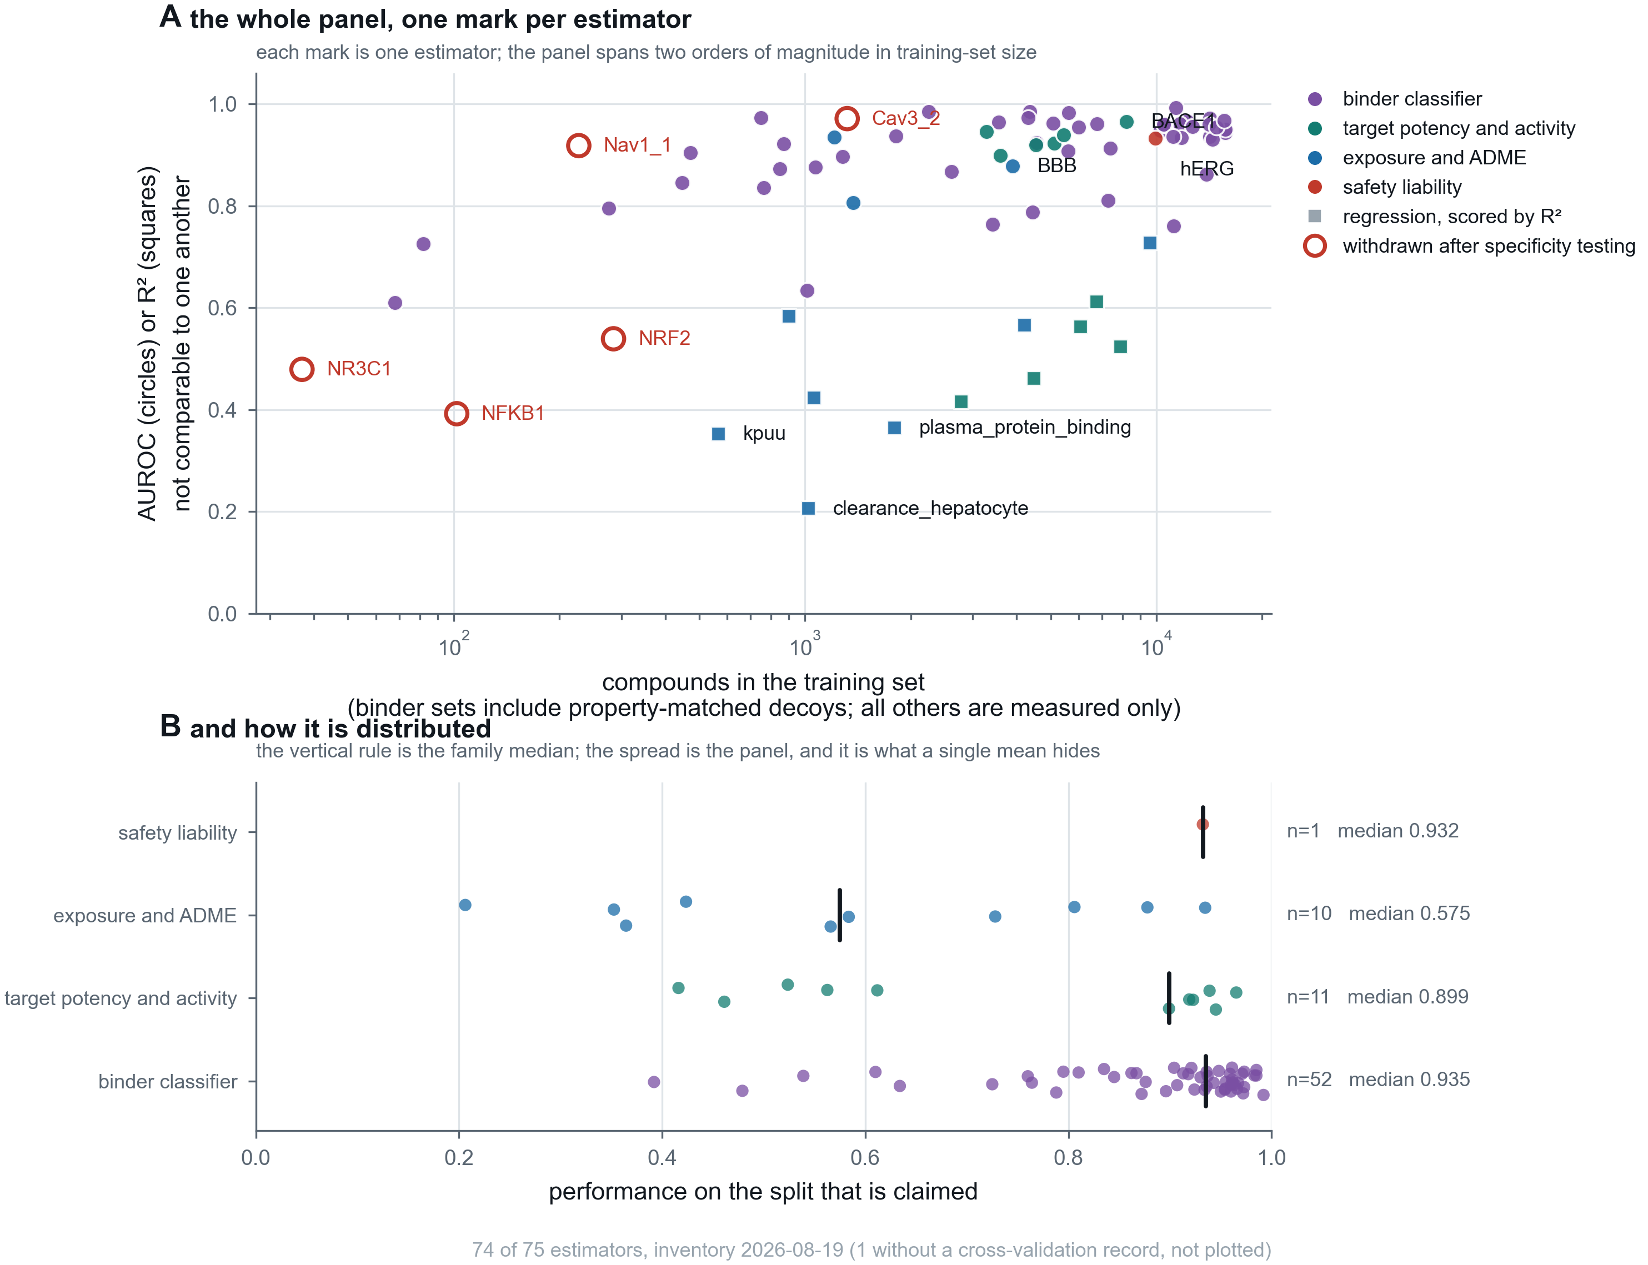
9
The binder panel, validated against measured inactives
Not against the decoys used to train it
AUROC against compounds tested and found inactive
0.917
0.947
mean over the 47 deployed
median, the fairer summary
Range 0.719 at GABA-A to 0.985 at CGRP.
Sensitivity: mean 0.898, median 0.932, from 0.639 at COX2 to 0.997 at CGRP.
One mark per estimator, so that no claim rests on a mean a reader cannot check. The 5 withdrawn estimators are drawn in outline, because a panel showing only what survived is a selection rather than an inventory.
submission_package/07_MODELS/binder_panel_registry.json; figure Figure9_model_atlas.png
Notes:
The mean flatters the panel and the median more so. Name GABA-A and COX-2 before an examiner does.

Slide 13
10
A probability that is not calibrated is not a probability
And a calibrated probability still says nothing about this compound
Calibration
Conformal coverage
Expected calibration error falls from 0.0801 to 0.0147
Empirical coverage 0.889 to 0.921 against a 0.90 target
Isotonic regression fitted on out-of-fold predictions, so no compound contributes to the calibrator that scores it. Per endpoint the calibrated error runs 0.0049 to 0.0412, the barrier model being the worst of them. Because the map is monotone it cannot reorder compounds, so AUROC is unchanged and only the probability moves.
A Mondrian, class-conditional predictor over 8 endpoints turns the applicability domain from a caveat into a coverage statement that is measured rather than assumed. The class-conditional form matters because marginal coverage can be satisfied while the rare class fails systematically.
A prediction set may be empty, meaning the compound conforms to neither class, or contain both, meaning it separates neither. Both are informative and both are displayed.
results/tables/calibration.csv; results/tables/rf_conformal.csv
Notes:
Expect a statistician to ask why Mondrian rather than marginal. The answer is on the slide.

Slide 14
11
Recall is a function of chemical distance, not of date
Three test sets built by unrelated rules trace one curve
An apparent temporal decay is a change in the population being tested, not decay in the models.
A random split of medicinal-chemistry data holds out mostly close analogues of its own training set, because the published record is series. A time split does not. Conditioned on distance, it makes no difference how the compound was withheld.
So the expected recall for the compound in hand is knowable at the moment of the query.
results/tables/external_novelty_strata.csv; the curator arm rests on three endpoints
Notes:
This is the most important result in the thesis and the one to spend time on. The finding is that the poor number is predictable, not that it is better than it looked.

Slide 15
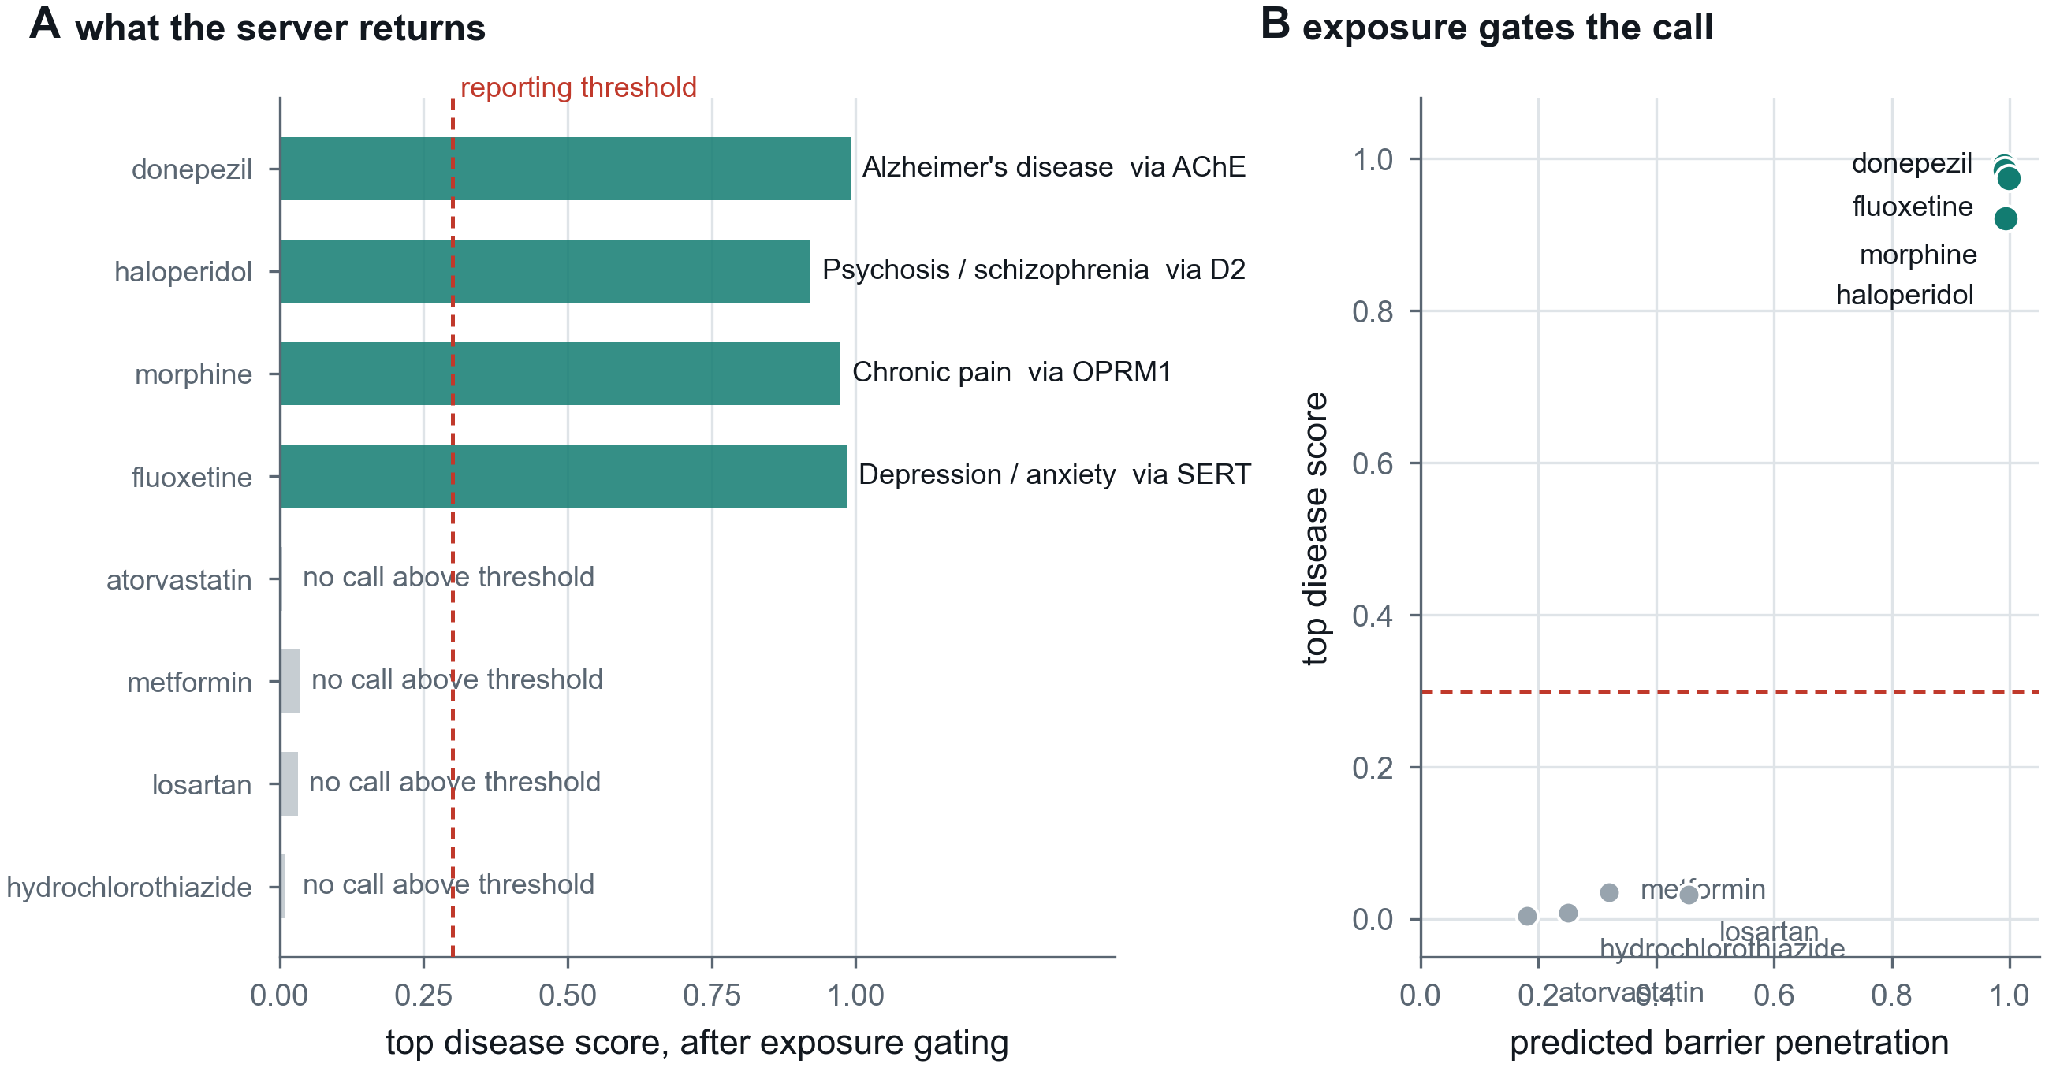
12
Therefore silence carries a number
The same design decision seen from both sides
Donepezil
in domain
0.86
A silence would be reasonably strong evidence of inactivity.
Atenolol
in domain
0.86
Every target sits below its base rate; the server is correctly quiet.
Withanolide A
near domain
0.55
At this distance the panel recovers barely half of what is there. The silence is not a result.
A compound that does not arrive cannot generate a disease call. Reported silence and reported engagement are one rule seen from opposite sides.
docs/TECHNICAL_REPORT.md section 5.1; recall figures from external_novelty_strata.csv
Notes:
Withanolide A is the slide that shows the system knows the difference between 'no' and 'I cannot see'. Most tools cannot make that distinction.

Slide 16
The falsification suite
4 of 9 hypotheses were refuted
Each was stated so that it could fail, and paired with a null model capable of producing the same apparent success by accident. All four are reported as refuted.
H2
the curated edge weights add value
curated 0.7901, uniform 0.7897, permuted 0.7874
H3
BBB gating discriminates between diseases
the gate multiplies every disease equally and cannot change their order
H7
some panel targets are non-discriminative and explain the silent antiepileptics
none of 37 targets ranks below AUROC 0.70; the cause is the operating point, with median deployed sensitivity 0.79 and 6 targets under 0.50
H8
engaged targets are independent observations
36 targets fire across approved drugs but span only 16 independent directions; 5 homologous pairs correlate above 0.5
4 supported, 1 weakened. The refutations changed the design and are the most useful output the project has produced.
Notes:
H2 removed a claim about the curated weights. H3 changed how gating is described. H7 changed how silence is reported. H8 changed how engaged targets are counted in the interface. Each cost something.

Slide 17
13
5 endpoints were trained, tested and withdrawn
The panel is reported as an inventory, not as a selection
Two fired on glucose, urea and atenolol at their calibrated thresholds. Three were added specifically to test natural-product coverage, and all three failed. Withdrawal is re-derived whenever the panel is refitted rather than carried forward, because it is a claim about a particular fit.
endpoint
AUROC
sensitivity
GluA2
0.696
0.103
Nav1.1
0.952
0.120
NRF2
0.789
0.545
NFKB1
0.459
0.000
NR3C1
0.410
0.167
submission_package/07_MODELS/binder_panel_registry.json, withdrawal reasons recorded per endpoint
Notes:
NFKB1 scores below chance against its own held-out measured inactives. Showing that is the point of reporting an inventory.

Slide 18
14
Specificity, stated as the bound it is
The assumption is named in the sentence that makes the claim
0.949
Why this is a lower bound
of 1,000 compounds with no recorded activity at any modelled target returned no actionable disease signal
Those compounds are presumed inactive because nothing is recorded about them, not proven inactive. The artefact itself labels the paired false-positive rate an upper bound. They are also drawn from within the reference library, so this does not bound behaviour on genuinely distant chemistry.
95 per cent interval 0.934 to 0.961
This is the pattern the whole thesis follows: report the number, then report the assumption that the number rests on, in the same breath rather than in a footnote.
results/tables/noncns_specificity_summary.csv
Notes:
If an examiner presses on specificity, agree with them. It is a lower bound and it is labelled as one in the artefact, not just in the prose.

Slide 19
15
What the system does not do
Stated in the introduction, not deferred
1
Chirality is not represented
Two enantiomers give identical predictions. Bounded in Chapter 10 at 0.19 per cent of the panel, which is a bound and not an absolution.
2
Agonism and antagonism are not distinguished
The training label is an affinity, which an agonist and an antagonist at the same receptor can share. The honest description of what the panel predicts is engagement, not modulation.
3
The disease layer does not predict indication
27 of the 51 targets in the pathway graph drive more than one of its 16 conditions, and what selects among them, dose, regimen and patient population, is not present in a structure.
4
Recall on genuinely novel chemistry is poor
Below Tanimoto 0.40 recall is 0.161. No analysis in this thesis improves that number. The finding is that it is predictable, not that it is better than it looked.
None of these is a defect discovered late. Each was measured, bounded, and written into the introduction, because a limitation an examiner has to find is worth less than one they are handed.
docs/TECHNICAL_REPORT.md section 8; inversion/results/; app.py KNOWLEDGE_GRAPH
Notes:
Leading with the limitations is a defence tactic and also the right thing to do. An examiner who has to find these themselves will trust everything else less.

Slide 20
The contribution
The estimator is a random forest over a fingerprint and twelve descriptors. None of the components is new.
What has not been assembled elsewhere is the coupling of a measured-label CNS target panel to a predicted exposure term, with a calibrated probability, a verified coverage statement and a distance-conditioned recall attached to every value, and with the failures reported at the same size as the successes.
Notes:
If asked to name the single contribution: the distance-conditioned recall reported at query time. Nothing else in this space tells a user what a silence is worth.

Slide 21
16
How the rest of the thesis is arranged
2
Data
3
Representation and models
Sources, censored-bound recovery, deduplication, per-endpoint sizes
The featuriser, why a forest, the five-family comparison
4
Uncertainty
5
Thresholds
Calibration, conformal prediction, the applicability domain
The three disjoint background pools
6
The binder panel
7
Exposure gating
Validation against measured inactives
The gate and the pathway graph
8
Validation
9
Falsification
External, prospective across 39 of 47 endpoints, and the composition finding
9 hypotheses, 4 refuted
10
Limitations
And the work that follows from them
Notes:
Keep this slide up while taking the first questions; it orients the panel.

Slide 22
17
Backup: where every number comes from
Nothing in this deck was typed by hand; the generator reads each value at build time
Panel shape, deployed count, targets
submission_package/07_MODELS/model_inventory.csv
Binder AUROC and sensitivity, withdrawals
submission_package/07_MODELS/binder_panel_registry.json
Record count, per-endpoint sizes, censored recovery
submission_package/06_TRAINING_DATA/endpoints/
Cross-validation, both split regimes
results/tables/rf_cv_summary.csv
Calibration and conformal coverage
results/tables/calibration.csv, rf_conformal.csv
Exposure layer R²
results/tables/adme_cv_summary.csv
Recall against chemical distance
results/tables/external_novelty_strata.csv
Specificity and its interval
results/tables/noncns_specificity_summary.csv
Falsification verdicts and each hypothesis
inversion/results/VERDICTS.csv and H1-H9 tables
Pathway graph shape
app.py, KNOWLEDGE_GRAPH read directly
Rebuild: brainsafe_env/Scripts/python.exe thesis/presentations/build_chapter01_defence.py
Notes:
If an examiner challenges a number, this slide says which file to open. That is the whole point of generating the deck rather than writing it.

