Slide 1
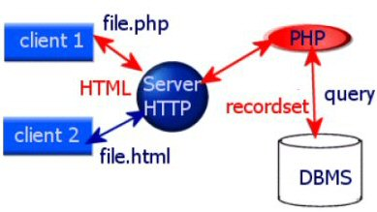
Client Server Architecture

Slide 2
HTML / HTML5
Stands for Hyper Text Mark up Language
HTML5 new Elements
Header
Nav
Main
Article
Section
Aside
Footer
HTML5 new Attributes
Input tag |  | Form tag
disabled | formnovalidate | autocomplete
size | placeholder | novalidate
autocomplete | required

Slide 3
Java Script
Programming lang for HTML
Easy to learn
document.getElementById
Common Events
onclick
onchange
onload
etc
Libraries and Frameworks
jQuery, AngularJS..etc

Slide 4
APACHE
Open source
HTTP stateless protocol
Php runs mod_php.so module
Runs on all platforms (Linux, Mac,IIS etc.)TCP/IP to transfer data
Handles Request and Response
FTP and SFTP (file upload and download)
Modules to execute no of languages (Php, Perl, python, etc)
Some directives : ServerRoot, DocumentRoot , Listen etc.

Slide 5
PHP
Hypertext Pre Processor
Developed by Rasmus Ledrof
Runs on cross platforms ( linux, windows, mac…)
Compatible with all servers ( http, iis, etc…)
Supports all databases ( mysql, oracle, sqlserver, etc..)
Free
Simple to learn
Current version is 7

Slide 6
MySQL
Open Source
Supports on many operating systems and languages like php,perl,c,c++
RDBS
Works with small and large data sets
Speed, reliable and easy to use
Distributed and supported by oracle corp.
Secure

Slide 7
JavaScript
Features
It is light weighted
Client-side validation
JavaScript is interpreter based scripting language
Event Handling

Slide 8
TERMINOLOGY
Web application
Webpage
Static and dynamic pages
Client and server
Request and Response
Stateless and stateful

