Slide 1
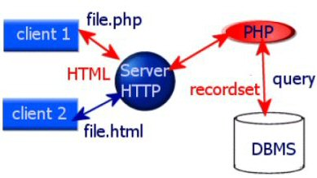
Client Server Architecture

