Slide 1


ICS 690: Blockchain
Krishna Chaitanya Kancharla
Professor/ Sponsor : Calcaterra, Craig

Slide 2
Introduction: What is Blockchain?
Smart Contracts
Crypto Zombies and Github Contribution
Deploying smart contracts with Truffle and Ganache CLI
Introduction: What is Chit fund?
How Chit fund in Block Chain works: Step by Step Process
Smart Contract Design for Chit fund.
Design of Chit fund in Block chain.
Deployment of smart contract in chit fund.
Agenda
Notes:
Image Courtesy of Microsoft

Slide 3
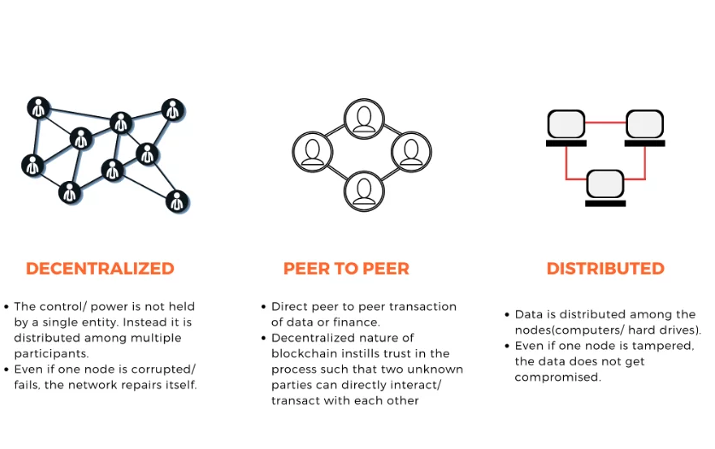
Introduction: What is Blockchain?
Blockchain is a new technology (2008) that is gradually evolving with the growing popularity of digital currencies such as Bitcoin.
In simple terms Blockchain is just a distributed ledger made up of blocks. Each block is chronologically linked to the previous block. Each block in the chain has a set of transactions, each person on the network is validated, and the entire process is open, transparent, and irrevocable.
An important aspect of blockchain technology is that it is designed to store information in such a way that it is impossible to change, delete, or add information without being discovered by other users. This will determine the origin and authenticity of the transaction and thereby increase overall transparency and trust when it is linked to a particular product.
Notes:
Image Courtesy of Microsoft

Slide 4
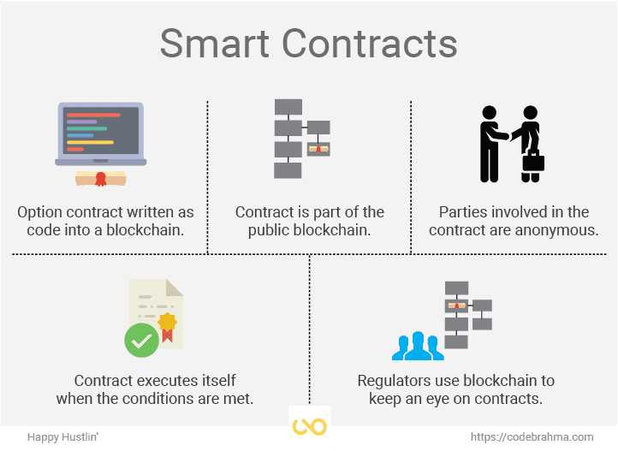
Smart Contracts
Smart contract is nothing but a simple program that can be written in Solidity, Vyper, Rust so on. Smart contracts contain code written in functions and data which are stored in blockchain at a specific address.
Like a regular contract smart contracts can define rules only difference it executes functions using the code written.
When conditions are met smart contracts executes automatically and transactions are made over network but are not controlled by any single user.
Smart contracts cannot be deleted by default.
Interactions with smart contracts are irreversible.
Notes:
Image Courtesy of Microsoft

Slide 5
Smart Contracts (Contd…)
I am new to Blockchain and have no/limited knowledge on how blockchain and solidity code works as a part of learning I started working on blockchain courses on https://cryptozombies.io/. As I progress through the course work Solidity Path module helped me to understand how smart contracts works and how to write them in Solidity.
As a starter I was able to completed Solidity Path: Beginner to Intermediate Smart Contracts and Decentralized Oracles modules.
As a Code learning are saved on to my github account.
https://github.com/krishna-github-metrostate/cryptozombies-lesson-code
Started with a simple zombie and increased the complexity by building multiple zombies in two different smart contracts.
To make it secure, additional security features are added by making functions public and private so only a specific individual can access the game. Openzeeplein is also used for added security.
Random number functions are generated to build more zombies and features for other players to join.
Standardizes the process by using ERC271 tokens using the default libraries.
Notes:
Image Courtesy of Microsoft

Slide 6
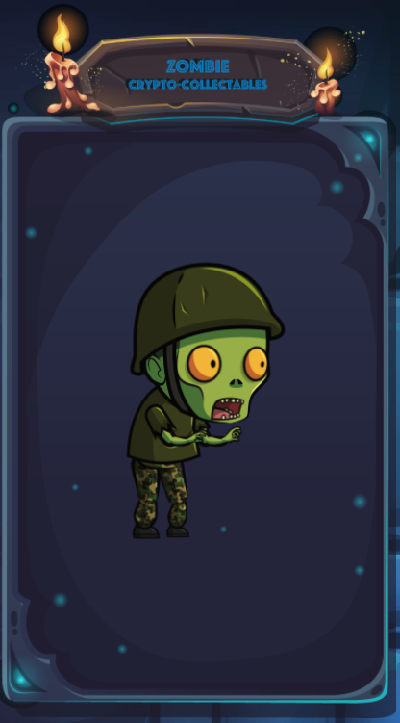
Crypto Zombies Learnings
Version Pragma: Every contract should always start with version; this is used to protect future compiler issues when changes are made.
State Variables and Integers: These variables are saved on contract storage, meaning they are written to the blockchain.
uint256 – a 256-bit unsigned integer.
Struct: can be used to create complicated datatype, with various properties.
Array: Collection of data points. Can be a fixed or dynamic, same as state variables these can be stores in contracts. Public array or private array.
Function Declaration: By value or by Reference, by value complier creates a copy of parameters and pass it to the function whereas by reference, parameters are referenced. Public (anyone can call it) or private (suggested - default) functions.
Events: To communicate to blockchain to app front-end and can take actions.
Addresses: Unique identifier for each account. Blockchain is made up of accounts. Each address is associated to a specific account.
Import: if sometime codes can get long when we write struc, functions and event to make them manageable we can split the file into multiple and use import function to call into the other contracts.
Storage and Memory: Storage is permanent whereas Memory is temporary storage.
Notes:
Image Courtesy of Microsoft

Slide 7
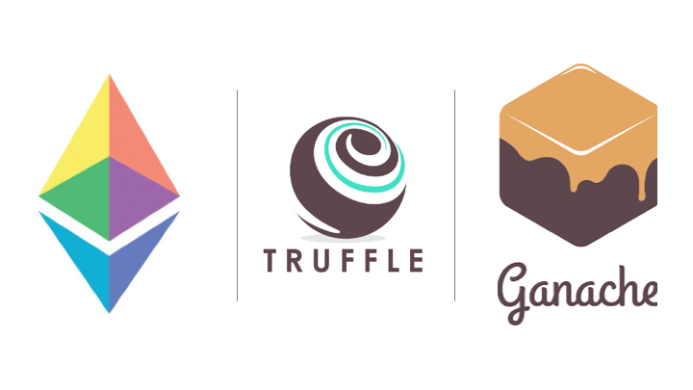
Deploying Smart Contract with Truffle and Ganache CLI
Truffle: Used to create solidity templates to deploy. It’s a testing framework which gives the developers the ability to spin up a smart contract with click of a button.
Ganache-CLI: It’s a simulation environment where full client behavior can be created resulting in faster, easier, and safe Ethereum based applications. It will allow us to create our own private Ethereum blockchain. It gives all the abilities to perform actions same as main blockchain but without any cost. Many developers as their testing ground.
Notes:
Image Courtesy of Microsoft

Slide 8
Deploying Smart Contract with Truffle and Ganache CLI (Contd..)
Prerequisites:
Operating Systems
Software: npm. npm must be installed from the root folder of the application.
$ sudo apt-get install nodejs
$ sudo apt-get install npm
$ sudo apt-get install npm
$npm -v (to check the version)
or
# npm install
Notes:
Image Courtesy of Microsoft

Slide 9
Deploying Smart Contract with Truffle and Ganache CLI (Contd..)
Installing Truffle and Ganache CLI:
First, we must make sure atleast V5.0 of npm has been installed then run npm install -g ganache-cli truffle (this is installed globally so we need not to be worried about installation location)
Run Ganache CLI:
We can now start to develop our own smart contracts. To run locally we need to create a simulated environment
$ ganache-cli
After running the above command ganache will create 10 accounts with private keys with test ethers (100). Since ganache is all in memory if we restart everything will be refreshed back to normal.
Notes:
Image Courtesy of Microsoft

Slide 10
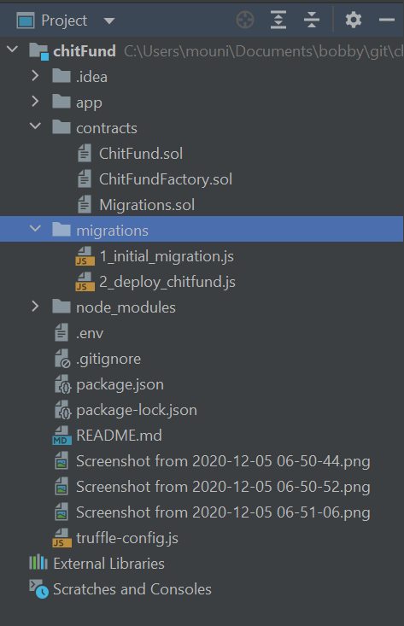
Deploying Smart Contract with Truffle and Ganache CLI (Contd..)
Build a Chit fund smart Contract:
/contracts: Directory path for smart contracts. Here is where we will save out 3 chit fund solidity contract files.
/migrations: used to deploy the smart contract in the contacts folder.
/node_modules: here is where we test codes for smart contracts that we built.
/truffle-config.js: no need to touch it, it’s just a configuration file.
Notes:
Image Courtesy of Microsoft

Slide 11
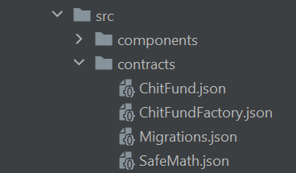
Deploying Smart Contract with Truffle and Ganache CLI (Contd..)
Compiling the Contracts:
Contracts can be complied with ease using $ truffle compile
when we execute this command what it does at the backend is it converts the original code into blockchain bytecode.
Once compiling is completed without issues there will be json files created under app/src/contracts
Notes:
Image Courtesy of Microsoft

Slide 12

Deploying Smart Contract with Truffle and Ganache CLI (Contd..)
Deploying the Contracts:
Under the migrations directory create a json file “2_deploy_chitfun.js” and enter below code.
const ChitFund = artifacts.require("ChitFund"); const ChitFundFactory = artifacts.require("ChitFundFactory"); module.exports = function (deployer) { deployer.deploy(ChitFund, "KrishnaChitFund", 1, 3, 3); deployer.deploy(ChitFundFactory); };
Modify the truffle-config.js to include the local host address (which connects to ganache) and run $ truffle migrate. Once you run it and navigate to ganache-cli we can see logs running in the terminal.
Notes:
Image Courtesy of Microsoft

Slide 13
Introduction: What is Chit fund?
Chit fund is a savings and credit system that is of a rotational process practiced in many countries. It can be initiated among friends and family or by financial institutions.
Chit fund can three different stages:
Before the start of the chit
During the chit life cycle
Closure.
There will be a foreman/regulator who plays a key role as a middleman for the life cycle of a chit fund.
Notes:
Image Courtesy of Microsoft

Slide 14
How Chit fund in Block Chain works:
As a start a new chit fund is created is Ethereum block chain.
Once the creation is completed users are asked to join the fund.
To allow users into the chit fund underwriter chooses a member and to underwrite and grant entry.
Underwriter has reputation token, where they can use those reputation token to underwrite users for each cycle of the fund.
Users run through the chit fund process as expected, funds and fees paid round completed.
Member are dropped either due to fraud activities or insufficient funds, resulting underwriter take over the process and takes the distribution or vice versa where member takes the distribution and defaults, resulting in loss for the member underwriter.
Notes:
Image Courtesy of Microsoft

Slide 15
Smart Contract Design for Chit fund:
We have 3 different smart contracts to run the chitfund app
ChitFund.sol
ChitFundFactory.sol
Migrations.sol.
For our project we are using version pragma solidity >=0.40.21 <0.7.0
ChitFunFactory.sol is the heart of the code designed in solidity version pragma solidity ^0.6.8 which contains the import of ChitFund.sol smart contract.
State variables and integers are designed and permanently stored in this contract which are written into blockchain. (CryotoZombies)
Function createFund with state variables uint256 amount, installments and participants are defined in this smart contract with a requirement of >0 and fund are deployed using this smart contract.
Notes:
Image Courtesy of Microsoft

Slide 16
Smart Contract Design for Chit fund: (Contd..)
In ChitFund.sol we used preinstalled openzeppllin to call SafeMath.sol which is used to wrap over arithmetic operations.
Contract ChitFund is created using state variables uint256 with public function fundName, jackpot, numOfInstallments, noOfInvestors, manager and installmentAmount.
All the critical parameters/variables such as noOfInvestorsJoined, fundBalance, currentRound are designed. Structure of the investor is also designed to get information about hasWonRound, hasJoined and isReadyToinvest.
All the testing parameters are also represented in this code using function contribute() that checks if the member has already Invested or contributed pr already paid all the installments.
Function bidForJackpot() is create that tell or define who is the jackpot winner and finally releaseFund() function is created to release the fund to the winner.
Notes:
Image Courtesy of Microsoft

Slide 17
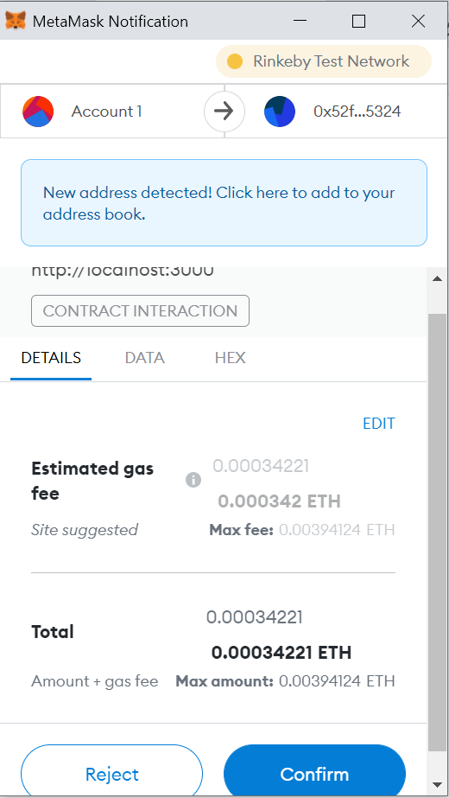
Design of Chit fund in Block Chain:
Who can join DAO: Members with a valid wallet ID and user credentials will be able to join.
MetaMask: MetaMask is designed to access Ethereum based applications. It gives a secure login, token wallet and token exchange that is needed to manage DAO. It generates passwords and keys so that user has complete access over the account using the passphrase.
Rinkeby Test Ether:
Test Ethereum: To test the decentralized application we used Rinkeby Faucet tool for tesetnet Ether (ETH) before go live. Rinkeby is used as its completely free and easy to use.
Testnet Tokens: These are test currencies which will be used to test/troubleshoot our DAO.
How it works: For every 24 hours without any authentication, we can request 0.1 Rinkeby ETH, but to increase the amount of ETH to 0.5 Rinkey ETH we can login to Alchemy which is also free to use/login.
Notes:
Image Courtesy of Microsoft

Slide 18
Design of Chit fund in Block Chain: (Contd..)
Infura: For developers like infura allows developers like us to take the testing application and scale it to production with easy access to Ethereum.
.env: To initiate the app .env file must be configured with user specific mnemonic passphrase from the metamask where test Ether is stored.
MNEMONIC="horse goat mouse"
RINKEBY_INFURA="https://rinkeby.infura.io/v3/6244d4354814c56f87159"
Notes:
Image Courtesy of Microsoft

Slide 19
Deployment of smart contracts in Chit fund Project:
Truffle framework is used to for compiling and deploying the smart contracts. Designing the DApp and developing it becomes easier with Truffle framework.
Truffle is a development tool for Ethereum solidity language. Solidity language is used for writing smart contracts and Atom is used as editor which is an open-source text editor.
JavaScript library Web3.js is used to interact smart contracts with blockchain. In this project truffle default builder is used for importing the complied contract artifacts automatically.
Notes:
Image Courtesy of Microsoft

Slide 20
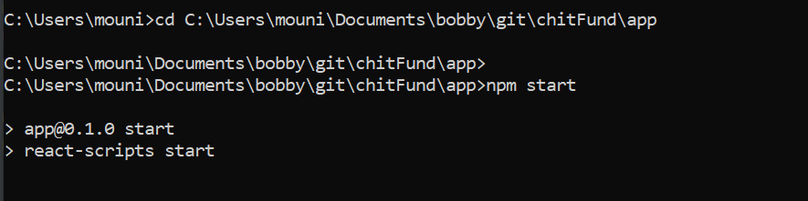
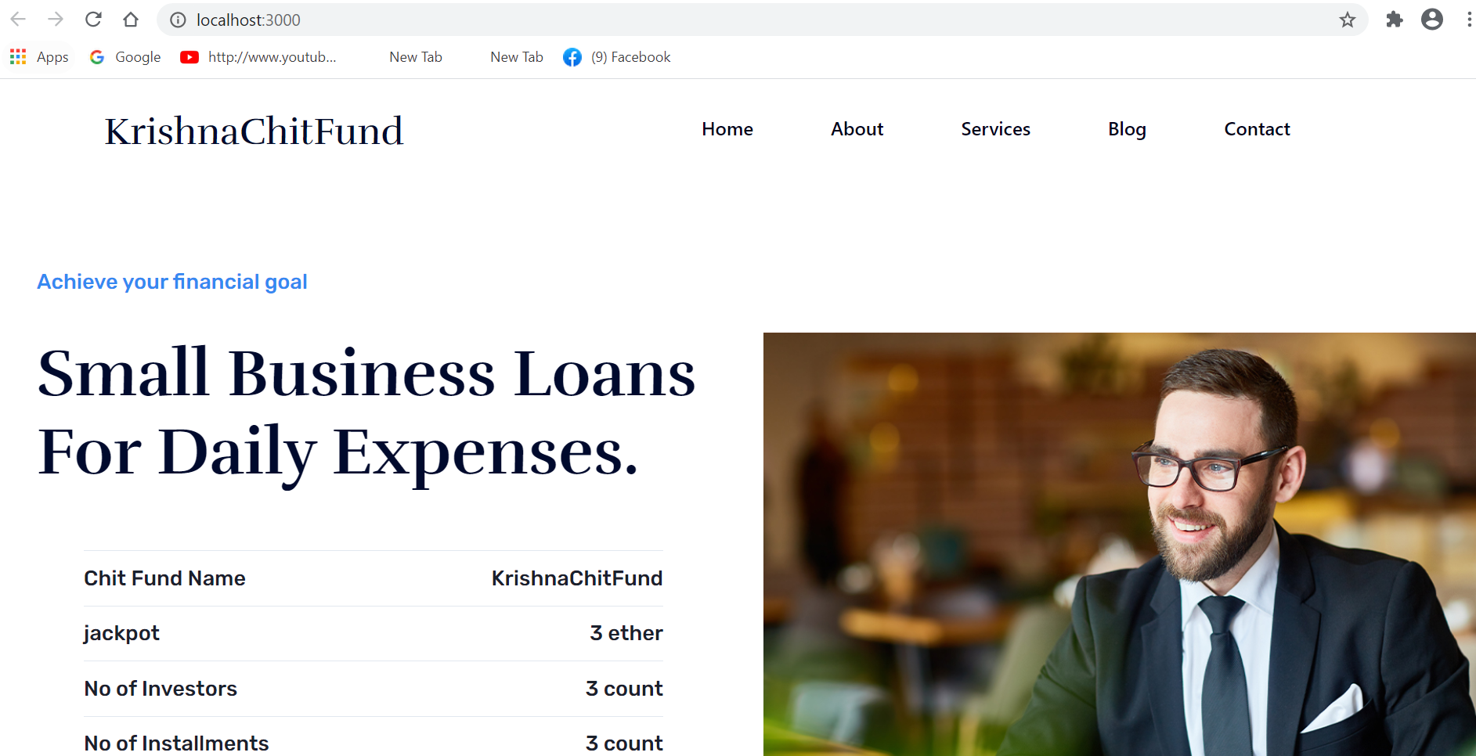
Deployment of smart contracts in Chit fund Project: (Contd..)
Run the Chit fund app:
Notes:
Image Courtesy of Microsoft

Slide 21
Underwriting contracts for the underwriter to underwrite members:
As a start a simple assumption is made i.e., 1:1 an underwriter will under a member.
Event 1: Event triggers when a member wants to join a chit fund to check if the member has any pre-build reputation tokens. If NO event 2. If YES join the chit fund.
Event 2: If a member has no preexisting reputation tokens member is in queue for the underwrite to choose and under write. Meaning underwriter will provide reputation tokens to join the fund.
Event 3: Underwriter verifies the userID for authentication and any fraud activates, if No event 4 if Yes event 5
Event 4: Underwriter underwrites for the member which will enable him to join the chit fund.
Event 5: Underwriter rejects the member request to join the chit fund.
InsuranceHelper Code Triggers when Underwriter wants to make decision on Approve or Reject:
When event 4 is trigger below event is called to check the history of the members.
Event 4.1: Checks if the members who is requesting to underwrite has history to make better decision on approving or rejecting the underwriting.
Notes:
Image Courtesy of Microsoft

Slide 22


Slide 23
contract InsuranceHelper {
struct ChitFund {
string name;
}
ChitFund[] public chitFunds;
mapping (uint => address) public chitFundToMember;
mapping (address => uint) memberChitFundCount;
function getChitFundsByMember(address _member) external view returns(uint[] memory) {
uint[] memory result = new uint[](memberChitFundCount[_member]);
uint counter = 0;
for (uint i = 0; i < member.length; i++) {
if (chitFundToMember[i] == _member) {
result[counter] = i;
counter++;
}
}
return result;
}
}

Slide 24
Module#1 Chit Fund
u_{i} – Under writer
M – Members of chit fund
p_{i} – Premium
d_{i} - distribution
R – Reputation tokens
Pool
R
u1
R
M1
u2
M2
p_{i}
u3
R
M3
.
.
.
.
.
.
.
.
.
.
.
.
.
.
_{5% Fee}
d_{i}
u10
R
M10

