Slide 1

JOGINPALLY.B.R ENGINEERING COLLEGE DEPARTMENT OF COMPUTER SCIENCE ENGINEERING
Gesture Based Communication Using Steganography
PRESENTED BY
G.KRISHNA (22J21A6620)
A.MAHESH KUMAR (22J21A6602)
D MADHU (22J21A6616)
UNDER THE GUIDANCE
MR. G.SANTHOSH KUMAR
ASSISTANT.PROFESSOR

Slide 2
Table of Contents
1.Abstract
2.Title Justification
3.Existing system
4.Limitations
5.Proposed system
6.Advantages
7.Software requirements
8.Hardware requirements

Slide 3
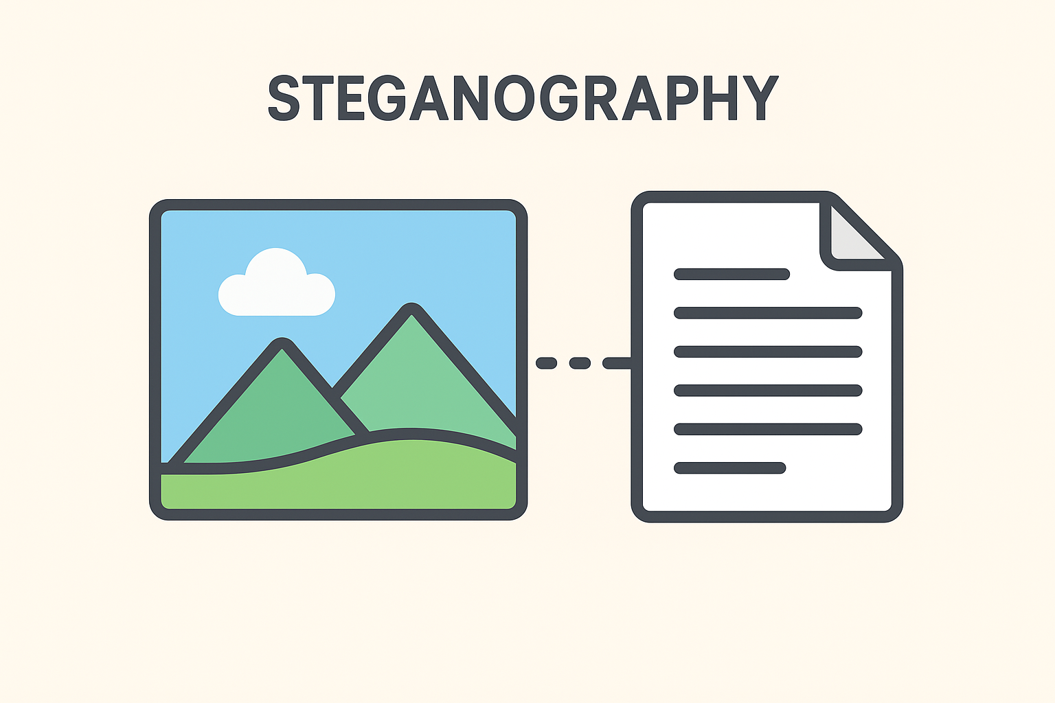
Abstract
Gesture-Based Secure Communication Using Steganography is a system that improves data security by using hand gestures to control the hiding and revealing of secret information. It uses steganography, a method of hiding data inside normal files like images so that no one can detect it. By combining gesture recognition with steganography, the system provides an extra layer of security, making the hidden data both encrypted and invisible to unauthorized users.
3

Slide 4
Introduction
With the rapid growth of digital communication, protecting sensitive information has become a major concern. Conventional security methods mainly rely on encryption, which makes data unreadable but still visible to attackers. This visibility often attracts hacking attempts. To overcome these issues, the proposed system introduces gesture-based control along with steganography. By using hand gestures for authentication and hiding data inside media files, the system ensures secure, contactless, and intelligent communication.
4

Slide 5
LITERATURE SURVEY
Review of Video-Based Steganography for Secure Communication
Title | Author | Methodology | Drawbacks | Improvement in Our Project
Data Encryption and Decryption Using Steganography | N. Manohar et al. | Video steganography using LSB, Neural Networks, and Fuzzy Logic with PSNR and MSE evaluation | Uses only steganography, no authentication layer, high computational complexity | Adds gesture-based authentication with steganography to provide dual-layer security

Slide 6
LITERATURE SURVEY
Review of Advanced Video Steganography Methods
Title | Author | Methodology | Drawbacks | Improvement in Our Project
Directional Pixogram: A New Approach for Video Steganography | Mohammed Baziyad et al. | Video steganography using motion vectors and DCT coefficients | High processing cost, suitable only for video, no authentication | Lightweight image-based steganography with gesture authentication

Slide 7
LITERATURE SURVEY
Review of Pixel-Based Image Steganography Algorithms
Title | Author | Methodology | Drawbacks | Improvement in Our Project
A Novel Pixel-Based Steganography Algorithm in Image Hiding | Jawwad A. R. Kazi et al. | Pixel-level embedding of text in images | Single-layer security, vulnerable if algorithm is known | Adds gesture-based verification for secure data extraction

Slide 8
Existing System
In the existing communication systems, most data protection methods depend on encryption and password-based security. Encryption hides the meaning of the message but does not hide the message itself — anyone can see that secret communication is happening. These systems mainly use text-based or key-based authentication, which can be easily targeted by hackers through brute-force or phishing attacks.
Existing secure systems also lack gesture-based controls, which could make the communication more private and hands-free. Since there is no integration of steganography or gesture recognition, the level of security remains limited.
5

Slide 9
Limitations
Only encryption is used, which can still attract attention to the hidden message.
Hackers can identify and try to break encrypted data.
No gesture-based or multi-layer security methods.
Risk of data leakage during transmission.
Not suitable for modern, real-time, or user-friendly communication.
Difficult for common users who are not familiar with complex encryption tools.
6

Slide 10
Proposed System
The system combines gesture recognition and steganography for secure data communication.
Users can use hand gestures instead of typing passwords or commands.
Gestures are used to control the encoding (hiding) and decoding (revealing) of secret information.
The hidden message is stored inside an image or media file using steganography, making it invisible to others.
Only authorized users who know the correct gesture sequence can access or reveal the hidden data.
Two-Layer Protection: First Layer: Gestures act as an authentication key. Second Layer: Steganography hides the actual message inside a media file.
7

Slide 11
Advantages
Dual-layer security (gesture + steganography) makes hacking nearly impossible.
Prevents unauthorized access and data detection.
User-friendly, contactless, and interactive communication.
Reduces risk of brute-force or phishing attacks.
Works with different file formats like images, videos, or audio.
Less data loss, fast processing, and minimal storage usage.
Suitable for modern AI-driven security applications.
8

Slide 12
System Requirement Specification (SRS)
Functional Requirements
The system should detect and recognize user hand gestures.
The system should allow users to hide secret data inside media files.
The system should extract hidden data only after correct gesture authentication.
The system should store and manage user inputs securely.
The system should support image-based steganography.
Non-Functional Requirements
The system should provide high security and reliability.
The response time should be fast and efficient.
The system should be user-friendly and easy to operate.
The system should ensure data privacy and integrity.
The system should be scalable for future enhancements.
8

Slide 13
Software Requirements
Programming Language: Python
• Libraries: OpenCV, NumPy, Matplotlib, Tkinter
• Database: MySQL or SQLite
• IDE: Jupyter Notebook / Visual Studio Code
9

Slide 14
Hardware Requirements
Hardware Requirements:
• System: Intel i5 Processor or above
• RAM: Minimum 4 GB
• Webcam or external camera for gesture detection
• Storage: Minimum 500 MB free space
10

Slide 15
Conclusion
The proposed system successfully combines gesture recognition and steganography to create a secure and innovative communication platform. By using hand gestures for authentication and data hiding within media files, it ensures a dual-layer protection mechanism that enhances both privacy and usability. This approach not only prevents unauthorized access but also makes communication contactless, intelligent, and efficient. Overall, it provides a modern, user-friendly, and robust solution for secure data transmission in today’s digital world.

Slide 16

The End
THANK YOU FOR LISTENING

