Slide 1

ShoppersDeal
Madan Mohan Malaviya University of Technology, Gorakhpur
A
Presentation
on
Submitted to:
Dr. Shiva prakash
Associate professor, csed, mmmut
&
Smt. Meenu
Assistant professor, csed, mmmut
Submitted by:
Tripti yadav
Roll. No. 2014024156
Mca iii year

Slide 2
Agenda
Introduction
Android
Product Specification
Software and Hardware Requirement
Design
Data Flow Diagram
E - R Diagram
Use Case Diagram
Flow Chart
Screen Shots
Conclusion
References

Slide 3
Introduction
The ShoppersDeal is the part of the sample application that provides customers with online shopping. Through a Web browser, a customer can browse the catalogue, place items to purchase into a virtual shopping cart. Create and sign in to a user account, and purchase the shopping cart contents by placing an order. After placing an order for selected items a user can make payment with through a credit card or through cash on delivery. There is no need to wait in long queue for purchase. Customer can purchase products sitting at home by viewing images of different category of products and adding in shopping cart.

Slide 4
Android
Android is an Operating System that is used to operate mobile phones that is typically based on the Linux kernel. It was originally developed by Andy Rubine along with his research team. It was later purchased by Google in 2005. The android kernel is based on the Linux kernel and from April 2014 onwards the android devices are based on Linux kernel 3.4 or 3.10 . The android applications are developed with the help of the android SDK that is the Software Development Kit for the android. SDK includes a set of built in libraries, a debugger, documentation, sample code and an emulator.
Earlier Google used Eclipse IDE with the ADT (Android Development Tools) plug-in and later it launched the Android Studio as its primary IDE. Google play store is the primary location for the android application where the developers launch their android apps and the users can download and install the applications by using the APK (Android application Package) files.

Slide 5
Product Specification
It consists of these modules:
Authentication and Authorization
Order the product
Password recovery
Change password

Slide 6
S/W & H/W Requirements
Software Requirement
Hardware Requirement
User Interface : HTML, CSS
Tools : Jenkins, Apache Maven, GIT, Selenium
Repository: GitHub or Others
Client-side Scripting : JavaScript
Programming Language : Java
Web Applications : JDBC, Servlets, JSP
IDE/Workbench : Eclipse 4.6 (Neon)
Database : Oracle 11g
Server Deployment : Tomcat 8.0.x and above
Frame Work : Struts 1.x
Browser : IE/Mozilla Firefox/Google Chrome
Processor : CORE i3 & above
Hard Disk : 40 GB
RAM : 2 GB or more

Slide 7
Design

Slide 8
DATA FLOW DIAGRAM
CONTEXT LEVEL DFD

Slide 9
first LEVEL DFD

Slide 10
SECOND LEVEL DFD

Slide 11
E-R DIAGRAM
Order-id
Prod_Name
Prod_id
Qty
Prod_id
U_name
address
Price
1
place
M
M
Has
M
Product
Email
User
ORDER
Contact_No
date
Category-ID
1
M
has
Has
Has
1
Prod_id
Has
Remarks
Date
1
M
CATEGORY
Sale-id
STOCK
M
DELIVERY
Category-id
Stock-id
SALE
Order-Id
Delivery_Qty
Category_Name
Date
Prod_id

Slide 12
USE CASE DIAGRAM

Slide 13
FLOW CHART

Slide 14
Screen Shots

Slide 15
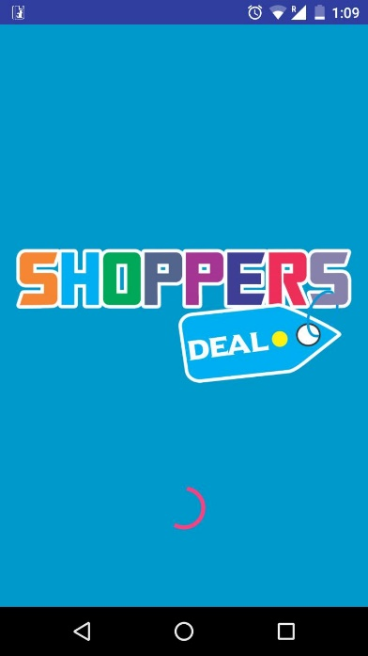
Splash Screen

Slide 16
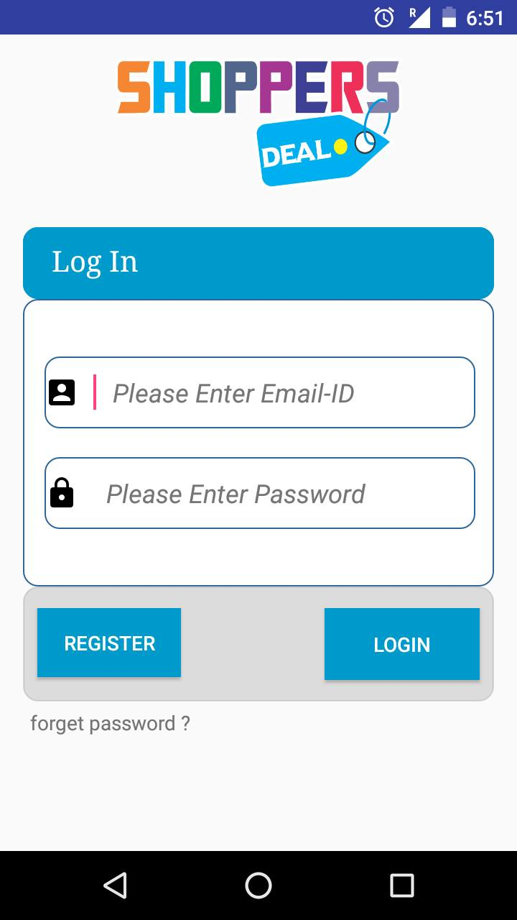
Login Activity

Slide 17
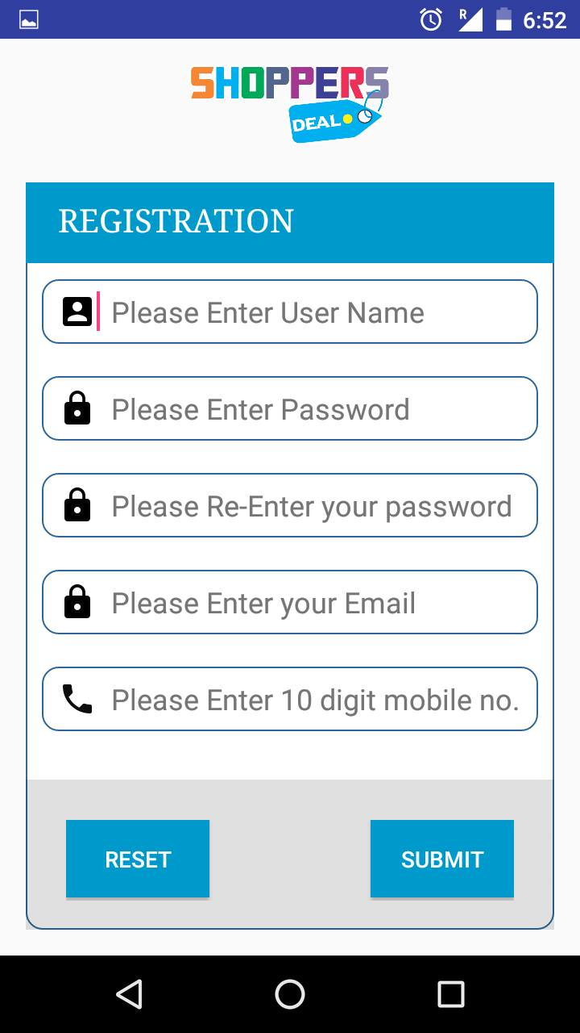
Registration Activity

Slide 18
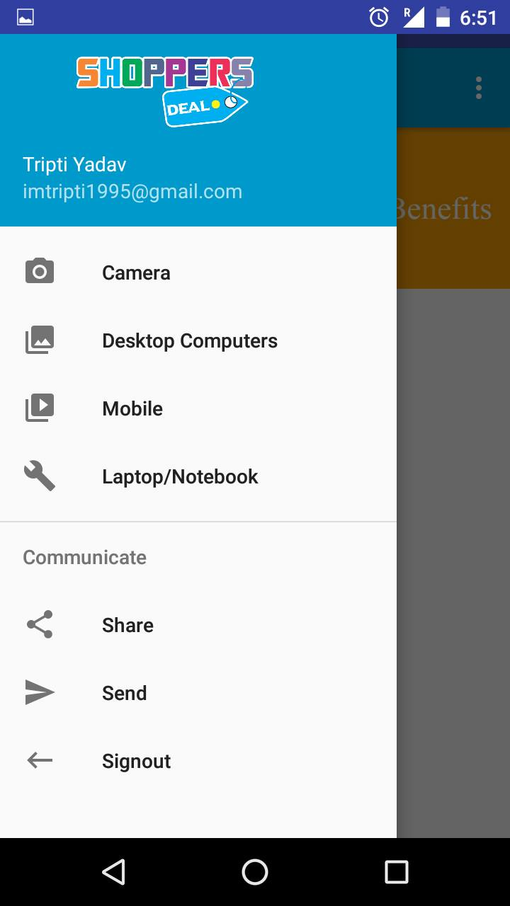
Activity

Slide 19
Conclusion
The android application fulfils the purpose of its creation by providing the basic help and guidance that it was expected to do. As proposed it does makes shopping easy and allows users to choose among from the various products available and choose to buy them. It is easily accessible and very easy to handle and use. It can be modified and developed further to serve many other purposes such as location tracking and order tracking etc. Its major advantage is that all the information is available to the front end users and at easy button clicks.

Slide 20
References
Android Recipes: A Problem-Solution Approach - Dave Smith & Jeff Friesen
Android Programming: The Big Nerd Ranch Guide - Bill Philips & Brian Hardy
Programming Android - Zigurd Mednieks, Laird Dornin, G. Blake Meike & Masumi
Android Design Patterns -Greg Nudelman
Android Application Development All-in-one for Dummies - Donn Felker

Slide 21

Any Query

Slide 22
Thank You

