Slide 1

Edunet Foundation Shell Skills4Future AICTE Internship on Green Skills & AI
Internship Project

Slide 2

Student Name : Krishna Karthik Eluripati
Student ID : STU63be7a3fca9ba1673427519
College Name : Vishnu Institute of Technology

Slide 3
CAPSTONE PROJECT SHOWCASE
Project Title : Power BI Driven Exhaustive Analysis of the Indian Agriculture Sector
Abstract | Problem Statement | Project Overview | Proposed Solution | Technology Used | Modelling & Results | Conclusion | Q&A

Slide 4
Abstract
Objective: Develop an interactive Power BI dashboard to analyze 19 years of agricultural data from India, covering 33 states, 646 districts, and 122 crops across five seasons.
Goal: To provide comprehensive insights into crop production trends, regional variations, and factors influencing minimum support prices (MSPs) to inform agricultural policies and strategies.

Slide 5
Problem Statement
Challenge: The Indian agriculture sector faces inefficiencies due to limited access to data-driven insights.
Need: A comprehensive analytical tool is required to visualize and understand trends in crop production, yield variations, market prices, and seasonal impacts across regions.
Data: Historical data spanning 19 years, across multiple states, districts, and seasons for 122 crops.

Slide 6
Project Overview
Scope: Analyzing agricultural data to uncover trends in crop production, yield, prices, and regional disparities.
Focus Areas:
Top Crops: Identifying the most produced crops like coconut.
Regional Insights: Analyzing crop distribution across states and districts.
Seasonal Trends: Understanding variations in crop production based on seasons.
Output: An interactive Power BI dashboard providing valuable, real-time insights

Slide 7
Proposed Solution
Interactive Dashboard: A Power BI-based solution to analyze data from multiple angles, allowing users to explore trends, regional patterns, and seasonality.
Key Features:
Visualization: Maps, time series charts, and graphs for easy interpretation.
Data Exploration: Drill-down options for detailed insights by state, district, crop, and season.
Predictive Analysis: Use of data mining techniques to predict MSPs and identify future trends.

Slide 8
Technology Used
Power BI: The primary tool for creating interactive dashboards and visualizations.
Data Modeling: Utilizing Power Query and DAX for data transformation and calculations.
Data Source: CSV files containing 19 years of data on agricultural production, crop types, and market prices.
Predictive Models: Applied data mining techniques for MSP prediction.

Slide 9
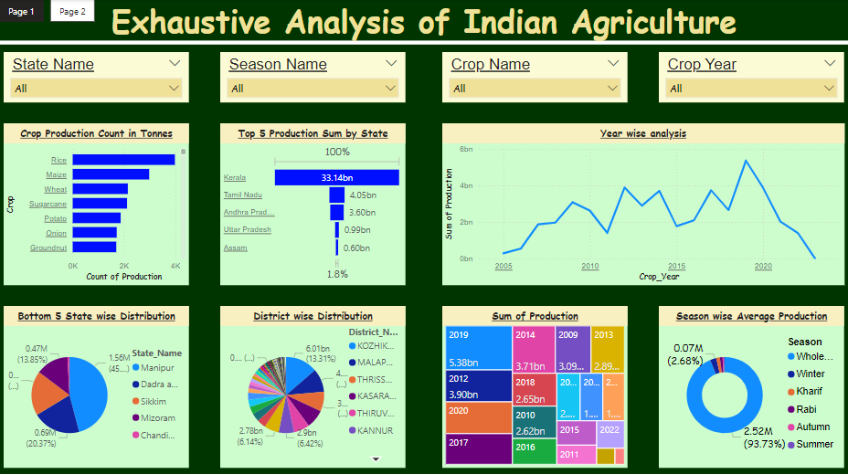
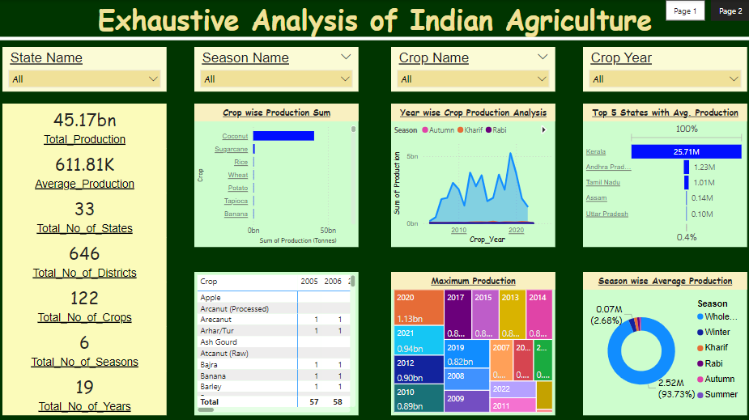
Modelling & Results

Slide 10
Conclusion
Insights: The dashboard reveals key trends in crop production, seasonal patterns, and regional disparities.
Policy Implications: The findings provide actionable insights for informed decision-making on subsidies, research, and climate-resilient farming.
Impact: The project empowers stakeholders with data-driven insights to drive sustainable and equitable growth in India’s agriculture sector.

Slide 11
Thank You!
Notes:
Thank You !!

