Slide 1
Secure Data Hiding in Image Using Steganography
CAPSTONE PROJECT
Presented By: STU63be7a3fca9ba1673427519
Student Name: Krishna Karthik Eluripati
College Name & Department: Vishnu Institute of Technology,
Computer Science and Business Systems

Slide 2
Problem Statement
Modern data breaches underscore the need for secure communication.
Traditional encryption can attract unwanted attention, making covert methods vital.
This project embeds sensitive information within digital images to keep it hidden.
The approach offers a stealthy yet robust means to secure confidential data.

Slide 3
Technology used
Programming Language: Python
Libraries & Tools: tkinter (GUI), OS, Pillow (PIL), stegano (LSB)
Technique: LSB-based image steganography algorithm
Development Environment: Windows/Linux using IDEs like Visual Studio Code or PyCharm

Slide 4
Wow factors
Seamless integration of data hiding with minimal impact on image quality.
Multiple layers of security including pre-embedding encryption.
Intuitive interface enabling easy encoding and decoding processes.
Unique combination of image processing and cryptographic methods for robust protection.

Slide 5
End users
Security professionals and corporate IT departments
Law enforcement and government agencies requiring confidential data transfer
Journalists and activists needing discreet communication channels
Academic researchers exploring innovative data security techniques

Slide 6
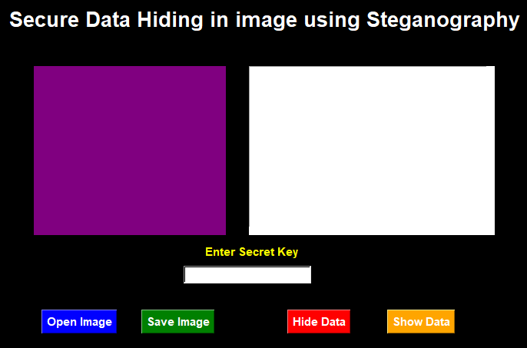
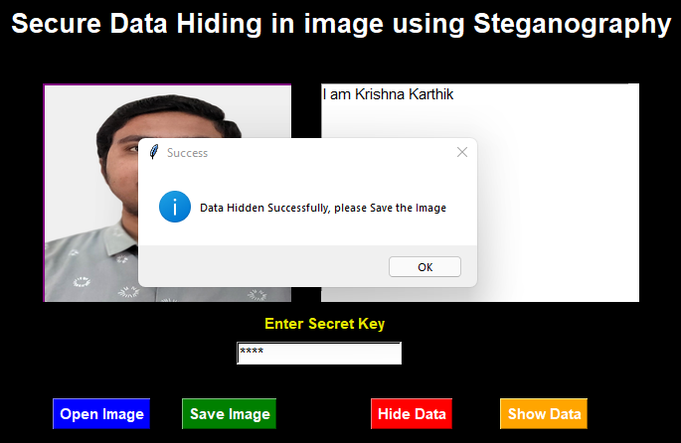
Results

Slide 7
Conclusion
The project effectively addresses data security challenges by hiding information within images.
It maintains the integrity and quality of the cover image while securing the payload.
The approach demonstrates a novel and scalable solution for confidential communication.
Overall, the solution is robust, user-friendly, and offers potential for further enhancements.

Slide 8
GitHub Link
https://github.com/krishna-karthik-22pa5a5702/Secure-Data-Hiding-in-Image-using-Steganography

Slide 9
Future scope
Integration with mobile platforms for on-the-go data protection
Real-time embedding and extraction processes
Support for multiple image formats and higher payload capacities
Enhanced encryption methods and potential expansion into video steganography
Incorporation of machine learning techniques for optimized data hiding

Slide 10
THANK YOU

