Slide 1
Sentinel
AI/NLP Risk Engine for Real-Time Market Risk
S&P Global & Crisil Campus Hackathon 2026
Krishna Kaushal · MNNIT
October 2026

Slide 2
Problem & Approach
THE PROBLEM
▸ Risk desks drown in headlines. Analysts can't read every wire, tweet, and filing intraday — material events get priced before they're read.
▸ Sentiment alone isn't a signal. A polarity score with no event type, no ticker linkage, and no impact estimate can't drive a portfolio decision.
▸ Stress tests lag the news. Scenario shocks are run quarterly on stale assumptions while the market reprices in minutes.
OUR APPROACH
▸ Three-stage NLP risk engine. FinBERT-style sentiment → zero-shot event classification → impact scorer (magnitude × novelty × credibility).
▸ Ticker-linked signal store. Every signal lands in signals.jsonl and a FastAPI layer (/signals, /analyze) — one contract for all consumers.
▸ Two downstream modules. (A) Index rebalancer tilts weights away from negative-risk names; (B) stress tester prices event-driven scenarios with loss attribution.

Slide 3
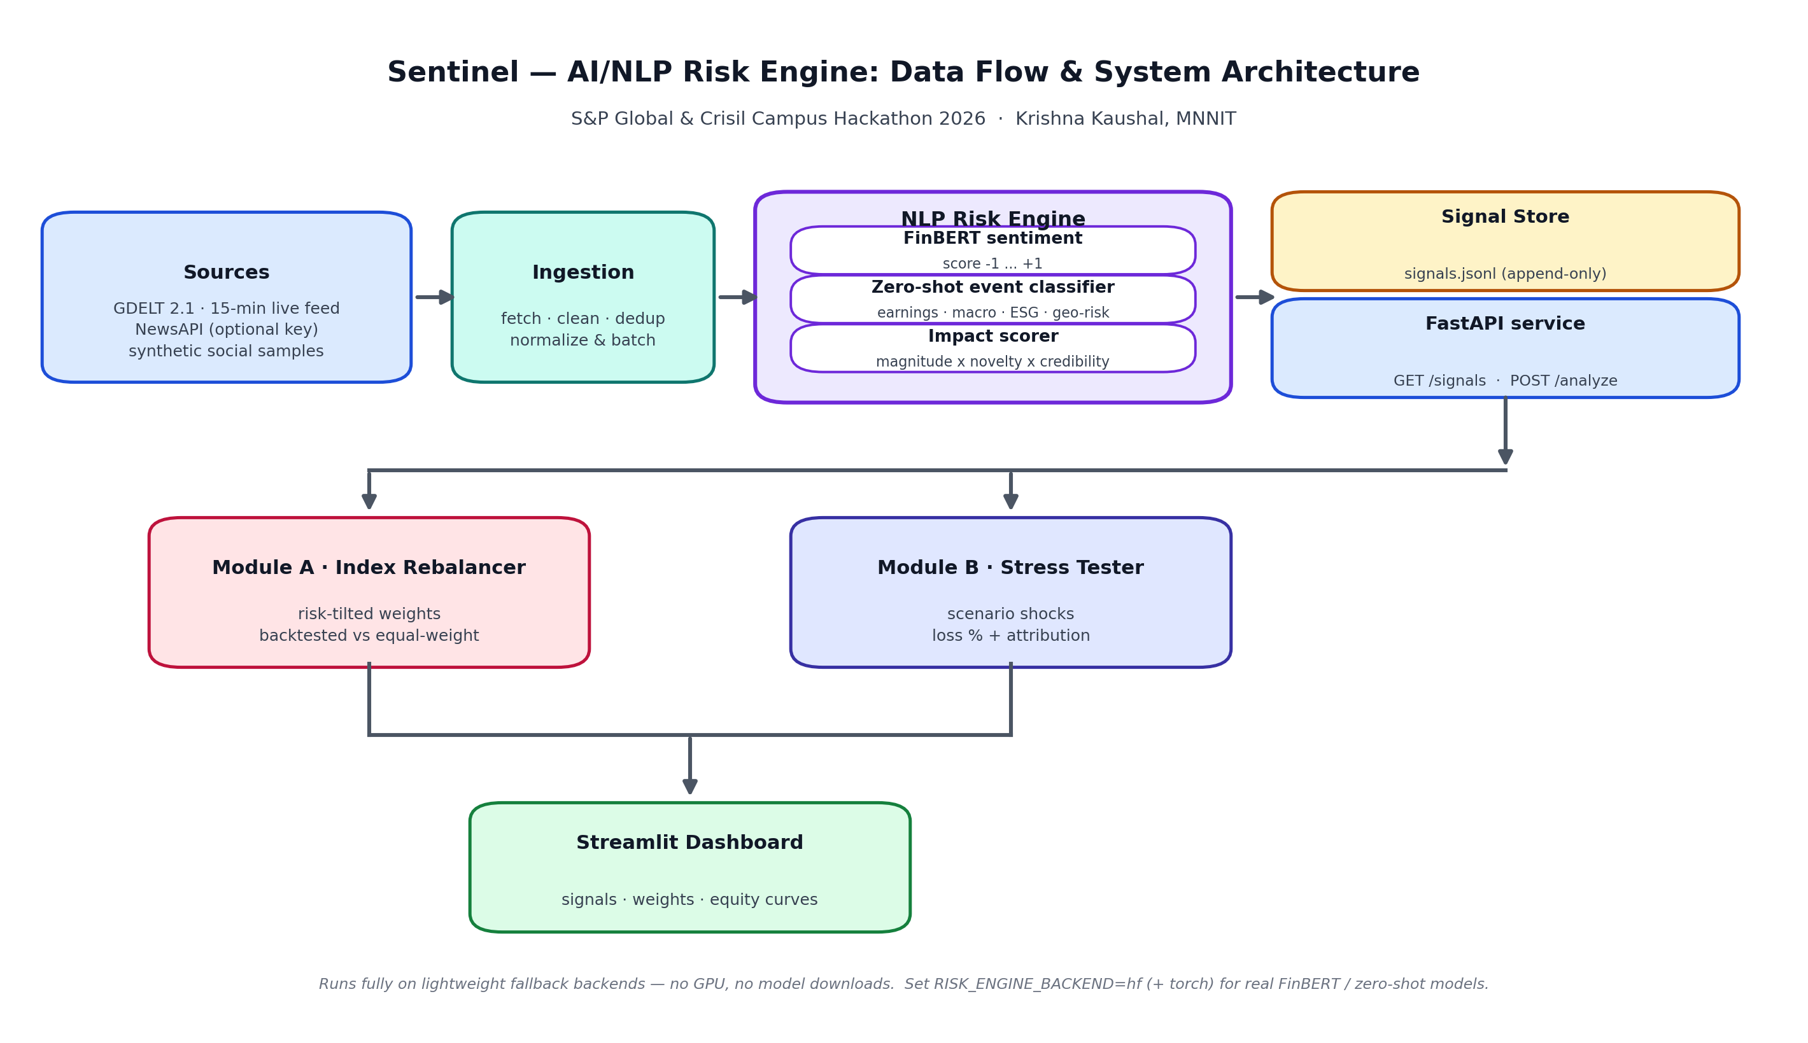
System Design
Sources → Ingestion → NLP Risk Engine → Signal Store + API → Modules A/B → Dashboard

Slide 4
Implementation Highlights
▸ Modular pipeline (risk_engine / module_a / module_b / api / dashboard). Each stage is runnable standalone — `PYTHONPATH=src python -m risk_engine.pipeline --sources synthetic_social --limit 40`.
▸ Zero-model default, real-model upgrade path. VADER-style lexicon sentiment + heuristic event classifier run with no downloads; set RISK_ENGINE_BACKEND=hf with torch for FinBERT/zero-shot via transformers.
▸ Keyless, offline-capable data. GDELT 2.1 needs no API key; NewsAPI is optional; yfinance prices and the wholesale portfolio both have deterministic synthetic fallbacks.
▸ Reproducible metrics pipeline. Backtest and stress test write data/module_a_results.json / data/module_b_results.json — this deck is generated from those files.
▸ Typed API + interactive dashboard. FastAPI serves signals and ad-hoc analysis; Streamlit/Plotly renders weights, equity curves, and loss attribution.

Slide 5
Key Results
Module A backtest vs. equal-weight baseline · Module B event-driven stress test
MODULE A — INDEX REBALANCER
Signals processed
40
Sharpe — risk-tilted
2.665
Sharpe — baseline
2.676
Cum. return — tilted
17.93%
Cum. return — baseline
18.02%
Max drawdown
5.43%
Turnover
82.80%
MODULE B — STRESS TESTER
Worst scenario loss
26.28%
Worst scenario
Geopolitical
Scenarios tested
3

Slide 6
Domain Impact
What a risk desk gains from Sentinel
▸ News-to-action in minutes, not hours. Ticker-linked risk signals flow intraday — no analyst required to read every headline first.
▸ Systematic de-risking. Module A trims exposure to names under negative event pressure before clusters compound.
▸ Board-ready worst cases. Module B turns 'what if rates spike?' into a loss % with per-position attribution a CRO can defend.
▸ Zero vendor lock-in. Keyless feeds, offline fallbacks, laptop-grade compute — deployable on a desk or a free-tier cloud box.
▸ Auditable by construction. Every signal, weight, and scenario result is a JSON artifact — reproducible and inspectable.

Slide 7
Limitations & Next Steps
LIMITATIONS
▸ Backtests ignore transaction costs and slippage.
▸ Entity→ticker mapping covers a fixed large-cap watchlist.
▸ Synthetic samples model headline structure, not market outcomes.
▸ Free-tier feeds can lag; no streaming WebSocket yet.
NEXT STEPS
▸ Fine-tune FinBERT on finance headlines; add multilingual ingestion.
▸ Live WebSocket push for breaking-signal alerts.
▸ Transaction-cost-aware rebalancing and turnover penalties.
▸ Expand scenario library (credit, liquidity, climate) with regulator templates.
Sentinel — real-time NLP risk signals, risk-tilted rebalancing, event-driven stress testing.

