Slide 1
Title
Bank Analytics Dashboard Overview loan Analytics
Credit & Debit Analytics
Subtitle
Understanding Key Financial Performance Indicators

Slide 2
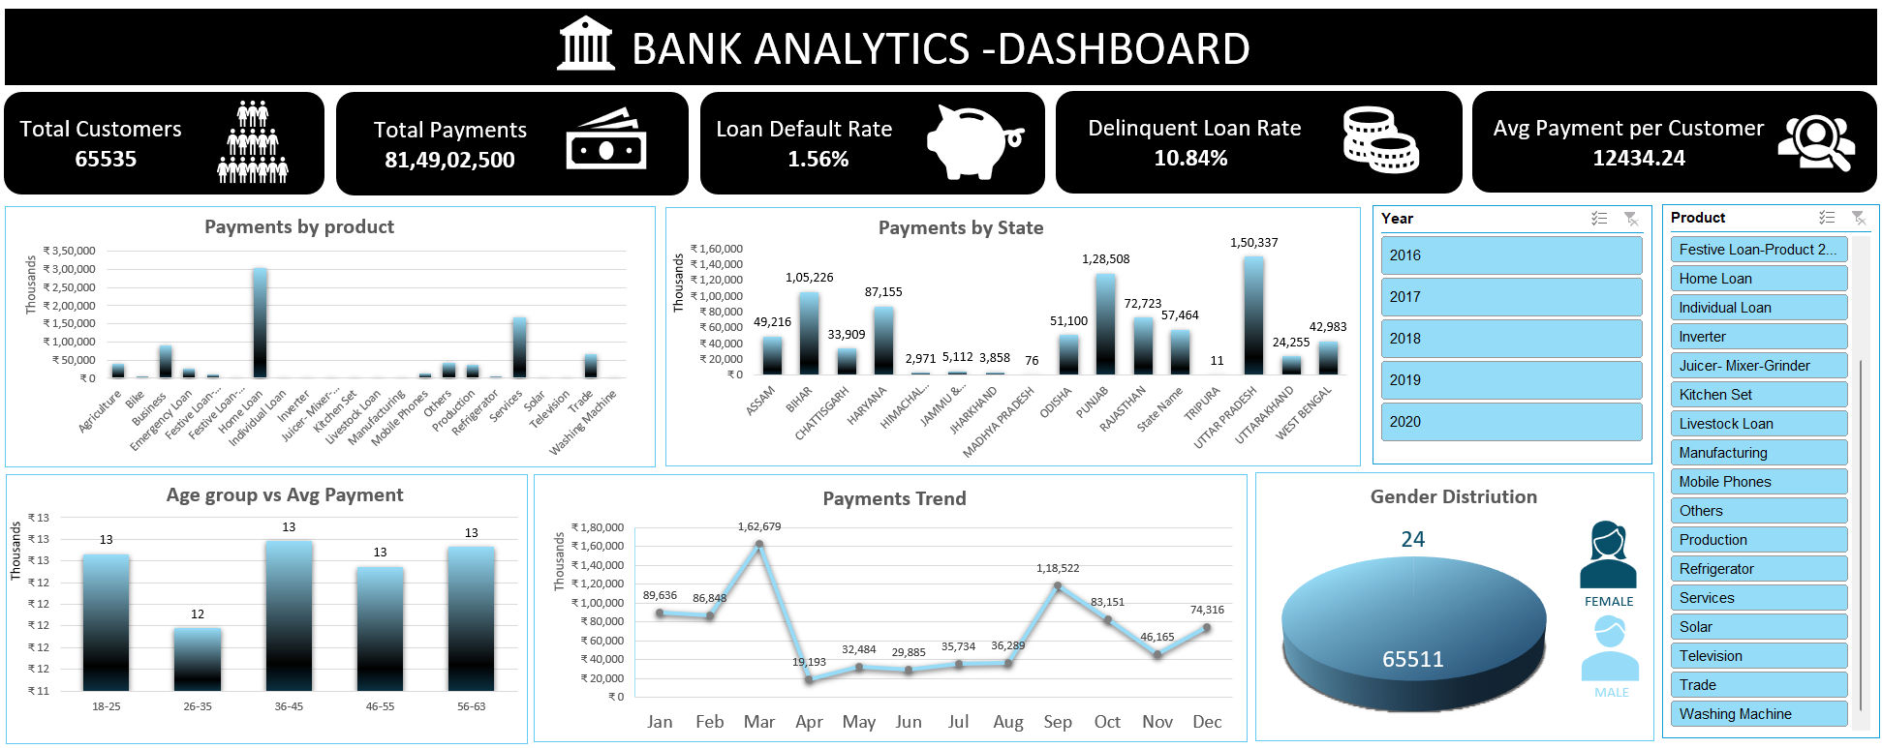
Excel Dashboard (loan analytics)

Slide 3
Title: Snapshot of Key Bank Metrics
Key Visualizations:
  Payments by product type (shows popular products like Home Loan, Emergency Loan)
  Payments by state (highlights high payment regions like Uttar Pradesh, Rajasthan)
  Age group vs. average payment (identifies key customer segments)
  Monthly payment trend (shows seasonal variations)
  Gender distribution of customers
Insight: This dashboard provides a high-level view of customer demographics, payment trends, and loan performance, indicating a stable but growing bank.

Slide 4
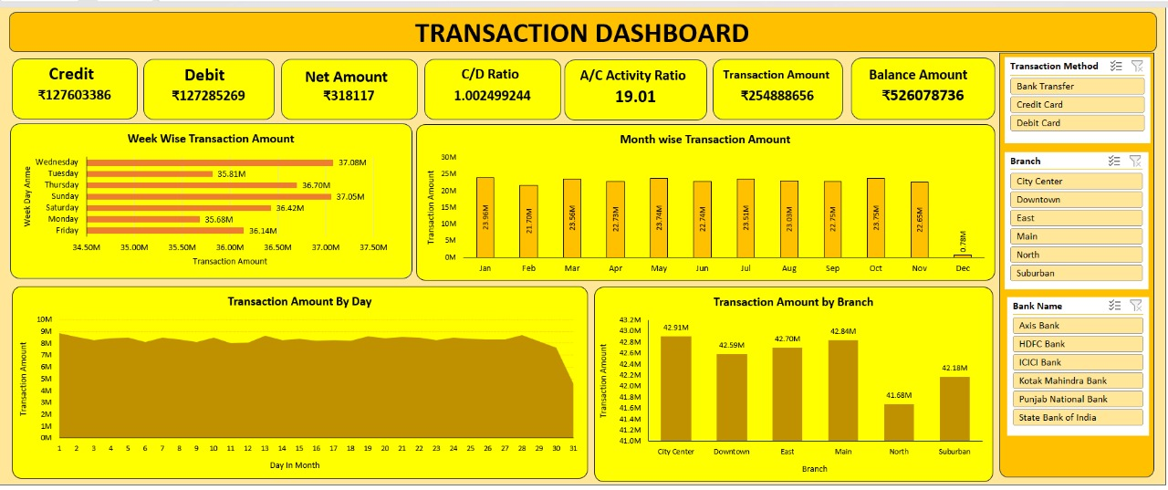
Excel Dashboard (Credit & Debit Analysis Dashboard)

Slide 5
Title: In-Depth Transaction Performance
Key Visualizations:
  Week-wise Transaction Amount (shows transaction volume distribution across days of the week, with Friday having the highest)
  Month-wise Transaction Amount (consistent volume throughout the year)
  Transaction Amount By Day (daily trend across the month)
  Transaction Amount By Branch (confirms City Center, East, Main, North, Suburban as key branches)
  Transaction Method filter (Bank Transfer, Credit Card, Debit Card)
  Bank Name filter (Axis Bank, HDFC Bank, IOO Bank, Kotak Mahindra Bank, Punjab National Bank, State Bank of India)
Insight: Transactions are spread relatively evenly throughout the month, with a slight peak on Fridays. The consistency in monthly transaction amounts suggests stable customer engagement. The dashboard allows for granular filtering by transaction method and bank name.

Slide 6
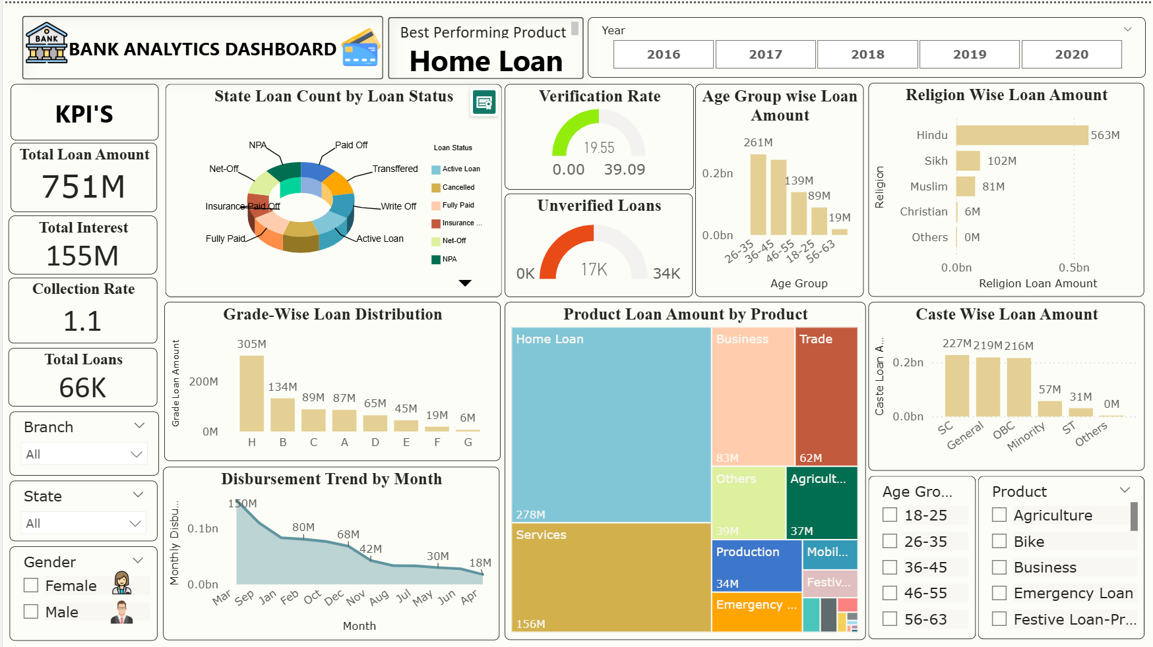
Power BI (Loan Analytics)

Slide 7
Title: In-depth Loan Metrics and Product Contribution
Key Visualizations:
  State Loan Count by Loan Status (provides a breakdown of active, paid off, and defaulted loans)
  Verification Rate (19.55% verified, 17K unverified loans)
  Age Group Wise Loan Amount (confirms previous insights)
  Religion Wise Loan Amount (reveals distribution across religious groups)
  Grade-Wise Loan Distribution (shows loan distribution by internal grades A-G)
  Product Loan Amount by Product (highlights Home Loan, Services, Agriculture, Business as major contributors)
  Disbursement Trend by Month
  Caste Wise Loan Amount
Insight: Home loans are the strongest product. There's a significant number of unverified loans, which could be an area for review. The collection rate is healthy.

Slide 8
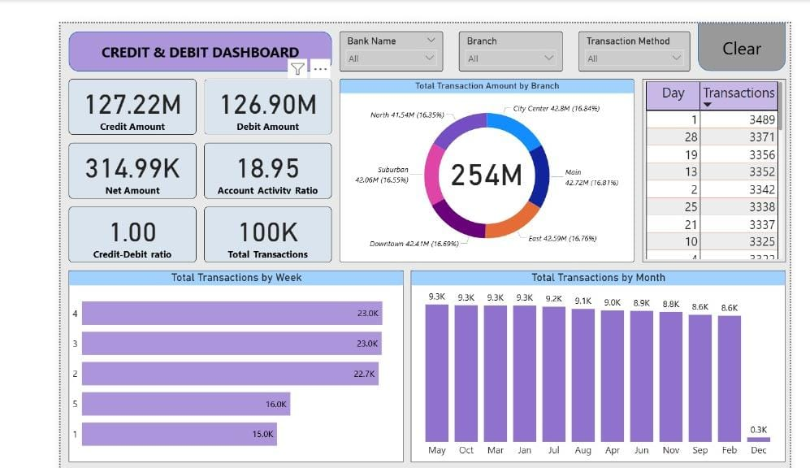
Power BI (Credit & debit Analysis)

Slide 9
Title: Credit and Debit Dashboard - High-Level View
Key Visualizations (Combined from both images):
  Total Transaction Amount by Branch (City Center, Suburban, Downtown, East as main contributors)
  Transactions by Day/Week/Month (showing daily, weekly, and monthly transaction patterns)
Insight: The bank maintains a balanced credit-debit flow with a C/D ratio close to 1. Transaction volumes are consistent across months, and City Center appears to be the most active branch.

Slide 10
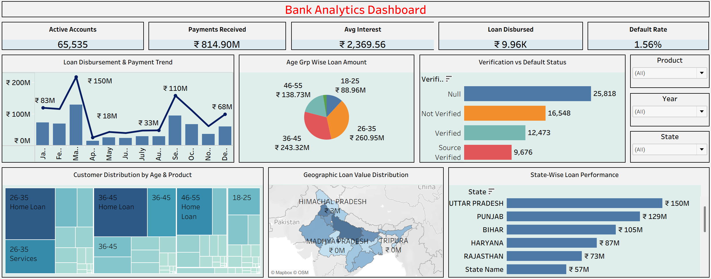
Tableau (Loan Analytics)

Slide 11
Title: Loan Portfolio Performance and Risk Assessment
Key Visualizations:
  Loan Disbursement & Payment Trend (monthly view)
  Age Group Wise Loan Amount (identifies top borrowing age groups: 26-35, 36-45)
  Verification vs Default Status (shows the impact of verification on default)
  Customer Distribution by Age & Product (reveals popular products for different age groups)
  Geographic Loan Value Distribution (identifies key states for loan disbursement)
  State-Wise Loan Performance (shows top states like Uttar Pradesh, Punjab)
Insight: The bank has a healthy disbursement trend, with specific age groups and states contributing significantly to the loan portfolio. Verification processes play a crucial role in mitigating defaults.

Slide 12
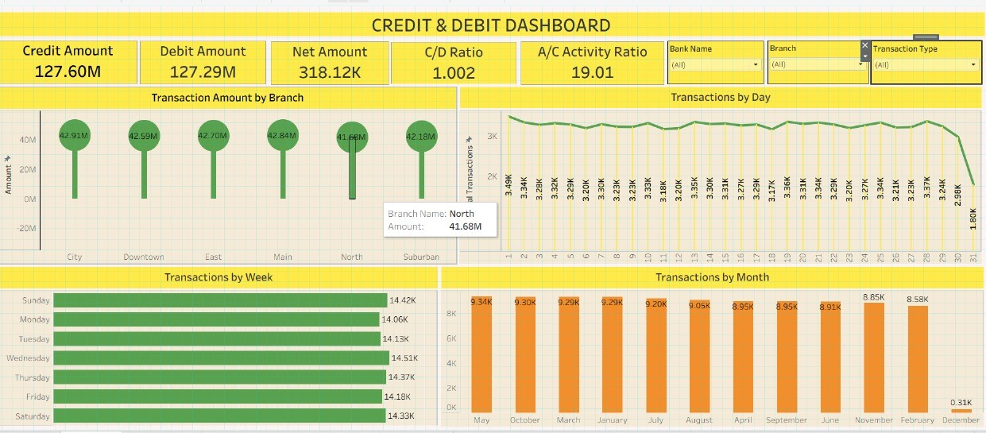
Tableau (Credit & debit Analysis)

Slide 13
Title: Analyzing Transaction Volume and Branch Performance
Total Transaction Amount by Branch: Confirms the key performing branches and their share of the total transaction value.
Account Activity Ratio (A/C Activity %): A metric reflecting the percentage of active accounts or a similar engagement measure.
Date Slicer: Shows the capability to filter the data by year.
Insight: Consistent transaction volumes across branches and months are a sign of reliable customer engagement. The high A/C Activity Ratio suggests a significant portion of customers are actively using their accounts.

