Slide 1
Writing C programs in Cortex-M4
Girish S Kumar

Slide 2
Usage of High level Language
High-level language is easy to learn and understand, and the most important point is that the programmers do not require to have very detailed knowledge about every instruction they are using in their development system.
Developers with good understanding and knowledge about the instruction set hardware components they used, can develop and build more professional and high efficient & optimized applications to be implemented in our real world.
Challenges with using high level language is : How do we directly access
Hardware components ?
Processor registers and Special purpose registers ?
How do we write interrupt handlers ?
For better optimization how can we use instruction set directly in C/C++ ?

Slide 3
To Solve this
Special API are implemented by the vendor to access Registers and other hardware components and special purpose registers
Use inline assembler, such as embedded assembler in Keil ARM toolchains, to insert the required assembly instructions in the C/C++ codes.
3. Use compiler specific feature such as keywords or idiom recognitions

Slide 4
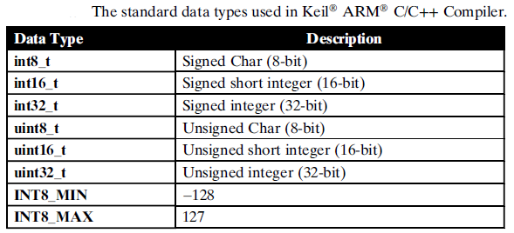
Data Types available for Cortex M4

Slide 5
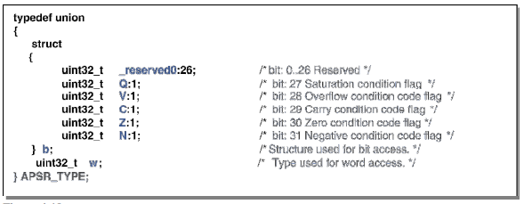
How APSR is accessed

Slide 6
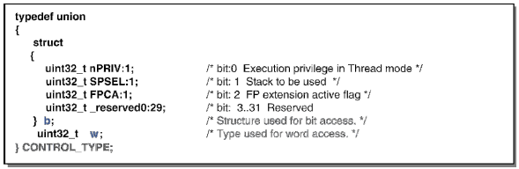
PSR
How is CONTROL Register
Accessed
PRIMASK
FAULTMASK
BASEPRI
BITS | Name | Function
31 …… 3 Bits | No name | Reserved
2 | FPCA | 0 = no floating-point context active 1 = floating-point context active.
1 | SPSEL | 0 = MSP is the current stack pointer 1 = PSP is the current stack pointer.
0 | nPRIV | Defines the Thread mode privilege level: 0 = privileged 1 = unprivileged.
CONTROL

Slide 7
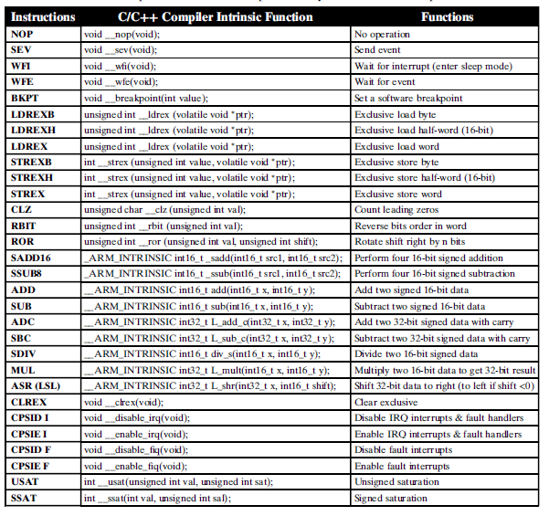
API provided by KIEL

Slide 8
How do we access registers
API to declare the general register R0 as a named register variable,
register intR0_asm.(“r0”);
API access Special purpose registers is
register intregname_asm(“regname”);

Slide 9
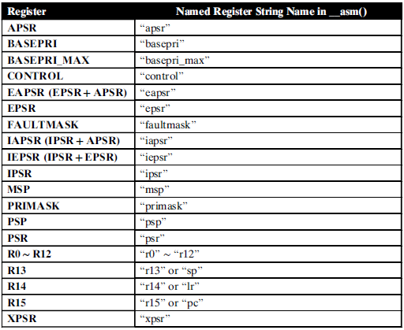
How all registers are accessed

Slide 10
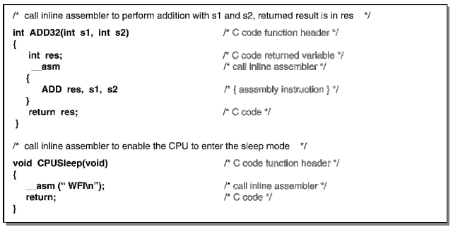
Idiom Recognition
when some C codes are constructed in a special way, the C/C++ Compiler can automatically
recognize and convert those codes into a special instruction sequence that can be executed
by cortex M4.

Slide 11
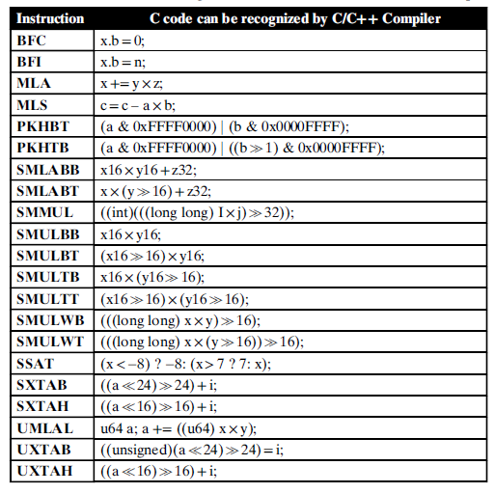
Idioms support by KEIL compiler
KEIL ARM C/C++ Compiler supports a limited number of idiom recognition forms

