Slide 1
Cortex M4 Exception Handling
Girish S Kumar

Slide 2
Cortex-M4 Block Diagram
ARM Cortex-M4 Microprocessor
Nested Vector
Interrupt
Controller
(NVIC)
Optional FPU
Optional
WIC
Optional
Embedded
Trace Macrocell
Processor core
Optional
Debug
Access Port
Optional Memory
protection unit
Optional Serial
Wire Viewer
Optional
Flash
patch
Optional
Data
watchpoints
Bus matrix
Code interface
SRAM and
peripheral interface

Slide 3
What are Interrupts and Exceptions
In an application it is necessary to stop the execution of the current set of programmed instructions and execute sets of instructions to handle special conditions,
Data received from network
A connection request from Blue Tooth headset
An incoming call indication on your mobile phone while a video clip is being played
To handle such situations processor put the execution of current set of instruction to hold and executes a different set (small set) of “pre-programmed” instructions
These requests, called Exceptions or interrupts, they are asynchronous nature. The set of pre-programmed instructions are called Interrupt Service Routines
After an exception/ interrupt service routine is executed , the main program resumes as if there had been no interruption. – This is very important aspect of Interrupt/Exception processing
In Cortex –M4 context there is a slight difference between Exceptions and Interrupts ,

Slide 4
What is difference between Exceptions and Interrupts
Exceptions
Exceptions are created within the CPU/Processor generated by an event, such as the system fault event and other system mis-operation, they have higher priority than others
Division by ZERO is a very good example where an exception is created
Interrupts
Interrupts are generated by an event from an internal peripheral (storage) or external peripherals like Blue tooth devices, keyboards they have lower priority when compared with Exceptions
Question : On a mobile phone, while running image editing two events happens almost at the same time, a division by zero and incoming call request, which one the phone should give priority ? Which is an exception and which is interrupt.

Slide 5
How Interrupts/Exceptions are processed
An exception or interrupt is first created by an exception/interrupt source and an interruptservice- request is sent to the Cortex-M4 CPU.
2. Based on the mask register’s content (PRIMASK) and the interrupt priority level (BASEPRI), CPU will determine whether to response or process the interrupt request.
3. If the interrupt request is accepted, the associated hardware will provide interrupt-related information, such as the interrupt source number and related Interrupt Service Routine (ISR) entry point, in a Vector Table.
4. Before the control can be transferred to the ISR, all related registers, including R0R3,
R12, LR, PSR, and PC, are pushed into the stack to reserve their contents. During this
protection process, all other interrupts or exceptions are masked or disabled to avoid any
data to be lost.

Slide 6
5. Then the control will be directed to the entry point (entry address of the ISR) stored in the
Vector Table to run the ISR to perform the required interrupt service. During this process, all other interrupts and exceptions are unmasked or enabled to allow higher-level-priority interrupts or exceptions to be requested and responded.
6. After the ISR is done and before the control can be transferred back to the main program,
(a) all other interrupts or exceptions are masked or disabled to avoid any data to be lost and,
(b) all related registers protected in step 4, including the PC, will be recovered by popping them back to the related registers.
7. Then the control can be directed to the main program to continue executing the normal
application codes based on the old PC content. At this time, all interrupts and exceptions are unmasked or enabled to allow any interrupt or exception to be requested and responded.

Slide 7
Nested Interrupt Vector control
External Peripherals
Internal Peripherals
NVIC
ARM Cortex
Processor
1
2
3
IRQs
IO PORT
Exceptions
IO PORT

Slide 8
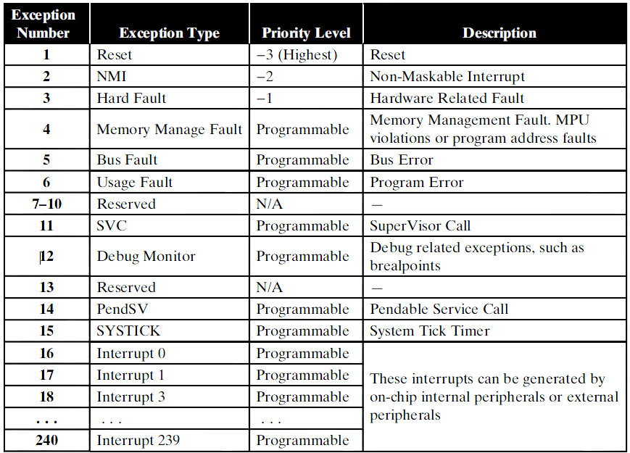
Exception and Interrupt types in the Cortex-M4 system

Slide 9
Exception and Interrupt types in the Cortex-M4 system
PSR
PRIMASK
FAULTMASK
BASEPRI
CONTROL
Cortex M4 define 15 exceptions which are numbered from 1 to 15 the table
The exceptions with number greater than 15 till 240 are called Interrupts
The smaller the number, the higher the priority level whether it is a exception or interrupt
First three in table Reset, NMI, and Hard Fault, have fixed priority levels as –ve numbers. Negative numbers means exceptions cannot be masked or disabled by
using PRIMASK register, and they have the highest priority level and must be handled first if they are coming.
For exception 4 onwards the priority levels for all exceptions and interrupts can be programmed to the different priority levels based priority given to peripheral devices (Eg: Keyboards, Sensors, Relay, display etc)
These exceptions and interrupts can be masked or disabled by using PRIMASK register in your application programs.

Slide 10
How are exception programmed
All exceptions and interrupts in the Cortex-M4are Handled by theNVIC.
The NVIC provides a group of programmable registers to manage exceptions and interrupts
There is module called System Control Block (SCB) which assists NVIC to manage exceptions and interrupts.
The registers in NVIC and SCB are used for programming Execptions and interrupts
The special registers such as PRIMASK, FAULTMASK, and BASEPRI, also provide mask, unmask, and priority level selections for most exceptions and interrupts to support their processing.

Slide 11
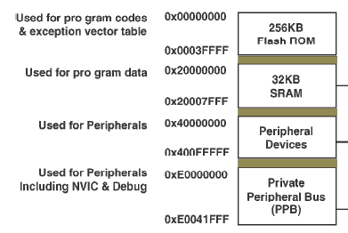
Where is NVIC located
NVIC and SCB are located in the
System Control Space (SCS) at the on-chip memory map with a memory range of
0xE000E0000xE000EFFF.

Slide 12
Processor Modes
Cortex –M4 has two modes
Thread Mode
Handler mode
Processor Mode | What happens in this mode
Thread mode | All User Application executes in this mode, when processor is RESET and completes the reset process, it automatically comes to Thread mode
Handler mode | All Exceptions are handled in this mode, once the exception handling is completed it goes back to thread mode

Slide 13
Processor Mode and Privileges
Privileged
User
Privileges
Processor mode
Use of this mode:
Exception Handling
Stack : Main
Handler
mode
Use of this mode:
Applications use this mode
Under special conditions
Stack : Main or process
Use of this mode:
Applications will be in this mode most of the time
Stack : Main or process
Thread
mode
Thread
mode
Privileged
User

Slide 14
Transition between modes
Thread mode
Handler mode
Switching to Handler Mode
For Exception handling
P
Exit from Exception
P
Transition through
Control Register
Switching to Handler Mode
For Exception handling
U
Exit from Exception

Slide 15
PSR
CONTROL Register
PRIMASK
FAULTMASK
BASEPRI
The CONTROL is a 32 bit register, that controls the
Which stack used at a given time
When the processor is in Thread mode it decides the privilege level
Indicates whether the Floating point Unit is active
CONTROL
BITS | Name | Function
31 …… 3 Bits | No name | Reserved
2 | FPCA | 0 = no floating-point context active 1 = floating-point context active.
1 | SPSEL | 0 = MSP is the current stack pointer 1 = PSP is the current stack pointer.
0 | nPRIV | Defines the Thread mode privilege level: 0 = privileged 1 = unprivileged.

Slide 16
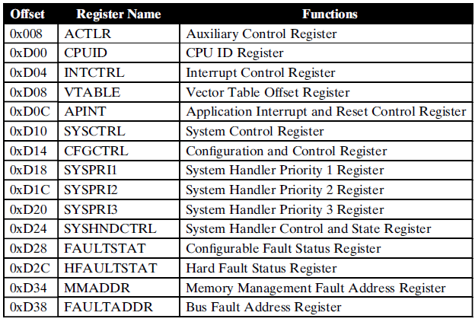
System Control Block
The System Control Block (SCB) provides system controls and implementation information, including configuration, control, and reporting of the system exceptions. These controls and implementations are performed via 15 control registers,

Slide 17
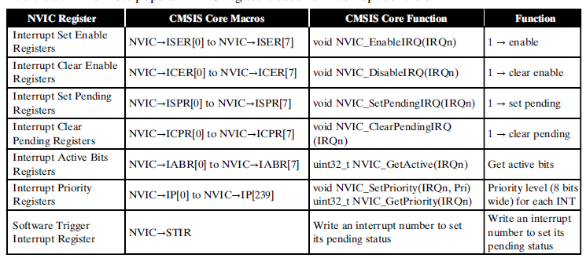
NVIC Registers

Slide 18
Sample Exception Handler
#include "TM4C123GH6PM.h“
int div(int lho, int rho)
{
return lho/rho;
}
void printMsg(const char * Msg)
{
while (*Msg != '\0'){
ITM_SendChar(*Msg);
++Msg;
}
}
void HardFault_Handler(void)
{
printMsg("In Hard Fault Handler\n");
while(1);
}

Slide 19
int main(void)
{
int x ;
int y ;
int z ;
char message[10];
SCB->CCR |= 0x10; //Enabling the Configuration Control Block in SCB
x = 10;
y = 20;
z = div(x, y);
sprintf (message,"Value of z = %d \n",z);
printMsg (message);
//Doing division by zero to create exception
y=0 ;
z = div(x, y);
}

Slide 20
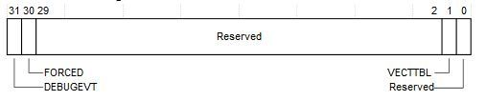
Root Causing the Fault
Now that we had found hard fault we need to find out what caused the fault for this we use register HardFault Status Register (SCB->HFSR)
For this we examine HFSR bit configuration,
If FORCED bit is set to 1, the HardFault handler must read Configurable Fault Status Register (SCB->CFSR) registers to find the root cause of the fault.

Slide 21
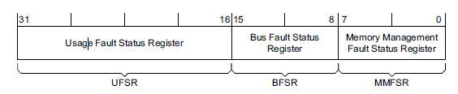
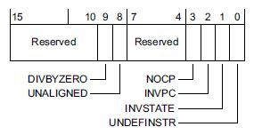
Configurable Fault Status Register

Slide 22
Anatomy of the Exception handler
The key part of the handler is the function void HardFault_Handler(void)
How does the processor know that this function has to be called in case of a exception ?
This routine is actually predefined in the file startup_TM4C123.s
HardFault_Handler\
PROC
EXPORT HardFault_Handler [WEAK]
B .
ENDP
In this file it is actually a empty implementation, which does not do anything. As a user we can over ride this implementation with an implementation of our own. Over riding the default behavior or implementation is easy in C++. But in C when a routine is declared as weak ,using the keyword WEAK, the linker with skip the default implementation and use the implementation provided by user, this is exactly what we had done here.

Slide 23
void printMsg(const char * Msg)
{
while (*Msg != '\0')
{
ITM_SendChar(*Msg);
++Msg;
}
}
Instruction trace: Generated by the Embedded Trace Macrocell (ETM)
• Data trace: Generated by the DWT unit
• Debug message: Generated by ITM, provides message output such as printf in the debugger graphical user interface
During tracing, the trace results, in the form of data packets, are output from the trace sources like ETM, using a trace data bus interface called Advanced Trace Bus (ATB)
The Function call ITM_SendChar() is the routine or function used for accessing the
Emebedded Trace Macrocell (ETM) this generates instrumentation trace hence it is called
ITM (Instrumentation Trace Macrocell)

Slide 24
How to generate a dump of all CPU registers in case of a Exception.
In Cortex M architecture, core registers [R0 to R3] R12, LR,PC and PSR (TODO:Reorder this as how is appears in stack) are automatically pushed to the system stack
During a exception, so if we can access the stack from our exception handler, we can take a copy a of all the registers and present it to developers for debugging. – In matured operating systems such a dump is called “core”

Slide 25
Vector Tables

Slide 26
Vector Tables
By default, the vector table starts at memory address 0, and the vector address is arranged
according to the exception number
Address | Exception No | Value
0x00000000 | NIL | MSP initial value
0x00000004 | 1 | Reset Vector
0x00000008 | 2 | NMI handler starting address
0x0000000C | 3 | Hard fault handler starting address
0x000000010 | 4 | Memory management fault
0x000000014 | 5 | Bus Fault
0x000000018 | 6 | Usage Fault

Slide 27
In the Beginning of any boot image we need the following
Initial main stack pointer value
Reset vector
NMI vector
Hard fault vector
Reset vector is needed to set the initial value of PC
NMI and hard fault can potentially occur during your boot process.
Once the booting is done these can be relocated to different
Location to memory ( READ/Write area) so that they can modified as per the needs.

Slide 28
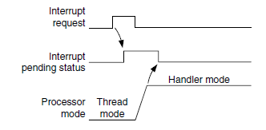
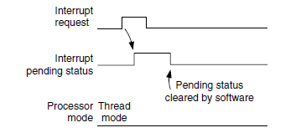
Pending Behavior of Interrupts
When an interrupt input is asserted, it will be pended, which means it is put into a state of waiting for the processor to process the request. Even if the interrupt source de-asserts the interrupt, the pended interrupt status will still cause the interrupt handler to be executed when the priority is allowed. Once the interrupt handler is started, the pending status is cleared automatically
If the pending status is cleared before the processor starts responding to the pended interrupt, pending status was cleared by software writing to NVIC interrupt control registers

Slide 29
Types on Interrupt support by ARM
Level Triggered
Asserts through the logic
Level
Edge Triggered
Asserts at the levels

Slide 30
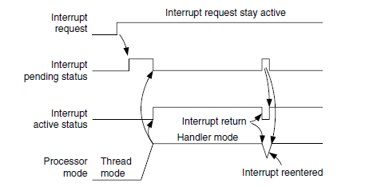
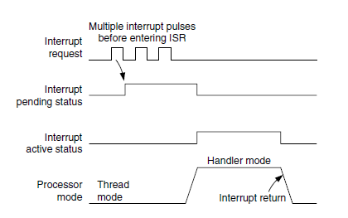
Different Scenarios of Interrupt processing
If an interrupt source continues to hold the interrupt request signal active, the interrupt will be pended again at the end of the interrupt service routine as shown in
If an interrupt is pulsed several times before the processor starts processing it, it will be treated as
one single interrupt request

Slide 31
Three Types of Faults
Type of fault
Bus Faults | Instruction fetch, commonly called prefetch abort Data read/write, commonly called data abort
Memory Management faults | Access to memory regions not defined in MPU setup • Writing to read-only regions • An access in the user state to a region defined as privileged access only
Usage Faults | Undefined instructions, Invalid interrupt return (link register contains invalid/incorrect values), Unaligned memory accesses using multiple load or store instructions, Divide by Zero
Hard faults | The hard fault handler can be caused by usage faults, bus faults, and memory management faults if their handler cannot be executed. In addition, it can also be caused by a bus fault during vector fetch (reading of a vector table during exception handling).

Slide 32
Different Situation of Bus Fault
When a bus faults take place and the bus fault handler is enabled and no other, the bus fault handler will be executed provided no other exceptions with the same or higher priority are running
If the bus fault handler is enabled but at the same time the core receives another exception handler with higher priority, the bus fault exception will be pending.
Bus fault can happen while executing Exception handler:
When an Bus fault exception happen in a situation where
Bus fault handler is not enabled
In an exception handler that has the same or higher priority than the bus fault handler,
The hard fault handler will be executed instead.
If another bus fault takes place when running the hard fault handler, the core will enter a lockup state
To enable the bus fault handler, you need to set the BUSFAULTENA bit in the System Handler Control and State register in the NVIC

Slide 33
Different Situation of Memory Fault
When a memory management fault occurs with memory management handler is enabled, the memory management fault handler will be executed.
If the fault occurs at the same time another higher- priority exception takes place, the higher priority exceptions will be handled first and then the memory management
In case the memory fault handler is not enabled and higher priority exception handler is already running the hard fault handler will be executed instead.
If a memory management fault takes place inside the hard fault handler or the NMI
handler, the processor will enter the lockup state.
To enable the memory fault handler, you need to set the MEMFAULTENA bit in the System Handler Control and State register in the NVIC

Slide 34
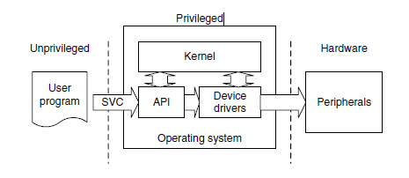
Supervisor Calls
Supervisor calls (SVC) is intended for providing OS support on Cortex M4. Usually
OS runs user application which may need access to the hardware registers, it is not possible to an un privileged app to trigger exception and go into privileged mode to give access to hardware.
SVC calls are usually made by the OS upon request by the user applications, hence it is up to the OS to ensure that app which request access to hardware is authentic

Slide 35
What happen when SVC is made while doing a important task
This is exactly when the PendSV call is used, PendSV can be pended and is useful for an OS to pend an exception so that an action can be performed after other important tasks are completed. PendSV is generated by writing 1 to the PENDSVSET bit in
the NVIC Interrupt Control State register.
Case Study of SYSTICK & PendSV
If an interrupt request takes place before the SYSTICK exception, the SYSTICK exception will preempt the IRQ handler. In this case, the OS should not carry out the context switching. Otherwise a usage fault could be generated if the OS tries to switch to thread mode when an interrupt is active
To avoid the problem of delaying the IRQ processing, some OS implementations carry out only context switching if they detect that none of the IRQ handlers are being executed. However, this can result in a very long delay for task switching, especially if the frequency of an interrupt source is close to that of the SYSTICK exception. The PendSV exception solves the problem by delaying the context-switching request until all other, IRQ handlers have completed their processing

