Slide 1
Cortex M4 Memory
Girish S Kumar

Slide 2
The Cortex-M3 processor has a total of 4 GB of address space, this mean Cortex has the ability to address up to 4GB of memory
Program code is located in the code region the Static Random Access Memory (SRAM) region, or the external RAM region.
Since Cortex M4 is based out of Harvard Architecture, it is efficient to put the program code in the code region, this will allow, the instruction fetches and data accesses are carried out simultaneously on two separate bus interfaces.
The SRAM memory range is for connecting internal SRAM. Access to this region is carried out via the system interface bus. In this region, a 32-MB range is defined as a bit-band alias. Within the 32-bit‑band alias memory range, each word address represents a single bit in the 1-MB bit-band region.
Another 0.5-GB block of address range is allocated to on-chip peripherals. Similar to the SRAM region, this region supports bit-band alias and is accessed via the system bus interface
Two slots of 1-GB memory space are allocated for external RAM and external devices. The difference between the two is that program execution in the external device region is not allowed, and there are some differences with the caching behaviors.

Slide 3
The last 0.5-GB memory is for the system-level components, internal peripheral buses, external peripheral bus, and vendor-specific system peripherals. There are two segments of the private peripheral bus (PPB):
Advanced High-Performance Bus (AHB) PPB, for Cortex-M3 internal AHB peripherals only; this includes NVIC, FPB, DWT, and ITM
Advance Peripheral Bus (APB) PPB, for Cortex-M3 internal APB devices as well as external peripherals (external to the Cortex-M3 processor);
This is only the high level outline of the memory map, the actual memory map will depends on the Silicon Vendor

Slide 4
Memory Access Attributes
Bufferable: Write to memory can be carried out by a write buffer while the processor continues on next instruction execution.
• Cacheable: Data obtained from memory read can be copied to a memory cache so that next time it is accessed the value can be obtained from the cache to speed up the program execution.
• Executable: The processor can fetch and execute program code from this memory region.
• Sharable: Data in this memory region could be shared by multiple bus masters. Memory system needs to ensure coherency of data between different bus masters in shareable memory region.

Slide 5
Memory Access attributes and regions in memory map
Memory | Address Range | Attribute
Code memory region | (0x00000000–0x1FFFFFFF) | Executable
SRAM memory region | (0x20000000–0x3FFFFFFF) | Executable, Bufferable
Peripheral region | (0x40000000–0x5FFFFFFF)
External RAM region | (0x60000000–0x7FFFFFFF) | Executable, Casheable
External RAM region | (0x80000000–0x9FFFFFFF) | Executable, Casheable
External devices | (0xA0000000–0xBFFFFFFF) | Shareable
External devices | (0xC0000000–0xDFFFFFFF)
System region | (0xE0000000–0xFFFFFFFF)

Slide 6
Bit Band operations
Bit-band operation support allows a single load/store operation to access (read/write) to a single data bit. In the Cortex-M3, this is supported in two predefined memory regions called bit-band regions.
The first 1-MB memory space for SRAM, 0x2000.0000 to 0x200F.FFFF, and the first 1-MB space for the Peripheral, 0x400.0000 to 0x400F.FFFF, in the memory map are called bit-band regions. These two memory regions can be accessed like normal memory, but they can also be accessed via a separate memory region called the bit-band alias . When the bit-band alias address is used, each individual bit can be accessed separately in the least significant bit (LSB) of each word-aligned address
A bit-band region maps each word in a bit-band alias region to a single bit or the Least Significant Bit (LSB) in the bit-band region. Since each word contains 32 bits, the 1MB bit-band region can be mapped to 32-MB bit-band alias regions. The memory map has two 32-MB alias regions that map to two 1-MB bit-band regions:
• Accesses to the 32-MB SRAM alias region map to the 1-MB SRAM bit-band region.
• Accesses to the 32-MB peripheral alias region map to the 1-MB peripheral bit-band region.

Slide 7
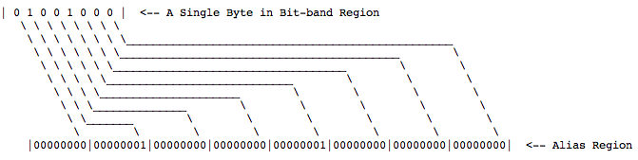
The benefit of Bit-banding is that a write to a word in the alias region performs a write to the corresponding bit in the Bit-band region. Also, reading a word in the alias region will return the value of the corresponding bit in the Bit-band region. These operations take a single machine instruction thus eliminate race conditions. This is especially useful for interacting with peripheral registers where it is often necessary to set and clear individual bits.

Slide 8
Relation between Bit Band region and Alias regions
The relationship between the bit-band region address and the bit-band alias address can be
described by the following equation:
Bit-band alias = bit-band-base + (byte_offset X32) + (bit_number X 4)
This means that the bit-band alias address can be calculated by using this equation,
where:
Example: The bit-band-base is the starting address of the bit-band alias regions. For the SRAM, it is
0x22000000, and for the peripheral it is 0x42000000.

Slide 9
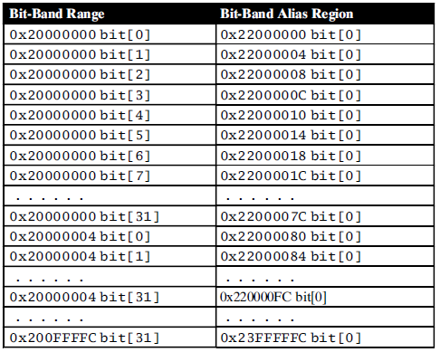
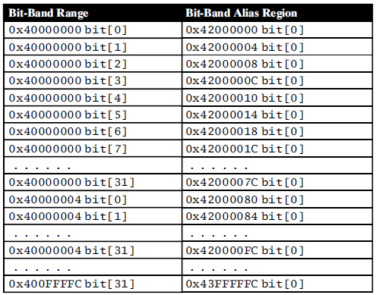
Remapping of bit-band addresses
SRAM Region
Peripheral Region

Slide 10
Memory Protection Unit

Slide 11
Why do we need a Memory protection Unit ?
MPU is implemented in Cortex M4 to provide support for Operating system. With an operating system and a scheduler we can have many threads running in the processor this opens up a set of vulnerabilities
User application corrupting OS data
One thread accessing the memory space other
Other important area of memory like Stack
Unprivileged tasks from accessing some peripherals that can be critical to the system applications.
Code injection to writeable spaces to attack the system
MPU provides a solution for all these vulnerabilities , it can be considered as a programmable security device used to protect the system memory and the user’s memory spaces from corrupting and attacking by undesired tasks.

Slide 12
Being a programmable security device used to protect the system memory and the user’s memory spaces from corrupting and attacking by undesired tasks. It can work with and without and OS
Without an OS MPU can be configured to have a static entity
Configure RAM or SRAM region as a read-only region to prevent important program data from attacks or corrupting.
Make a part or a portion of a RAM or SRAM region at the bottom of the stack inaccessible to detect stack overflow.
Set a SRAM or RAM region as non-executable to prevent code injection attacks.
Define the memory attributes that can be used by system level catch or the memory controllers.

Slide 13
With an embedded OS, the MPU can be configured to make each application to have its own MPU settings
1. Set memory access permissions to the different levels for the stack operations of all
applications to enable each application to access its own stack space to prevent stack
corruptions of other stacks if the stack leaking situation occurred.
2. Set memory access permissions to limit any application to only access to a limited number of peripherals to avoid any conflict among peripherals.
3. Set memory access permissions to limit each application to access its own data to prevent any possible data corruption.

Slide 14
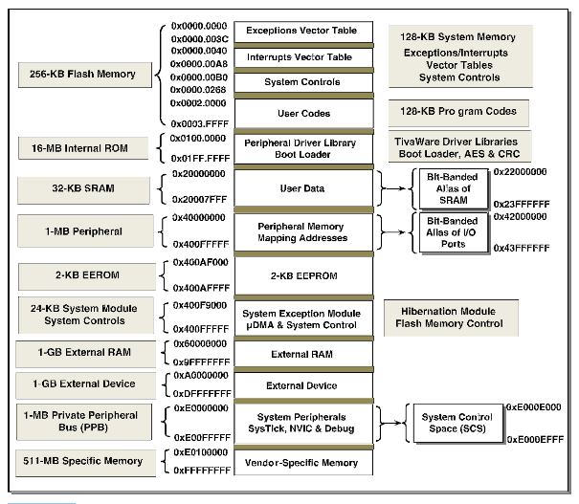

Slide 22
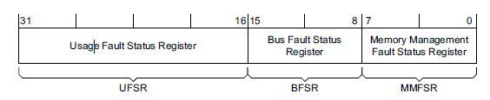
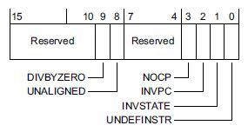
Configurable Fault Status Register

