Slide 1
Introduction to ARM Processor
Girish S Kumar

Slide 2
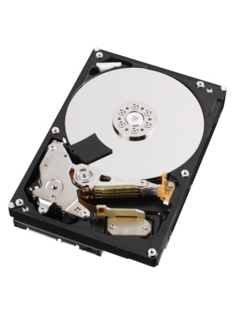


Primary Memory
(RAM)
Instruction
Data Address
Data
Secondary Memory
(Hard Disk)
CPU
Basic Computer Architecture

Slide 3
Two Popular Computer Architecture
Von Neumann Architecture
Data and Instructions are accessed by processor through the SAME BUS
Harvard Architecture
Data and Instructions are accessed by processor through Separate Buses

Slide 4
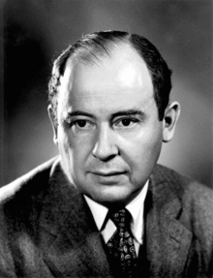
Von Neumann Architecture
Von Neuman architecture is also called Princeton Architecture was published in 1945 by Mathematician , physicist & Computer Scientist John von Neumann
Data & Instructions memory
Data & Instructions
CPU

Slide 5
Harvard Architecture
The Harvard architecture is a computer architecture with physically separate storage and signal pathways for instructions and data. The term originated from the Harvard Mark I relay-based computer, which stored instructions on punched tape (24 bits wide) and data in electro-mechanical counters.
Data
Memory
Instruction
Memory
Data
Instructions
CPU

Slide 6
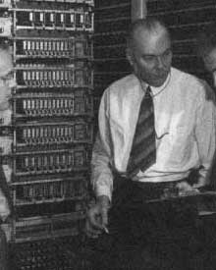
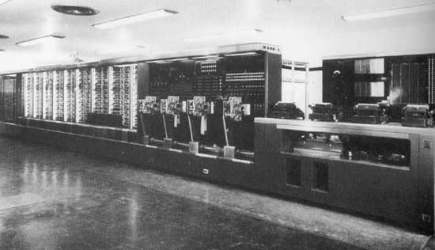
Some time in 1936 or possibly in early 1937, the Harvard physician Howard Aiken started to make plans about an automatic calculation machine. IBM agreed to construct for Harvard an automatic computing plant comprising machines for automatically carrying out a series of mathematical computations adaptable for the solution of problems in scientific fields, the machine was called ASCC (Automatic Sequence Controlled Calculator), but later on it became also known as Harvard Mark I.

Slide 7
Instruction Set Architecture
Instruction set architecture (ISA), is the part of the computer architecture related to programming, including the native data types, instructions, registers, addressing modes, memory architecture, interrupt and exception handling, and external I/O.
CISC
Where single instructions can execute several low-level operations (such as a load from memory, an arithmetic operation, and a memory store) or are capable of multi-step operations or addressing modes within single instructions.
Intel x86 Motorola 68K
RISC
A simplified instruction set provides higher performance also uses fewer cycles per instruction. Has specific instructions for data processing and moving data to and from memory
All ARM Series

Slide 8
HOW did ARM Series Evolved from early days

Slide 9
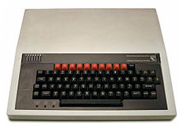
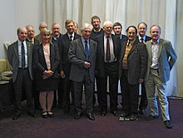
Acorn Computers Ltd.
Originally ARM Comes from Acorn Risk Machine
Acorn was Computer design company based out of UK who build one of the early personal computer called BBC Microcomputer based on a 8-Bit processor (1982)
By 1983, Engineers who build BBC Micro begin to think of next steps to build a successor to take their product to next level

Slide 10

What were the thoughts
Must deliver higher value that the existing BBC Micro
A 16 Bit CPU
With a good interrupt response may better than or comparable to that of 8-bit 6502, has to be identified ……..
MOS Technology, Inc. also known as CSG (Commodore Semiconductor Group), build 6502

Slide 11
What were the technical Challenges
All the 16 bit Microprocessors available in the market were CISC based and much slower than what they were looking for.
Instructions were complex and tool multiple cycles to complete
They long Interrupt latencies compared to 6508
It is not easy to build a new processor that can meet their expectations …….

Slide 12
They decided not to give up .. Instead they continued their search, started looking all the latest research happening, around world on processor design

Slide 13
They came across a processor designed by Post Graduate students at Berkley called RISC I.
It had very simple instructions and low interrupt latency
Students designed it in less than year
This was the starting point of ARM

Slide 14
Three main guiding principles they
Based on they started the design was
A Load and store Architecture
Fixed length instructions (32 Bit length)
3 Address Instruction format

Slide 15
Two Address Instructions
MOV R1, R0
ADD R1, R2
MOV R2, R3
ADD R2, R5
MUL R1, R2
MOV R3, R1
LDR R0 , =0xE000Ed88
STR r1, r[0]
Three Address Instructions
ADD R1, R0, R1
ADD R2, R3,R4
MUL R5, R1, R2

Slide 16
1990 as Advanced RISC Machines Ltd.(ARM) , a joint venture of Apple Computer, Acorn Computer Group, and VLSI Technology.
In 1991, ARM introduced the ARM6 processor family,
and VLSI Technology became the initial licensee.
Today around 2 billion ARM based processors are shipped every year
ARM does not fabricate or sell any of these chips. Fabrication and selling by Semiconductor Companies who has partner with ARM. They design microprocessor, SoC and microcontrollers based on the design (IP) given by ARM
This is called Intellectual property licensing – a very successful and practical model in developing processor designs (Synthesizable core)

Slide 17
Developed
By ARM
Processor
Core
Debug
System
Developed
By ARM and
Semiconductor
Companies
Peripherals
Memory
Clock and Reset
I/O

Slide 18
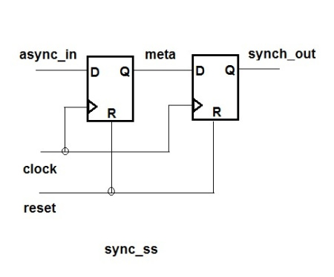
module sync_ss (clk, async_in, reset);
input clk, async_in, reset;
output synch_out;
always @(posedge clk)
if (reset)
meta <= 1’b0;
sync_out <= 1’b0;
else
meta <= async_in;
sync_out <= meta;
endmodule
Verilog Synthesizer

Slide 19

What is a synthesizable core ?
In Electronics a semiconductor intellectual property core, IP core, or IP block is a reusable unit of logic, cell, or integrated circuit layout design that is the intellectual property of a company
IP cores may be licensed to another company or can be owned and used by the owner itself. The term is derived from the licensing of the patent and/or source code copyright that exist in the design.
IP cores are used as the building blocks within ASICs, FPGA or Soc designs
Soft IP | IP cores are typically offered as synthesizable RTL. Synthesizable cores are delivered in a hardware description language such as Verilog
Hard IP | Hard cores, by the nature of their low-level representation, offer better predictability of chip performance in terms of timing performance and area. Eg: Analog and mixed-signal logic are generally defined as a lower-level

Slide 20
IP Vendors
Processor | Memory I/F | D/A and A/D | On-chip SRAMs | Peripherals
Altera - Nios II | Actel | S3 Group | ARM | Eureka Technology
ARM - ARM | Altera | Cadence Design Systems | ChipStart | Digital Blocks, Inc.
Cambridge Consultants - | ARM | Cosmic Circuits | Dolphin Integration
Cortus | Barco Silex | Dolphin Integration | M31 Technology
CEVA, Inc. - | Cadence Design Systems (through acquisition of Denali Software) | Omniphy | MoSys, Inc.
Digital Blocks, Inc. - 8051 with Standard and Configurable Peripherals | Eureka Technology |  | Synopsys
Dolphin Integration - 8051, 80251 | Faraday Technology |  | eSilicon
EnSilica - eSi-RISC | Lattice Semiconductor
Freescale and others - ColdFire
IBM and others -

Slide 21
What is a Debug Architecture ?
ln modern ARM processors include hardware debugging facilities, allowing software debuggers to perform operations such as halting, stepping, and break pointing of code starting from reset. These facilities are built using JTAG support
The ARMv7 architecture defines basic debug facilities at an architectural level. These include breakpoints, watchpoints and instruction execution in a "Debug Mode
. Both "halt mode" and "monitor" mode debugging are supported. The actual transport mechanism used to access the debug facilities is not architecturally specified, but implementations generally include JTAG support.
There is a separate ARM "CoreSight" debug architecture,

Slide 22
What is JTAG
The Joint Test Action Group (JTAG) is an electronics industry association formed in 1985 for developing a method of verifying designs and testing printed circuit boards after manufacture
JTAG implements standards for on-chip instrumentation in electronic design automation (EDA) as a complementary tool to digital simulation.^{[1]}
It specifies the use of a dedicated debug port implementing a serial communications interface for low-overhead access without requiring direct external access to the system address and data buses.
The interface connects to an on-chip test access port (TAP) that implements a stateful protocol to access a set of test registers that present chip logic levels and device capabilities of various parts.

Slide 23
Due to the different requirements of embedded systems, ARM had split the processor cores into three distinct families,
where the end application now determines both the nature and the design of the processors, but all of them go by
the trade name of Cortex.
The Cortex-A, Cortex-R, and Cortex-M families continue to add new processors each year, generally based on performance requirements as well as the type of end application the cores are likely to execute

Slide 24
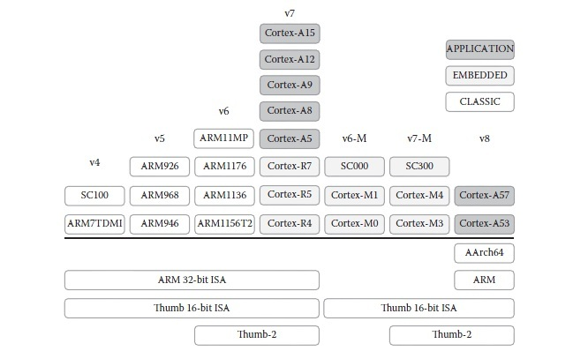

Slide 25
ARM Cortex Portfolio Today
CORTEX-A
CORTEX-R
CORTEX-M
Cortex-A73
Cortex-A72
Cortex-A57
Cortex-A53
Cortex-A35
Cortex-A17
Cortex-A15
Cortex-A9
Cortex-A8
Cortex-A7
Cortex-A5
Cortex-A5
Cortex-R8
Cortex-R7
Cortex-R5
Cortex-R4
Cortex-M0
Cortex-M0+
Cortex-M3
Cortex-M4
Cortex-M7
smallest/lowest power Optimized for discrete processing and microcontroller
Fast response Optimized for high-performance, hard real-time applications
Highest performance Optimized for rich operating systems

Slide 26
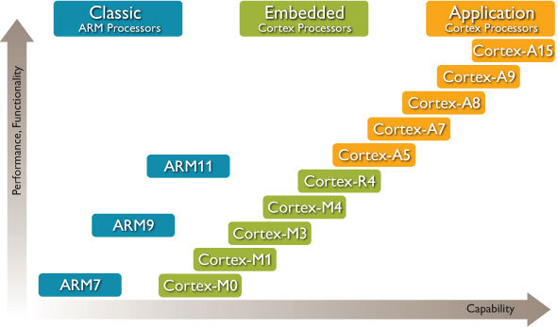

Slide 27
A system on a chip or system on chip (SoC or SOC) is an integrated circuit (IC) that integrates all components of a computer or other electronic system into a single chip. It may contain digital, analog, mixed-signal, and often radio-frequency functions—all on a single chip substrate. SoCs are very common in the mobile computing market because of their low power-consumption. A typical application is in the area of embedded systems.

Slide 28
A typical SoC consists of:
A microcontroller, microprocessor or digital signal processor (DSP) core – multiprocessor SoCs (MPSoC) having more than one processor core
memory blocks including a selection of ROM, RAM, EEPROM and flash memory timing sources including oscillators and phase-locked loops peripherals including counter-timers, real-time timers and power-on reset generators external interfaces, including industry standards such as USB, FireWire, Ethernet, USART, SPI
analog interfaces including ADCs and DACs
voltage regulators and power management circuits

Slide 29
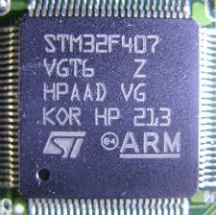
ARM SoC build by ST Microelectronics

Slide 30
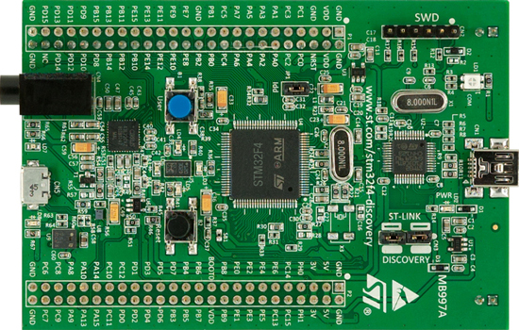
A computer build using STMF32VG704

Slide 31


Slide 32
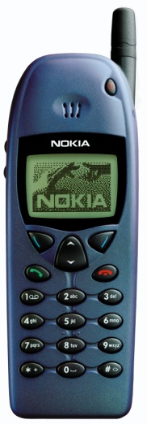
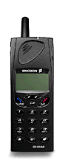
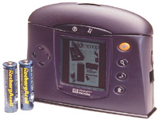
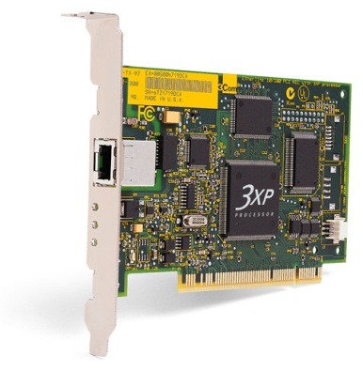
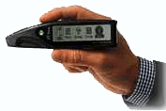
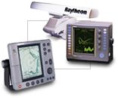
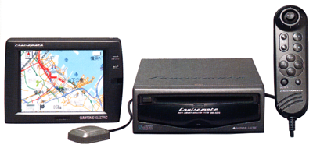
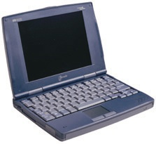
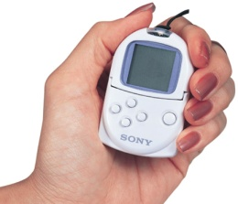
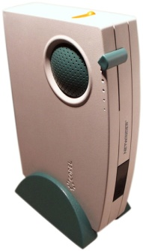

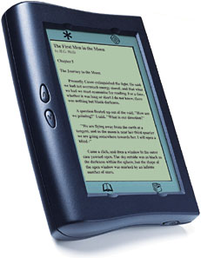
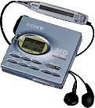

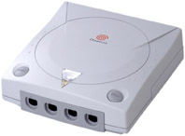
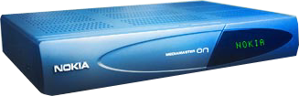
ARM Powered Products

Slide 33
Raspberry PI- ARM Cortex-A53
Samsung Galaxy Grand - 1.2 GHz dual core Cortex-A9 processor
Galaxy S4 1.6 GHz quad-core Cortex-A15 cluster and a 1.2 GHz quad-core Cortex-A7 cluster.
Galaxy duos 1.2 GHz dual core Cortex-A9
Nokia 3230 123 MHz 32-bit RISC CPU ARM-9

Slide 34
Focus of this course
Applications/OS
High Level Languaged JAVA/C++
Instruction Set Architecture
Micro Architecture
Gate Level
Transistor Level

Slide 35
Series | Uses | Processor | Instruction Set Arch
Cortex –A | Feature phone (non smart phone) | CortexA5 | ARMv7A
 | Entertainment in a car (Video player + music) | Cortex A15 (TI OMAP) | ARMv7A
 | Raspberry Pi-1 | ARM1176JZF-S BCM 2835 (32 bit) | ARMv6A
 | Raspberry Pi-2 | Cortex-A7 cluster. Quad-core BCM 2836 (32 bit) | ARMv7A
 | Raspberry Pi-3 | Cortex A53 Quad Core BCM2837 (64 bit) | ARMv8A

Slide 36
Series | Uses | Processor | Instruction Set Arch
Cortex –R | Smallest Cortex-R processor Digi cams, Hard disk controllers wireless base band | Cortex-R4 TI (RM4, TMS570) | Armv7-R
 | Cloud storage, Industrial and automotive (Used in is commonly used in high-volume, deeply embedded SoC applications, such as Industrial, automotive, Mass Storage | Cortex-R5 Scaleo OLEA Texas Instruments RM57 Xilinx ZynqMP | Armv7-R
 | High performance, high energy efficiency, real-time responsiveness, advanced features Wireless Modem, Network Routers, Industrial, Automative Storage | Cortex-R7 | Armv7-R
 | The Cortex-R8 processor has the highest performance in its class of real-time processors. All the the above uses with better performance | Cortex-R8 | Armv7-R
 | Extended safety features, high performance, and hard real-time determinism. Used for Robotics, health care, building automation, Industrial and automotive | Cortex-R52 | Armv8-R
Designed for high performance hard real-time and safety critical applications.

Slide 37
No | Features common to all R series | Description
1 | Non overlapping memory regions
2 | Tightly coupled memory | is to provide low-latency memory that the processor can use without the unpredictability that is a feature of caches. You can use TCM to hold critical routines, such as interrupt handling routines or real-time tasks where the indeterminacy of a cache is highly undesirable.
3 | Increased exception handling in hardware
4 | Hardware division instructions
5 | Memory protection unit (MPU) | The main purpose of memory protection is to prevent a process from accessing memory that has not been allocated to it.
6 | Deterministic interrupt handling as well as fast non-maskable interrupts
7 | L1 cache and buses | Larger caches have better hit rates but longer latency. To address this tradeoff, many computers use multiple levels of cache, with small fast caches backed up by larger, slower caches. Multi-level caches generally operate by checking the fastest, level 1 (L1) cache first; if it hits, the processor proceeds at high speed
8 | Dual-core lockstep for CPU fault tolerance | Lockstep systems are fault-tolerant computer systems that run the same set of operations at the same time in parallel.^{[1]} The redundancy allows error detection and error correction: the output from lockstep operations can be compared to determine if there has been a fault if there are at least two systems (dual modular redundancy), and the error can be automatically corrected

Slide 38
Series | Uses | Processor | Instruction Set Arch
Cortex –M | All small embedded system controllers starting with home appliances to industrial control | Cortex-M0 | ARMv6-M
 |  | Cortex-M0+
 |  | Cortex-M1
 |  | Cortex-M3 | ARMv7-M
 |  | Cortex-M4 | ARMv7E-M
 |  | Cortex-M7
 |  | Cortex-M23 | ARMv8-M
 |  | Cortex-M33

Slide 39
ISA | Width | Processor Architecture | Date
ARMv1 | 32 | ARM1 | 1983
ARMv2 | 32 | ARM2, ARM250, ARM3 | 1987
ARMv3 | 32 | ARM6, ARM7
ARMv4 | 32 | ARM8
ARMv4T | 32 | ARM7TDMI, ARM9TDMI, SecurCore SC100
ARMv5TE | 32 | ARM7EJ, ARM9E, ARM10E
ARMv6 | 32 | ARM11 | 1990
ARMv6-M | 32 | ARM Cortex-M0, ARM Cortex-M0+,ARM Cortex-M1, SecurCore SC000
ARMv7-M | 32 | ARM Cortex-M3, SecurCore SC300
ARMv7E-M | 32 | ARM Cortex-M4, ARM Cortex-M7
ARMv8-M | 32 | ARM Cortex-M23,^{[39]} ARM Cortex-M33^{[40]}
ARMv7-R | 32 | ARM Cortex-R4, ARM Cortex-R5,ARM Cortex-R7, ARM Cortex-R8
ARMv8-R | 32 | ARM Cortex-R52
ARMv7-A | 32 | ARM Cortex-A5, ARM Cortex-A7,ARM Cortex-A8, ARM Cortex-A9,ARM Cortex-A12, ARM Cortex-A15,ARM Cortex-A17
ARMv8-A | 32 | ARM Cortex-A32
ARMv8-A | 64/32 | ARM Cortex-A35,^{[45]} ARM Cortex-A53, ARM Cortex-A57,^{[46]} ARM Cortex-A72,^{[47]}ARM Cortex-A73^{[48]}

Slide 40
ARM Processor Families
Cortex-A series (Application)
High performance processors capable of full Operating System (OS) support;
Applications include smartphones, digital TV, smart books, home gateways etc.
Cortex-R series (Real-time)
High performance for real-time applications;
High reliability
Applications include automotive braking system, powertrains etc.
Cortex-M series (Microcontroller)
Cost-sensitive solutions for deterministic microcontroller applications;
Applications include microcontrollers, mixed signal devices, smart sensors, automotive body electronics and airbags;
SecurCore series
High security applications.
Previous classic processors
Include ARM7, ARM9, ARM11 families
Cortex-A57
Cortex-A53
Cortex-A15
Cortex-A9
Cortex-A8
Cortex-A7
Cortex-A5
Cortex-R7
Cortex-R5
Cortex-R4
Cortex-M4
Cortex-M3
Cortex-M1
Cortex-M0+
Cortex-M0
SC000
SC100
SC300
ARM11
ARM9
ARM7
Cortex-A
Cortex-R
Cortex-M
SecurCore
Classic

Slide 41
Design an ARM-based SoC
Select a set of IP cores from ARM and/or other third-party IP vendors
Integrate IP cores into a single chip design
Give design to semiconductor foundries for chip fabrication
IP libraries
SoC
Cortex-A9
Cortex-R5
Cortex-M4
ROM
ARM
processor
RAM
ARM7
ARM9
ARM11
ARM-based
SoC
System bus
DRAM ctrl
FLASH ctrl
SRAM ctrl
Peripherals
AXI bus
AHB bus
APB bus
GPIO
I/O blocks
Timer
External Interface
Licensable IPs
SoC Design

Slide 42
ARM Processors vs. ARM Architectures
ARM architecture
Describes the details of instruction set, programmer’s model, exception model, and memory map
Documented in the Architecture Reference Manual
ARM processor
Developed using one of the ARM architectures
More implementation details, such as timing information
Documented in processor’s Technical Reference Manual
ARMv4/v4T Architecture
ARMv5/ v4E Architecture
ARMv6 Architecture
ARMv7
Architecture
ARMv8 Architecture
ARMv7-A
e.g. Cortex-A9
ARMv8-A
e.g. Cortex-A53
Cortex-A57
ARMv7-R
e.g. Cortex-R4
ARMv8-R
ARM v6-M
e.g. Cortex-M0, M1
ARMv7-M
e.g. Cortex-M4
e.g. ARM7TDMI
e.g. ARM9926EJ-S
e.g. ARM1136
As of Dec 2013

Slide 43
ARM Cortex-M Series Family
Processor | ARM Architecture | Core Architecture | Thumb® | Thumb®-2 | Hardware Multiply | Hardware Divide | Saturated Math | DSP Extensions | Floating Point
Cortex-M0 | ARMv6-M | Von Neumann |  | Subset | 1 or 32 cycle | No | No | Software | No
Cortex-M0+ | ARMv6-M | Von Neumann | Most | Subset | 1 or 32 cycle | No | No | Software | No
Cortex-M1 | ARMv6-M | Von Neumann | Most | Subset | 3 or 33 cycle | No | No | Software | No
Cortex-M3 | ARMv7-M | Harvard | Entire | Entire | 1 cycle | Yes | Yes | Software | No
Cortex-M4 | ARMv7E-M | Harvard | Entire | Entire | 1 cycle | Yes | Yes | Hardware | Optional

