Slide 1
ARM Processor Fundamentals
Girish S Kumar
Notes:
Click to add notes

Slide 2
Differences between processor Core and CPU core
Processor Core mean
Engine which fetches the instruction & data
Processes them
Put is back into registers and memory
CPU Core mean
Processor Core & tightly coupled functions like
CPU Cache
Memory management blocks
Notes:
How presentation will benefit audience: Adult learners are more interested in a subject if they know how or why it is important to them.
Presenter’s level of expertise in the subject: Briefly state your credentials in this area, or explain why participants should listen to you.

Slide 3
Question
Processor
Core
Debug
System
Peripherals
Memory
Clock and Reset
I/O

Slide 4
What is a Data path
A data path is a collection of functional units, such as arithmetic logic units, MAC, that perform data processing operations, registers, and buses.
In ARM Processor Data path consists of
Register R0 – R15
ALU
MAC
Barrel Shifter
Address Register
Incrementer
Notes:
Lesson descriptions should be brief.

Slide 5
ARM Instructions
.
ARM Instructions are 32 Bit Instructions and uses Three Address
The three address corresponds to Registers
We need four bit to represent a register (3 X 4 = 12 Bits for operands
Op- Code (function)
Address of Operand 1
Address of Operand 2
Address of Operand 3

Slide 6
ARM-7 TDMI Data path
ADD Rd, Rn, Rm ; Rd = Rn + Rm
Rd, Rn and Rm can be any of the 15
Registers except R15 which is PC
Standard ARM instructions set uses a
3 address where three address corresponds to one the registers in CPU and not memory.
We need only 4 bits to represent any
Of the general purpose registers.
Rn
Rm
Barrel Shifter
ADD R0, R1, R2
SUB R0, R1, R2
ALU
Rd
Notes:
Example objectives
At the end of this lesson, you will be able to:
Save files to the team Web server.
Move files to different locations on the team Web server.
Share files on the team Web server.

Slide 7
ALU
It fetches the values from the registers mentioned in the instruction
Based on the OP-Code in the instruction the ALU performs the operation with the
Operands
The Results of the operation is written back to the destination register mentioned
In the instruction

Slide 8
ARM7TDMI Data path
Instructions
Memory
Memory Read
Memory Write
Instruction
Decoder
Register File R0 – R15
Rm
R15
PC
Rn
R15 Update
Barrel Shifter
Rd : Result
ALU
Addr Register
Incrementer
32 –Bit address

Slide 9
ARM7TDMI Data path
Instructions
Memory
Memory Read
Memory Write
Instruction Decoder
Register File R0 – R15
R15
PC
MAC
Rm
Rn
Barrel Shifter
ALU
R15 Update
Rd : Result
Addr Register
Incrementer
32 –Bit address

Slide 10
What is a Barrel Shifter
A barrel shifter is a combinational logic circuit with N data inputs, N data outputs, and a set of control inputs that specify how to shift the data between input and output.
N inputs
Controls
N outputs

Slide 11
D0
D1
D2
D3
X0
X1
X2
X3
D0 – X0
D1 – X1
D2 – X2
D3 – X3
Pull Down

Slide 12
D3
D0
D1
D2
X0
X1
X2
X3
D0 -> X3
D1 – X2
D2 – X1
D3 – X0
Pull Down

Slide 13
D0
D1
D2
D3
X0
X1
X2
X3
0 -> X0
D0 – X1
D1 – X2
D2 – X3
Pull Down

Slide 14
D0
D1
D2
D3
X0
X1
X2
X3
0 -> X0
0 – X1
D0 – X2
D1 – X3
Pull Down

Slide 15
D0
D1
D2
D3
X0
X1
X2
X3
D2 -> X0
D3 – X1
0– X2
0 – X3
Pull Down

Slide 16
Barrel Shifter
Shift contents of the specified 32 BIT register right or left by a specific number
The Shift process happens within a cycle
The barrel shifter increases the efficiency of data processing
LSL r4, r6, #4 ; r4 = r6 << 4 bits
LSL r4, r6, r3 ; r4 = r6 << # specified in r3
ROR r4, r6, #12 ; r4 = r6 rotated right 12 bits
; r4 = r6 rotated left 20 bits
In Logical Shift Data is treated as unsigned where there another Shift operation
ASR - Arithmetic shift Right, where data is treated as signed

Slide 17
Arithmetic Shift Right
Let us take -6 (negative six) as an example and represent it as four bit binary
+6 = 0110
Once complement = 1001
Two Complement = 1010
-6 in Two complement format is 1010
Arithmetic Shift Right of 1010 on ARM processor will result in 1101
+3= 0011
Once complement = 1100
Two Complement = 1101
Arithmetic Shift Right by one will result in dividing the number by two preserving the sign bit

Slide 18
Arithmetic Shift Left
Let us take -6 (negative six) as an example and represent it as binary
+6 = 0110
Once complement = 1001
Two Complement = 1010
-6 in Two complement format is 1010
Arithmetic Shift Left of 1010 on ARM processor will result in 10100 Logical shift of 1010
Will also result in 10100
Two compliment of -12 is 10100
Arithmetic Shift Left by one is same as Logical Shift left by one hence there
Is not separate instruction for Arithmetic Shift Leflt

Slide 19
Implementation of Barrel shifter
"A barrel shifter is a combinational logic circuit with N data inputs, N data outputs, and a set of control inputs that specify how to shift the data between input and output.
A barrel shifter that is part of a microprocessor CPU can typically specify the direction of shift (left or right), the type of shift (circular, arithmetic, or logical), and the amount of shift (typically 1 to n‐1 bits, but sometimes 1 to n bits)."

Slide 20
Verilog Implementation
module barrel_shifter(d,out,q,c);
input [7:0]d;
output [7:0]out,q;
input[2:0]c;
mux m1(q[0],d,c);
mux m2(q[1],{d[0],d[7:1]},c);
mux m3(q[2],{d[1:0],d[7:2]},c);
mux m4(q[3],{d[2:0],d[7:3]},c);
mux m5(q[4],{d[3:0],d[7:4]},c);
mux m6(q[5],{d[4:0],d[7:5]},c);
mux m7(q[6],{d[5:0],d[7:6]},c);
mux m8(q[7],{d[6:0],d[7:7]},c);
assign out=q;
endmodule

Slide 21
Verilog Implementation
module mux(y,d,c);
input[7:0]d;
output y;
reg y;
input [2:0]c;
always @ (c)
begin
if (c==3'b000)
y = d[0];
else if (c==3'b001)
y = d[1];
else if (c==3'b010)
y = d[2];
else if (c==3'b011)
y = d[3];
else if (c==3'b100)
y = d[4];
else if (c==3'b101)
y = d[5];
else if (c==3'b110)
y = d[6];
else if (c==3'b111)
y = d[7];
end
endmodule

Slide 22
Importance of Barrel shifter
"The world of home computers didn't really become interesting until late 1986 when Intel released its 3rd generation chip ‐ the 80386, or simply the 386....Both chips introduced something known as a barrel shifter, a circuit in the chip which can shift or rotate any 32‐bit number in one clock cycle. Something used often by many different machine language instructions."
Lack of Barrel Shifter in the Pentium 4 The removal of the barrel shifter from Intel's P4 design (the barrel shift algorithm is implemented in the code instead of in the hardware)is blamed by most for its slowness
Athlon and K5 and Pentium‐III benefit in RC5 work because they implemented a "barrel shifter" in hardware ‐ RC5 relies a LOT on one particular instruction that uses that barrel shifter. The P4 suffers a LOT from having it's barrel shifter implemented in microcode, which makes that particular instruction a LOT slower."

Slide 23
Patents on Barrel shifter
1. Numeric Data Processor ‐ U.S. Patent 4,338,675, Palmer, et al. (Intel Corporation) July 6, 1982 "The numeric processor also includes a programmable shifter capable of arbitrary numbers of bit and byte shifts in a single clock cycle.“
http://patft.uspto.gov/netacgi/nph‐Parser?Sect2=PTO1&Sect2=HITOFF&p=1&u=%2Fnetahtml%2Fsearch‐bool.html&r=1&f=G&l=50&d=PALL&RefSrch=yes&Query=PN%2F4338675
2. Patent for a Barrel shifter circuit having rotation function ‐ U.S. Patent 5,155,698, Niimi, October 13, 1992
http://patft.uspto.gov/netacgi/nph‐Parser?Sect2=PTO1&Sect2=HITOFF&p=1&u=%2Fnetahtml%2Fsearch‐bool.html&r=1&f=G&l=50&d=PALL&RefSrch=yes&Query=PN%2F5155698
3. Patent for a Bi‐Directional Barrel Shifter ‐ U.S. Patent 5,465,223, Nishimura (inventor), November 7, 1995
http://patents.nimblewisdom.com/patent/5465223‐Barrel‐shifter

Slide 24
MAC
digital signal processing, the multiply–accumulate operation is a important operation
That computes the product of two numbers and adds that product to an accumulator.
Y(n) = X(n) + K * y(n-1)

Slide 25
Address Register and Incrementor
When Processor is ready to fetch the next instructions in “Copies” the content
of R15 (PC) to Address Register
Address Register the fetch the next instruction from memory and it goes to instruction
Decoder
At the same time “Incrementer” will copy the current address and increment it by
Four bytes - That will be next instruction to be executed and copies it to R15
In case of a bulk memory read where address of four continious location has to be
Loaded into four Registers (Load and Store Instuructions) the incrementer will
Automatically increment in address each time by 4 bytes and address bus will fetch
Contents on the memory and that will be loaded into the Registers

Slide 26
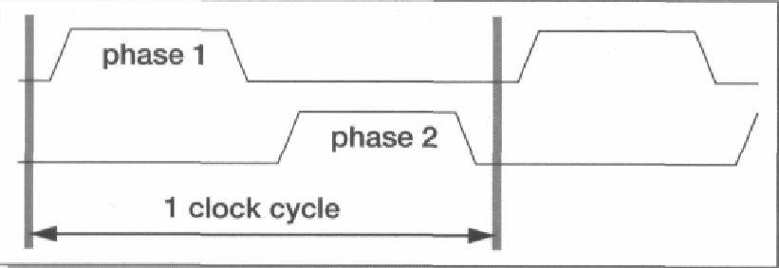
Data Path Timings
Two Clock cycles which are not overlapping and derived from the same source
There is a bit of offset between the two clock cycles.

Slide 27
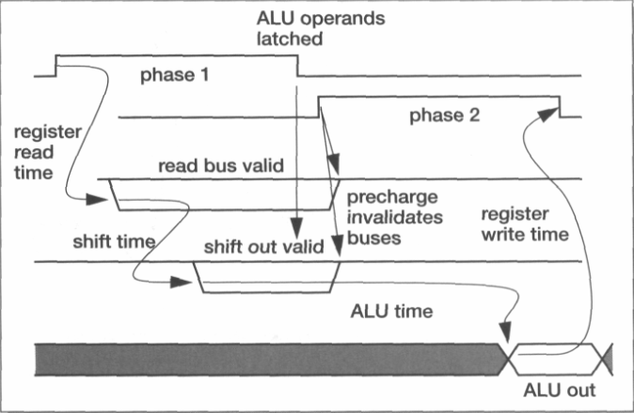
Data Path timings

Slide 28
What happens between two clocks
All circuits in the Data path of ARM flip-flop are level Triggered (D-Flipflop).To avoid race conditions there are two part which activated at two different times.
 | Phase-1 | Phase-2
 | ALU Input Latches are opened
 | Read bus to ALU are valid and data starts arriving at ALU
 | Barrel Shifter does its Job
 | ALU latches closed by end of Clock-1
 |  | ALU Performs the action as per the instruction
 |  | Valid out is produced by ALU and that is written to the destination register by end of clock cycle

Slide 29
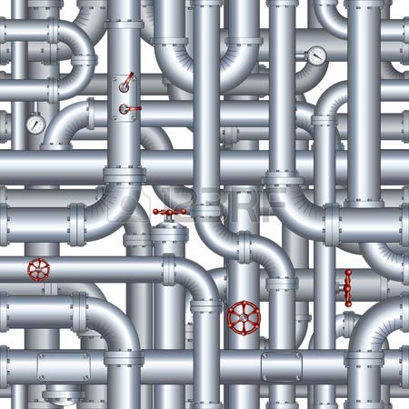
INSTRUCTION Pipelining
This process is invisible to programmers

Slide 30
Three independent Stages of Instruction processing
Fetch
Instruction is fetched from memory (Bus)
Decode
Instruction is decoded using hard wire Decoder
Execute
Instruction is executed – through the data path

Slide 31
What is pipe lining
Is the process by which independent instructions are overlapped for execution
Pipeline cycle is the time required to move an instructions one step in pipe line

Slide 32
Fetch
‘Decode
Execute
During
Fetch
‘Decode
Execute
Are idle
Fetch
‘During Decode
Execute
is idle
is idle
Fetch
‘Decode
During Execute
Are idle

Slide 33
MCLK
Fetch
‘Decode
Execute
MOV R0, R5
Fetch
‘Decode
Execute
ADD R6, R0, R1
Fetch
‘Decode
Execute
MOV R0, R7
0
1
2
3
4

Slide 34
Salient points about Pipeline
If there are N stages in a pipe line the
processing will the n times faster compared
To non pipe line
The clock speed has to be n times faster than
a non pipe lined processor. MCLK has to run
With a period of T/no of stage ( T is the total
time taken to execute the whole instruction)
The memory should match up the with speed

Slide 35
Multi Cycle Instructions
Multicycle instructions are those instructions which
take more than one cycle to execute. Load or Store
instruction which need memory access is a good
example
Pipelining will be impacted when Multi cycle
instructions get executed – Pipe lining
will not be regular.

Slide 36
MOV R1,#100
Fetch
‘Decode
Execute
STR R1,[R0]
Fetch
‘Decode
‘Addr
Calculation
Transfer
Data
ADD R2, R1,R0
Fetch
‘Decode
Execute
MOV R0,#200
Fetch
‘Decode
Execute
ADD R3, R2,R0
Fetch
‘Decode
Execute
0
1
2
3
4
5
6
7
8

Slide 37
MOV R1,#100
Fetch
‘Decode
Execute
PC=1000
STR R1,[R0]
Fetch
‘Decode
‘Addr
Calculation
Transfer
Data
PC=1004
ADD R2, R1,R0
Fetch
‘Decode
Execute
PC=1008
MOV R0,#200
Fetch
‘Decode
Execute
PC=100C
ADD R3, R2,R0
Fetch
‘Decode
Execute
PC=1010
0
1
2
3
4
5
6
7
8

Slide 38
What happens during branch ?
MOV R2 #100
STR R1,[R0]
ADD R2, R1,R0
MOV R0,#200
ADD R3, R2,R0
MOV R2 #100
STR R1,[R0]
Start BL func ; branch to subroutine
ADD R2, R1, R0
MOV R0,#200
ADD R3, R2,R0
func ADR r0, Start ; => SUB r0, PC, #offset to Start
ADR r1, DataArea ; => ADD r1, PC, #offset to DataArea
; ADR r2, DataArea + 4300 ; This would fail because the offset
BX lr ; return
;

Slide 39
MOV R1,#100
Fetch
‘Decode
Execute
STR R1,[R0]
Fetch
‘Decode
‘Addr
Calculation
Transfer
Data
BL func
Fetch
‘Decode
Execute
ADD R2, R1, R0
Fetch
‘Decode
Execute
ADR R0, Start
MOV R0,#200
Fetch
‘Decode
Execute
ADR R1, DataArea
0
1
2
3
4
5
6
7
8

Slide 40
Flushing the Pipe Line
When ever Branch instruction is executed
Or when the program counter is modified
all the pending instructions has to be
Removed and replaced with new once
All these are done by the processor core

Slide 41
What happens during an interrupt
`
Something very similar will happen when
Interrupt happens, except that the pipeline will
be automatically flushed and replaced with the entries in Interrupt service routine
Upon Completion of the ISR the return instruction is
Executed and pipeline will filled again with instructions which comes after the completed instruction or which was in decode stage when the interrupt happened

Slide 42
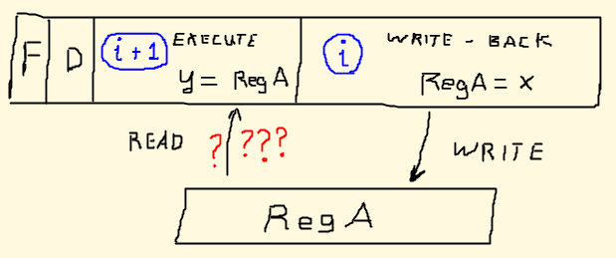
Pipe Line Hazards

Slide 43
What are Hazards ?
During, Fetch, Decode, Execute Cycle, more than one instruction is processed in parallel. Hence pipeline is not free from issues that arise to parallel processing.
These issues obstruct the smooth operation of the pipeline and can result in wrong computation of results.
Those issues are collectively called as
Pipeline Hazards

Slide 44
Classification of Hazards
Hazards
Data Hazards
Structural
Hazards
Control Hazards

Slide 45
Data Hazards ?
ADD R3, R2, R1
ADD R4, R3, R1
ADD R3, R1, R2
ADD R3, R2,R1
Fetch
‘Decode
Execute
ADD R4, R3, R1
Fetch
‘Decode
Execute
Operands of R3 should
Be ready during decode
phase
ADD R3, R1, R2
Fetch
‘Decode
Execute
0
0
1
2
3
4

Slide 46
Control Hazards ?
Branching hazards occur when a branch instruction is executed
When a branching happens
When a branching takes place, the pipeline is flushed, pipe
Lining cannot resume until the instruction to which the
“branching” has to happen is fetched
Common solution is to introduce bubbles till the instruction is
fetched

Slide 47
Structural Hazards ?
Hazards arising due to resource conflicts
A good example is memory unit that is accessed both in the
fetch stage where an instruction is retrieved from memory,
and the memory stage where data is written and/or read from
memory
STR R3, [R2]
Fetch
‘Decode
Execute
LDR R4, R3, R1
Fetch
‘Decode
Execute
ADD ……
Fetch
‘Decode
Execute

Slide 48
Solution to Hazards
Data Forwarding
If these two assembly pseudocode instructions run in a pipeline, after fetching and decoding the second instruction, the pipeline stalls, waiting until the result of the addition is written and read.
Pipe Line bubbling
Is a method to preclude data, structural, and branch hazards.As instructions are fetched, control logic determines whether a hazard could/will occur. If this is true, then the control logic inserts s (NOPs) into the pipeline. Thus, before the next instruction (which would cause the hazard) executes, the prior one will have had sufficient time to finish and prevent the hazard.

Slide 49
Solution to Hazards
The CPU control unit must implement logic to detect dependencies where operand forwarding makes sense. A multiplexer can then be used to select the proper register or flip-flop to read the operand from.

Slide 50
Five Stage Pipeline
Fetch
Instruction is fetched from memory (Bus)
Decode
Instruction is decoded using hard wire Decoder
Execute
Memory
Results written back to memory
Register write back
Memory Access
Instruction is executed – through the data path

Slide 51
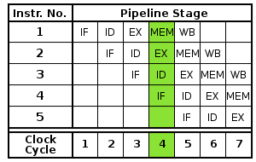
Five Stage Pipeline

Slide 52
Comparison of different ARM Architecture
Feature | ARM7 | ARM9 | ARM10 | ARM11
Pipeline | 3 stages | 5 stages | 6 stages | 8 stages
Arch | Von Neumman | HARDARD | HARward | HARWARD
MIPS | 0.97 | 1.1 | 1.3 | 1.2
MHz | 80 | 150 | 260 | 331
MAC | 8 X 32 | 8X32 | 8X 32 | 8 X 32

Slide 53
TODO
Pipel lining in other ARM Architecture like
A series
and R series https://en.wikipedia.org/wiki/ARM_Cortex-R
and M series

Slide 54
References
 | Cortex M3 M4 Pipeline And hazards | http://infocenter.arm.com/help/index.jsp?topic=/com.arm.doc.dai0321a/BIHGJICF.html

Slide 55
Advanced SIMD (NEON)
The Advanced SIMD extension (aka NEON or "MPE" Media Processing Engine) is a combined 64- and 128-bit SIMD instruction set that provides standardized acceleration for media and signal processing applications. NEON is included in all Cortex-A8 devices but is optional in Cortex-A9 devices.^{[84]} NEON can execute MP3 audio decoding on CPUs running at 10 MHz and can run the GSMadaptive multi-rate (AMR) speech codec at no more than 13 MHz. It features a comprehensive instruction set, separate register files and independent execution hardware.^{[85]} NEON supports 8-, 16-, 32- and 64-bit integer and single-precision (32-bit) floating-point data and SIMD operations for handling audio and video processing as well as graphics and gaming processing. In NEON, the SIMD supports up to 16 operations at the same time. The NEON hardware shares the same floating-point registers as used in VFP. Devices such as the ARM Cortex-A8 and Cortex-A9 support 128-bit vectors but will execute with 64 bits at a time,^{[81]} whereas newer Cortex-A15 devices can execute 128 bits at a time.

