Slide 1

MailTone AI
Intelligent Email Tone & Intent Analyzer
Combining Traditional NLP with Generative AI for Smarter Professional Communication
Krishna Nema
B.Tech CSE — Data Science
Manipal University Jaipur
Academic Year 2026

Slide 2
The Problem
Written communication lacks:
Voice tone
Facial expressions
Immediate feedback
Sender Intent
Email Text
Recipient Perception
⚠ Intent ≠ Perception — possible mismatch
A direct or urgent message may be read as:
Rude
Aggressive
Impatient
Unprofessional

Slide 3






Project Objectives
Analyze sentiment & linguistic features
Detect tone-related indicators
Identify sender intent
Estimate recipient perception
Detect communication risks
Suggest improvements & rewrite professionally

Slide 4
Technology Stack
Frontend
NLP
Generative AI
Backend / Support
Streamlit
TextBlob
Google Gemini API
Python
Scikit-learn
Google GenAI SDK
Pydantic
TF-IDF
PyYAML
python-dotenv

Slide 5



System Architecture
Traditional NLP
Gemini API
Sentiment
Tone
TF-IDF
Intent
Email Input
Pre-processing
Urgency
Professionalism
Streamlit Dashboard
Formality
Perception
Aggression
Risks
Readability
Suggestions
↑ Email + NLP features
↑ Structured JSON (Pydantic)

Slide 6
Traditional NLP Analysis
1
Text preprocessing
EXAMPLE
2
Tokenization
“I have already asked you three times to send the report.”
3
Sentiment analysis (TextBlob)
Detected
4
TF-IDF keyword extraction
Negative sentiment
Frustration-related wording
Keyword: report
Possible communication risk
5
Linguistic indicators
6
Readability analysis
7
Communication risk estimation

Slide 7
Generative AI Analysis
NLP gives measurable features. Gemini adds contextual understanding.
Traditional NLP
+
Original Email
Gemini
Contextual Interpretation
Gemini returns
Tone
Intent
Professionalism
Politeness
Urgency
Recipient Perception
Communication Risks
Suggestions
Improved Email

Slide 8

Prompt Engineering & Structured Output
The prompt instructs Gemini to:
{
"primary_tone": "Frustrated",
"intent": "Request",
"professionalism_score": 55,
"urgency_score": 85,
"communication_risks": [...]
}
Analyze wording, not personality
Avoid inventing information
Preserve the original meaning
Consider traditional NLP results
Pydantic schema → reliable structured output
Return structured results

Slide 9
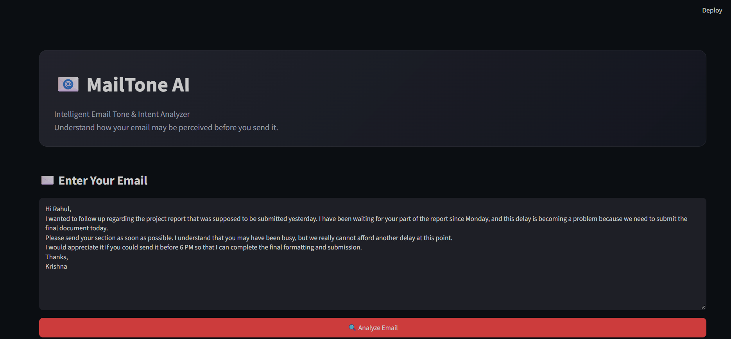
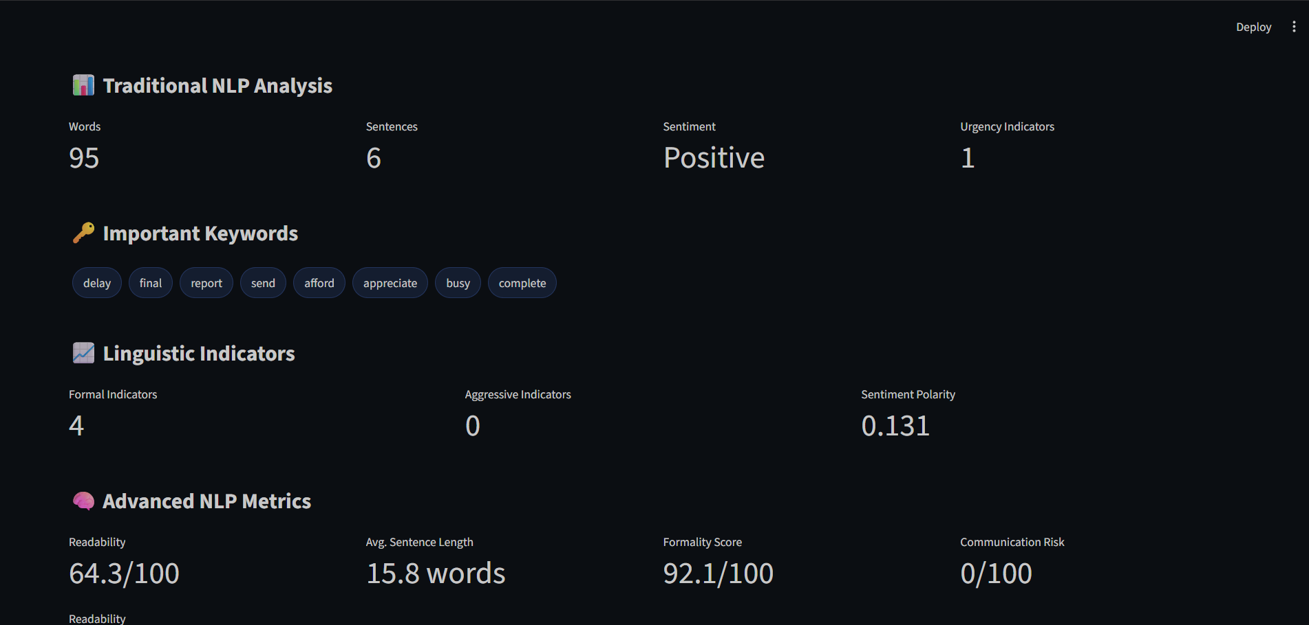
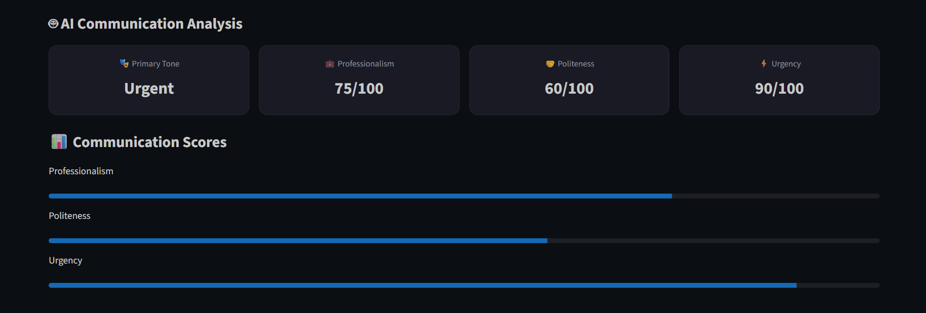
Application & Results
1 · Email input
2 · Traditional NLP analysis
3 · AI communication analysis
Screenshots from the running Streamlit app

Slide 10
Example Analysis
BEFORE
AFTER
“I have already asked you three times to send the report. Please send it today because I need to submit it before the deadline.”
“Could you please send the report today? I would appreciate it, as I need to submit it before the deadline.”
Detected in the original email
Primary Tone
Sentiment
Professionalism
Urgency
Risk
Frustrated / Urgent
Negative
Low–Moderate
High
Potentially confrontational

Slide 11

Advantages & Limitations
Advantages
Limitations
Traditional NLP + Generative AI
Rule-based indicators may miss context
Context-aware analysis
Tone perception is subjective
Explainable linguistic features
Gemini API dependency
Actionable suggestions
Currently English-focused
Professional email rewriting
Heuristic scores are estimates
Interactive interface

Slide 12
Conclusion & Future Scope
MailTone AI combines measurable NLP features with LLM-based contextual understanding to help users communicate more effectively.
Future scope
Gmail / Outlook integration
Multilingual support
Personalized writing styles
Batch email analysis
Email history analytics
ML-based tone classification
Analyze • Understand • Improve
Thank You

