Slide 1
Phase separation journal club
Krishna Shrinivas
Nov 13th 2018

Slide 2
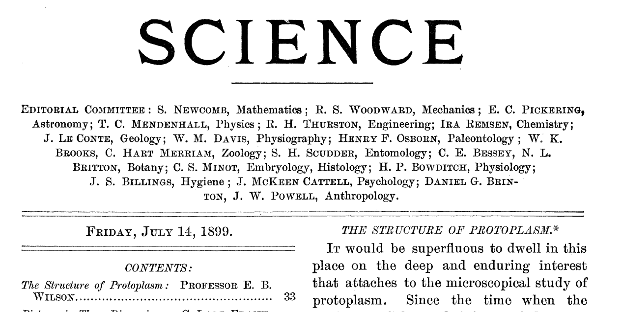
Liquid droplets in the cell – Historic perspective
E.B. Wilson
“a mixture of liquids”
“suspended drops … of different chemical nature”
Lipid rafts (2000s)
Dishevelled protein
(mid 2000s)
Richard Sear

Slide 3
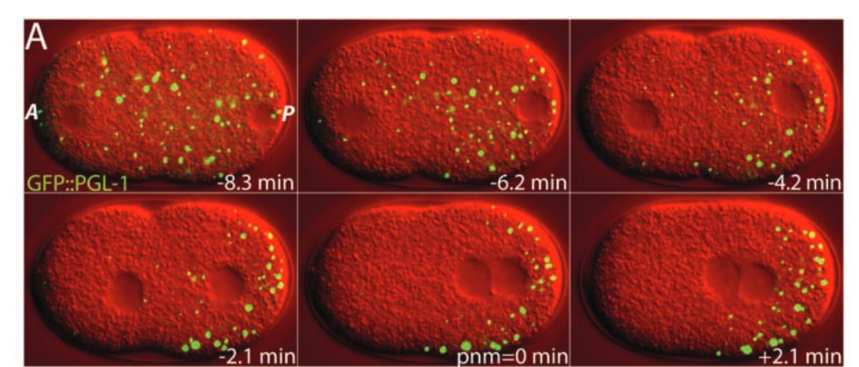
P-granule – modern foray into phase separation
Symmetry breaking of embryo into germ and soma lineages are due to different dew points in the cell
Brangwynne et al., Science 2009

Slide 4
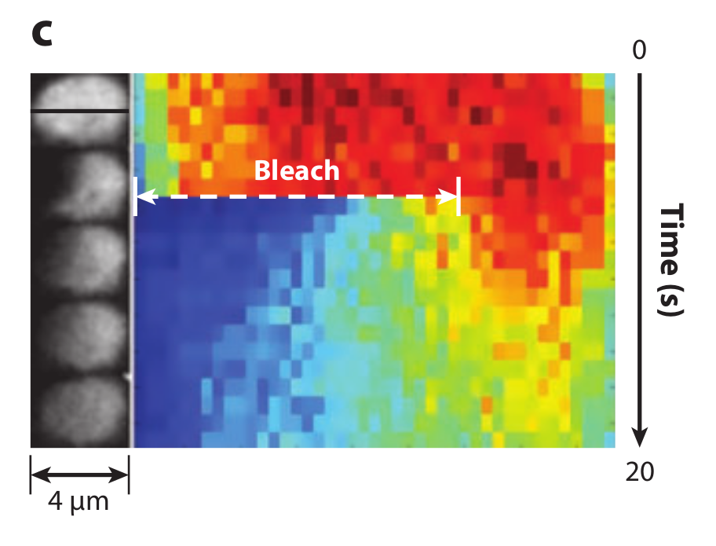
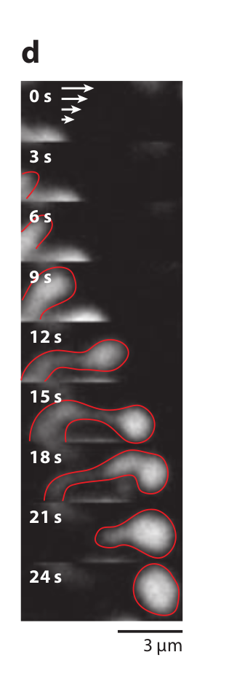
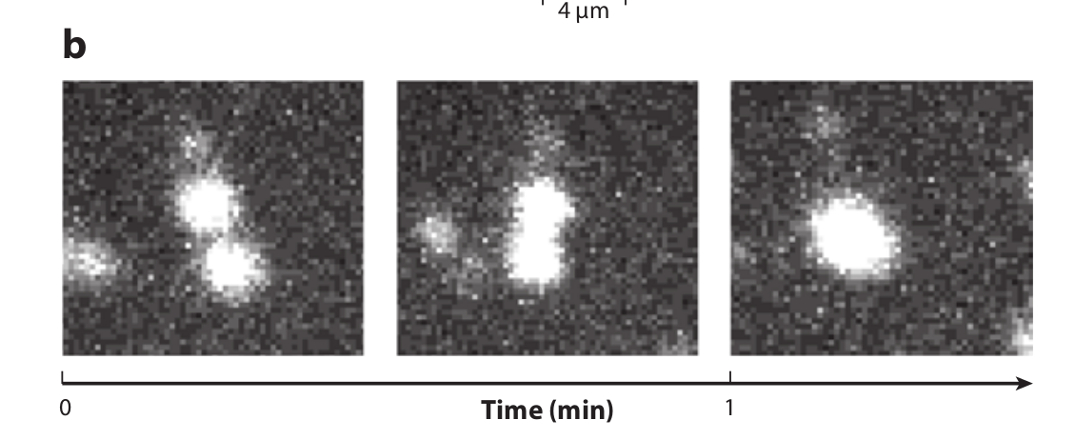
P-granule – liquid like behavior
Fast recovery upon bleaching
No membrane
Fusion
Deformation on shearing
Brangwynne et al., Science 2009

Slide 5
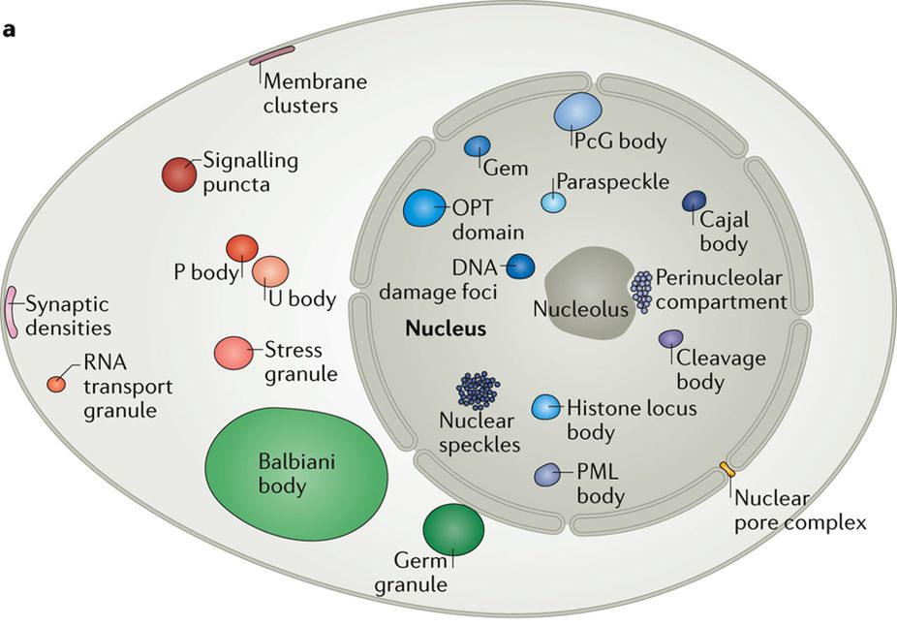
Many biological organelles linked to phase separated droplets
Phase separation implicated in:
Cell Signalling
Chromatin structure and function
Nucleolus formation
Transport and storage bodies
Stress response
Improper condensation in disease
Banani et al., Nature Reviews, 2017

Slide 6
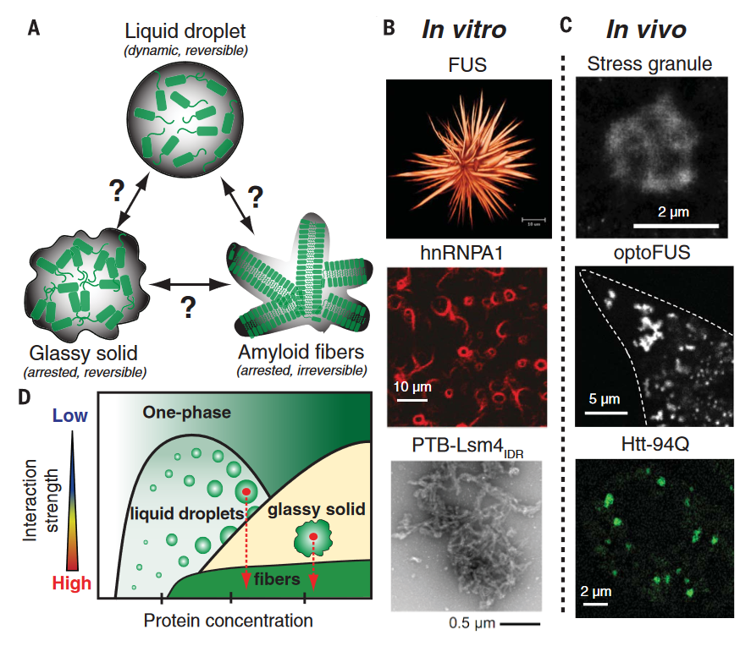
Many biological organelles linked to phase separated droplets
Phase separation implicated in:
Cell Signalling
Chromatin structure and function
Nucleolus formation
Transport and storage bodies
Stress response
Improper condensation in disease
Various phase behavior in healthy and diseased states:
Dynamic droplets
Kinetically arrested gel/glassy states
Fibers (amyloid)
Shin et al., Science, 2017

Slide 7
Current biological tools for assaying phase separation (not exhaustive)
In vitro:
Reconstructing phase behavior of purified protein through microscopy
Rheological properties of condensed droplets/gels
In vivo:
Microscopic (and super-resolved) techniques
Optogenetic tools for engineering light-sensitive phase behavior
Genetic and biochemical perturbations of proteins
FCS based measurements of physico-chemical properties

Slide 8
Theoretical advances (not exhaustive)
Equilibrium behavior:
Multi-component phase behavior
Molecular grammar – charge patterning/ hydrophobic residues on binary phase behavior
Out-of-equilibrium
Combining phase separation and reaction kinetics
Memory and spatially inhomogenous stimuli to pattern phase separation

