Slide 1
Objective & Overview
Goal: Deploy containerized Flask application to AWS ECS securely and efficiently.
Infrastructure Provisioning Tools: Terraform .
Automate the terraform apply, Docker build, push, deploy, and health check steps using Bash scripts. Github: https://github.com/krishna-sre/python-api.git

Slide 2
Terraform Approach
Components Deployed: maif.tf
VPC, Subnets, IGW
AWS ECS Cluster (Fargate)
AWS ECR Repository
ECS Task Definition & Service
Application Load Balancer
Benefits:
Declarative syntax.
Easy change management.
Scalable and reusable . Note: Terraform will launch infrastructure by using bash script no need of manual commands.

Slide 3
Bash Deployment Script Workflow
Script Steps:
Build Docker image.
Authenticate & login to AWS ECR.
Push Docker image to ECR.
Update ECS Service to pull new image.
Perform health check on ALB endpoint.
Script Automation Highlights:
No manual intervention.
Immediate feedback via health check.

Slide 4
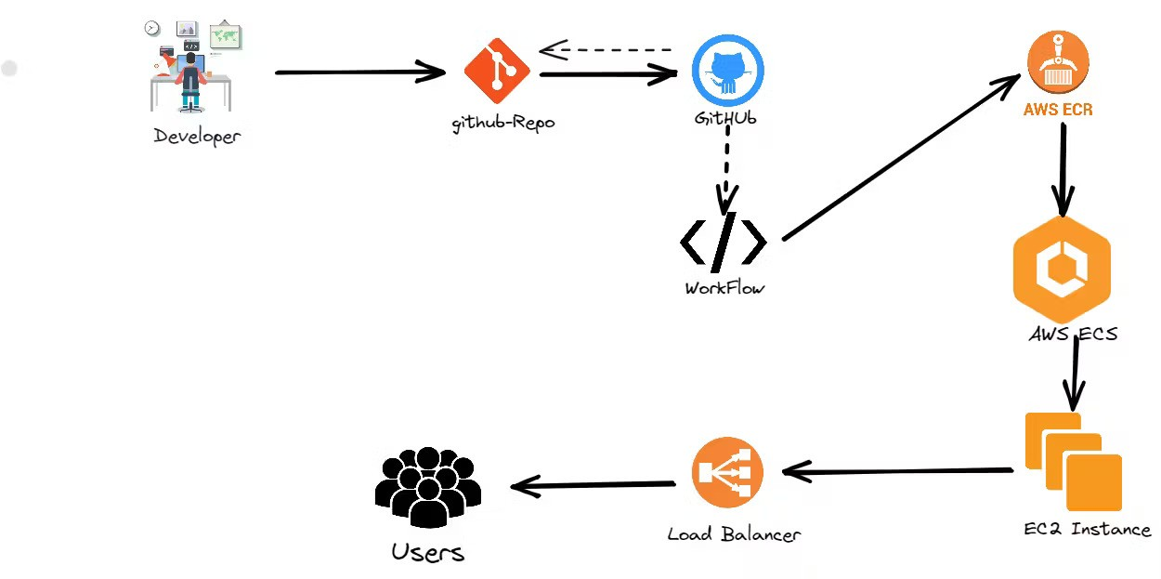
Architecture Diagram Flow: GitHub Repo → Docker Build → AWS ECR → ECS Cluster → ALB → End User

