Slide 1
Register

Slide 2
Introduction to register
• Flip-flop is a 1 bit memory cell which can be used for storing the
digital data.
• To increase the storage capacity in terms of number of bits, we have
to use a group of flip-flop.
• Such a group of flip-flop is known as a Register.
• The n-bit register will consist of n number of flip-flop and it is capable
of storing an n-bit word.
• A register is a digital circuit with two basic functions: data storage and
data movement. The storage capability of a register makes it an
important type of memory device.

Slide 3
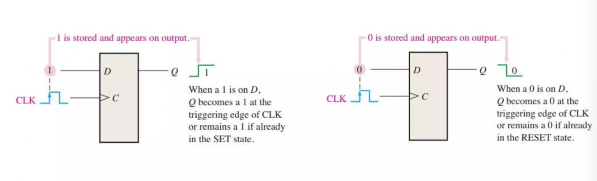
Figure below illustrates the concept of storing a 1 or a 0 in a D flip-flop

Slide 4
Shift Register
• The information stored within the registers can be transferred with
the help of shift registers.
• Shift Register is a group of flip flops used to store multiple bits of
data. The bits stored in such registers can be made to move within
the registers and in/out of the registers by applying clock pulses.
• The registers which will shift the bits to left are called “Shift left
registers”.
The registers which will shift the bits to right are called “Shift right
registers”.

Slide 5
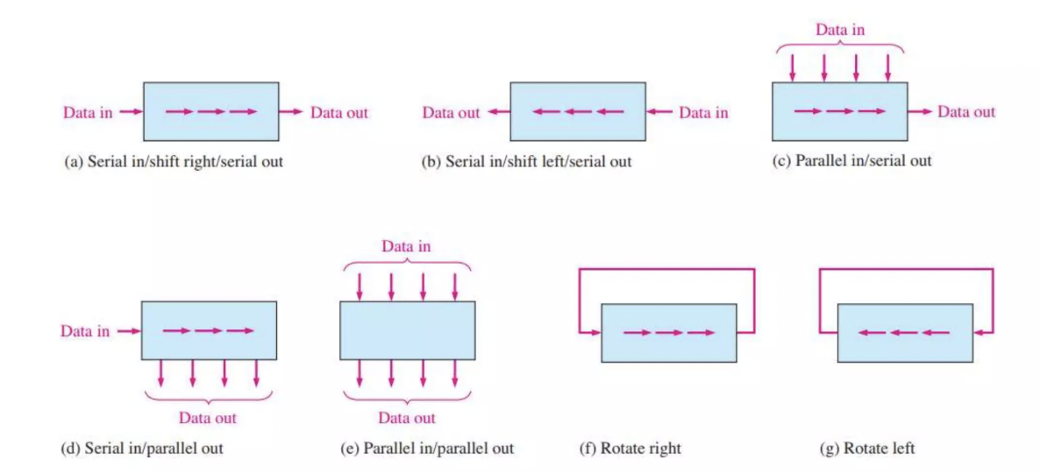
Data Movement in Shift Registers

Slide 6
Types of Shift Register
• Shift registers are basically of 4 types. These are:
1. Serial In Serial Out shift register(SISO)
2. Serial In parallel Out shift register(SIPO)
3. Parallel In Serial Out shift register(PISO)
4. Parallel In parallel Out shift register(PIPO)

Slide 7
Serial-In Serial-Out Shift Register (SISO)
• The shift register, which allows serial input (one bit after the other
through a single data line) and produces a serial output is known as
Serial-In Serial-Out shift register.
• Since there is only one output, the data leaves the shift register one
bit at a time in a serial pattern, thus the name Serial-In Serial-Out
Shift Register.
• In this type of register, N number of clock pulses is required to load
data into the flipflop and further (N-1) number of clock pulses are
required to retrieve data from register.

Slide 8
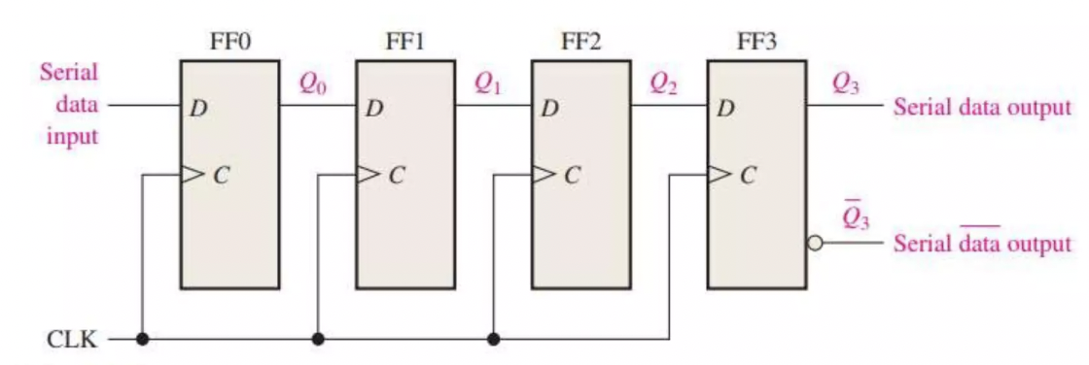
4 bit SISO

Slide 9
Serial-In Parallel-Out shift Register (SIPO)
• The shift register, which allows serial input (one bit after the other
through a single data line) and produces a parallel output is known as
Serial-In Parallel-Out shift register.
• In this type of register, N number of clock pulses is required to load
data into the flipflop and further no more clock pulses are required to
retrieve data from register.

Slide 10
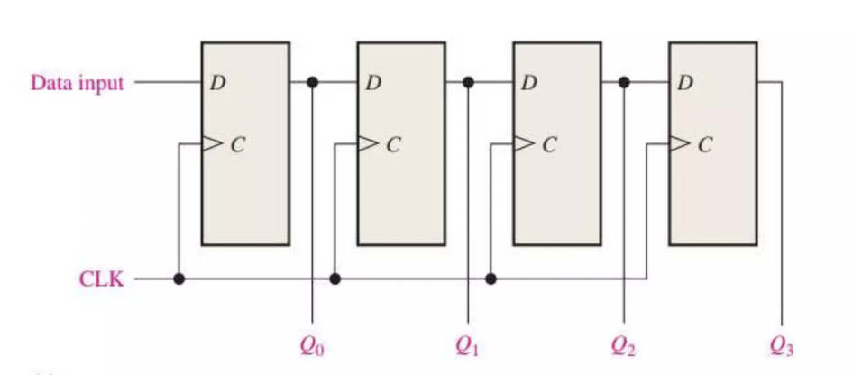
4-bit SIPO

Slide 11
Parallel-In Parallel-Out Shift Register (PIPO)
• The shift register, which allows parallel input (data is given separately
to each flip flop and in a simultaneous manner) and also produces a
parallel output is known as Parallel-In parallel-Out shift register.
• In this type of register, 1 number of clock pulse is required to load
data into the flipflop and further no more clock pulses are required to
retrieve data from register.

Slide 12
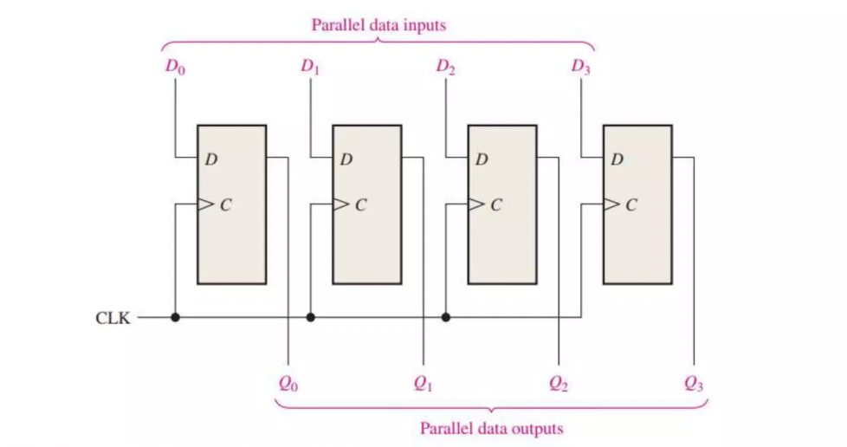
4-bit PIPO

Slide 13
Parallel-In Serial-Out Shift Register (PISO)
• For a register with parallel data inputs, the bits are entered
simultaneously into their respective stages on parallel lines rather
than on a bit-by-bit basis on one line as with serial data inputs.
• The shift register, which allows parallel input (data is given separately
to each flip flop and in a simultaneous manner) and produces a serial
output is known as Parallel-In Serial-Out shift register.
• In this type of register, 1 number of clock pulses is required to load
data into the flipflop and further (N-1) number of clock pulses are
required to retrieve data from register.

Slide 14
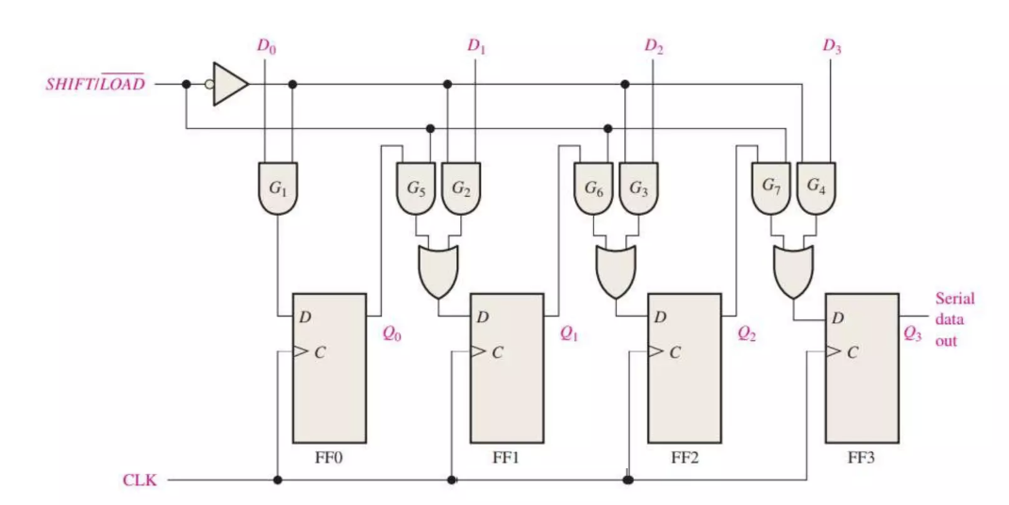
4-bit PISO

Slide 15
Shift Register Counter
• A shift register counter is basically a shift register with the serial
output connected back to the serial input to produce special
sequences.
• These devices are often classified as counters because they exhibit a
specified sequence of states.
• Two of the most common types of shift register counters, the
Johnson counter and the ring counter, are introduced in this section

Slide 16
Ring Counter
• A ring counter is basically a shift register counter in which the output
of the first flip flop is connected to the next flip flop and so on and
the output of the last flip flop is again fed back to the input of the first
flip flop, thus the name ring counter.
• The data pattern within the shift register will circulate as long as clock
pulses are applied.
• Number of states = Number of flipflops

Slide 17
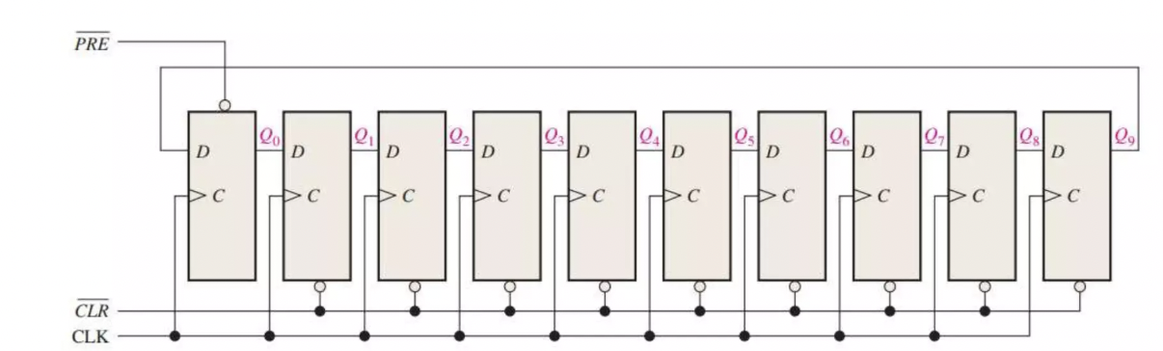
10-bit Ring Counter

Slide 18
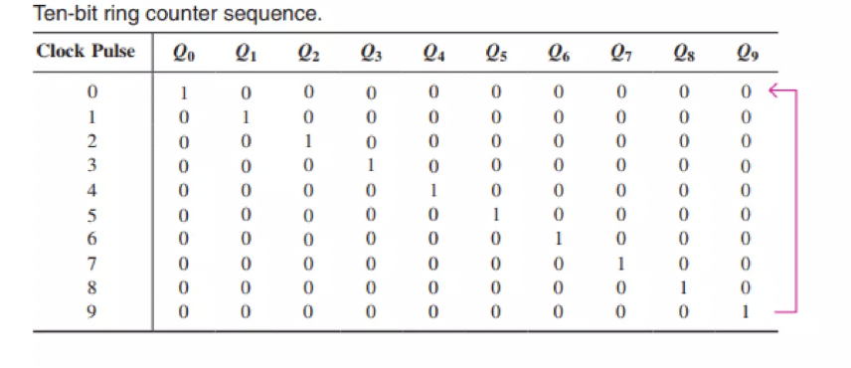
d

Slide 19
Johnson Counter
• A Johnson counter is basically a shift register counter in which the
output of the first flip flop is connected to the next flip flop and so on
and the inverted output of the last flip flop is again fed back to the
input of the first flip flop.
• They are also known as twisted ring counters.
• It is also known as switch-tail ring counter, walking ring counter or
Johnson counter.
• Number of states = 2 * Number of flipflops

Slide 20
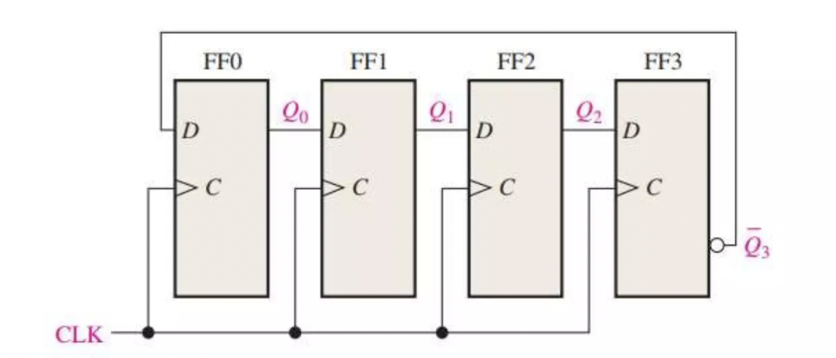
4-bit Johnson Counter

Slide 21
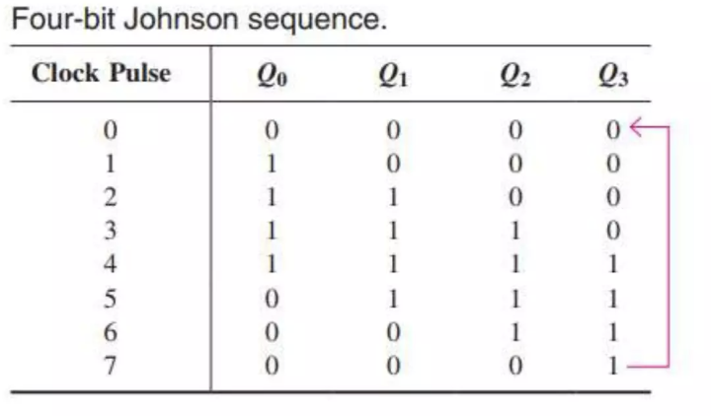

Slide 22
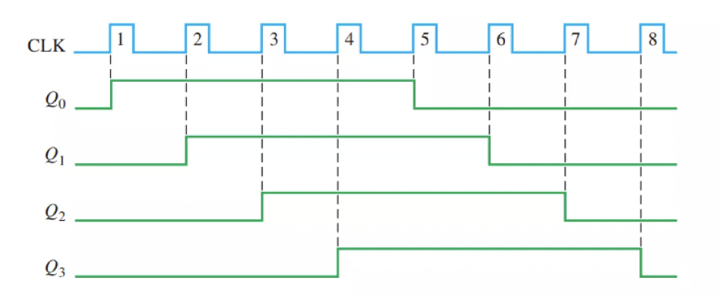
Timing Diagram

