Slide 1
NETRA
TRACEABILITY STACK
Evidence-first
network forensics
CASE CONTEXT
EVIDENCE IDENTITY
PACKET + SESSION RECORDS
From authorized packet capture to reviewable findings, reports, exports, integrity state, and custody history.
EXPLAINABLE FINDINGS
REPORT + EXPORT
HACKATHON SOLUTION
ENGINEERING PROTOTYPE
CUSTODY VERIFICATION
Solution presentation
18 JUN 2026

Slide 2
THE INVESTIGATION GAP
02
The tools are capable. The case continuity is fragmented.
01
02
03
04
Specialized outputs
Manual correlation
Opaque automation
Separate trust records
Packets, logs, alerts, notes, and screenshots use different identifiers and schemas.
Evidence context can detach during transfer, reporting, and reviewer handoff.
A label or score without trigger context is weak forensic support.
Hashes, access history, artifacts, and custody notes often live outside analysis.
CORE QUESTION
How can an investigator move from stored network evidence to a traceable, explainable, reviewable case package?
Source: NETRA Solution Document, §§1 and 4
NETRA / EVIDENCE-FIRST NETWORK FORENSICS

Slide 3
PROPOSED SOLUTION
03
One controlled workflow keeps evidence identity attached to every conclusion.
01
02
03
04
05
06
INGEST
VALIDATE
ANALYZE
DETECT
REVIEW
PACKAGE
PCAP / PCAPNG
type • size • header
TShark • Zeek
rules • anomaly
human disposition
report • export
Evidence continuity
Tool orchestration
Reviewable outputs
Case, evidence, session, finding, artifact, and custody records remain linked.
Established engines are invoked inside a trusted processing boundary.
Rules and feature context support human judgment rather than replace it.
Source: NETRA Solution Document, §§5-6 | CLM-001 to CLM-006
NETRA / EVIDENCE-FIRST NETWORK FORENSICS

Slide 4
SYSTEM ARCHITECTURE
04
A trusted backend separates the browser from raw evidence and privileged storage.
INVESTIGATOR EXPERIENCE
TRUSTED PROCESSING
ANALYSIS ENGINES
MANAGED DATA PLANE
React + TypeScript console
Django API boundary
TShark dissection
PostgreSQL case state
Case views • timeline • graph
Validation + temporary plaintext
Zeek records
Private encrypted objects
User identity token
Analysis orchestration
Deterministic rules
PGMQ worker coordination
Artifact generation + downloads
Random Forest prototype
Realtime events + polling
Source: NETRA Solution Document, §8 | CLM-013
NETRA / EVIDENCE-FIRST NETWORK FORENSICS

Slide 5
EVIDENCE LIFECYCLE
05
Every transformation remains attributable to the original capture.
1
VALIDATE
2
IDENTIFY
3
PROTECT
Extension, structure, size policy, case context
Plaintext SHA-256 establishes evidence identity
Encrypt artifact; store privately with manifest
4
ANALYZE
5
DERIVE
6
VERIFY
Limit temporary plaintext; invoke native tools
Persist packets, sessions, alerts, graph, timeline
Recalculate hashes; validate custody continuity
Invariant: case ID + evidence ID + method + timestamp context travel with every derived record.
Source: NETRA Solution Document, §9 | CLM-003, CLM-006
NETRA / EVIDENCE-FIRST NETWORK FORENSICS

Slide 6
DETECTION METHOD
06
Hybrid detection prioritizes explainability and human review.
DETERMINISTIC
PROBABILISTIC
HUMAN AUTHORITY
Behavior rules
Anomaly prototype
Findings are hypotheses,
not proof of compromise.
Scanning + brute force
Random Forest
01
Trigger
Why the behavior matched
Beaconing + tunneling
Explainable feature scoring is implemented, but the artifact has only six training rows.
Remote execution hints
02
Context
Packets, sessions, features
Exfiltration hypotheses
03
Disposition
Confirm • dismiss • investigate
PROTOTYPE ONLY
Source: NETRA Solution Document, §10 | CLM-007 to CLM-009
NETRA / EVIDENCE-FIRST NETWORK FORENSICS

Slide 7
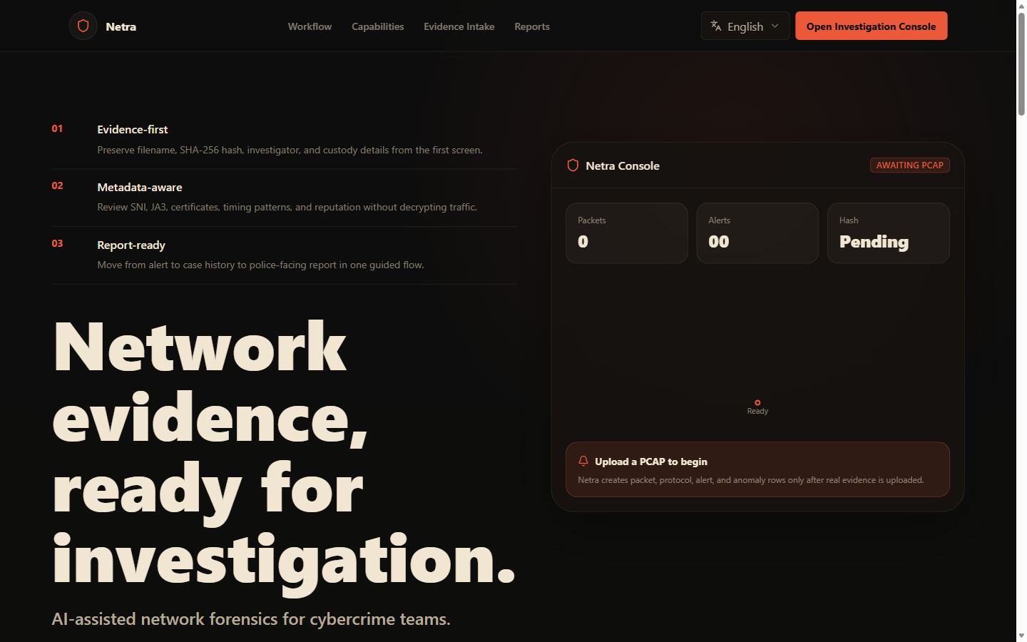
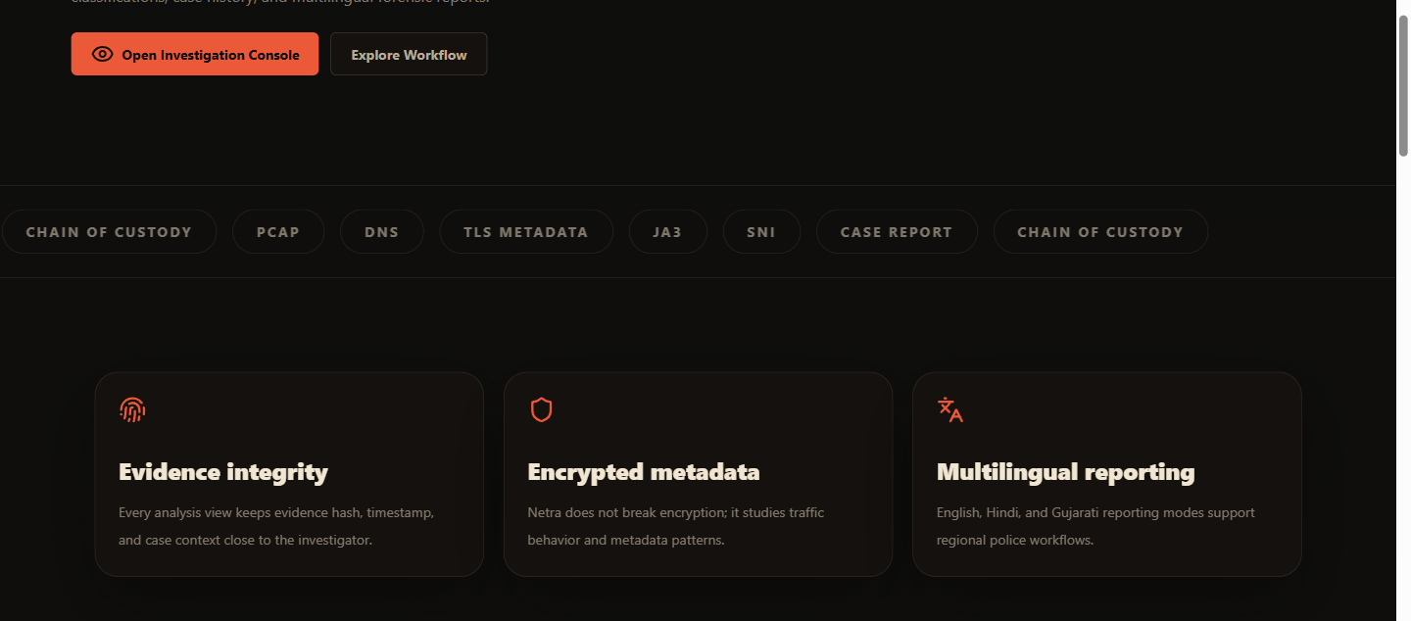
INVESTIGATOR EXPERIENCE
07
The interface organizes analysis around a case, not around disconnected tool output.
CASE-CENTERED VIEWS
•
Evidence and traffic review
•
Suspicious activity + disposition
•
Graph, timeline, report, export
•
Integrity state + custody history
Assets: repository-provided NETRA screenshots | Source: Solution Document, §6.4 and §13.3
NETRA / EVIDENCE-FIRST NETWORK FORENSICS

Slide 8
EVALUATION EVIDENCE
08
The prototype shows signal, while the evidence base remains intentionally bounded.
SIX-CASE LOCAL DETECTION BENCHMARK
MODEL ROWS
READINESS
6
GATED
Demonstrates the path, not generalizable accuracy.
Production release remains blocked.
WHAT THE EVIDENCE SUPPORTS
✓ Stored PCAP/PCAPNG workflow
✓ Case-scoped analysis and exports
✓ Integrity + custody engineering checks
× Field accuracy, scale, or legal certification
5 expected attack cases detected • 3 false positives
Sources: phase6 benchmark 2026-06-16; claims CLM-007, CLM-008, CLM-012, CLM-014
NETRA / EVIDENCE-FIRST NETWORK FORENSICS

Slide 9
TRUST MODEL
09
Technical integrity is engineered; operational and legal authority remain external gates.
01 IDENTITY
SHA-256 establishes the original evidence identity.
02 PROTECTION
Encrypted private storage, manifests, controlled temporary plaintext.
03 CONTINUITY
Hash-linked custody events and artifact verification preserve traceability.
04 AUTHORITY
Procedure, examiner testimony, jurisdiction, and legal review determine admissibility.
Boundary: NETRA can produce technical evidence suitable for review; it does not certify court admissibility.
Source: NETRA Solution Document, §12 | CLM-003, CLM-006, CLM-014
NETRA / EVIDENCE-FIRST NETWORK FORENSICS

Slide 10
ROADMAP
10
Move from integrated prototype to governed operational pilot through explicit gates.
NOW
0–30 DAYS
1–3 MONTHS
3–6 MONTHS
6–12 MONTHS
Validated baseline
Security + reliability
Analytical quality
Pilot readiness
Operational approval
Stored evidence workflow, analysis, exports, integrity, custody
Secrets, RBAC/RLS, CORS, fault recovery, release checklist
Broader corpus, tuned rules, reproducible benchmarks
Investigator research, usability, scale, monitoring
Authority review, SOPs, training, controlled rollout
01
02
03
04
05
THE THESIS
NETRA does not replace packet tools. It turns their output into a traceable case package that another reviewer can interrogate.
Source: NETRA Solution Document, §§17-19 | Status remains production-gated
NETRA / EVIDENCE-FIRST NETWORK FORENSICS

