Slide 1

Project On Virtual Personal Assistant Using Speech Recognition
GITAM School of Technology
GITAM (Deemed to be University)
Bengaluru
Under the guidance
Dr. Dayanand Lal N
Assistant Professor
Dept. of CSE
Presented by: (Project Batch F2)
Y. Krishnakaanth reddy (321910306039)
K. Vishnu (321910306038)
R. Prasaana kumar reddy (321910306059)
c. Saisumanth (321910306041)
K. Pramod Reddy (321910306008)

Slide 2
Agenda
Abstract
Introduction
Literature Survey
Problem statement
Requirement specifications
Workflow
Skeleton implementation
Conclusion

Slide 3
ABSTRACT
In this modern era, day-to-day life has become more innovative and interlinked with technology. In the proposed voice assistance system, we have evolved with the idea of virtual assistants for laptops.
The design and implementation of the Speech recognition use OpenCV approach for experimental analysis. Finally, the result is represented in graphical form.

Slide 4
INTRODUCTION
The Idea is to build an Application, that works with Human voice based recognition ,which directly helps physically disabled community.
In recent years there has been many invention with several hardware devices to help physically disabled community.
Computer based systems has provided enormous support to differently abled personalities among which some of them are SIRI, Alexa, Etc.

Slide 5
PROBLEM STATEMENT
Aim of the Project:
To Develop an application named “Lexi” which provides voice-based recognition for the physically disabled community.

Slide 6
Objectives
1. To Develop a quick responsive voice-based digital assistant.
2. To Implement digital assistants in any pc/Desktop device.
3. To save the voice recording in real-time environment for a limited period.

Slide 7
REQUIREMENTS SPECIFICATION
HARDWARE :
Microphone
RAM
SOFTWARE :
Windows OS
Internet
Python
Integrated development Environment (Pycharm preferable)

Slide 8
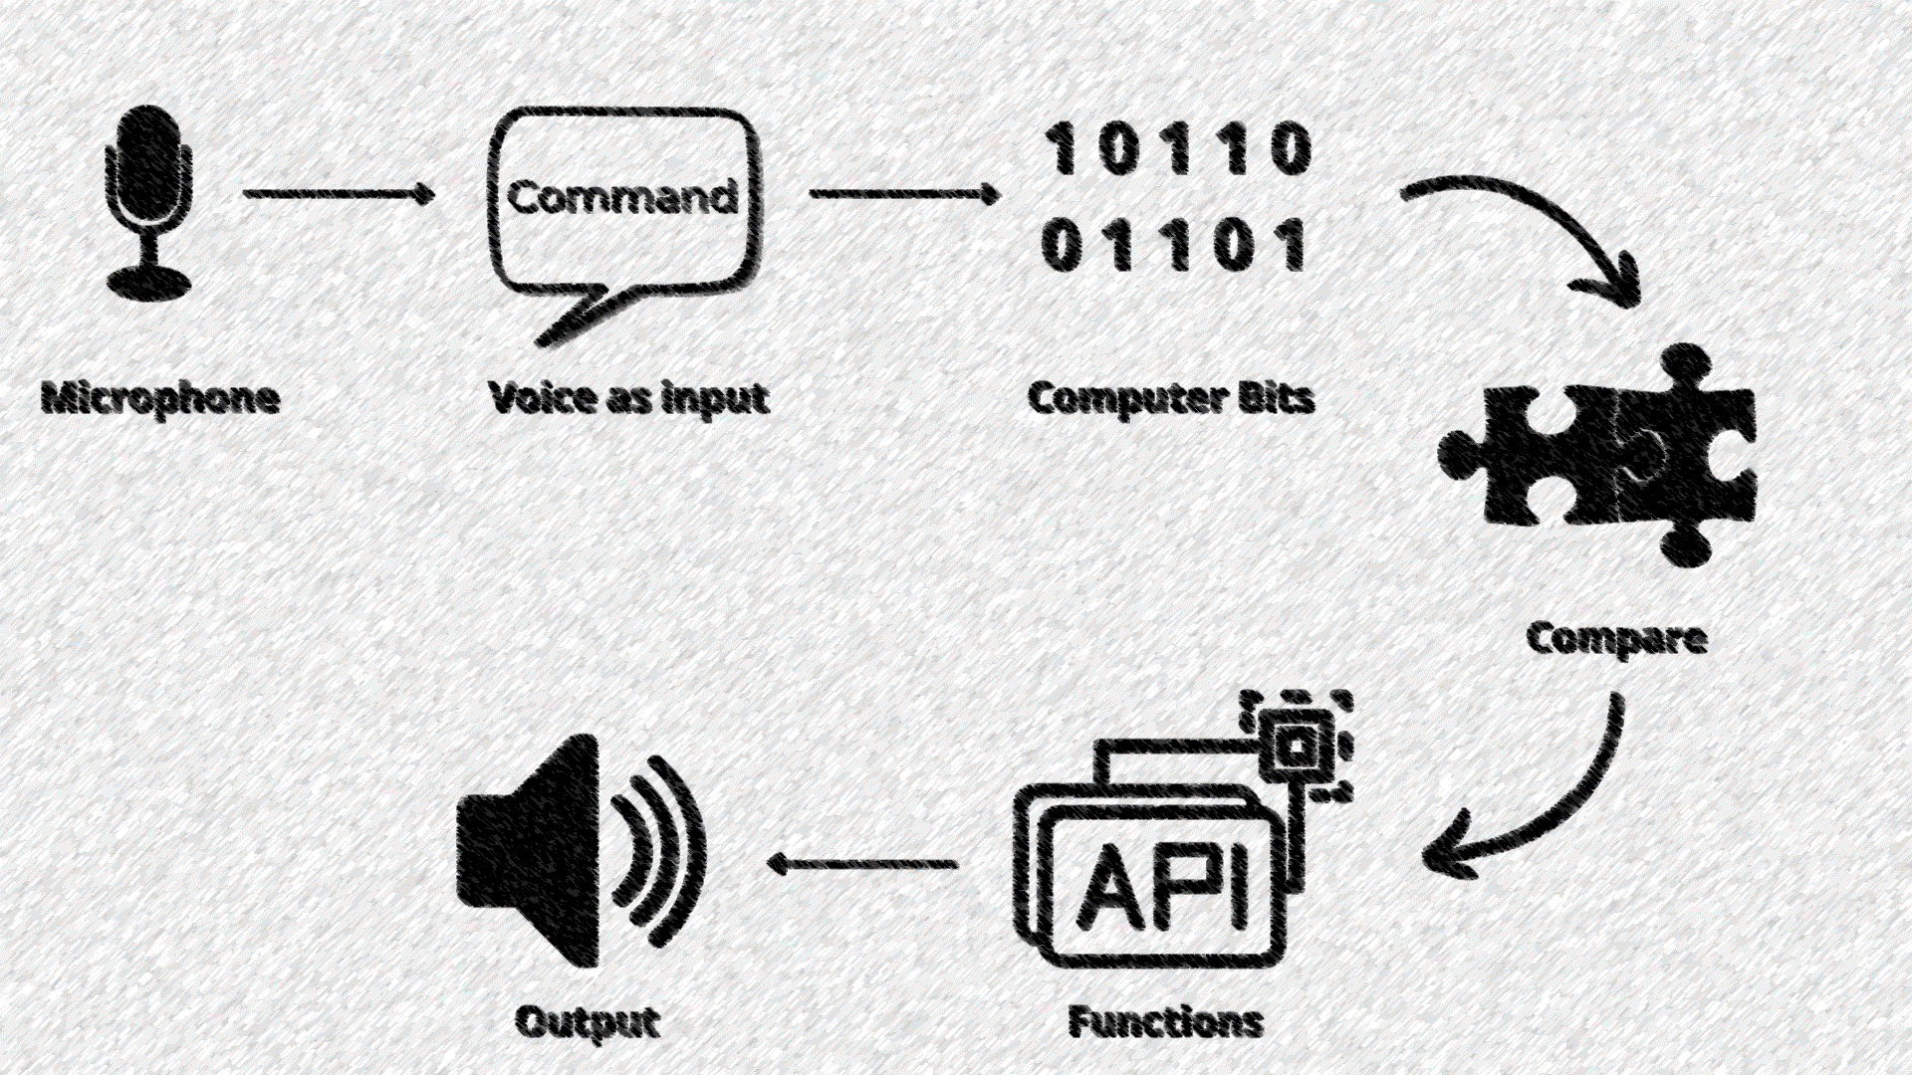
Skeleton Process of the work

Slide 9

WORK FLOW
Install Required Packages
Setup the packages Using methods available
Make the Application Ready To Listen And Reply
Define Functions For Various Commands
Ready To Assist You

Slide 10
Using speech recognition, we try to recognize the voice and assign it to a variable.
We access the microphone and then will be capturing the voice from the microphone, and match the voice samples from any search engine: preferably in lower case values.
Further, we try to use a robust package that Plays a vital role in our project is certainly known as Pywhatkit.
Usage of pywhatkit, It helps us do many things like researching or playing YouTube channels or getting time or sending WhatsApp messages or many other things.

Slide 11
Using pywhat kit, we will be able to access speech command and if the voice-based search string has the best match then that will be played.
Similarly. We found some common package for Date-Time, which provides current date and time.
the same concept can be applied to search and recognize the content based on some textual information from Wikipedia even.
Finally, the software application “Lexi” will return use every uh command at the end of the program to speak out everything.

Slide 12
Advantages
lexi makes it easy to keep track of everything that needs to get done
You can also ask lexi to set a reminder or an alarm when you need to get something done.
When you need to know the meaning of a word, just ask for lexi for help
It can open exact location in map
lexi can also give you quick answers to questions you have.
You can also ask lexi for the latest news

Slide 13
difference between lexi and cortona
LEXI | CORTONA
Accurate results | Cortona no accurate results
Accurate Weather updates | No Weather updates
No Network issue | Network issue
Send messages | Can't send messages

Slide 14
CODE
from ast import While
import traceback
import speech_recognition as sr
import pyttsx3
import pywhatkit
import datetime
import Wikipedia
import pyjokes
import subprocess
import webbrowser
import wolframalpha
import json

Slide 15
import requests
import winshell
import ctypes from urllib
import request
import Urlopen
listener = sr.Recognizer()
engine = pyttsx3.init()
voices = engine.getProperty('voices’)
engine.setProperty('voice', voices[1].id)
engine.say('Hello I am Lexi!, your Virtual personal Assistant’)
engine.runAndWait()def talk(text):
import requests
import winshell

Slide 16
import ctypes
from urllib import request
import urlopen
listener = sr.Recognizer()
engine = pyttsx3.init()
voices = engine.getProperty('voices’)
engine.setProperty('voice', voices[1].id)
engine.say('Hello I am Lexi!, your Virtual personal Assistant')engine.runAndWait()
def talk(text):
engine.say(text)
engine.runAndWait()

Slide 17
def take_command():
command = "Krishna"
try:
with sr.Microphone() as source:
print('Listening')
voice = listener.listen(source)
command = listener.recognize_google(voice)
print(command)
except:
pass
return command

Slide 18
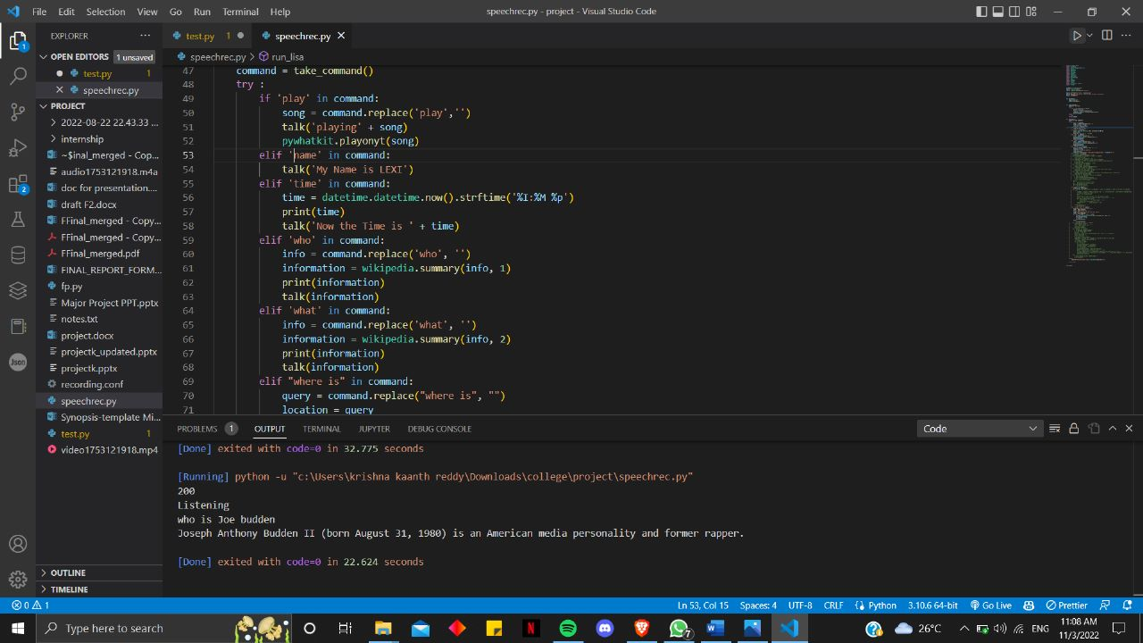

Slide 19
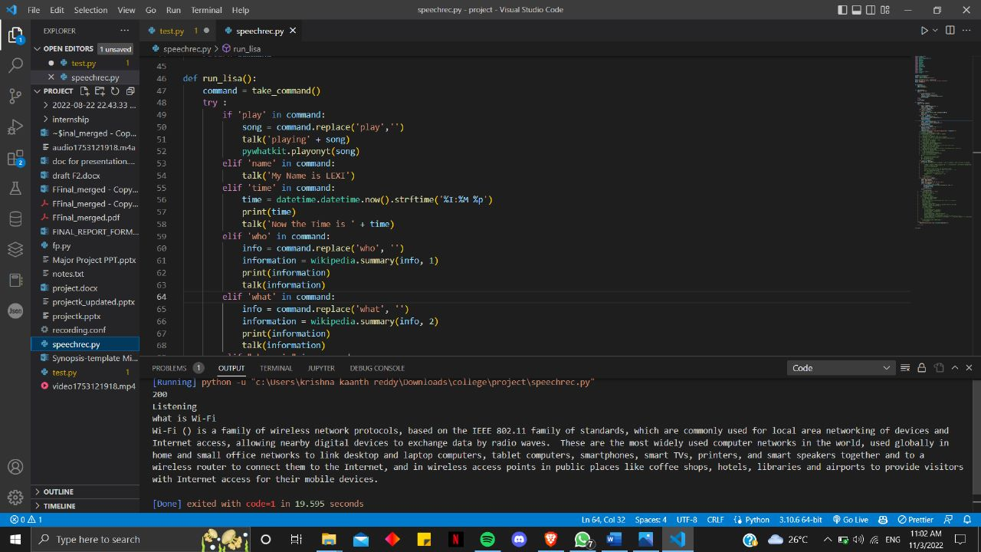

Slide 20
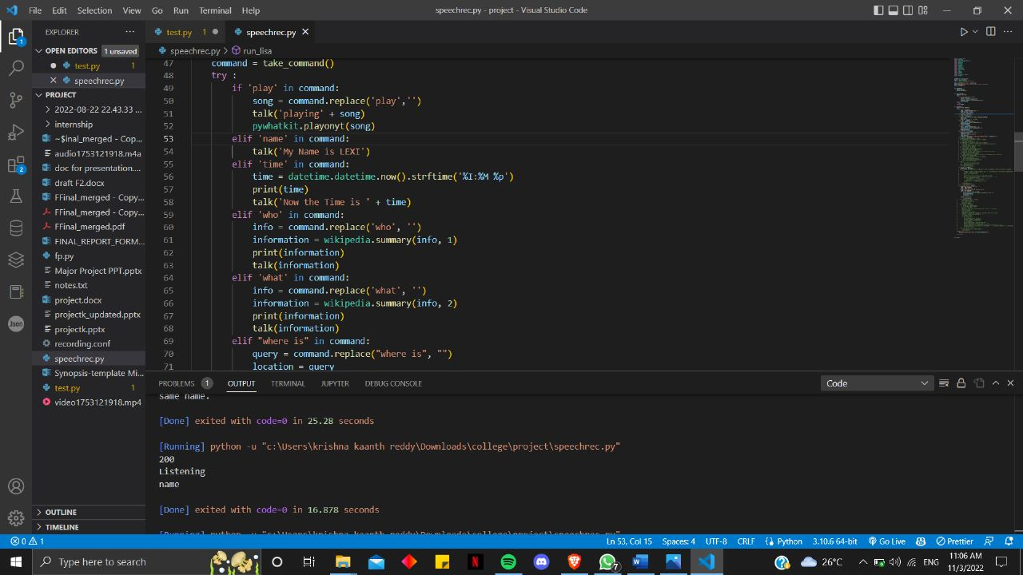

Slide 21
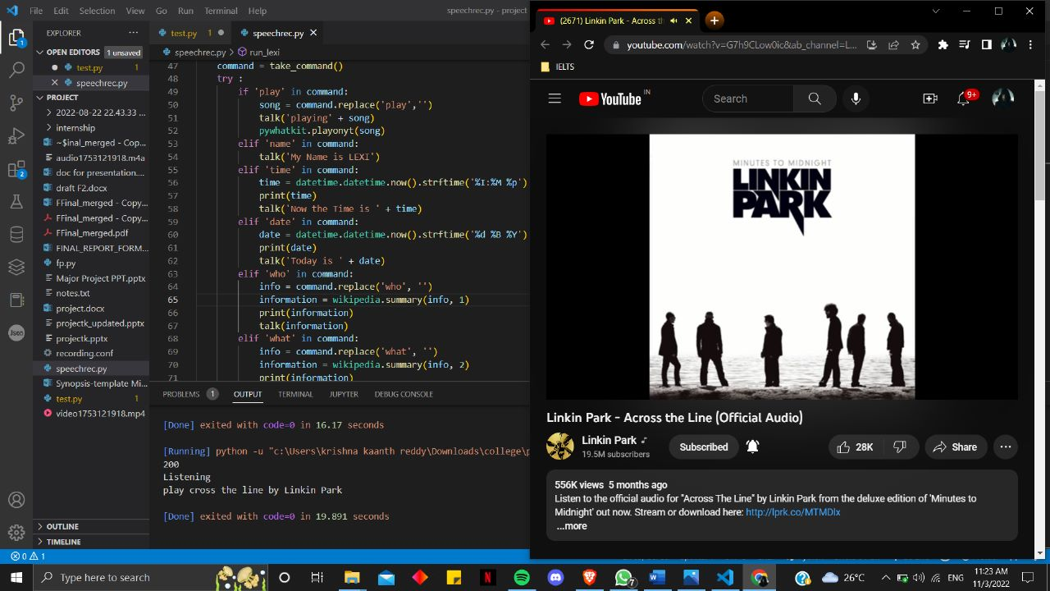

Slide 22
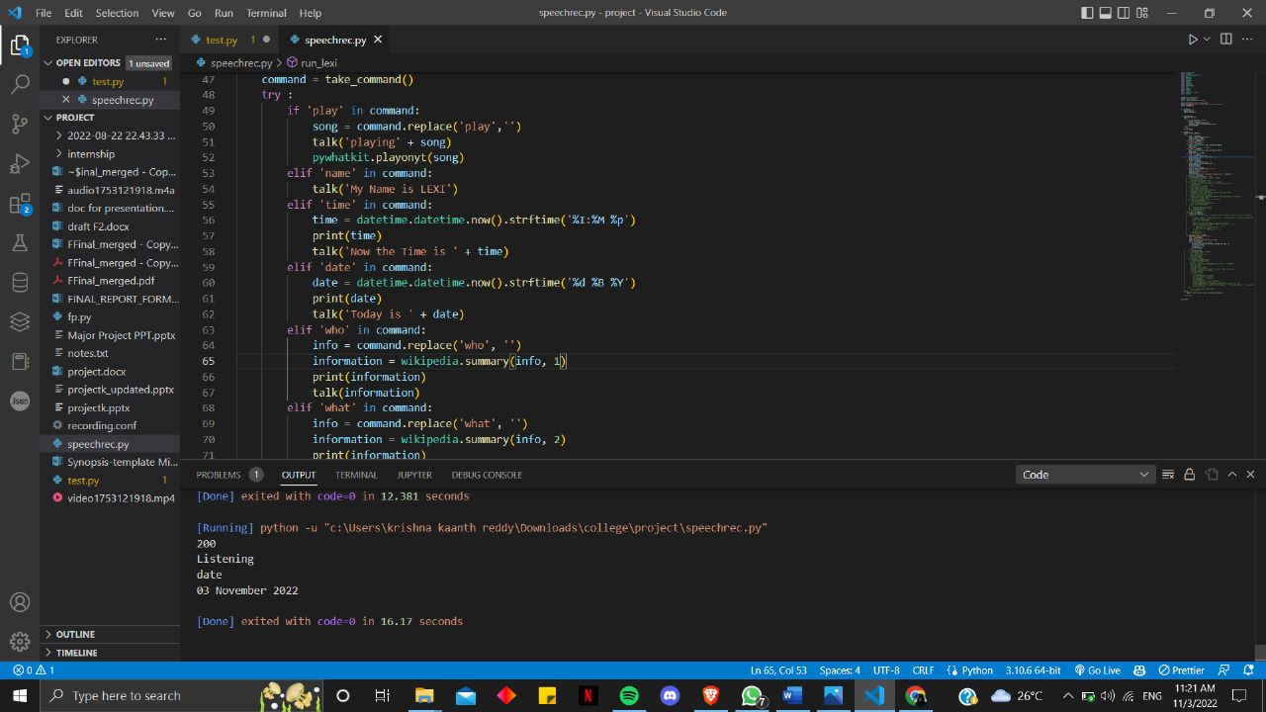

Slide 23
Short note
Today the advancement of AI systems that are able to create a natural Human-Machine-Interaction (through voice, communication, gestures, facial expressions, etc.) are gaining popularity. One of the most observed and popular was the direction of interaction, based on the understanding of the machine by the machine of the natural language processing. It is no longer a human self-learns to communicate with a machine, but a machine self-learns to communicate with a human, exposing his actions, habits, behavior and trying to become his best personalized as assistant. The work on making and improvising such personalized assistants has been going on for a long period of time. These systems are constantly improving and improving, go beyond personal computers and have already firmly established themselves in different mobile devices and gadget. One of the most popular voice assistants are Siri, from Apple, Amazon Echo, which responds to the name of Alexa from Amazon, Cortana from Microsoft, Google Assistant from Google, and the recently appeared intelligent assistant under the name AIVA.

Slide 24
This paper presents a brief introduction to the architecture and construction of voice assistants. It provides proposed plan of work and also provides methodology of the work of a voice assistant. It also describes the test results of the voice assistant. The primary goal of this work is to build a local voice assistant that performs the work of human and the daily task that a human needed to do in day-to-day life. It has some new features like posting comments on the social media websites such as Facebook, Instagram, etc. by just few simple commands. You can also know the weather around and can get the climate conditions in your local region. It can open and launch web applications and the local storage of the user computer.

Slide 25
LITERATURE SURVEY
Paper and Author Details | Methodology | Disadvantages
A vision and speech-enabled, customizable, virtual assistant for smart environments By Giancarlo Iannizzotto. | Machine Learning | Most virtual assistants are smart enough to understand natural language, but you have to be specific.
Next-Generation of Virtual Personal Assistants (Microsoft Cortana, Apple Siri, Amazon Alexa and Google Home) By Veton Këpuska | Deep Neural Networks | If dim light was there image will be hardly recognized.
Goal-Oriented Modelling for Virtual Assistants By B. Martinez and M. F. Valstar | Goal Net and MADE as the basis of framework | They are limited to specific types of applications such as quizzes and flashcards
TABLE 1: LITERATURE SURVEY

Slide 26
Giancarlo Iannizzotto[1] have proposed A vision and speech enabled, customizable, virtual assistant for smart environments which describes about Popular Virtual currently include Amazon Alexa, Apple’s Siri. Google Assistant and Microsoft’s Cortina and The digital assistant built into windows phone 8.1 and windows 10. It is used for Speech enable Virtual assistants (Often named smart speakers), Offer a wide variety of network-oriented services and In some cases, can connect to smart environments, thus enhancing them with new and effective user interfaces. It has also some limitations like Most virtual assistants are smart enough to understand natural language, but you have to be specific. For instance, if you connect Amazon Echo with the Uber app, Alexa can request a ride, but you have to phrase the command correctly. You have to say, "Alexa, ask Uber to request a ride.

Slide 27
Veton Këpuska[1][2] have proposed Next-Generation of Virtual Personal Assistants (Microsoft Cortana, Apple Siri, Amazon Alexa and Google Home) which described about Google has improved the Google Assistant by using the Deep Neural Networks (DNN) method which highlights the main components of dialogue systems and new deep learning architectures used for these components, Microsoft used the Microsoft Azure Machine Learning Studio with other Azure components to improve the Cortana dialogue system.

Slide 28
Gamal Bohouta[2][2] have proposed Next-Generation of Virtual Personal Assistants (Microsoft Cortana, Apple Siri, Amazon Alexa and Google Home). It is used for automatic extracted features in three modalities: text, audio and video. It has also had some limitations like we need to be very specific in voice and image clarity. If dim light was their image will be hardly recognized.

Slide 29
Jonathan Leung have proposed Goal-Oriented Modelling for Virtual Assistants which describes for GoalNet and MADE as the basis of framework. It is used for Users can interact with the assistant by either typing a message or using spoken language. It has also some limitations. They are limited to specific types of applications such as quizzes an flashcard, The task specifications are written in C++ and must be compiled before usage, making it difficult for end users to personalize their virtual assistants and Python library aimed at providing machine learning methods for developers less familiar with dialogue systems. However, such libraries are targeted at developers and are not suitable for users without programming experience.

Slide 30
CONCLUSION
Through this voice assistant, we will try to automate various services using a single line command. It gives a clear approach for most of the tasks of the user like searching the web, retrieving weather forecast details, vocabulary help and medical-related queries.
Speech recognition in future will evolve the way people do business around the web and will ultimately integrate world class e-business. Virtual assistant using only speech recognition clearly represent the next generation of the web.

Slide 31
Thank You

