Slide 1

Team Detail
Predicting chances of disease/s using
Machine Learning
Student Names : Guide Name:
Abhishek Jain Prof. Aditya Patel
Bhola Prasad Chilhate
Krishna Yadav

Slide 2
Background Information
  This project involves the concept of machine learning to predict whether the patient is affected by a particular disease.
  Prerequisites of the project are :
  Knowledge of Machine Learning concepts such as training, testing, modelling, regression, classification, etc.
  Knowledge of a programming language such as python.
  Knowledge of front-end development and backend development.
  The project would require dataset of similar cases of disease diagnosed in the past with its full report and results in order to train and test the ML algorithm.
  The generated ML algorithm will take medical data of patient through an interface and predict the chances of having a disease.

Slide 3
Project Objective
This project aims at developing a smart and efficient way of diagnosing patients for particular disease/s.
It will provide an interface to feed-in the patient’s medical data and store it in the database for further processing. The ML algorithm will be processing the medical data on the server and will predict whether the patient is suffering from the disease or not. The result will be reflected back on the user interface.

Slide 4
Project Significance
This project is significant for the following reasons:
The project uses modern technologies and concepts to solve real world problems.
It makes the use of medical reports generated everyday in hospitals to provide solution to the Health Care Society.
It helps in reducing the workload of doctors in diagnosing a patient by predicting automatically.
This system can be preferred in case of high amount of patients coming-in or in lack of availability of doctors for fast diagnosis.
It can also be used for verification of patient’s diagnosis by the doctors.

Slide 5
Background Study
This project requires following skills and knowledge:
OOP’s concepts and programming skill such as Python.
Concepts and practical applications of Machine Learning.
Front-end development such as Web Development.
Backend development such as MySQL, Oracle, etc.
Server-side scripting such as PHP, Node.js, etc.
Basic knowledge of problem domain, in this case, brief knowledge of medical field, diseases, etc.
Other IT skills such as Networking, etc

Slide 6
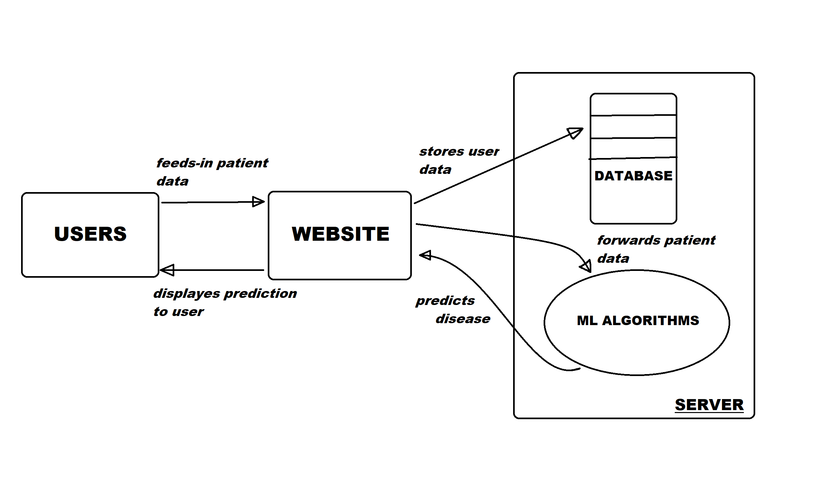
Block Diagram/Flow Chart

Slide 7
Initial Timeline
Project timeline would have following stages:
Objective | Weeks required
Gathering of datasets for ML. | 1
Developing, training and testing of ML algorithm. | 3
Backend development and server-side scripting. | 2-3
Front-end developing and testing. | 2-3
Deployment and testing of project. | 1

Slide 8
Hardware/Software Requirement
Hardware Requirements:
Any PC, Laptop, Tablet or Smartphone.
Working internet connection.
Memory: min. 1 GB RAM (recommended).
Software Requirements:
Operating System: Any (Windows, Linux, Android, etc.)
Any Browser with JavaScript enabled. (Chrome, Firefox, etc.)

Slide 9
Resource
https://elitedatascience.com/
https://shiring.github.io/machine_learning/2017/03/31/webinar_code
http://archive.ics.uci.edu/ml/datasets/Breast+Cancer+Wisconsin+%28Diagnostic%29
https://www.google.com/

Slide 10

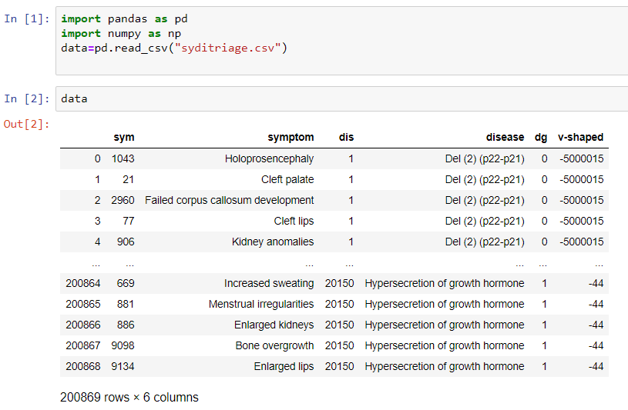
Gathering of datasets for ML

Slide 11
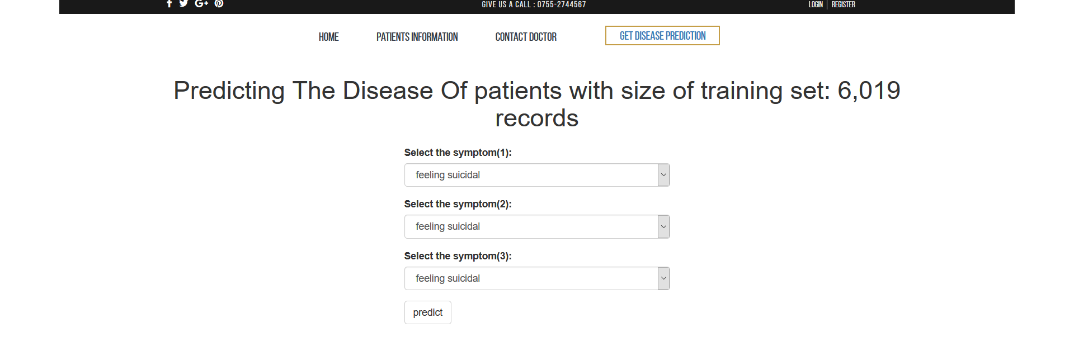
Snapshot of the disease prediction form

