Slide 1

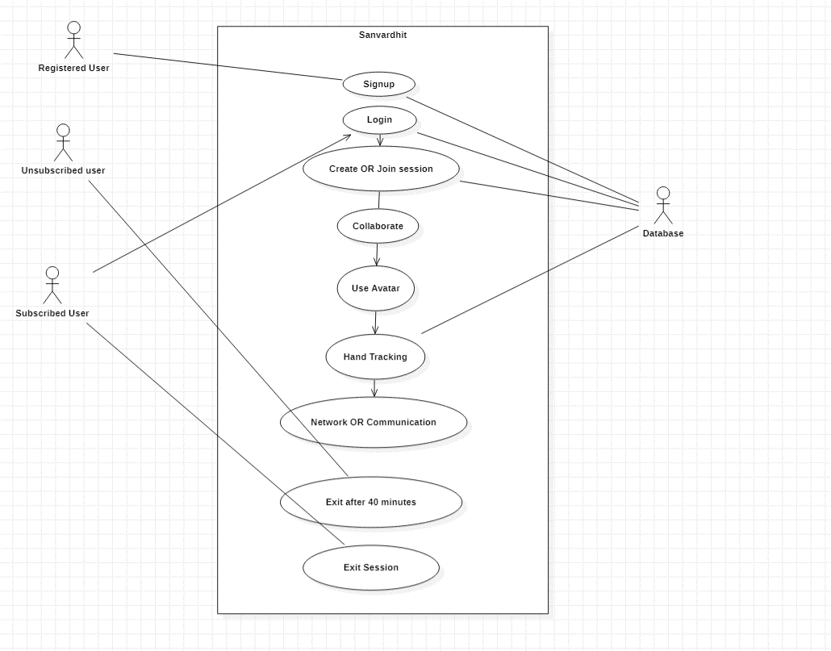
MIT SCHOOL OF COMPUTING
DEPARTMENT OF COMPUTER SCIENCE & ENGINEERING
Sanvardhit
Krishnaprasad Awala, Keerti Satpute, Arun Hirmukhe, Ayush Neelkant
Faculty Guide:
Prof. Rishikesh Yeolekar
Abstract/ Objectives:
Proposed Architecture/ Diagram:
Scope of the Project :
In
These are all great steps in developing a mixed reality application.
1. Hand tracking is a crucial aspect of augmented reality, and using a combination of OpenCV, Unity, and Vuforia can provide a strong foundation for implementing hand tracking functionality.
2. Implementing hand tracking to enable users to hold and move augmented objects can add a great deal of interactivity to the application, making it more engaging for users. A whiteboard integration is a good starting point, as it can demonstrate the capabilities of the hand tracking system and provide a practical use case for users.
3. Allowing multiple users to join a session and collaborate with each other is a major step in the development of a mixed reality application. It's important to keep in mind that this will require the implementation of a networking system to allow users to communicate with each other, as well as the creation of user avatars to represent each user in the virtual environment. This can add a level of complexity to the project, but it is a key aspect of developing a collaborative mixed reality experience.
Problem Statement:
Immersive And Mixed Reality for social collaboration.
Need/ Scope of the Project : Traditional online collaboration technologies are ineffective in fostering a sense of presence and engagement among remote team members, which is an issue for business.
Domain: Augmented Reality / Mixed Reality
Technology:
C#, Unity Engine, Vuforia Engine.
Expected Outcomes:
Proposed Outcome: The proposed outcome of a social collaboration platform in augmented reality is to provide a collaborative environment for users to share information, ideas, and other content in a more engaging and interactive manner than traditional communication methods. With the use of hand tracking, whiteboard integration, and user avatars, the platform enhances the user experience and enables users to participate in a more interactive and immersive virtual environment.

