Slide 1

Customer Shopping Behavior Analysis
Analysis of 3,900 purchases to reveal spending patterns, segments, product preferences, subscriptions.

Slide 2
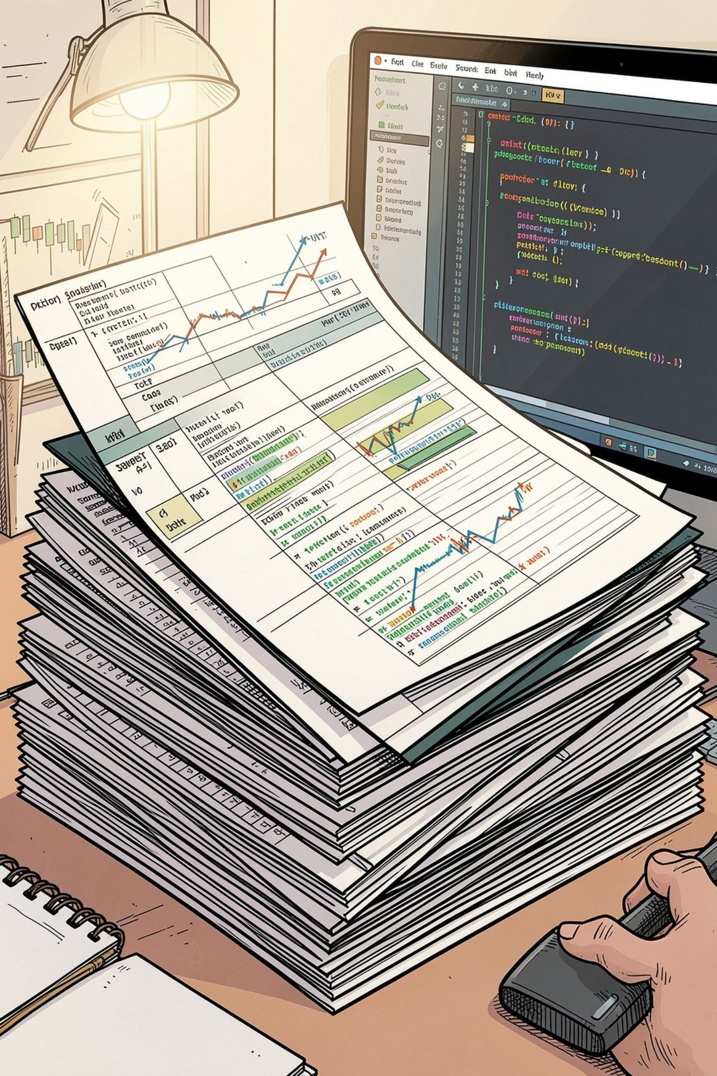
Dataset Snapshot
Rows
Columns
3,900
18
Missing
37 values in Review Rating

Slide 3

Data Preparation (Python)
01
Load & Inspect
pandas, df.info(), describe()
02
Missing Values
Imputed Review Rating by category median
03
Standardize & Engineer
snake_case, age_group, purchase_frequency_days
04
DB Load
Exported to PostgreSQL for SQL analysis

Slide 4

SQL Analysis — Key Queries
Revenue by Gender
Shipping Comparison
Female: 75,191 • Male: 157,890
Standard: $58.46 • Express: $60.48
Subscribers vs Non
Yes: 1,053 customers • Avg $59.49 • Revenue $62,645
No: 2,847 customers • Avg $59.87 • Revenue $170,436

Slide 5

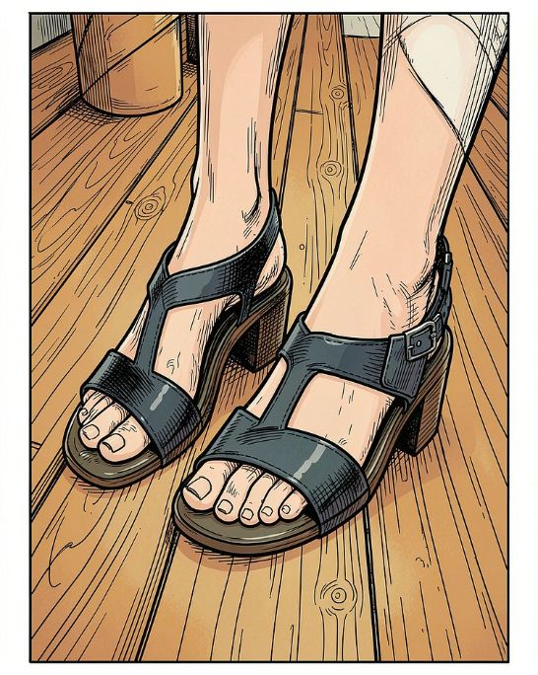

Top Products & Ratings
Gloves
Sandals
Boots
Avg rating 3.86 — Top rated
Avg rating 3.84
Avg rating 3.82

Slide 6
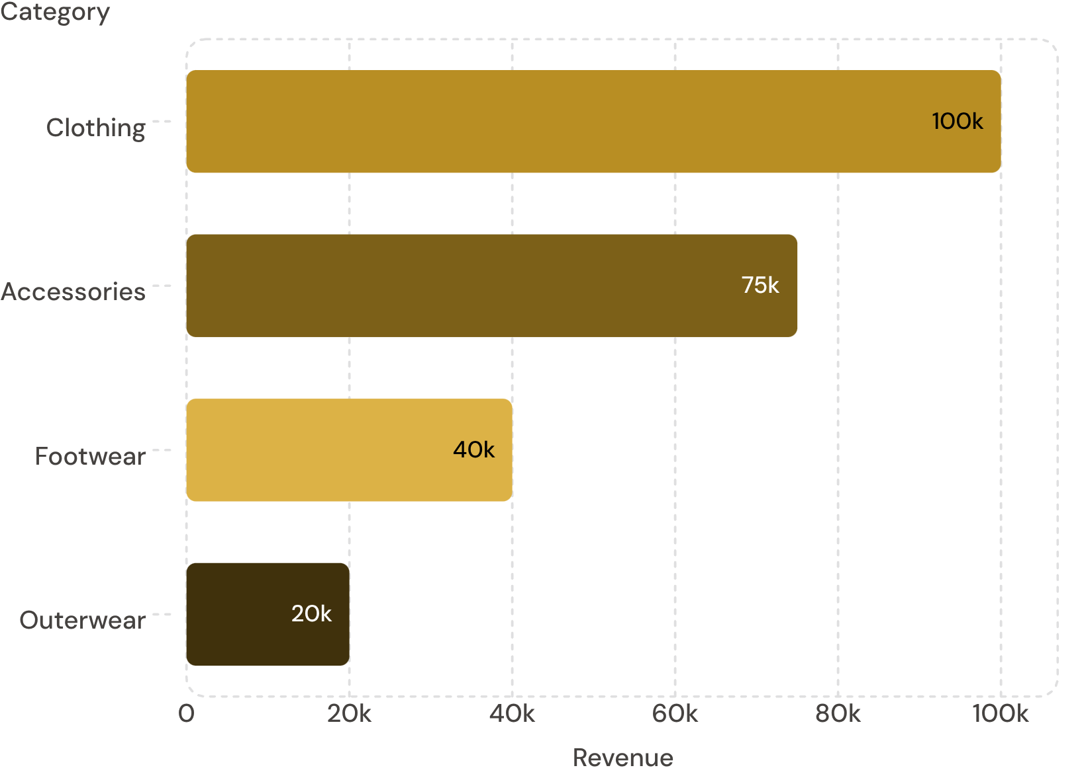
Revenue by Category
Clothing leads revenue; Accessories second. Use for merchandising focus.
Discount-Dependent Items
Top discount rates: Hat 50%, Sneakers 49.66%, Coat 49.07%, Sweater 48.17%, Pants 47.37%

Slide 7
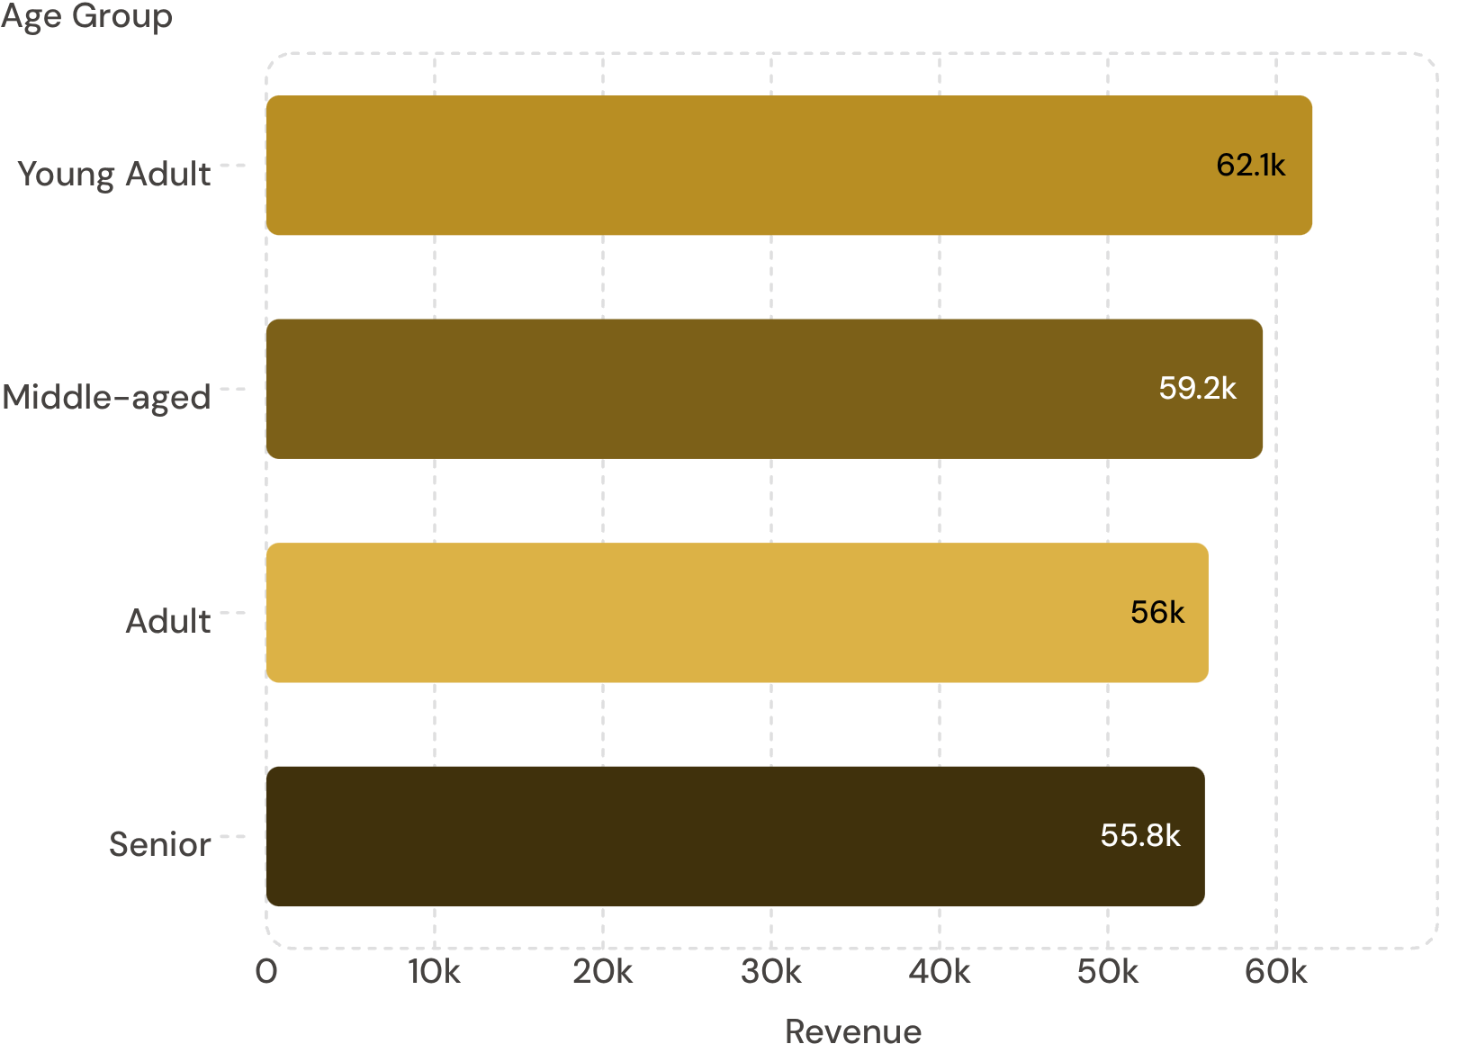
Revenue by Age Group
Young Adults highest — prioritize targeted campaigns.
Sales by Age (summary)
Young Adult ~1,000 sales; Middle-aged ~950; Senior ~850; Adult ~850

Slide 8
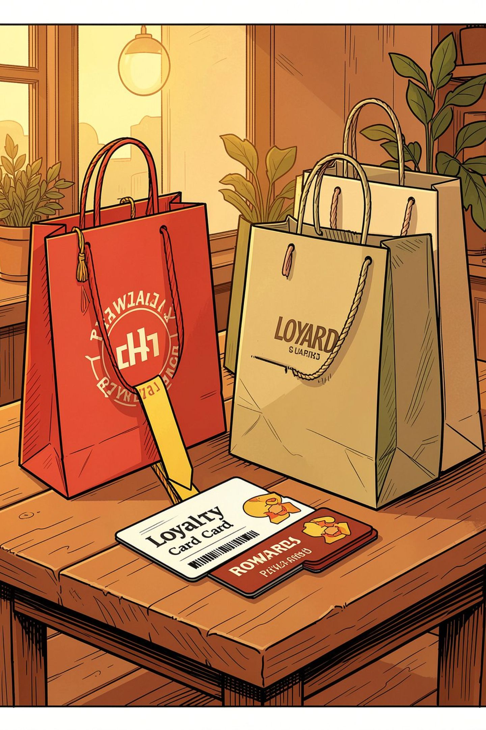
Customer Segments & Repeat Buyers
Loyal
Returning
3,116 customers
701 customers
New
83 customers
Repeat buyers (>5 purchases): 958 — higher subscription propensity

Slide 9
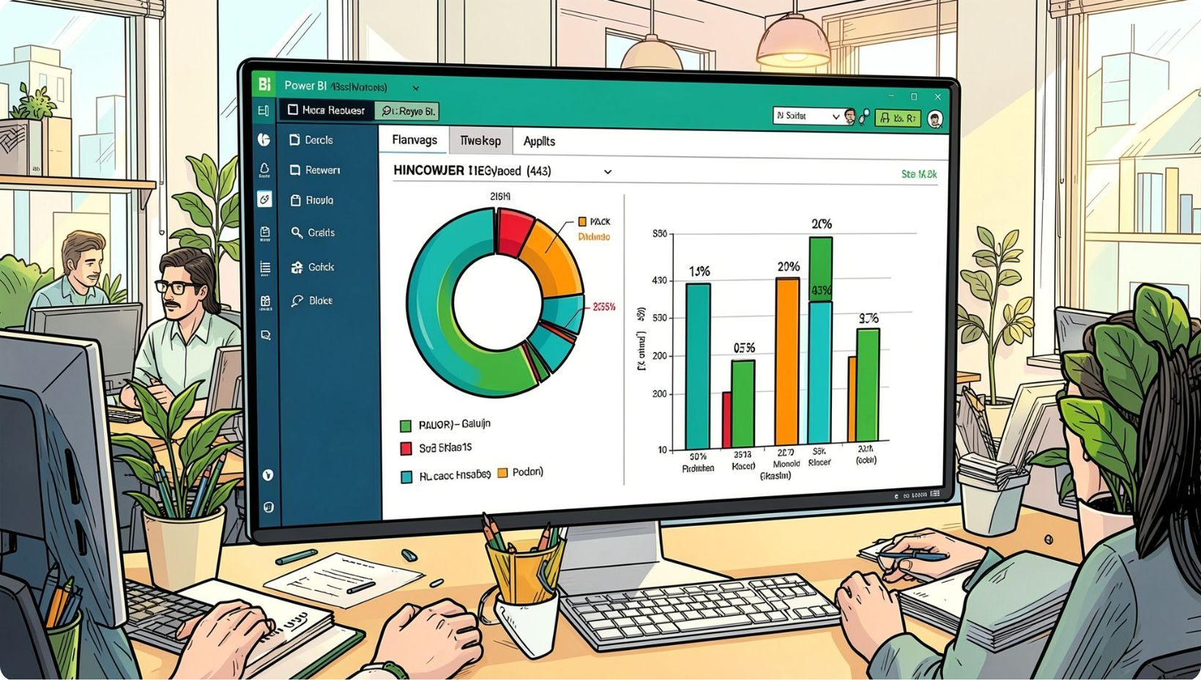
Dashboard Highlights (Power BI)
3.9K customers
Avg purchase $59.76
Avg review rating 3.75
Subscription: Yes 27% • No 73%
Visuals: subscription donut, revenue & sales by category, age-group bars.

Slide 10





Business Recommendations
Boost Subscriptions
Loyalty Programs
Review Discount Policy
Promote exclusive benefits for subscribers
Reward repeat buyers to grow Loyal segment
Balance sales uplift with margin control
Product Positioning
Targeted Marketing
Feature top-rated & best-selling products
Focus on high-revenue age groups & express-shipping users

