Slide 1
Project On REAL TIME DRIVER DROWSINESS DETECTION USING OPENCV
PRESENTATION BY
Palagani Padma (23033I1020)
PROJECT GUIDE
Dr.K.NAGESWAR RAO (MCA,M.TECH,M.PHIL,PHD)

Slide 2
Contents
Abstract
Problem Definition
Existing System
Disadvantage
Proposing System
Advantage
System Requirements
Modules
Module Description
System Architecture
Result
Conclusion
References

Slide 3
Abstract
A computer’s vision-based thoughts concept has been used for creating this Drowsy Driver Detection System. The camera being the initial point of the system by providing the live feed of the driver to the framework that concentrates it straight towards the face of driver and checks the driver's eyes with a particular objective to catch drowsiness of the driver.
On analyzing the live video an alert is issued to the driver in circumstances where drowsiness is outcome of the analysis.
The framework moves the control of the program forward using information picked up from the picture to find the facial tourist spots, which helps the system to identify where the eye’s location of an individual exist.
If the eyes of driver are closed for a specific amount of time, the proposed framework draws a conclusion that the driver is feeling drowsy and an alarm for safety is sound. The system works after initially face is recognized and eyes are spotted, it also works well in dim lighting conditions too

Slide 4
Problem definition
Behavioral methods measure levels of drowsiness through the use of mounted cameras in the car to observe facial features such as eye state, head movement, blinking rate and yawning.
Most researchers follow a general process to extract facialfeatures from the camera feed. After obtaining these features,further processing is applied to determine the level ofdrowsiness,

Slide 5
Existing system
Traffic congestion is one of the major modern-day crises in every big city in the world.
Previously different techniques had been proposed, such as infra-red light sensor, induction loop etc.
In recent years, image processing has shown promising outcomes in acquiring real time traffic information using CCTV footage installed along the traffic light.
Some of them count total number of pixels, some of the work calculate number of vehicles.
These methods have shown promising results in collecting traffic data.
However, calculating the number of vehicles may give false results if the intra vehicular spacing is very small (two vehicles close to each other may be counted as one) which are the quotidian means of traffic especially in South-Asian countries.

Slide 6
DISADVANTAGE
Traffic congestion is one of the head ach. Here using infra-red light sensor to detect traffic

Slide 7
Proposing System
typically by applying machine learning techniques such as Support Vector Machines (SVM), Convolutional Neural Networks (CNN) or Hidden Markov Models (HMM).
These techniques are trained using features and labelled outputs to build models that can be used for drowsines sprediction.
The most challenging part of this process is findingalarge dataset that covers the expected variability across races and different skin pigments.
This is a particular challenge dueto security and confidentiality issues that arise whenpublishing datasets for academic and commercial use.

Slide 8
ADVANTAGE:
Here, we implemented both machine learning and deep learning algorithms.
DRIVER DROWSINESS DETEC detection accuracy is 98.2%.

Slide 9
System Requirements
HARDWARE REQUIREMENTS:
Processor : Pentium IV or higher
Hard Disk : 512 GB
RAM : 4 GB

Slide 10
Software Requirements:
Operating System : Windows 10
Coding Language : Python 3.9
Database : MySQL

Slide 11
Modules
Data Acqisition
Face Detection
Facial Landmark Making
Feature Extraction
Classification

Slide 12
Data Acquisition:
The video is recorded using webcam (Sony CMU-BR300) and the frames are extracted and processed in a laptop.
After extracting the frames, image processing techniques are applied on these 2D images. Presently, synthetic driver data has been generated.
The volunteers are asked to look at the webcam with intermittent eye blinking, eye closing, yawning and head bending.
The video is captured for 30 minutes duration.

Slide 13
Face detection:
After extracting the frames, first the human faces are detected.
Numerous online face detection algorithms are there. In this study, histogram of oriented gradients (HOG) and linear SVM method [10] is used.
In this method, positive samples of descriptors are computed on them.
Subsequently, negative samples (samples that do not contain the required object to be detected i.e., human face here) of same size are taken and HOG descriptors are calculated.
After obtaining the features for both the classes, a linear SVM is trained for the classification task.
To improve the accuracy of VM, hard negative mining is used.

Slide 14
Face landmark making:
After detecting the face, the next task is to find the locations of different facial features like the corners of the eyes and mouth, the tip of the nose and so on.
Prior to that, the face images should be normalized in order to reduce the effect of distance from the camera, non-uniform illumination and varying image resolution.
Therefore, the face image is resized to a width of 500 pixels and converted to grayscale image.
After image normalization, ensemble of regression trees [11] is used to estimate the landmark positions on face from a sparse subset of pixel intensities.
In this method, the sum of square error loss is optimized using gradient boosting learning.
Different priors are used to find different structures.

Slide 15

Feature extraction
After detecting the facial landmarks, the features are computed as described below.
Eye aspect ratio (EAR): From the eye corner points, the eye aspect ratio is calculated as the ratio of height and width of the eye as given by
Eye Aspect Ratio Calculation
EAR= $\frac{\left\|P2−P6\right\|+\left\|P3−P5\right\|}{2\left\|P1−P4\right\|}$

Slide 16
Classification:
After computing all the three features, the next task is to detect drowsiness in the extracted frames.
In the beginning, adaptive thresholding is considered for classification. Later, machine learning algorithms are used to classify the data.
The higher values are considered so that no eye closing instances will be present.
If the test value is less than this threshold, then eye closing (i.e., drowsiness) is detected.
As the size of eye can vary from person to person, this initial setup for each person will reduce this effect.
Similarly, for calculating threshold of MOR, since the mouth may not be open to its maximum in initial frames (setup phase) so the threshold

Slide 17
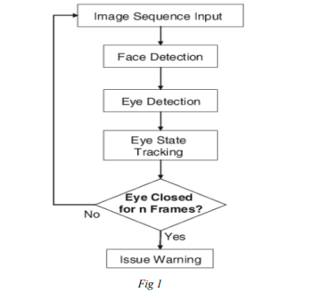
SYSTEM ARCHITECTURE:

Slide 18
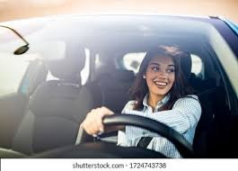
RESULT:
Home Page
Fig 1
Eyes is open

Slide 19
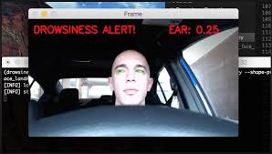
EYES CLOSE

Slide 20
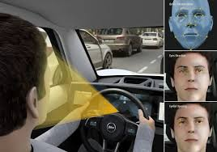
Detecting drowsiness

Slide 21
CONCLUSION:
With the help of study aids and research papers we conclude that the driver's drowsiness program is important and should be a mandatory part of a driver's life. Therefore, we would successfully design and improve the implementation of the Driver Drowsiness Detector using Python and OpenCv and web cam to get a face.

Slide 22
reference:
[1] W. L. Ou, M. H. Shih, C. W. Chang, X. H. Yu, C. P. Fan, "Intelligent Video-Based Drowsy Driver Detection System under Various Illuminations and Embedded Software Implementation", 2015 international Conf. on Consumer Electronics - Taiwan, 2015.
[2] W. B. Horng, C. Y. Chen, Y. Chang, C. H. Fan, “Driver Fatigue Detection based on Eye Tracking and Dynamic Template Matching”, IEEE International Conference on Networking,, Sensing and Control, Taipei, Taiwan, March 21-23, 2004.
[3] S. Singh, N. P. papanikolopoulos, “Monitoring Driver Fatigue using Facial Analysis Techniques”, IEEE Conference on Intelligent Transportation System, pp 314-318

Slide 23
THANK YOU

