Slide 1
Backend Engineering-I Project
TradeX
Team Details:
1. Keshav Bareja 2310992119
2. Prateek Balwada 2310992127
3. Krishna Yadav 2310992128
4. Madhur Goyal 2010991377
Faculty Coordinator: Dr. Kirandeep Singh
:
Chitkara University Institute of Engineering and Technology,
Chitkara University, Punjab

Slide 2
Table of Contents
Introduction
Problem Statement
Technical Details
Key Features
Project Highlights
Bonus Feature
Conclusion
References/Links used

Slide 3
Introduction
REGISTRATION FORM
Objective:
To develop a registration form with a backend system for storing and managing user data.
Key Features:
Frontend form validation.
Backend data storage in a JSON file.
Dynamic display of registered users.

Slide 4
Problem Statement
To develop a user registration system with frontend validation, backend storage in a JSON file, and a dynamic interface for displaying registered users. This solution ensures accurate data collection, secure storage, and real-time user management.

Slide 5
Technical Details
.
Frontend: HTML, CSS, JavaScript
Backend: Node.js
Data Storage: JSON
Tools: Visual Studio Code, Browser

Slide 6
Key Features
Frontend Validation: Ensures accurate user input with real-time checks for required fields and valid formats.
Backend Data Storage: Stores user data securely in a JSON file for easy access and management.
Dynamic User Display: Displays a list of registered users that updates automatically upon new submissions.
Responsive Design: A mobile-friendly, visually appealing registration form for a smooth user experience.
User-Friendly Interface: Simple, intuitive design that guides users through the registration process easily.

Slide 7
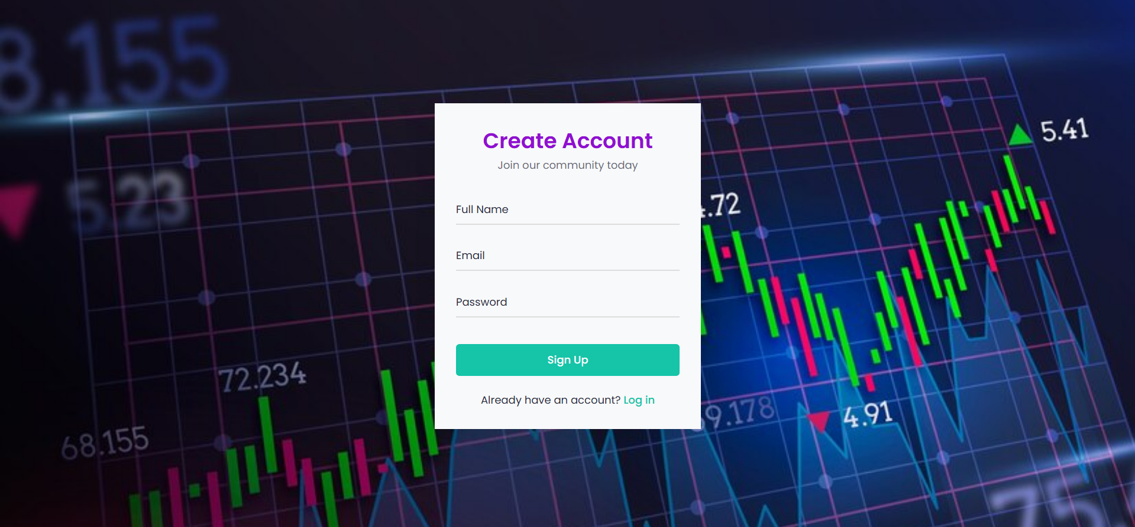


Slide 8
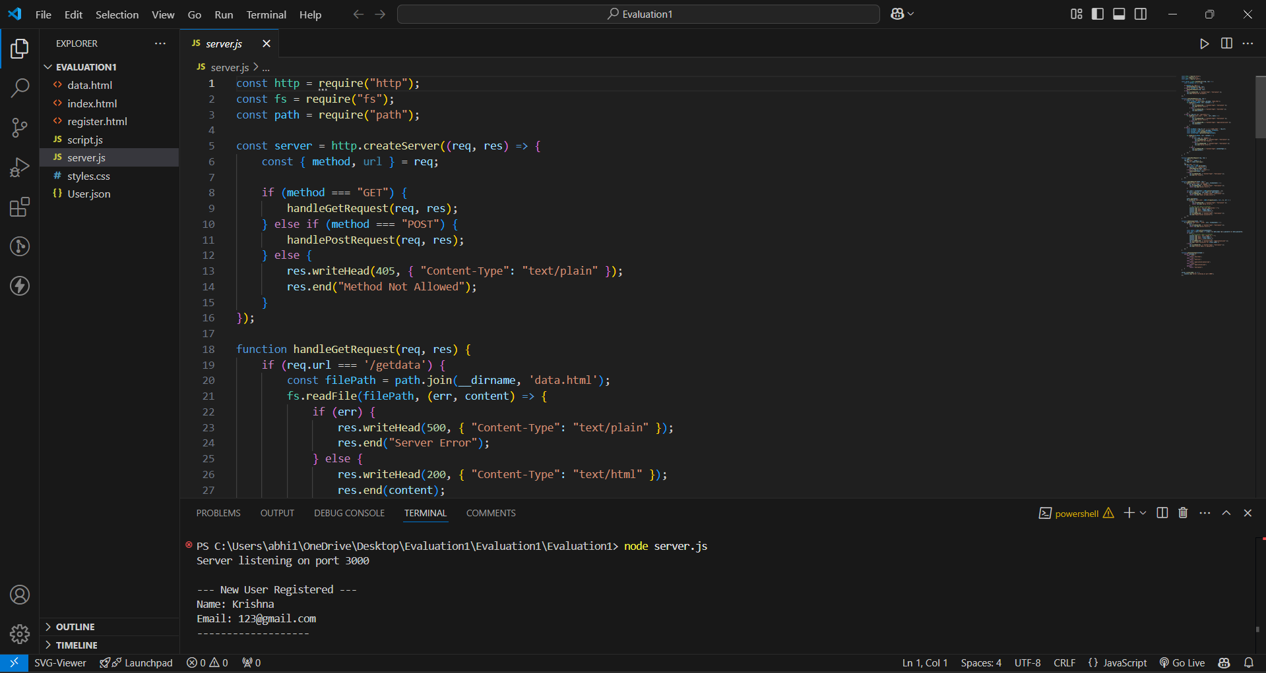
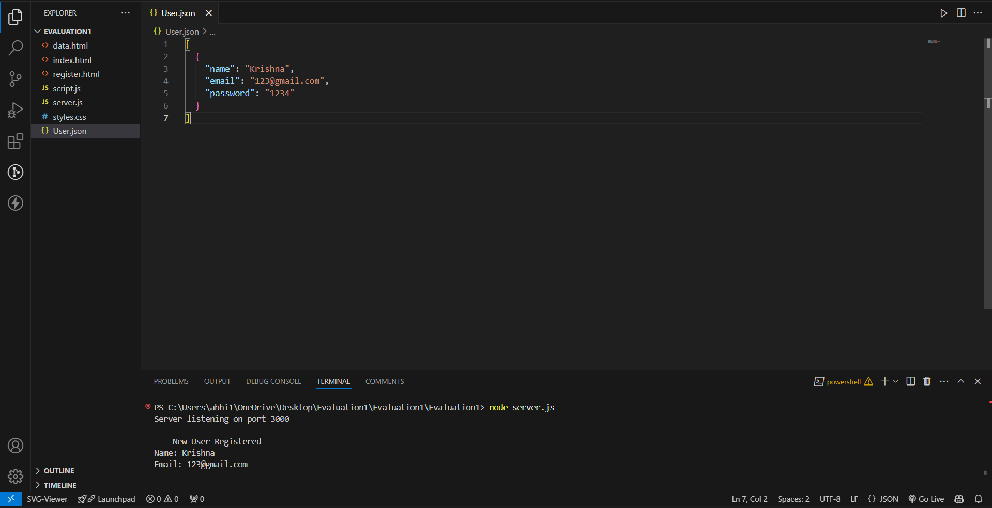

Slide 9
Conclusion
Key Points:
Minimalistic Approach: Developed a user registration form with HTML, CSS, and backend JSON storage, demonstrating the power of simple web technologies.
Design and Styling Expertise: Created a responsive, visually appealing form with smooth animations and dynamic updates.
Collaboration: Worked effectively as a team to integrate frontend design with backend data management.
Problem Solving: Overcame challenges in connecting frontend validation with backend storage, finding creative solutions within the tech constraints.

Slide 10
Conclusion
Team Takeaways:
We enhanced our skills in form creation and validation using HTML and CSS, gaining a solid understanding of front-end and backend development for user-friendly interfaces.
Innovation: We explored innovative methods to build a seamless registration form, focusing on dynamic data display and backend integration without relying on complex frameworks.
Adaptability: We adapted to the challenges of integrating frontend validation with backend JSON storage, demonstrating resourcefulness and problem-solving capabilities.
User-Centric Design: We prioritized user experience by creating an intuitive, visually appealing registration form and a dynamic user display for easy data access and management.

Slide 11
References/Links used
This slide should include a list of all the sources and references used in the project.
https://www.youtube.com/?feature=ytca

Slide 12


