Slide 1
Speaker Verification
Group 4
Abhay Diwakar 2020164
Chehak Malhotra 2021141
Krishna Somani 2021058
Rishabh Dhawan MT23002
Rahul Kishore Gorai MT23070

Slide 2
Problem Statement
Use Gaussian mixture model for the task of speaker verification, use equal error rate as performance metric.

Slide 3
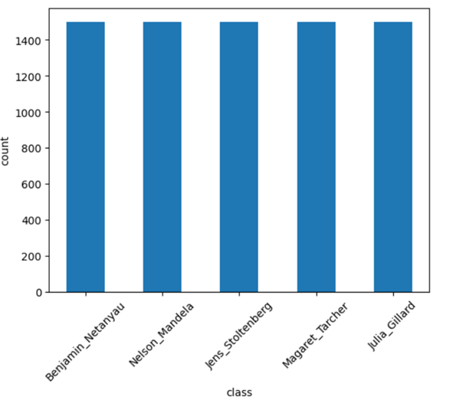
EDA/Dataset Description
We have a balanced dataset where almost every folder has the same number of wav files i.e. 1500 wav files. After loading any wav file, we are getting a sample rate of 16000 Hz from it
We have Imbalanced classes in the Noise folder.
One folder contains 4 files, and the other one contains 2 files. After analyzing, we found that all the noise files have a duration greater than 1 second and none of them have a sample rate of 16000 Hz. Therefore, we resampled them to 16000 Hz and break them into 1-second chunks which further helps in training of our model.

Slide 4
Methodology
1. Data Preprocessing
Resampled noise files to 16000 Hz sample rate.
Thus 6 noise files were split into 354 noise samples, where each is 1 sec long.
Then, before extracting features we added a random 1 sec sample to the training audio sample.
In general, audio recordings often contain background noise. Training models on data that include such noise can make them more robust and better handle real-world, noisy environments.
2. Feature Extraction
The Cepstral Domain Features, include Mel-frequency cepstrum coefficients (MFCC), delta coefficients, double-delta coefficients, LPCC etc.
On thorough literature review and testing we concluded using MFCC (mel-frequency cepstrum coefficients) and its delta and double delta coefficients are optimal for our task.
We also tried using LPCC and other spectral features in our model testing

Slide 5
Proposed Model
Data Preparation
Data
Preprocessing
Feature Extraction & Selection
Raw Audio Data
GMM 1
Training Dataset
Testing Dataset
GMM 2
Model Learning
Model Validation
GMM 3
Equal Error Rate
GMM 4
GMM 5

Slide 6
Results
Preprocessing | Features | EER
- | MFCC, Delta, Double Delta | 0.246
- | LPCC, MFCC | 0.190
- | MFCC, Delta, Double Delta, Spectral Bandwidth, Spectral Contrast, Spectral Flatness, Spectral RollOff | 0.177
Normalization | MFCC, Delta, Double Delta, Spectral Bandwidth, Spectral Contrast, Spectral Flatness, Spectral RollOff | 0.236
Normalization | MFCC, Delta, Double Delta | 0.274
Noise | LPCC, MFCC | 0.257
Normalization + Noise | MFCC, Delta, Double Delta | 0.367
Noise | MFCC, Delta, Double Delta | 0.237

Slide 7
Comparison with existing analysis
Model | EER
GMM, MFCC, Cepstral, Gender dependent Coeffs | 12%
I - vectors | 12.8 %
CNN | 11.3 %
GMM-UBM | 17.1%
References:
https://arxiv.org/pdf/1803.05427.pdf
https://sci-hub.se/10.1109/TASL.2007.902758

Slide 8
Conclusion
The speaker recognition system, utilizing GMMs and MFCC feature extraction, achieves effective identification of speakers from diverse 1-second WAV files.
Integration of MFCC with the GMM system enhances speaker recognition accuracy.
The likelihood correlation, evaluated through Gaussian mixture models, proves to be a simple yet effective method for speaker detection across varied speech samples.
The system, designed for 5 speakers, attains a reliable Equal Error Rate (EER) of 0.177, highlighting its reliability.
Future plans involve expanding the system to accommodate a larger pool of speakers and optimizing computational efficiency through diverse preprocessing and feature extraction methods.
The commitment is to maintain precise speaker classification accuracy while streamlining computational processes.

