Slide 1

Health X
A MEDICAL HISTORY INTERFACE

Slide 2
01
02
03
Abstract
Process
Services
Contents
04
05
06
Portfolio
Team
Contact

Slide 3

Health X
In this project, we introduce "HealthEx," a patient-doctor interface that allows the doctor to access a patient's medical history with the patient's consent and allows the doctor to add new entries so that the patient's illnesses and the medications he has been prescribed can be understood by the patient's subsequent doctor.
Abstract

Slide 4






1 )webcam scans patient photo
2) patient’s details are identified and health history is verified
3) doctors examine the patient and prescribe the medicines to the patient
process
4 )Doctor updates the details in the software
6) Patient and doctor happy with the efficient and clutter free software
5) Patient can access the prescription and get medicines

Slide 5

All your data in one go
The doctor can view the patient's whole medical record at once and can update the information about the patient's current visit.
Storing health history
services
After the visit, the doctor updates the patient's medical history. This past cannot be altered again, not even by the doctor. He must create a fresh entry if anything changes.
Accessing records
The data is accessible to both the patient and the doctor. The doctor may use it for reference or updatingThe patient may use it as a guide or as a prescription for medications.

Slide 6
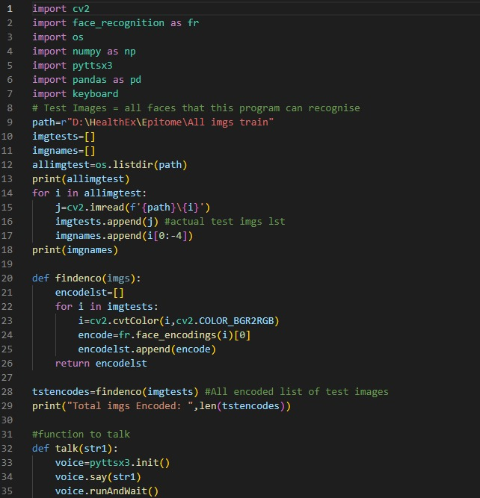
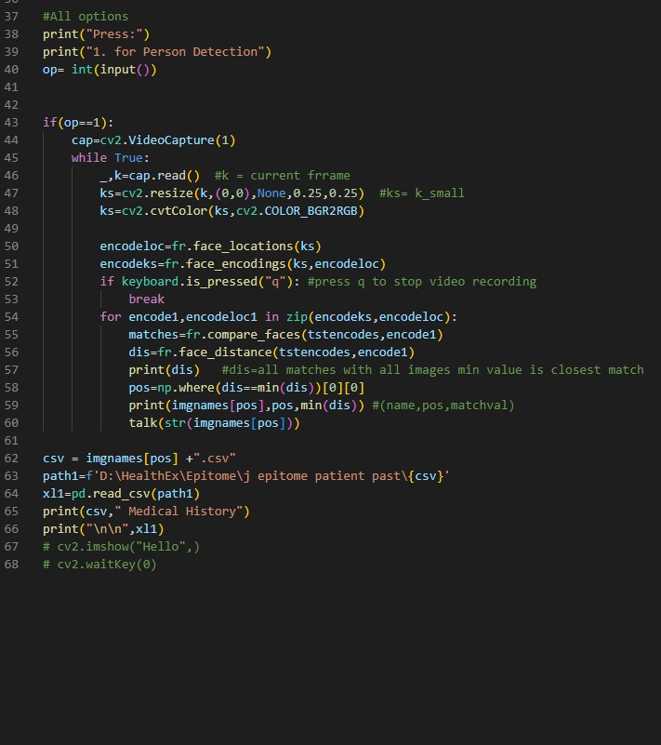
Code For Scanning And Recognition (Python)
Face scanning
Recognition And Response
portfolio

Slide 7
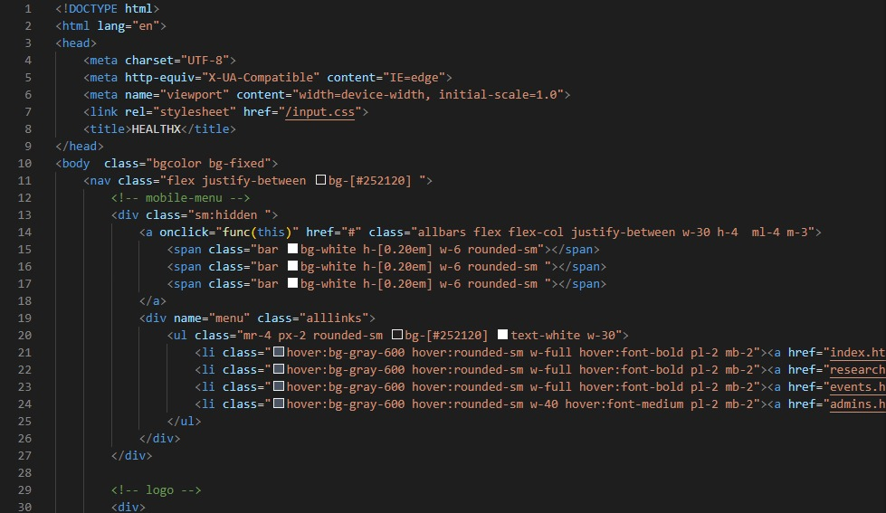
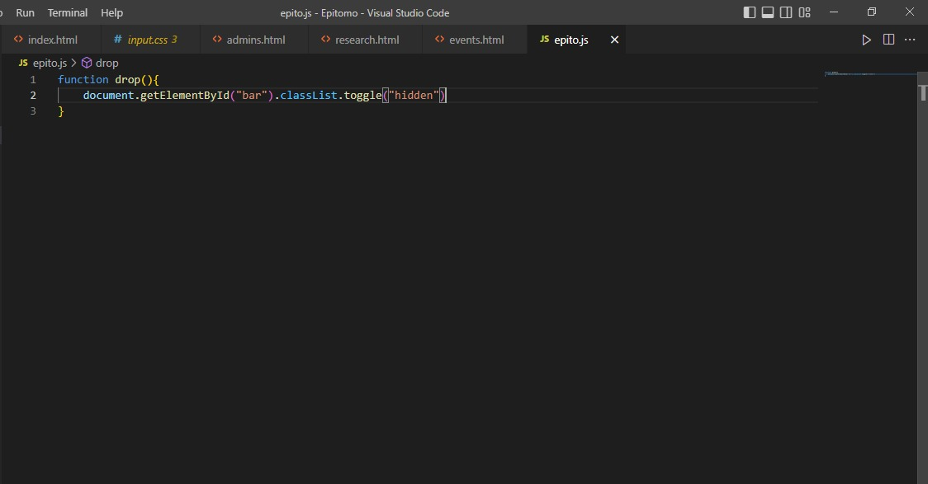
Code Of the website (HTML,CSS,JAVA SCRIPT)
portfolio

Slide 8




Our Team
E.KRANTHI RAJ
L.KRISHNA TEJA
H.RAMA ADITYA
R. VARUN
This software was created by us Griet college students to make it simple to store, access, and update health history. We can relate to the blind community's struggles and the recent pandemic's happenings. and created this read-only touch-free identification programme.

Slide 9

Website
www.healthx.com
Ph number
+91 87547587538
Contact
healthx@gmail.com
mail
address
GRIET, Bachupally,
HYD,
500019

