Slide 1
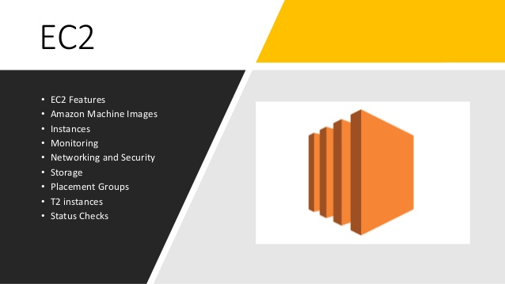

Slide 2
Elastic Compute Cloud
Amazon EC2 provides scalable computing capacity in the AWS cloud.
You can use Amazon EC2 to launch as many or as few virtual servers as you need , Configure security and networking and manage storage.
Amazon EC2 enables you to scale up or scale down the instance.
Amazon EC2 is having two storage options i.e EBS & instance store.
( Root Volume)
Preconfigured templates are available known as Amazon Machine Image.
By Default , when you create an EC2 instance with amazon , your account is limited to a maximum of 20 instances per EC2 region.

Slide 3
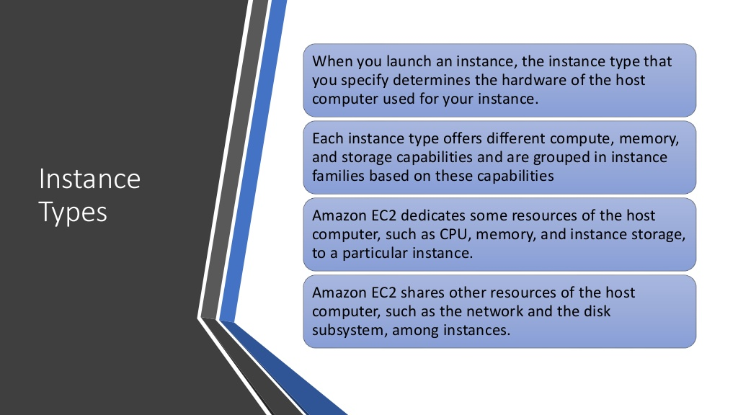

Slide 4
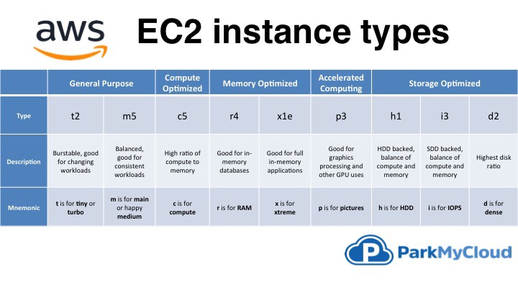

Slide 5
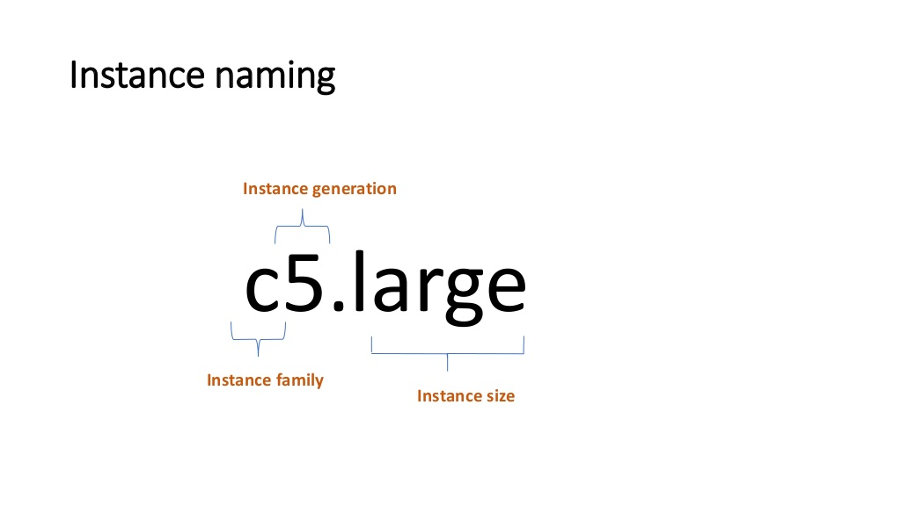
Instance Naming Convention

Slide 6
EC2 Instances Types
Instances have 5 distinct characteristics advertised on the website:
R: The RAM (type, amount, generation) – amount of RAM in memory caches
C: The CPU (type, make, frequency, generation, number of cores)-compute/databases
I: The I/O (disk performance, EBS optimisations)- databases
G: The Graphical Processing Unit (GPU) – video rendering/machine learning
M: application that are balanced (think “medium)-general/web app
T2/T3:burstable instances (up to capacity)
T2/T3-unlimited:unilimited burst

Slide 7
INTRODUCTION TO SECURITY GROUPS
Security Groups are the fundamental of network security in AWS
They control how traffic is allowed into or out of our EC2 Machines.
INBOUND TRAFFIC
WWW
It is the most fundamental skill to learn to troubleshoot networking issues.
SECURITY GROUP
EC2 Machine
OUTBOUND TRAFFIC

Slide 8
Private VS Public IP (IPv4) Fundametal Differences
Public IP:
Public IP means the machine can be identified on the internet(WWW)
Must be unique across the whole web (not two machines can have the same public IP)
Can be geo-located easily.
Private IP:
Private IP means the machine can only be identified on a private network only
The IP must be unique across the private network
BUT two different private networks (two companies) can have the same IPs
Machines connect to WWW using a internet gateway (a proxy)
Only a specified range of IPs Rcan be used as private IP

Slide 9
ELASTIC IPs
When you stop and then start an EC2 instance, it can change its public IP.
If you need to have a fixed public IP for your instance ,you need an Elastic IP.
An Elastic IP is a public IPv4 IP you own as long as you don’t delete it
You can attach it to one instance at a time.

Slide 10
AWS EC2 Launch Types
An Amazon EC2 launch type determines the type of infrastructure on which your tasks and services are hosted.
Amazon EC2 provides purchasing options to enable you to optimize your costs based on your needs.
On-demand.
reserved.
scheduled reserved.
spot instances.
dedicated instances.
dedicated hosts.

Slide 11
On-Demand Instances
Pay, by the second, for the instances that you launch.
No longer-term commitments or upfront payments are needed.
You have full control over its lifecycle, you decide when to launch, start, stop, reboot, or terminate it.
You pay only when your On-Demand Instances are in the running state.
Can increase or decrease your compute capacity.

Slide 12
Reserved Instances
Up to 75% savings compared to On-Demand Instance pricing.
You can purchase a Reserved Instance for a one-year or three-year commitment, with the three-year commitment offering a bigger discount.
Commitment includes instance type and Region.
Reserved Instances do not renew automatically; when they expire, you can continue using the EC2 instance without interruption, but you are charged On-Demand rates.
After you purchase a Reserved Instance, you cannot cancel your purchase. However, you may be able to modify, exchange, or sell your Reserved Instance if your needs change.

Slide 13
Spot Instances
The most cost-efficient instance in AWS. Up to 90% savings compared to On-Demand Instance pricing.
Request unused EC2 instances, which can reduce your Amazon EC2 costs significantly.
Instances that can "lose" at any point of time if your max price is less than the current spot price.
Well-suited for batch jobs, background processing, and optional tasks. Not good for critical jobs.

Slide 14
Dedicated Hosts
Dedicated Hosts
Pay for a physical host.
Physical server with EC2 instance capacity fully dedicated to your use.
Full control of the Instance placement.
Visibility into the underlying socket, the core of the hardware.
You must purchase a Dedicated Hosts Instance minimum for one year.

Slide 15
Dedicated Instances
Pay, by the hour, for instances that run on hardware that's dedicated to a single customer.
May share hardware with other instances from the same AWS account.

Slide 16
Which host is right for me?
On demand: coming and staying in resort whenever we like, we pay the full price
Reserved: like planning ahead and if we plan to stay for a long time, we may get a good discount.
Spot instances: the hotel allows people to bid for the empty rooms and the highest bidder keeps the rooms. You can get kicked out at any time
Dedicated Hosts: We book an entire building of the resort

Slide 17
EC2 User data
• It is possible to bootstrap our instances using an EC2 User data script.
• bootstrapping means launching commands when a machine starts
• That script is only run once at the instance first start
• EC2 user data is used to automate boot tasks such as:
Installing updates
Installing software
Downloading common files from the internet
Anything you can think of
• The EC2 User Data Script runs with the root user

Slide 18
EC2 User Data Hands-On
We want to make sure that this EC2 instance has an Apache HTTP server installed on it – to display a simple web page
For it, we are going to write a user-data script.
#!/bin/bash
yum update -y
yum install -y httpd.x86_64
systemctl start httpd.service
systemctl enable httpd.service
echo "Hello World" >/var/www/html/index.html
This script will be executed at the first boot of the instance.

Slide 19
Placement groups
When you launch a new EC2 instance, the EC2 service attempts to place the instance in such a way that all of your instances are spread out across underlying hardware to minimize correlated failures.
When you launch a new EC2 instance, the EC2 service attempts to place the instance in such a way that all of your instances are spread out across underlying hardware to minimize correlated failures.
You can use placement groups to influence the placement of a group of interdependent instances to meet the needs of your workload.

Slide 20
Placement group strategies:
Cluster – packs instances close together inside an Availability Zone. This strategy enables workloads to achieve the low-latency network performance
Partition – spreads your instances across logical partitions such that groups of instances in one partition do not share the underlying hardware with groups of instances in different partitions. This strategy is typically used by large distributed and replicated workloads, such as Hadoop, Cassandra, and Kafka.
Spread – strictly places a small group of instances across distinct underlying hardware to reduce correlated failures.

Slide 21
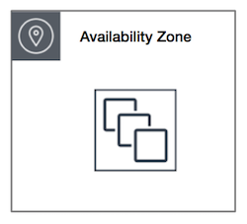
Cluster placement groups
A cluster placement group is a logical grouping of instances within a single Availability Zone.
Instances in the same cluster placement group enjoy a higher per-flow throughput limit for TCP/IP traffic and are placed in the same high-bisection bandwidth segment of the network.
Cluster placement groups are recommended for applications that benefit from low network latency, high network throughput, or both

Slide 22
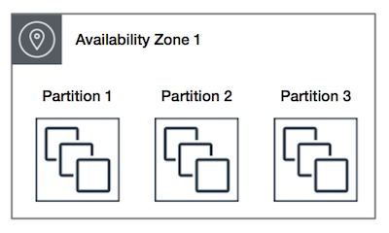
Partition Placement Groups
. When using partition placement groups, Amazon EC2 divides each group into logical segments called partitions.
Amazon EC2 ensures that each partition within a placement group has its own set of racks. Each rack has its own network and power source.
No two partitions within a placement group share the same racks, allowing you to isolate the impact of hardware failure within your application.
Partition placement groups help reduce the likelihood of correlated hardware failures for your application

Slide 23
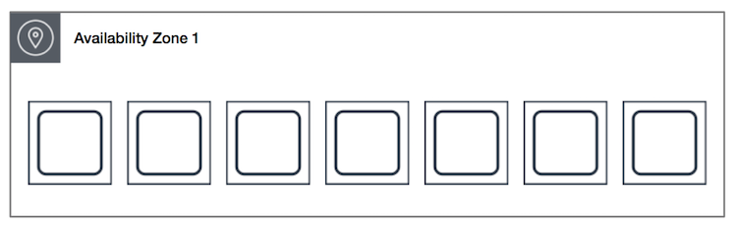
Spread placement groups
A spread placement group is a group of instances that are each placed on distinct racks, with each rack having its own network and power source.
Spread placement groups are recommended for applications that have a small number of critical instances that should be kept separate from each other.
Launching instances in a spread placement group reduces the risk of simultaneous failures that might occur when instances share the same racks.
Spread placement groups provide access to distinct racks, and are therefore suitable for mixing instance types or launching instances over time.
A spread placement group can span multiple Availability Zones in the same Region. You can have a maximum of seven running instances per Availability Zone per group.

Slide 24
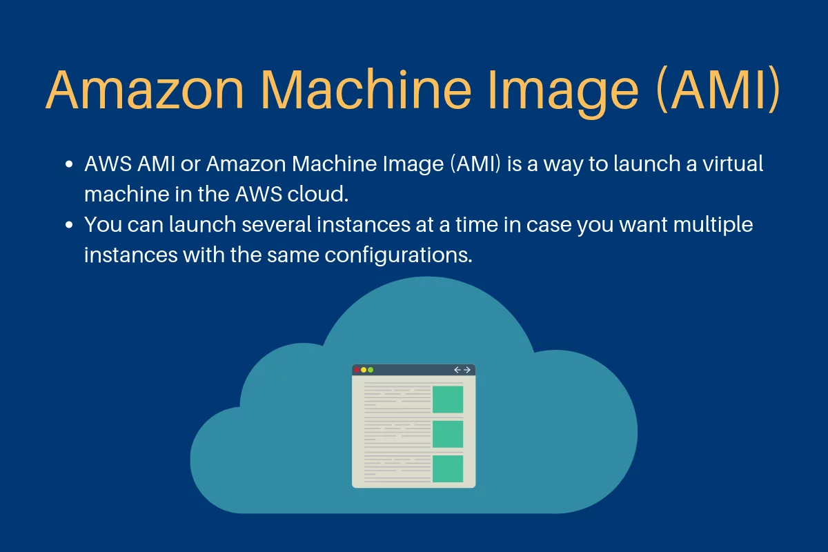
AMI

