Slide 1
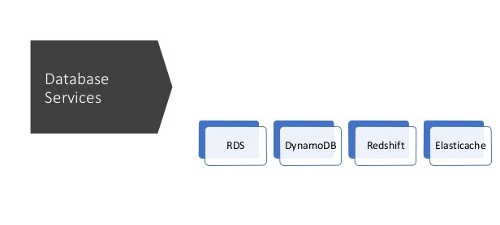

Slide 2
DATA/DATABASE/DBMS
DATA
Data is any sort of information which is stored in computer memory. This information can later be used for a website, an application or any other client to store for future purpose. The most common information is User information in the form of user personal, address and banking information.
Database
A database is a collection of information that is organized so that it can be easily accessed, managed and updated. Computer databases typically contain aggregations of data records or files, containing information about sales transactions or interactions with specific customers.

Slide 3
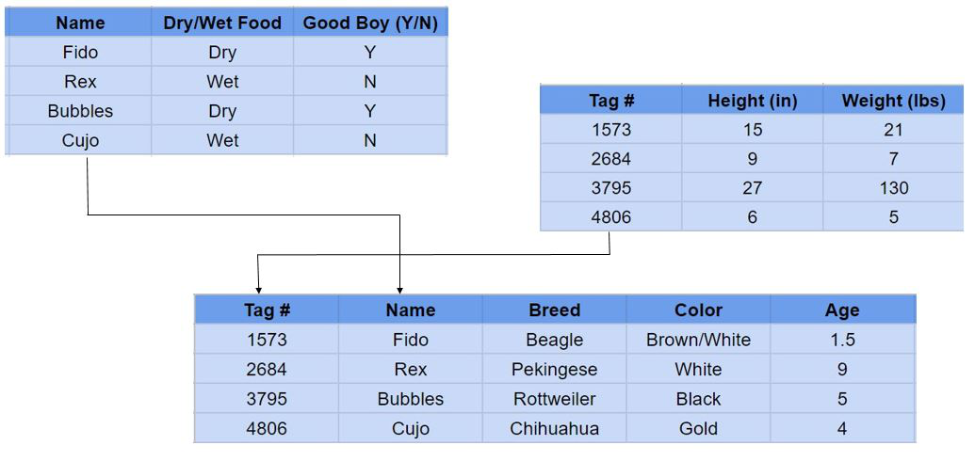
Relational vs. Non-Relational Database
A relational database is one that stores data in tables. The relationship between each data point is clear and searching through those relationships is relatively easy. The relationship between tables and field types is called a schema.
Relational databases are also called SQL databases. SQL stands for Structured Query Language and it’s the language relational databases are written in. SQL is used to execute queries, retrieve data, and edit data by updating, deleting, or creating new records.

Slide 4
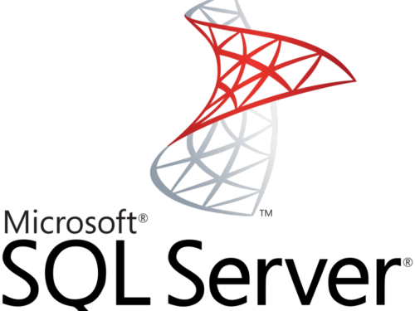
Popular Relational/SQL Databases
SQL Server is a relational database management system developed Microsoft. They offer multiple editions with varying features to target different users.
Pros: SQL Server boasts a rich user interface and can handle large quantities of data.
Cons: It can be expensive – with the Enterprise level costing thousands of dollars.

Slide 5
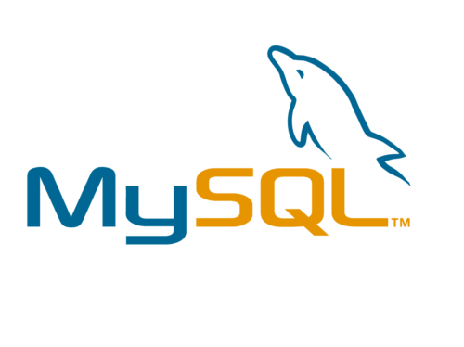
CREATE TABLE Persons ( PersonID int, LastName varchar(255), FirstName varchar(255), Address varchar(255), City varchar(255) );
INSERT INTO Persons(FirstName)
VALUES ('Rushika');
First released in 1995, MySQL is a free and open-source software, and one of the most popular databases in the world. It is used by many high-traffic websites like Facebook and YouTube.
Pros: It’s free and open-source. There’s also a lot of documentation and online support.
Cons: It doesn’t scale very well. MySQL tends to stop working when it’s given too many operations at a given time.

Slide 6
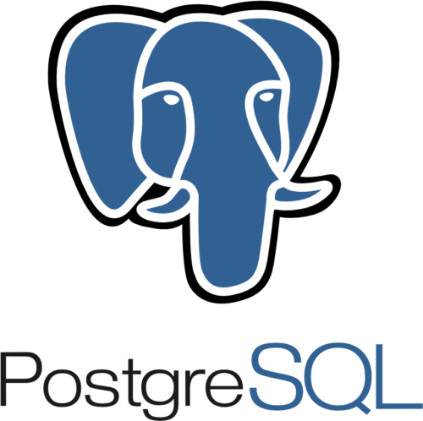
Where MySQL is based on the relational model, PostgreSQL is based on the object-relational model. Another free and open-source database, PostgreSQL was released in 1996 with an emphasis on extensibility. It’s able to handle complicated data workloads due to its diversified extension functions.
Pros: Like we said, extensible. If you need additional features in PostgreSQL, you can add it yourself – a difficult task in most databases.
Cons: For beginners, installation and configuration can be difficult. There’s also not nearly as much documentation as more popular databases like MySQL.

Slide 7
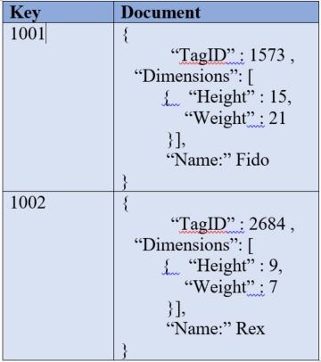
Non-Relational Databases
A non-relational database is any database that does not use the tabular schema of rows and columns like in relational databases. Rather, its storage model is optimized for the type of data it’s storing
Back to your “data dog.” This time, it went over to the Word doc. Why? All the open space! The data comes in all different shapes and sizes – it needs room to spread out.
Non-relational databases are becoming more popular as more and more businesses begin to leverage big data for analysis and reporting. Since critical data doesn’t always fit well into a pre-defined schema, NoSQL databases allow more flexibility.

Slide 8

Popular Non-Relational/NoSQL Databases
MongoDB is a document store and currently the most popular NoSQL database engine in use. It uses JSON-like documents to store data and is run over multiple servers. MongoDB allows for auto-sharding which is a type of database partitioning that separates very large databases into smaller, faster, more easily managed parts called data shards.
Pros: MongoDB is very easy to setup and provides a lot of professional support.
Cons: They don’t allow joins. Joins are used to combine data or rows from two or more tables based on a common field between them. MongoDB does have a LOOKUP function but tells its users not to rely on them.

Slide 9
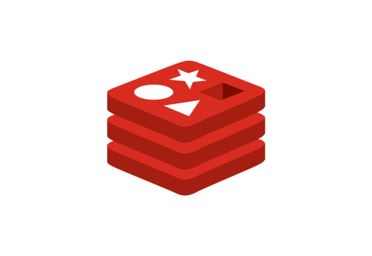
Redis
Redis – Remote Dictionary Server – is a key-value store. It supports different kinds of abstract data structures such as strings, lists, maps, sets, sorted sets, and more. It’s also open-source.
Pros: It supports a large variety of data types and is easy to install.
Cons: Like MongoDB, it doesn’t support joins. It also requires knowledge of Lua, a high-level programming language.

Slide 10
Relational vs Non-Relational Databases
To summarize the difference between the relational and non-relational databases: relational databases store data in rows and columns like a spreadsheet while non-relational databases store data don’t, using a storage model (one of four) that is best suited for the type of data it’s storing.
Pros of a Relational Database
Data is easily structured into categories.
Your data is consistent in input, meaning, and easy to navigate.
Relationships can be easily defined between data points.
Pros of a Non-Relational Database
Data is not confined to a structured group.
You can perform functions that allow for greater flexibility.
Your data and analysis can be more dynamic and allow for more variant inputs.

Slide 11
DBMS
A database management system is a software used to perform different operations, like addition, access, updating, and deletion of the data, like adding your name in the database for an online retail store as a customer.
A database management system acts as the backbone of a database and makes using a database a cakewalk as it makes access and management of data a lot easier.

Slide 12
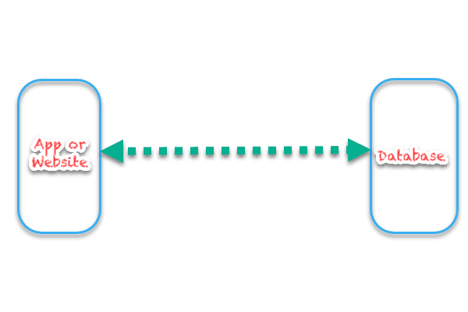
Database VS Database Management System
Here, we can see an App or a website with its own database. So, the most function is to connect the database to the App or Website. While database can provide the data to the website and have a meaningful way to access data, it still cannot understand the language or method which a website may use to fetch the data, i.e., it cannot understand the commands on its own. Thus, to tackle this problem, we bring in the concept of Database Management System. A DBMS understand the commands and the queries which define what data is required by the App or Website and thus use the meaningful method of accessing the database to retrieve the information. Therefore, it can be said that a DBMS act as connecting bridge between the database and the user and DBMS actually understand the queries and help database to understand the requirements.

Slide 13
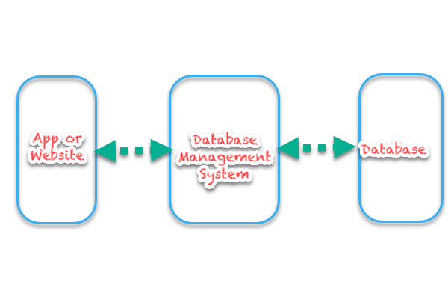
Database acting as a connector between both the App and the database. With this basic difference is clear that a database store the data and provide a method to access it, a DBMS actually converts the queries into a meaningful command to invoke the method used to access the database.

Slide 14
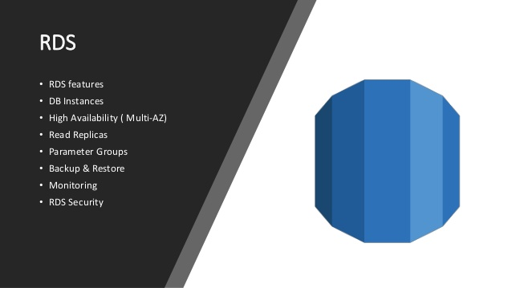

Slide 15
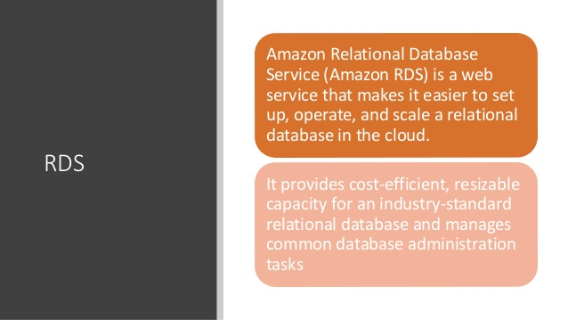

Slide 16
RDS
RDS stands for Relational Database Service
It’s a managed DB service for DB use SQL as a query language.
Amazon Relational Database Service (Amazon RDS) makes it easy to set up, operate, and scale a relational database in the cloud.
It provides cost-efficient and resizable capacity while automating time-consuming administration tasks such as hardware provisioning, database setup, patching and backups.
It frees you to focus on your applications so you can give them the fast performance, high availability, security and compatibility they need.
Amazon RDS is available on several database instance types - optimized for memory, performance or I/O

Slide 17






RDS provides you with six familiar database engines to choose from, including Amazon Aurora, PostgreSQL, MySQL, MariaDB, Orcle Database, and SQL Server

Slide 18
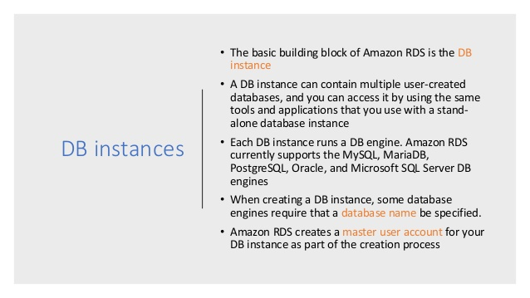

Slide 19
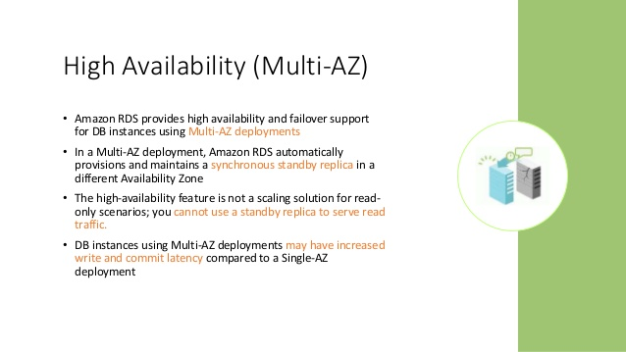

Slide 20
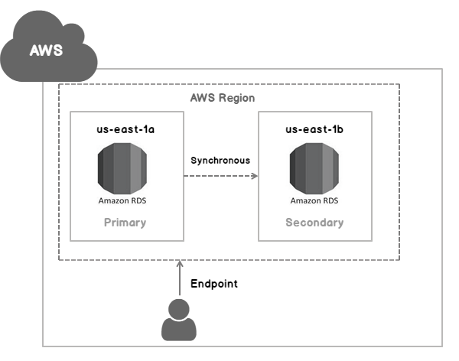
You can select Multi AZ option during RDS DB instance launch.
RDS Service creates a standby instance in a different AZ.
You can not read/write to the standby RDS DB instance.
You cannot select which AZ in the region will be chosen to
Create the DB instance.
You can however view which AZ is selected after the standby
Is created.

Slide 21
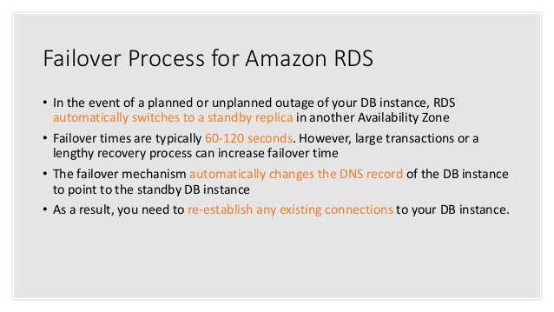

Slide 22
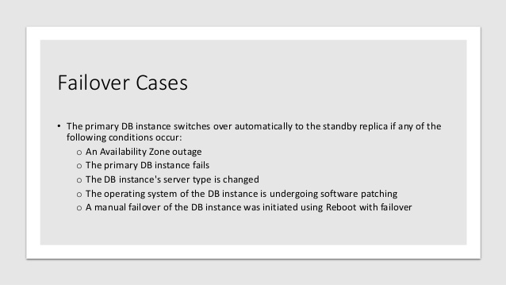

Slide 23
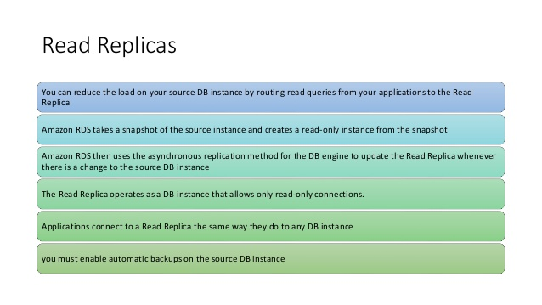

Slide 24
RDS Read Replicas – Use Cases
• You have a production database that is taking on normal load
• You want to run a reporting application to run some analytics
• You create a Read Replica to run the new workload there
• The production application is unaffected
• Read replicas are used for SELECT (=read) only kind of statements (not INSERT, UPDATE, DELETE).

Slide 25
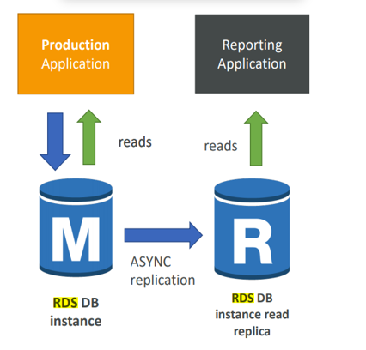

Slide 26
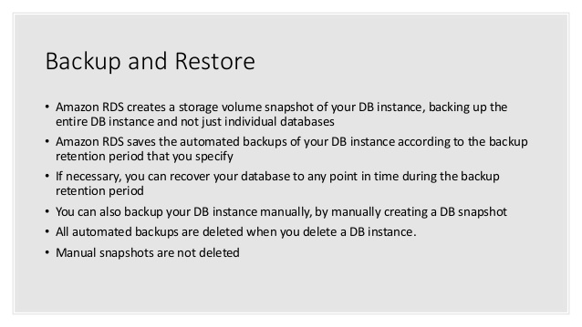

Slide 27
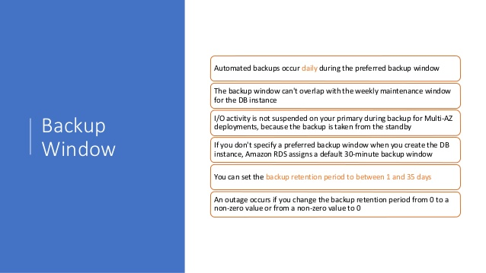

Slide 28
Advantage over using RDS versus deploying DB Engine on EC2
RDS is a managed service:
Automated provisioning, OS patching
Continuous backups and restore to specific timestamp (Point in Time Restore)!
Monitoring dashboards
Read replicas for improved read performance
Multi AZ setup for DR (Disaster Recovery)
Maintenance windows for upgrades
Scaling capability (vertical and horizontal

Slide 29
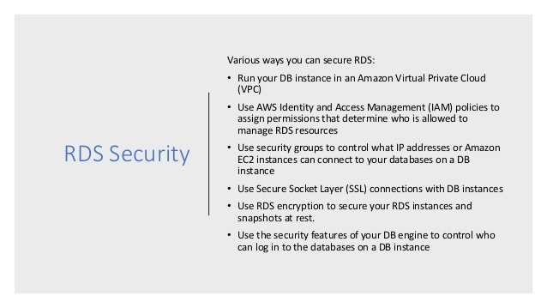

Slide 30
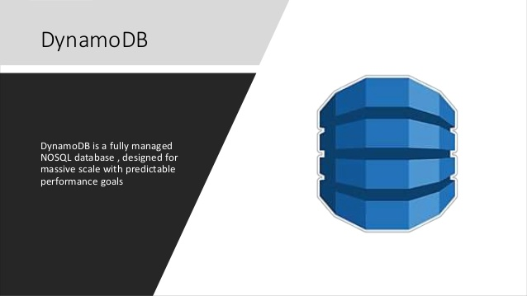

Slide 31
DynamoDB
Fully Managed, Highly available with replication across 3 AZ
NoSQL database - not a relational database
Scales to massive workloads, distributed database
Millions of requests per seconds, trillions of row, 100s of TB of storage
Fast and consistent in performance (low latency on retrieval)
Integrated with IAM for security, authorization and administration
Enables event driven programming with DynamoDB Streams
Low cost and auto scaling capabilities

Slide 32
DynamoDB
DynamoDB is made of tables
Each table has a primary key (must be decided at creation time) Each table can have an infinite number of items (= rows)
Each item has attributes (can be added over time – can be null)
Maximum size of a item is 400KB
Data types supported are:
Scalar Types: String, Number, Binary, Boolean, Null
Document Types: List, Map
Set Types: String Set, Number Set, Binary Set

Slide 33
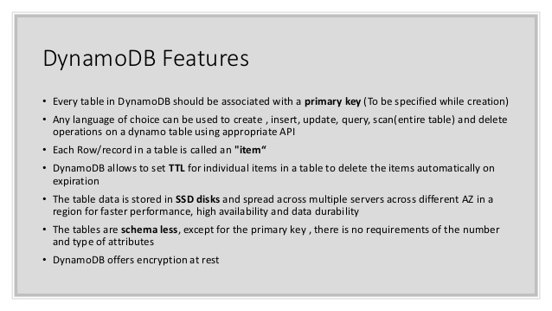

Slide 34
Dynamo DB
Table : is a collection of data items .
DynamoDB allows low latency read/write access to items ranging from 1 byte to 400 Kb.
DynamoDB can be used to store pointers to S3 store objects or items of sizes larger than 400 KB too if needed.
DyanamoDB stored indexed by a primary key.
You Specify the primary key when you create the table .
Each item in the table has a unique identifier or primary key that distinguishes the item from all of the other in the table .
The primary key is the only required attribute for items in a table.
DynamoDB tables are schemaless which means that neither the attributed nor their data type need to be defined beforehead.
Each item has its own distinct attributes.

Slide 35
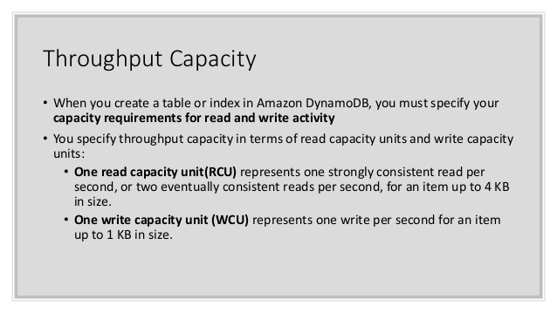

Slide 36
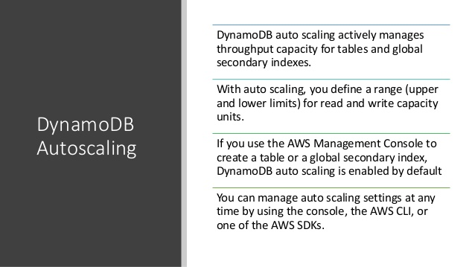

Slide 37
Amazon Aurora
Amazon Aurora is a MySQL and PostgreSQL-compatible relational database built for the cloud, that combines the performance and availability of traditional enterprise databases with the simplicity and cost-effectiveness of open source databases.
Aurora is a proprietary technology from AWS (not open sourced)
Postgres and MySQL are both supported as Aurora DB (that means your drivers will work as if Aurora was a Postgres or MySQL database)
Aurora is “AWS cloud optimized” and claims 5x performance improvement over MySQL on RDS, over 3x the performance of Postgres on RDS
Aurora storage automatically grows in increments of 10GB, up to 64 TB.
Aurora can have 15 replicas while MySQL has 5, and the replication process is faster

Slide 38
Features of Aurora
• Automatic fail-over
• Backup and Recovery
• Isolation and security
• Industry compliance
• Push-button scaling
• Automated Patching with Zero Downtime
• Advanced Monitoring
• Routine Maintenance
• Backtrack: restore data at any point of time without using backups

Slide 39
Aurora Security
• Similar to RDS because uses the same engines
• Encryption at rest using KMS
• Automated backups, snapshots and replicas are also encrypted
• Encryption in flight using SSL (same process as MySQL or Postgres)
• Possibility to authenticate using IAM token (same method as RDS)
• You are responsible for protecting the instance with security groups

Slide 40
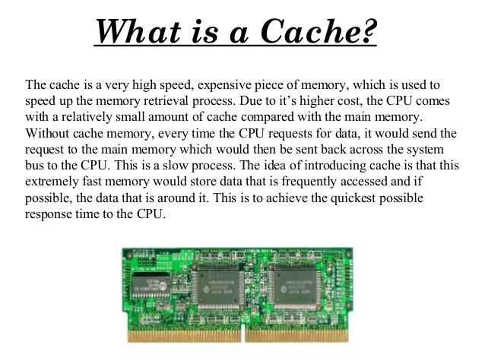
Amazon ElastiCache

Slide 41
Amazon ElastiCache
Amazon ElastiCache allows you to seamlessly set up, run, and scale popular open-source compatible in-memory data stores in the cloud.
Build data-intensive apps or boost the performance of your existing databases by retrieving data from high throughput and low latency in-memory data stores.
Amazon ElastiCache is a popular choice for real-time use cases like Caching, Session Stores, Gaming, Geospatial Services, Real-Time Analytics, and Queuing.

Slide 42
Amazon ElastiCache Overview •
The same way RDS is to get managed Relational Databases
ElastiCache is to get managed Redisor Memcached
Caches are in-memory databases with really high performance, low latency
Helps reduce load off of databases for read intensive workloads
Helps make your application stateless
AWS takes care of OS maintenance / patching, optimizations, setup, configuration, monitoring, failure recovery and backups
Using ElastiCache involves heavy application code changes

Slide 43
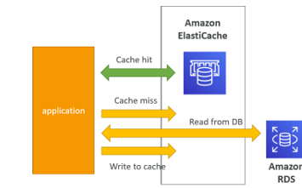
Amazon ElastiCache Working
• Applications queries ElastiCache, if not available, get from RDS and store in ElastiCache.
• Helps relieve load in RDS
• Cache must have an invalidation strategy to make sure only the most current data is used in there.

Slide 44
REDIS VS Memcached
REDIS
Multi AZwith Auto-Failover
Read Replicasto scale reads and have high availability
Data Durability using AOF persistence
Backup and restore features
Memcached
Multi-node for partitioning of data (sharding)
Non persistent
No backup and restore
Multi-threaded architecture

