Slide 1
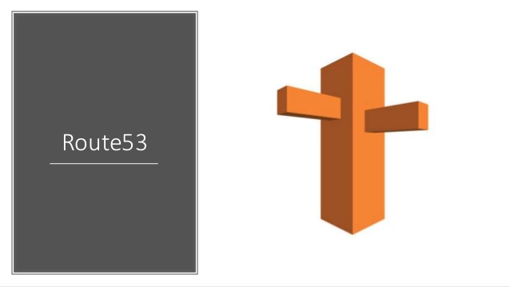

Slide 2
Amazon Route 53
Amazon Route 53 is a highly available and scalable cloud Domain Name System (DNS) web service.
It is designed to give developers and businesses an extremely reliable and cost effective way to route end users to Internet applications by translating names like www.example.com into the numeric IP addresses like 192.0.2.1 that computers use to connect to each other.
Amazon Route 53 effectively connects user requests to infrastructure running in AWS – such as Amazon EC2 instances, Elastic Load Balancing load balancers, or Amazon S3 buckets – and can also be used to route users to infrastructure outside of AWS

Slide 3
AWS Route 53 Overview
• Route53 is a Managed DNS (Domain Name System)
• DNS is a collection of rules and records which helps clients understand how to reach a server through URLs.
• In AWS, the most common records are:
A: hostname to IPv4
AAAA: hostname to IPv6
CNAME: hostname to hostname
Alias: hostname to AWS resource.

Slide 4
Route 53
You can use Amazon Route 53 to register new domains , transfer existing domains , route traffic for your domains to your AWS and external resources and finally to monitor the health of your resources.
Route53
1. DNS Management
2. Traffic Management
3.Availability Managmenent.
4. Domain Migration.

Slide 5
Route 53
1. Register a domain.
2. As a DNS , It routes internet traffic to the resources for your domain.
3. Check the health of your resources.
Route 53 send automated request over the internet to a resource (can be a webserver) to verify that the server is reachable , functional or available.

Slide 6
Also you can choose Route 53 to receive notifications when a resource becomes unavailable and choose to route internet traffic away for unhealthy instances.
You can choose Route 53 for any combination of these functions.
For eg 1. you can choose route 53 to register your domain name & to route internal traffic for the domain.
2. you can use Route53 to route internet traffic for a domain that your registered with to another domain register.

Slide 7
When you register a domain with Route 53 v, the service automatically makes itself the DNS Service for the domain by doing the following :
It creates a hosted zone that has the same name as your domain name.
It assigns a set of four name servers to the hosted zone , unique to the account.
When someone uses a browser to access your website , these name servers inform the browser where to find your Resources .
Such as web server or an Amazon S3 bucket.
It gets the name servers from the hosted zone and add them to your domain.

Slide 8
AWS Supports
1 . Generic Top level domains .
2 . Geographic top level domains.
Registering a domain with route 53
You can register a domain with Route53 if the TLD is included on the Supported TLD list.
If the TLD is not included you can’t register the domain with Route 53.

Slide 9
A hosted zone is a container for records, and records contain information about how you want to route traffic for a specific domain, such as example.com, and its subdomains (acme.example.com, zenith.example.com). A hosted zone and the corresponding domain have the same name. There are two types of hosted zones:
Public hosted zones contain records that specify how you want to route traffic on the internet. For more information, see Working with public hosted zones.
Private hosted zones contain records that specify how you want to route traffic in an Amazon VPC.
Record Set : Creating records by using the Amazon Route 53 console · Choose and define the applicable routing policy and values
Each Amazon Route 53 account is limited to a maximum of 500 hosted zones and 10,000 resource record sets per hosted zone.

Slide 10
In AWS, the most common records are:
• A: hostname to IPv4
• AAAA: hostname to IPv6
• CNAME: hostname to hostname
• Alias: hostname to AWS resource

Slide 11
CNAME vs Alias
CNAME:
Points a hostname to any other hostname. (app.mydomain.com=> blabla.anything.com)
ONLY FOR NON ROOT DOMAIN (aka. something.mydomain.com)
Alias:
Points a hostname to an AWS Resource (app.mydomain.com=> blabla.amazonaws.com)
Works for ROOT DOMAIN and NON ROOT DOMAIN (aka mydomain.com)
Free of charge
Native health check

Slide 12
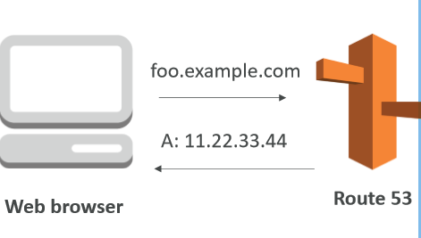
Simple Routing Policy
Maps a hostname to another hostname
Use when you need to redirect to a single resource
You can’t attach health checks to simple routing policy
If multiple values are returned, a random one is chosen by the client

Slide 13
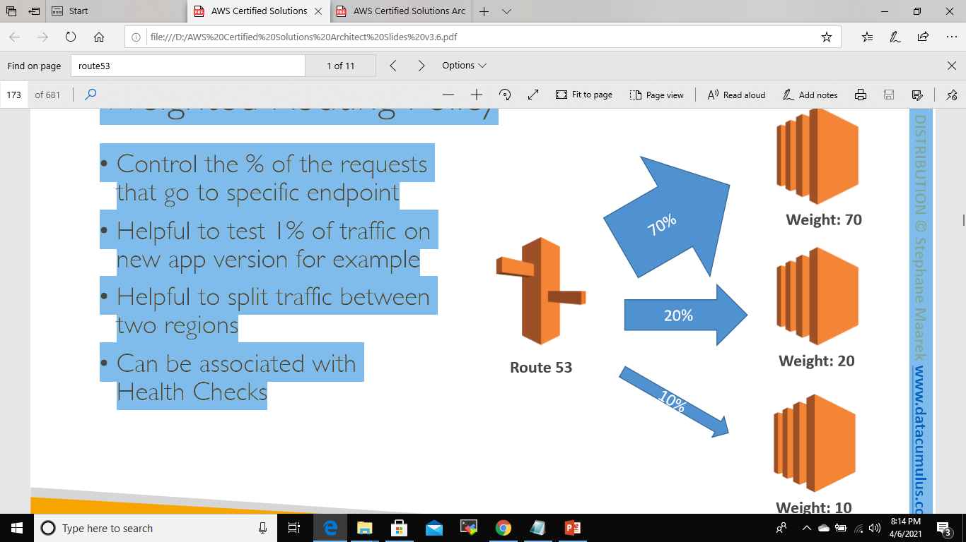
Weighted Routing Policy
• Control the % of the requests that go to specific endpoint
• Helpful to test 1% of traffic on new app version for example
• Helpful to split traffic between two regions • Can be associated with Health Checks

Slide 14
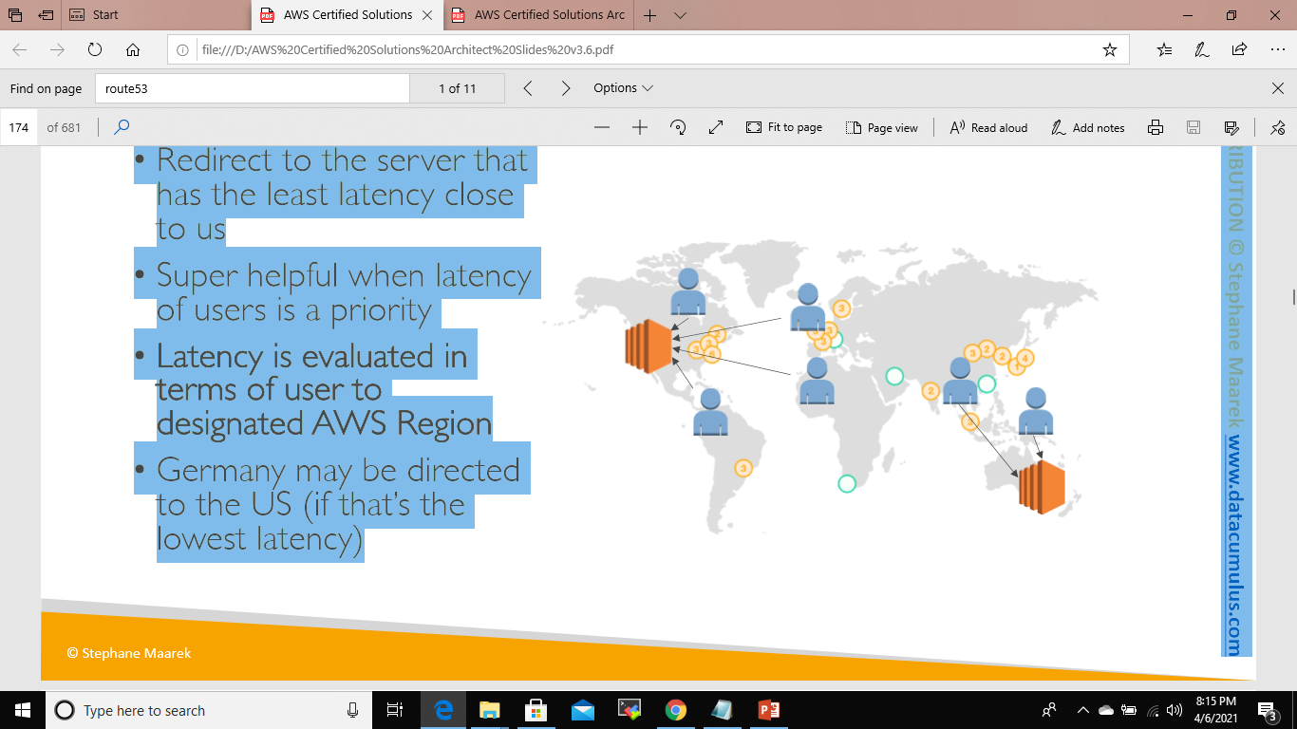
Latency Routing Policy
Latency Routing Policy
• Redirect to the server that has the least latency close to us
• Super helpful when latency of users is a priority
• Latency is evaluated in terms of user to designated AWS Region
• Germany may be directed to the US (if that’s the lowest latency)

Slide 15
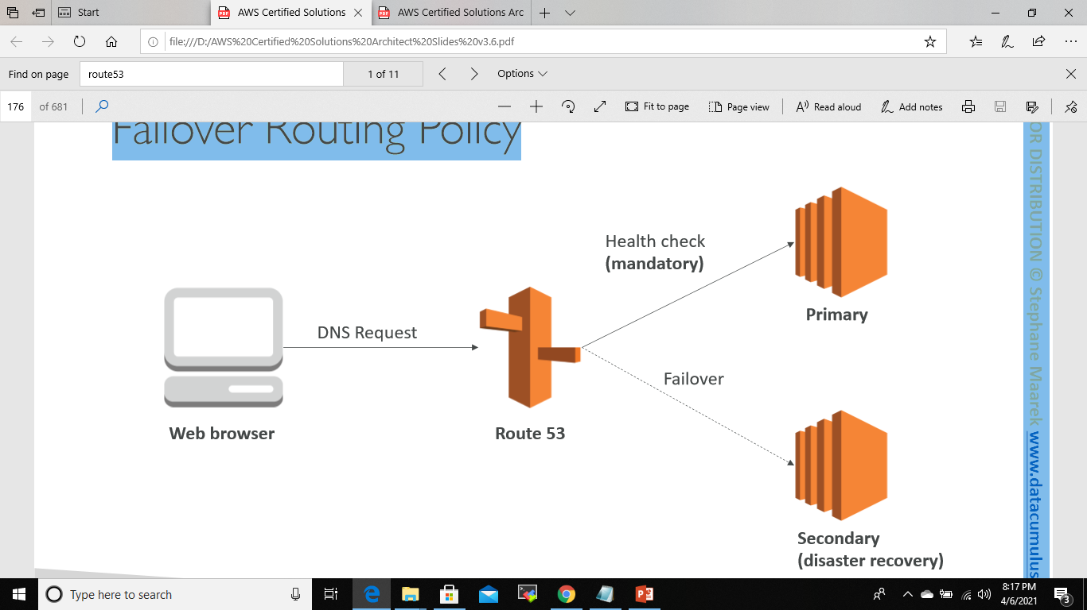
Failover Routing Policy
Failover routing lets you route traffic to a resource when the resource is healthy or to a different resource when the first resource is unhealthy.

Slide 16
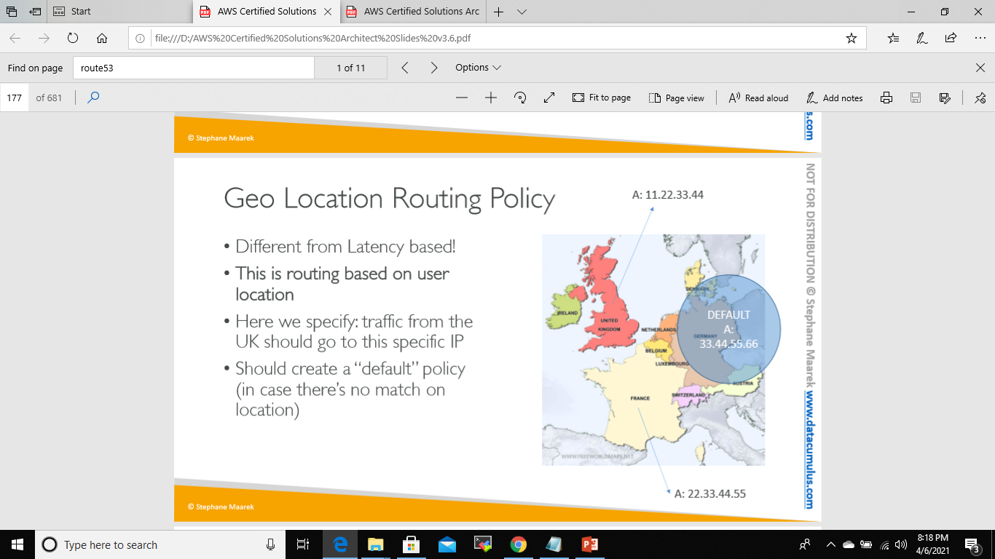
Geo Location Routing Policy
Geo Location Routing Policy
Different from Latency based!
This is routing based on user location
Here we specify: traffic from the UK should go to this specific IP
Should create a “default” policy (in case there’s no match on location)

Slide 17
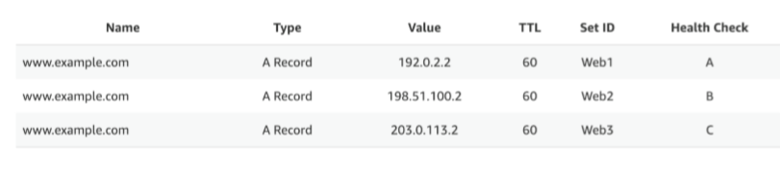
Multi Value Routing Policy
Multi Value Routing Policy
Use when routing traffic to multiple resources
Want to associate a Route 53 health checks with records
Up to 8 healthy records are returned for each Multi Value query
Multi Value is not a substitute for having an ELB

