Slide 1
CSE140L
Attend discussion hours
  Come to lab hours
    Check Q&A on the website
      Log In to the webboard
        Send me email jhliu@cs.ucsd.edu

Slide 2
CSE140L
About software
  ISE WebPack 7.1 and ModelSim XE III 6.0a in tutorials and examples
  If any question about older versions, come to my lab hour

Slide 3
CSE140L
What’s the exact function of each design in Lab2?
How to design the circuits?

Slide 4




CSE140L Lab2-I Shift Register
What’s that for?
1
0
1
1
1
1
0
1
0
1
0
1
1
0
0
1
0
1
0
0
0
1
0
0
0
0
0
1
8:00pm
8:01pm
8:02pm
8:03pm

Slide 5
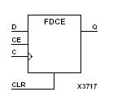
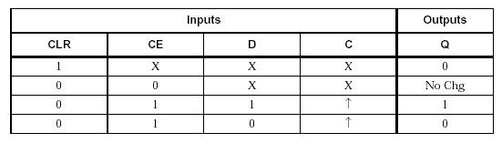
CSE140L Lab2-I Shift Register
CLK
8:00pm
8:01pm
8:02pm
8:03pm
Din
1
0
1
1
D0
0
1
0
1
1
We want
D1
0
0
1
0
1
D2
0
0
0
1
0
D3
0
0
0
0
1
We have

Slide 6
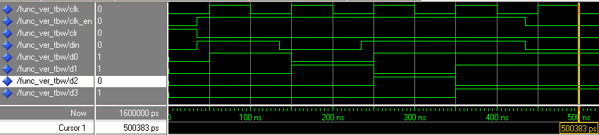
CSE140L Lab2-I Shift Register
Design
CLR
Din
D
Q
D
Q
D
Q
D
Q
CLK
CLK
CLK
CLK
CLK
D0
D1
D2
D3
Verification

Slide 7
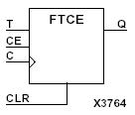
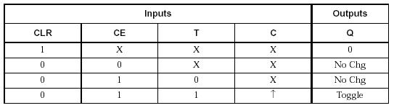
CSE140L Lab2-II Asyn Counter
1
2
3
4
5
6
7
8
9
10
11
12
13
14
15
16
CLK
D0
0
1
0
1
0
1
0
1
0
1
0
1
0
1
0
1
0
D1
0
0
1
1
0
0
1
1
0
0
1
1
0
0
1
1
0
D2
0
0
0
0
1
1
1
1
0
0
0
0
1
1
1
1
0
D3
0
0
0
0
0
0
0
0
1
1
1
1
1
1
1
1
0
We want
We have

Slide 8
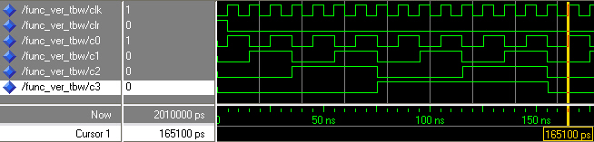
CSE140L Lab2-II Asyn Counter
Design
CLR
‘1’
(VCC)
T
T
Q
Q
CLK
CLK
CLK
D0
D1
Verification

Slide 9
CSE140L Lab2-III Syn Counter
1
2
3
4
5
6
7
8
9
10
11
12
13
14
15
16
CLK
D0
0
1
0
1
0
1
0
1
0
1
0
1
0
1
0
1
0
D1
0
0
1
1
0
0
1
1
0
0
1
1
0
0
1
1
0
D2
0
0
0
0
1
1
1
1
0
0
0
0
1
1
1
1
0
D3
0
0
0
0
0
0
0
0
1
1
1
1
1
1
1
1
0
We want
We have
Combinational Logic

Slide 10
CSE140L Lab2-III Syn Counter
D0_{i} = D0’_{i-1}
D1_{i} = D0_{i-1}⋅D1’_{i-1}+ D0’_{i-1}⋅D1_{i-1} = D0_{i-1}⊕D1_{i-1}
D2_{i} = ?
D3_{i} = ?
D
Q
D
Q
CLK
CLK
CLK
D0
D1
D1

Slide 11
CSE140L Lab2-IV Gray Counter
1
2
3
4
5
6
7
8
9
10
11
12
13
14
15
16
CLK
D0
0
1
1
0
0
1
1
0
0
1
1
0
0
1
1
0
0
D1
0
0
1
1
1
1
0
0
0
0
1
1
1
1
0
0
0
D2
0
0
0
0
1
1
1
1
1
1
1
1
0
0
0
0
0
D3
0
0
0
0
0
0
0
0
1
1
1
1
1
1
1
1
0
We want
We have
Combinational Logic

Slide 12
CSE140L Lab2-IV Gray Counter
T0 | 00 | 01 | 11 | 10
00 | 1 |  | 1
01 |  | 1 |  | 1
11 | 1 |  | 1
10 |  | 1 |  | 1
D0D1
T2 | 00 | 01 | 11 | 10
00 |  | 1
01
11 |  | 1
10
D0D1
D2D3
D2D3
T0=(D0⊕D1⊕D2⊕D3)’
T2=D0’⋅D1⋅(D2⊕D3)’
T1=?
T3=?

Slide 13
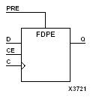
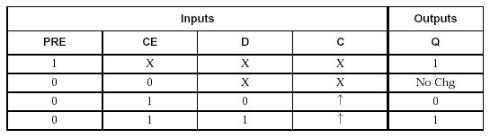
CSE140L Lab2-V Random Sequencer
We want
1
2
3
4
5
6
7
8
9
10
11
12
13
14
15
16
CLK
D0
1
0
0
0
1
0
0
1
1
0
1
0
1
1
1
1
0
D1
1
1
0
0
0
1
0
0
1
1
0
1
0
1
1
1
1
D2
1
1
1
0
0
0
1
0
0
1
1
0
1
0
1
1
1
D3
1
1
1
1
0
0
0
1
0
0
1
1
0
1
0
1
1
15
14
12
8
1
2
4
9
3
6
13
10
5
11
7
15
14
We have

Slide 14
CSE140L Lab2-V Random Sequencer
Hint
PRE
?
D
Q
D
Q
D
Q
D
Q
CLK
CLK
CLK
CLK
CLK
D0
D1
D2
D3

