Slide 1
CSE140L – Lab4
Overall picture of Lab4
Tutorial on Bus & Memory
Tutorial on Truth table

Slide 2
CSE140L – Lab4
A simple computer system with a minimal instruction set.
  Load/store data
  Addition
  Shift
  Compare
  Mask

Slide 3





CSE140L – Lab4
System architecture
CLK
Pencil & Paper
Register
Profile
RST
Marker
Program
Counter
Calculator
Datapath
Memory
(instructions)
Control
Logic
Task List
You

Slide 4
CSE140L – Lab4
Function of each module
  Program counter: mark the current instruction
  Memory: hold instructions
  Datapath: compute results
  Registers: hold data
  Control logic: compile instructions to actions.

Slide 5
CSE140L – Lab4
Overall picture of Lab4
  A system design including register profile, datapath, memory, program counter and control logic.
  http://www.cse.ucsd.edu/classes/sp05/_x000b_cse140L/lab/lab4/lab4.htm

Slide 6
CSE140L – Lab4
Tutorial on Bus & Memory
  Build a 16x4bit memory block
  Memory Elements:
  (http://www.cse.ucsd.edu/classes/sp05/cse140L/lab/lab2/lib.pdf)
    RAM (Writable)
    ROM (Read-only) ✓
    ROM16x1

Slide 7
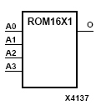
CSE140L – Lab4
ROM16x1
INIT
The data output (O) reflects the bit selected by the 4-bit address
(A3 – A0).
The ROM is initialized to a known value during configuration with the INIT=value parameter.
0
1
1
0
1
0
1
1
0
0
0
0
1
1
1
1
O
A0A1A2A3

Slide 8
CSE140L – Lab4
16x4 memory block
addr(3:0)
data(3:0)

Slide 9
CSE140L – Lab4
16x4 memory block initialize
addr | 1111 | 1110 | 1101 | 1100 | 1011 | 1010 | 1001 | 1000 | 0111 | 0110 | 0101 | 0100 | 0011 | 0010 | 0001 | 0000 | INIT
data0 | 0 | 1 | 1 | 0 | 0 | 0 | 0 | 1 | 0 | 1 | 0 | 1 | 1 | 1 | 1 | 1 | 615F
data1 | 1 | 1 | 1 | 0 | 0 | 1 | 0 | 0 | 1 | 1 | 1 | 1 | 1 | 1 | 1 | 1 | E4FF
data2 | 0 | 0 | 1 | 1 | 1 | 1 | 0 | 1 | 1 | 1 | 0 | 0 | 0 | 0 | 0 | 0 | 3DC0
data3 | 0 | 1 | 1 | 1 | 1 | 0 | 1 | 1 | 0 | 1 | 0 | 1 | 0 | 0 | 0 | 0 | 7B50

Slide 10
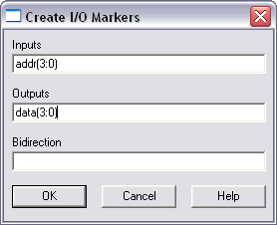
CSE140L – Lab4
Tutorial
  Create a project memblk
  Add a schematic diagram memblk to the project
  Create I/O markers
  Menu → Tools → Create I/O Markers

Slide 11

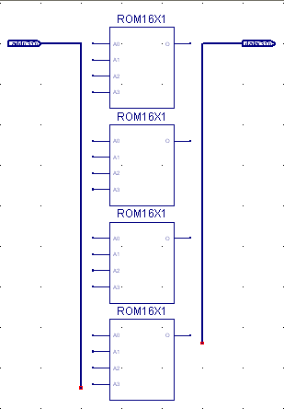
CSE140L – Lab4
  You will see two I/O buses on the canvas
  Place 4 ROM16x1 modules
  Extend two I/O buses before
  and after the ROM modules
  by using “add wire” button
  (You will see thicker wires)

Slide 12
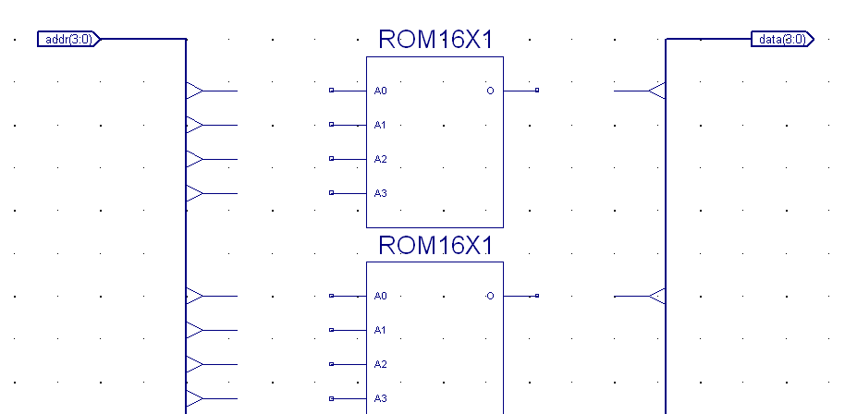
CSE140L – Lab4
  Add bus taps by using “Add Bus Tap” button.
  You can change the direction of by selecting the orientation in the options window.

Slide 13
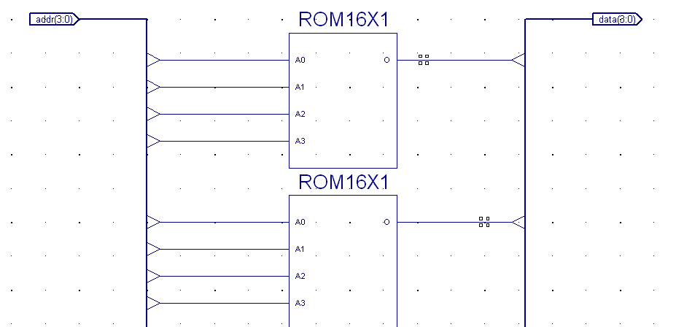
CSE140L – Lab4
  Connect the taps to module pins by wire

Slide 14
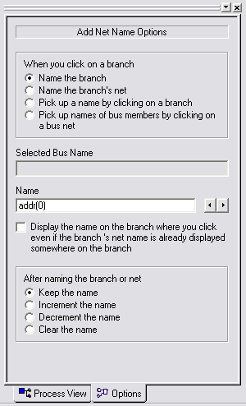
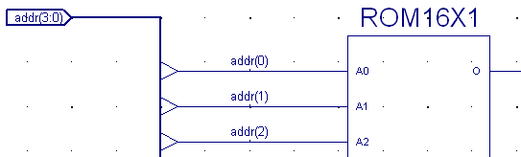
CSE140L – Lab4
  Click on “Add Net Name”
  Then type the net name in the options window.
  Now you will see the name appear after the cursor.
  Click on the wire you want to name.

Slide 15
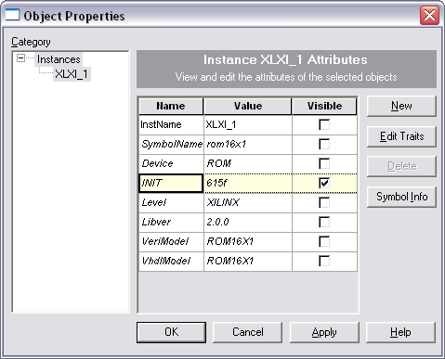
CSE140L – Lab4
  Name all the nets
  Double click on a ROM module, the property window will pop up. Change the INIT value and make it visible.

Slide 16
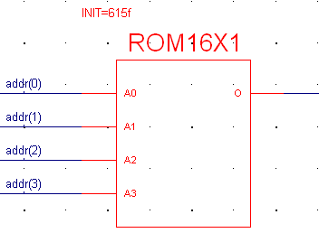
CSE140L – Lab4
  Click OK. You will see the initial value appears.
  Change the initial values for other ROM modules and save the diagram.

Slide 17
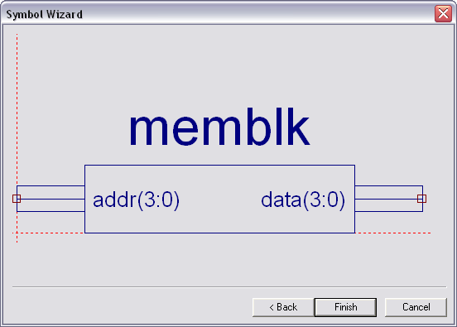
CSE140L – Lab4
  Create a symbol for the memory block.

Slide 18
CSE140L – Lab4
Tutorial on VHDL Truth Table
A2 | A1 | A0 | D1 | D0
0 | 0 | 0 | 0 | 1
0 | 0 | 1 | 1 | 1
0 | 1 | 0 | 1 | 0
0 | 1 | 1 | 1 | 0
1 | 0 | 0 | 1 | 0
1 | 0 | 1 | 0 | 1
1 | 1 | 0 | 1 | 1
1 | 1 | 1 | 0 | 0

Slide 19
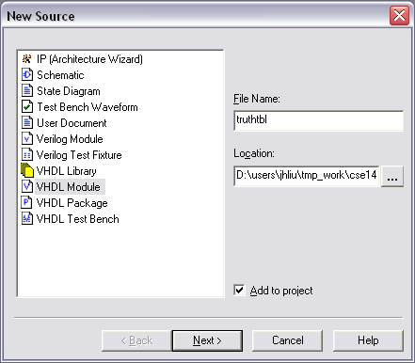
CSE140L – Lab4
Tutorial
  Create a project truthtbl
  Add a VHDL Module truthtbl to the project

Slide 20
CSE140L – Lab4
  You will see a template
library IEEE;
use IEEE.STD_LOGIC_1164.ALL;
use IEEE.STD_LOGIC_ARITH.ALL;
use IEEE.STD_LOGIC_UNSIGNED.ALL;
---- Uncomment the following library declaration if instantiating
---- any Xilinx primitives in this code.
--library UNISIM;
--use UNISIM.VComponents.all;
entity truthtbl is
end truthtbl;
architecture Behavioral of truthtbl is
begin
end Behavioral;

Slide 21
CSE140L – Lab4
  Add the following port declaration into the entity declaration.
  Add the following code to the architecture part.
entity truthtbl is
PORT (A :IN STD_LOGIC_VECTOR(2 DOWNTO 0);
D : OUT STD_LOGIC_VECTOR(1 DOWNTO 0) );
end truthtbl;
architecture Behavioral of truthtbl is
begin
process (A)
begin
if (A(2 downto 0)="000") then
D(1 downto 0) <= "01";
end if;

Slide 22
CSE140L – Lab4
if (A(2 downto 0)="001") then
D(1 downto 0) <= "11";
end if;
if (A(2 downto 0)="010") then
D(1 downto 0) <= "10";
end if;
if (A(2 downto 0)="011") then
D(1 downto 0) <= "10";
end if;
if (A(2 downto 0)="100") then
D(1 downto 0) <= "10";
end if;
if (A(2 downto 0)="101") then
D(1 downto 0) <= "01";
end if;
if (A(2 downto 0)="110") then
D(1 downto 0) <= "11";
end if;

Slide 23
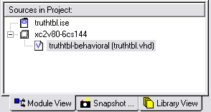
CSE140L – Lab4
if (A(2 downto 0)="111") then
D(1 downto 0) <= "00";
end if;
end process;
end Behavioral;
  Save the VHDL file.
  Click on the VHDL file in the Sources window

Slide 24
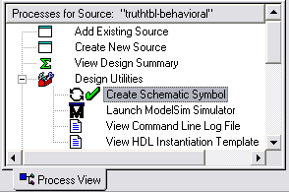
CSE140L – Lab4
  Under the Design Utilities category in Process View, double click on Create Schematic Symbol
  Now the truth table has been implemented and can be used in top level schematic diagram.

