Slide 1
MAC Layer Implementation
Alvin Jeng
Nitay Joffe

Slide 2
Goal of project
- Implement a Wireless 802.11b MAC Layer
- Utilize advantages of hardware and software together in order to achieve peak performance and greater flexibility
Main tradeoff with hardware
- Performance v. Area
Notes:
,kljl

Slide 3
Hardware
Design goal
- Reduce area and delay times
- Reduce cost of production
Advantages
- Performance
Disadvantages
- Development time
- Costly

Slide 4
Software
Design goal
- Use the least amount of resources while performing the task in minimal time
Advantages
- Cheap
- Easy to update
Disadvantage
- Slow

Slide 5
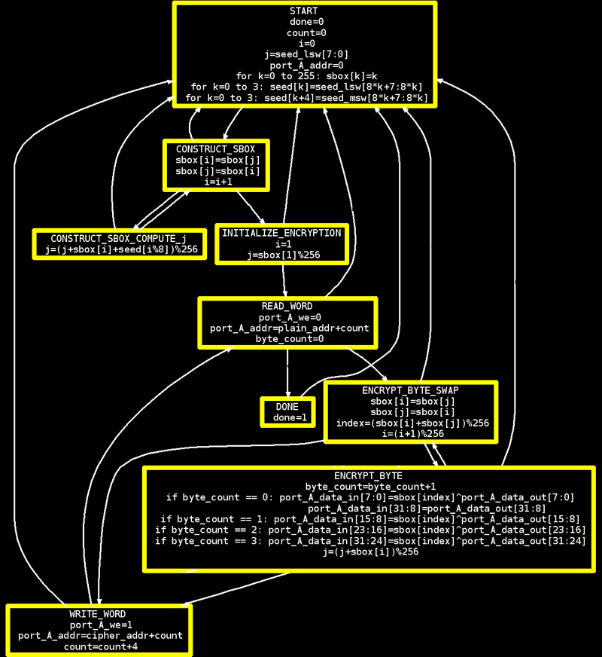
Cycles | 1293
Clock time | 22.4ns
Area | 50,688

Slide 6
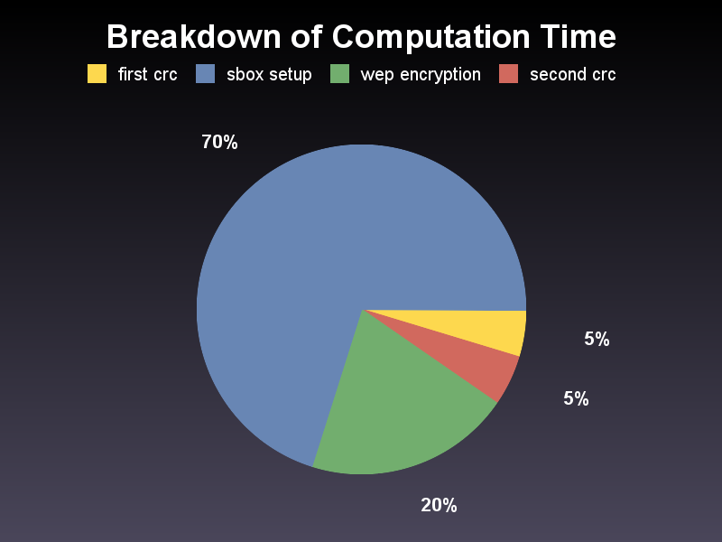
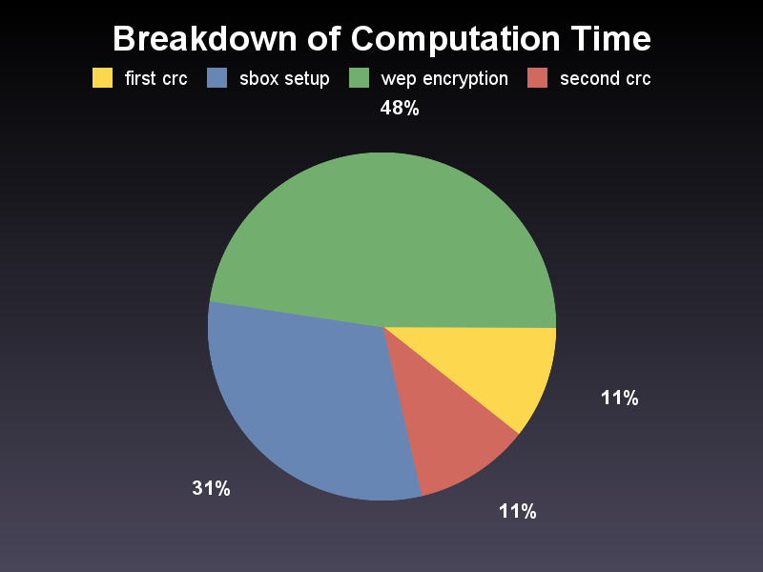
48 bytes
256 bytes

Slide 7
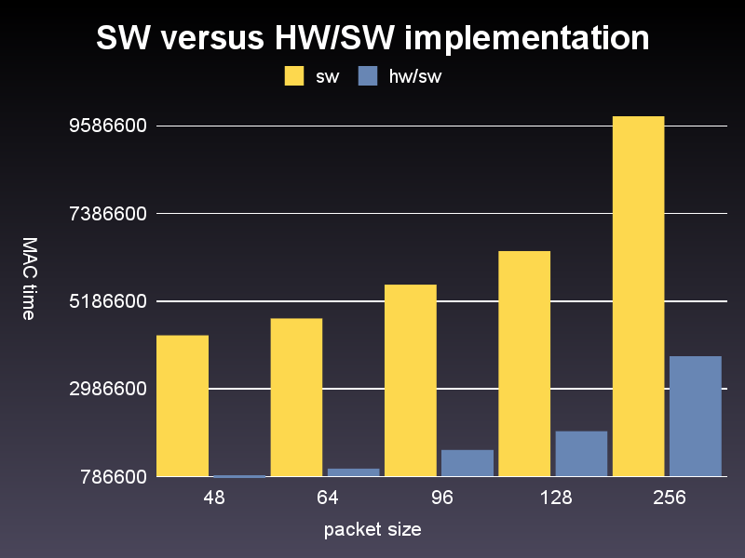
Graph

Slide 8
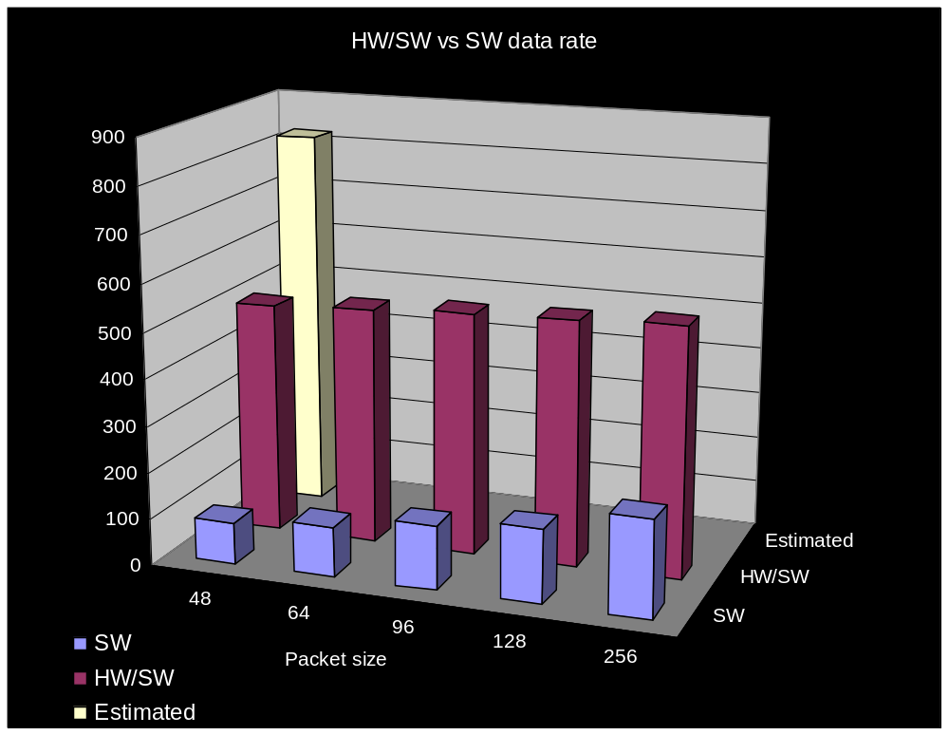
48 (est) | 465,960 ns
48 | 768,600 ns
64 | 1,003,960 ns
96 | 1,473,800 ns
128 | 1,943,320 ns
256 | 3,819,880 ns
48 (est) | 824kb/s
48 | 499kb/s | 88kb/s
64 | 509kb/s | 107kb/s
96 | 521kb/s | 136kb/s
128 | 526kb/s | 158kb/s
256 | 536kb/s | 208kb/s

Slide 9
Analysis of results
Software communication with hardware was slow (200,000ns) resulting in a low data rate
Future considerations
- Attempt different methods for communicating with hardware
- Look into further minimizing time delay in hardware
- Integrate parallel techniques to improve performance

