Slide 1

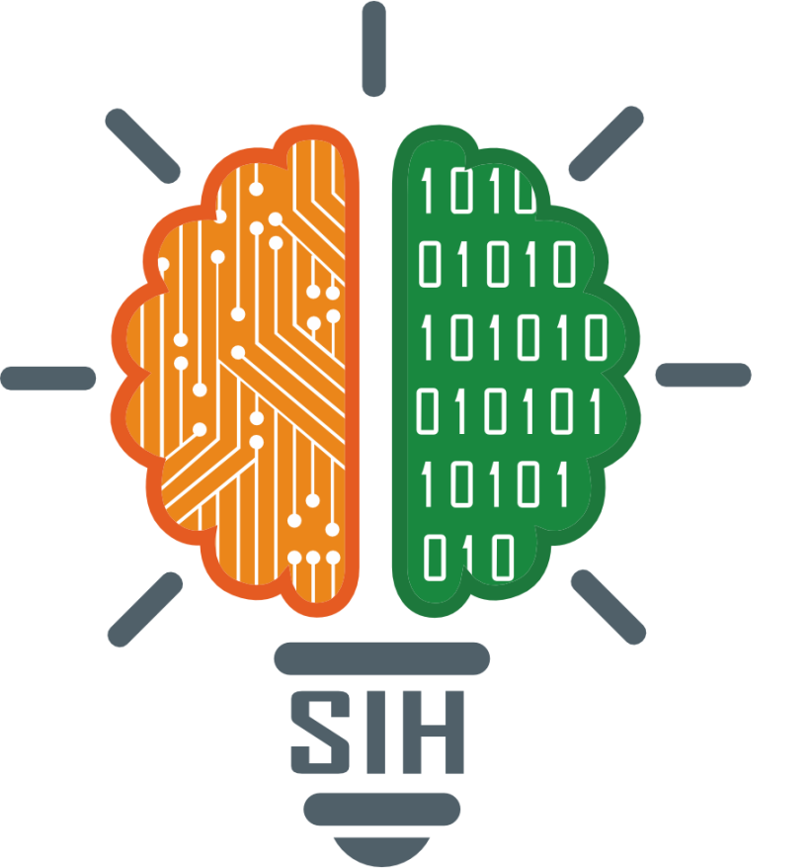
SMART INDIA HACKATHON 2025
ECR-Eco Crime Rebellion
Problem Statement ID –25009
Problem Statement Title-Gamified Environmental Education Platform for Schools and Colleges
Theme-Smart Education
PS Category- Software
Team Name -Kop Creators

Slide 2
ECR-Eco Crime Rebellion
Kop Creators
Proposed Solution: Eco Crime Rebellion (ECR)
Large-scale open-world action-adventure addressing global environmental challenges.
Dynamic world with cities, forests, and oceans plagued by eco-crimes (logging, poaching, toxic dumping, corporate exploitation).
Missions: confront eco-crimes, expose corruption, and lead a rebellion for sustainability.
How It Addresses the Problem
Makes environmental issues exciting and engaging for youth.
Player choices directly impact the world (clean or polluted, thriving or collapsing).
Builds an emotional, interactive link to sustainability.
Innovation & Uniqueness
First eco-crime themed open-world narrative merging fun + awareness.
Dynamic ecosystem engine reacting to every decision.
Choice-driven storytelling with multiple outcomes.
Scalable multiplayer where communities shape a shared environment.

Slide 3
TECHNICAL APPROACH
Kop Creators
Technologies to be Used
Game Engine: Unity 3D / Unreal Engine 5
Programming: C# / C++ (game logic), Python (AI, NPCs)
Frameworks: ML Agents, Photon/Netcode (multiplayer), AR/VR optional
Graphics & Assets: Blender, Maya, Substance Painter
Backend & Cloud: Firebase / AWS (data, saves, servers)
Hardware: Cross-platform (PC, Console, Mobile), scalable rendering
Methodology & Process
Design: World map, eco-crime themes, story arcs
Prototype: Core mechanics + Eco-Meter system
Development: Environments, AI-driven NPCs, missions (heists, chases, sabotage)
Integration: Multiplayer eco-gangs, cloud saves
Testing & Deployment: Fun + awareness balance, scalable release with DLC/updates
Mini-Prototype – Eco Runner
Endless runner where players collect eco-items (seeds, water drops, recycling tokens) & dodge pollution obstacles.
Core mechanics: eco-points instead of coins, obstacles (waste, trucks), power-ups (solar boost, recycling magnet).
Tech: Unity 3D (C#), Blender assets, Android/iOS deployment.
Purpose: Engaging demo proving eco-awareness can merge with fun gameplay; scalable toward ECR’s AAA scope.

Slide 4
FEASIBILITY AND VIABILITY
Kop Creators
Feasibility
Growing demand for open-world action-adventure games.
Rising interest in impactful, socially relevant gaming.
Scalable with Unity/Unreal + cloud tech, feasible at prototype & AAA levels.
Dual value: entertainment + awareness for broad audiences.
Challenges & Risks
High cost & long dev cycles.
Balancing fun with awareness (avoiding “educational” feel).
Technical complexity (large maps, AI eco-systems).
Competition from major studios.
Strategies
Begin with mini-prototype (Eco Runner) → scale to AAA.
Modular dev: core mechanics first, expand in phases.
Cross-platform rollout (mobile → PC/console).
Partnerships with NGOs/brands for funding & reach.
Community-driven online mode to sustain engagement.

Slide 5
IMPACT AND BENEFITS
Kop Creators
Potential Impact on the Target Audience
Engages youth and gamers with an immersive and thrilling experience while subtly raising awareness about environmental crimes.
Encourages critical thinking and responsibility by linking in-game choices to visible environmental outcomes.
Inspires curiosity about sustainability, green innovation, and collective action in an entertaining way.
Benefits of the Solution
Social:
Creates awareness among younger generations through entertainment.
Promotes community collaboration via multiplayer eco-rebellion features.
Economic:
Scalable as a franchise with strong market appeal in gaming and edutainment sectors.
Opens opportunities for partnerships with eco-tech companies, NGOs, and educational institutions.
Environmental:
Provides a virtual model of real-world eco-challenges and solutions.
Encourages eco-friendly behaviors by rewarding sustainable actions in gameplay.
Acts as a digital advocacy tool for climate action and anti-pollution campaigns.

Slide 6
RESEARCH AND REFERENCES
Kop Creators
Gaming Industry & Trends
Newzoo Global Games Market Report 2025
Statista – Video Game Industry Overview
Environmental Challenges & Awareness
UN Environment Programme (UNEP) – Resources
World Wildlife Fund (WWF) – Deforestation
IPCC – Climate Change Sixth Assessment Report (AR6)
Game Development & Technology
Unity Documentation
Unreal Engine Documentation
Photon Engine – Multiplayer Framework
Inspiration from Serious Games
Games for Change – Impact Games
Springer – Gamification & Sustainability Research

