Slide 1
Angular 11
By : S.M.SONI INFOSOFT
+91-8128992581 (M) Whats App
Visit www.smsoni.in

Slide 2
Introduction to Angular
Angular is a front end development framework.
It is developed by Google.
It is used to develop SPA (Single Page Application).
We can’t create SPA in PHP, Wordpress, Jquery or in .Net.
It is an open source framework. We don’t need to buy any license.
It’s follow MVC (Model, View & Controller) framework.

Slide 3
Angular Version
VERSION | STATUS | RELEASED | ACTIVE ENDS | LTS ENDS
^11.0.0 | Active | Nov 11, 2020 | May 11, 2021 | May 11, 2022
^10.0.0 | LTS | Jun 24, 2020 | Dec 24, 2020 | Dec 24, 2021
^9.0.0 | LTS | Feb 06, 2020 | Aug 06, 2020 | Aug 06, 2021

Slide 4
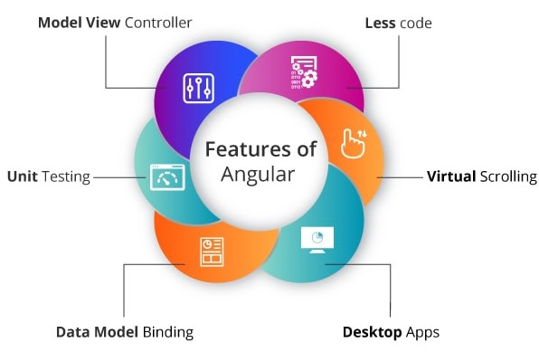
Features of Angular

Slide 5
Less code:
Plenty of scripts is necessary just to design an application when performing DOM manipulation. But the very minimal amount of code is enough for DOM manipulation if using Angular.
Model View Controller:
The angular framework is constructed on a well-known idea called Model-View-Controller (MVC). I hope you all are aware that MVC is a design pattern that is used in the entire web applications in today’s modern trend.
Unit Testing:
We have an excellent test framework known as Karma designed by the Google development team. This is very much helpful for performing designing unit tests for AngularJS applications.
Data Model Binding:
While binding data to the HTML controls, special code is not required. Simply by adding very few snippets of code is possible to bind data, which is done through Angular.
Desktop Apps:
Using Angular, you can easily create applications that are desktop-installed across various operating systems such as Windows, Mac, and Linux.
Virtual Scrolling:
To load and unload items from DOM, Virtual Scrolling in Angular is principally used. This process is completely based on visible parts of lists.

Slide 6
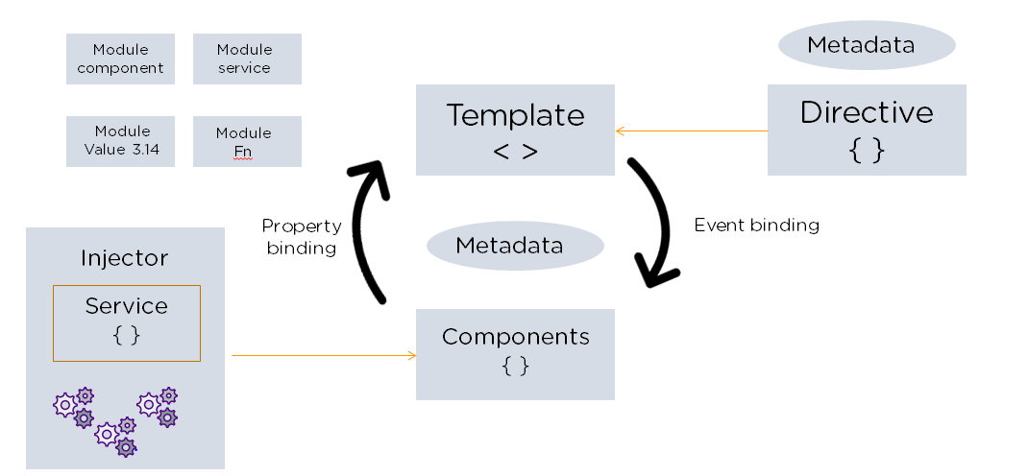
Angular Architecture
Angular is a full-fledged model-view-controller (MVC) framework. It provides clear guidance on how the application should be structured and offers bi-directional data flow while providing real DOM.

Slide 7
The following are the eight building blocks of an Angular application:
Modules : An Angular app has a root module, named AppModule, which provides the bootstrap mechanism to launch the application.
2. Components : Each component in the application defines a class that holds the application logic and data. A component generally defines a part of the user interface (UI).
3. Templates : The Angular template combines the Angular markup with HTML to modify HTML elements before they are displayed. There are two types of data binding:
Event binding: Lets your app respond to user input in the target environment by updating your application data.
Property binding: Enables users to interpolate values that are computed from your application data into the HTML.

Slide 8
4. Metadata : Metadata tells Angular how to process a class. It is used to decorate the class so that it can configure the expected behavior of a class.
5. Services : When you have data or logic that isn’t associated with the view but has to be shared across components, a service class is created. The class is always associated with the @Injectible decorator.
6. Dependency Injection : This feature lets you keep your component classes crisp and efficient. It does not fetch data from a server, validate the user input, or log directly to the console. Instead, it delegates such tasks to the services.
More Details to Visit : https://angular.io/guide/dependency-injection

Slide 9
Angular Vs. Angular JS
Architecture:
Angular JS: Supports Model-View-Controller design. The view processes the information available in the model to generate the output. Angular: Uses components and directives. Components are the directives with a template.
Written:
Angular JS: Written in JavaScript. Angular: Written in Microsoft’s TypeScript language, which is a superset of ECMAScript 6 (ES6).
Mobile support:
Angular JS: Does not supported by mobile browsers. Angular: But Angular supported by all the popular mobile browsers.

Slide 10
Expression Syntax:
Angular JS:ng-bind is used to bind data from view to model and vice versa. Angular: Properties enclosed in “()” and “[]” are used to bind data b/w view and model.
Dependency Injection:
Angular JS: Does not use Dependency Injection. Angular: Hierarchical Dependency Injection system used.
Routing:
Angular JS: AngularJS uses $routeprovider.when() for routing configuration. Angular: Angular uses @Route Config{(…)} for routing configuration.
Structure:
Angular JS: It is less manageable in comparison to Angular. Angular: Better structure compare to AngularJS, easier to create and maintain large applications but behind in AngularJS in case of small applications.

Slide 11
Prerequisites of Angular
Html : The angular renders the HTML from the template file which is associated with the separate component so learning and having knowledge about HTML is necessary.
CSS : Whenever we develop any application, we need to have stylesheets so angular may contain separate CSS files for each component in order to provide different stylesheets.
JavaScript : It is a hero because every frontend platform like Angular, React and Vuejs used JavaScript heavily so we must know javascript before starting with the Angular.
TypeScript : It is the superset of JavaScript, and Typescript is developed by the JavaScript, the most important thing that Angular is completely has written in TypeScript so its and advice to have basic knowledge in TypeScript makes your Angular journey easier.
Other thing you may learn is OOPS concepts, Model view and the controller architecture basic HTML DOM properties and events, different rules of ECMAScript 6 and plus, that it, so if you are done with the above guideline you may start learning the Angular in a very steady pace without worrying about other libraries and so on.

Slide 12
Why TypeScript is developed while having JavaScript?
When JavaScript was developed then JavaScript development team introduced JavaScript as a client-side programming language. But when people was using JavaScript then developer get to know that JavaScript can be used as a server-side programming language also. But When JavaScript was growing then the code of JavaScript became complex and heavy. Because of this, JavaScript was even not able to full fill the requirement of Object-oriented programming language. This prevents JavaScript from succeeding at the enterprise level as a server-side technology. Then TypeScript was developed by the development team to bridge this gap.

Slide 13
Features of TypeScript
TypeScript Code is converted into Plain JavaScript Code:: TypeScript code is not understandable by the browsers. Thats why if the code is written in TypeScript then it is compiled and converted the code i.e. translate the code into JavaScript.The above process is known as Trans-piled. By the help of JavaScript code, browsers are able to read the code and display.
JavaScript is TypeScript: Whatever code is written in JavaScript can be converted to TypeScript by changing the extension from .js to .ts.
Use TypeScript anywhere: TypeScript code can be run on any browser, devices or in any operating system. TypeScript is not specific to any Virtual-machine etc.
TypeScript supports JS libraries: With TypeScript, developers can use existing JavaScript code, incorporate popular JavaScript libraries, and can be called from other JavaScript code.

Slide 14
Typescript Vs. JavaScript
TypeScript is known as Object oriented programming language whereas JavaScript is a scripting language.
TypeScript has a feature known as Static typing but JavaScript does not have this feature.
TypeScript gives support for modules whereas JavaScript does not support modules.
TypeScript has Interface but JavaScript does not have Interface.

Slide 15
Setup & Installation
How to Install Node & NPM? For Node, go to https://nodejs.org/en/ and install nodejs.
How to Install Angular CLI? For AngularCLI, search AngularCLI in google, and got to https://cli.angular.io/
Create First Angular App.
npm install -g @angular/cli
ng new my-dream-app
cd my-dream-app
ng serve

Slide 16
Thank You

