Slide 1

Introduction to TypeScript
RamaKrishna
.NET and UI Developer and Corporate Trainer

Slide 2
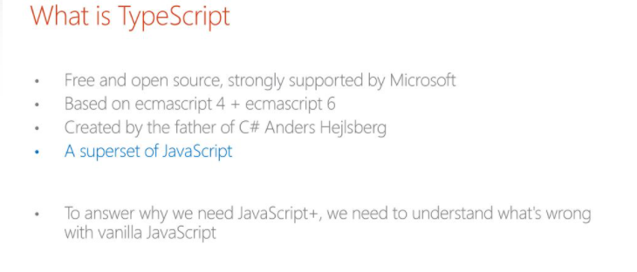

Slide 3
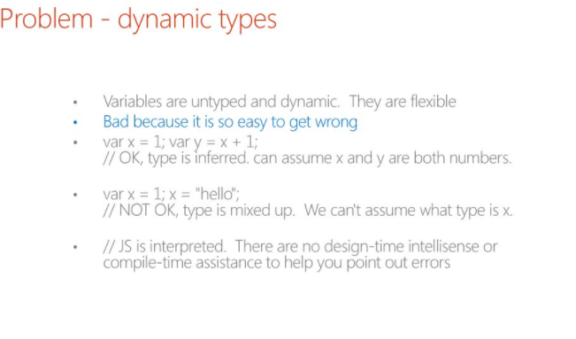

Slide 4
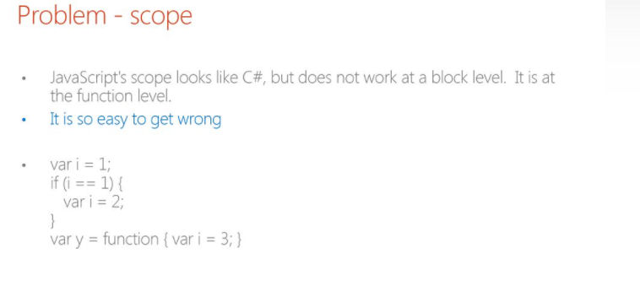

Slide 5
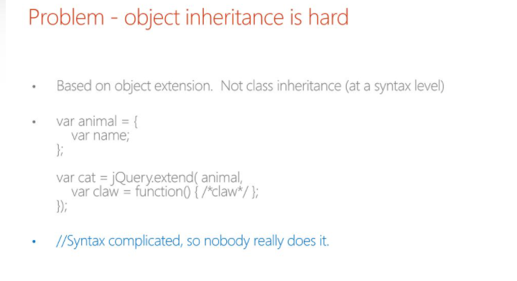

Slide 6
Typescript Introduction
Typescript is an open source language that compiles to JavaScript.
Typescript is a typed superset of JavaScript that compiles to plain JavaScript.
All JavaScript is Valid Typescript.
Key features: o Code encapsulation o Classes and Interfaces o Code Reusability using Inheritance o Type support
TypeScript
JavaScript

Slide 7
Advantages of TypeScript over JavaScript
Scalable HTML5 Client-Side Development
Modular Development
Easy Learning for Java Developer
Existing Library Browser Support
Long Term Version
Clean Output

Slide 8
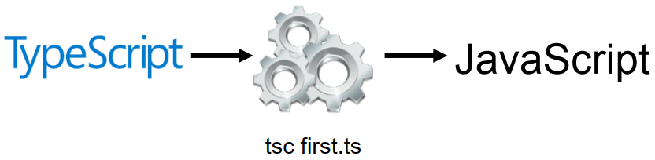
Typescript Compiler
Typescript files are compiled into JavaScript using Typescript compiler.
The compiler can be installed as typescript package through npm.
We can compile typescript file using tsc compiler.

Slide 9
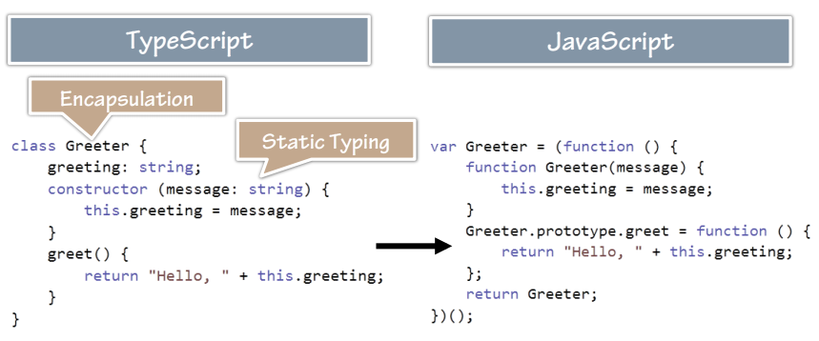
Typescript ➔ JavaScript
JavaScript has a Dynamic Pattern but Typescript has Object Oriented Approach.

Slide 10
Installing and Setting Up TypeScript on Windows

Slide 11
Node Package Manager (NPM)
NPM is a command line tool that installs, updates or uninstalls Node.js packages.
It is also an online repository for open-source Node.js packages.
Official website: https://www.npmjs.com
NPM is included with Node.js installation.
It has now become a popular package manager for other open-source JavaScript frameworks like AngularJS, jQuery, Gulp, Bower etc.

Slide 12
Choosing a Typescript Editor
Visual Studio
VS Code
Sublime Text
WebStorm
Atom
Vim

Slide 13
Installing and Transpiling TypeScript
Run the command below to install TypeScript
npm install –g typescript
Run the command below to transpile TypeScript to JavaScript
tsc program-name.ts

Slide 14
Transpile and Configure TypeScript

Slide 15
Data Types and Variables in TypeScript

Slide 16
Data Types in TypeScript
TypeScript supports type checking for basic types (primitives and object types).
Supports generics, decorators and ES6 module types as well.
Type System in typescript is designed to be optional.
Thus, all javascript programs are typescript programs as well.

Slide 17
Data Types
Primitive Types
Object Types
Number
String
Boolean
Void
Any
Array
Tuple
Interface
Class
Enum
Function

Slide 18
var, let and const Keyword

Slide 19
TypeScript Variable
TypeScript follows the same rules as JavaScript for variable declarations. Variables can be declared using var, let and const.
Variables in TypeScript can be declared using var keyword, same as in JavaScript.
let and const are two relatively new types of variable declarations in JavaScript.
With TS being a superset of JS, the language naturally supports let and const.

Slide 20
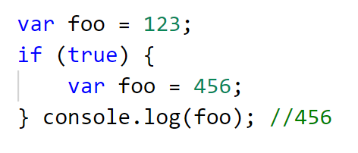
var Keyword
var variables in JavaScript are function scoped.
This means that they can be accessed by any function sharing the same scope.
In JavaScript, if you do not use var keyword for variable declaration (implicit declaration) then variable will be created in global scope.

Slide 21
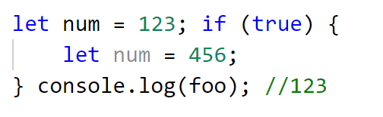
let Keyword
When a variable is declared using let, it uses what some call block scoping.
A variable declared using let cannot be used before its declaration or an error will result.

Slide 22
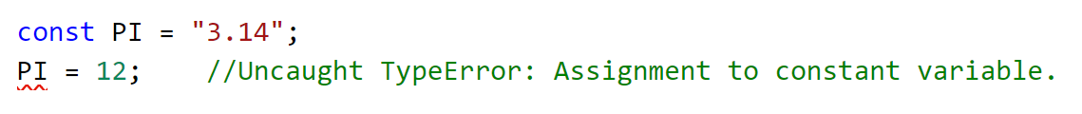
const Keyword
const declares a block-scoped variable with a constant value.
const follows the same scoping principles as the let keyword.
If you know that the variable you are declaring cannot and should not be allowed to reassign, then declare it with const, else use the let keyword.

Slide 23
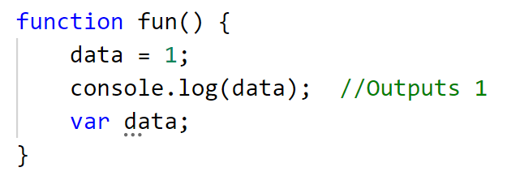
Hoisting of var declarations
Variables declared with the var keyword are subject to hoisting.
Hoisting means that if we declare a variable (declared but not initialized) at the end of a function, the runtime will hoist it to the top and we will not have any error if we would have used that variable before being declared.

Slide 24
TypeScript Functions

Slide 25
TypeScript Functions
Functions are the fundamental building block of any application.
TS adds some new capabilities to the JS functions to make them easier to work.
Function Types
Named Function
Function Expressions
Function with Optional Parameters
Function with Default Parameters
Function with REST Parameters

Slide 26
Arrow Function
Arrow notations are used for anonymous functions or function expressions.
They are also called lambda functions in other languages i.e. C# and Java.
Using fat arrow function (=>) we drop the need to use the 'function' keyword.
Syntax:
(param1, param2, ..., paramN) => expression

