Slide 1
Grpc with AKS

Slide 2
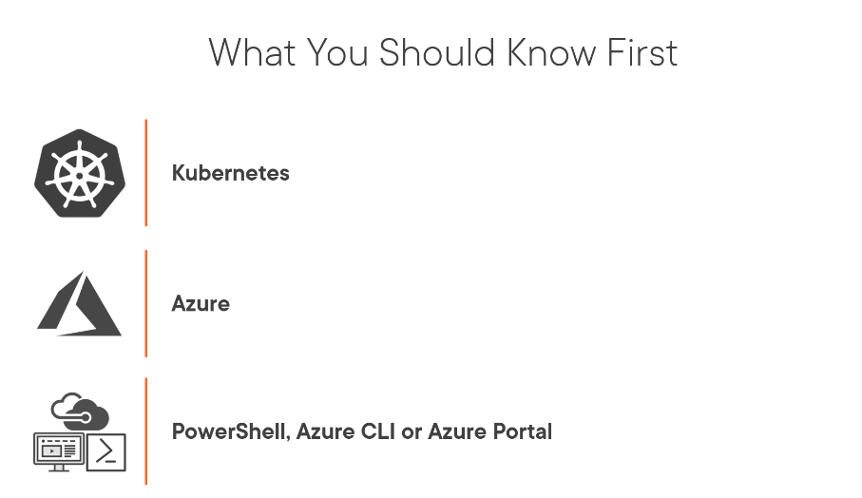

Slide 3
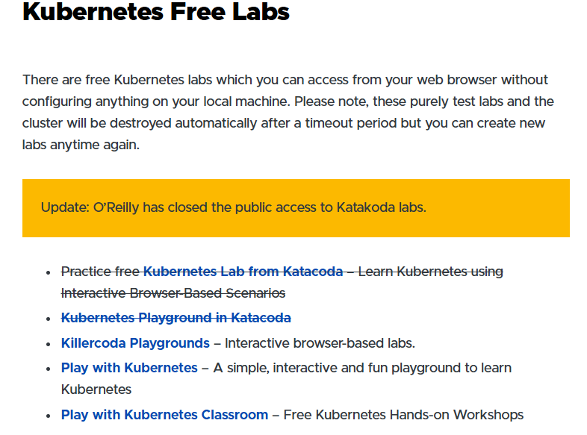

Slide 4
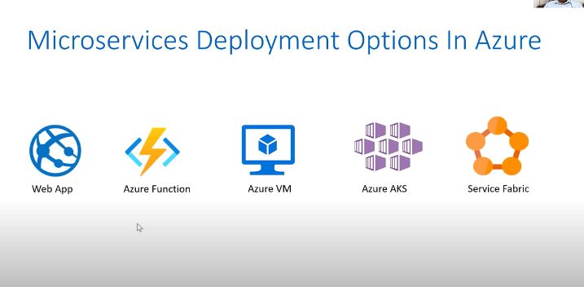

Slide 5
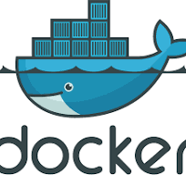
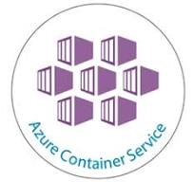
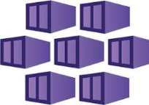
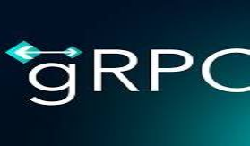
Steps to Deploy to AKS
Add Dockerfiles to the gRPC project
Publish docker container to ACR
Build & Test docker container locally
Access your AKS deployed app
Access your AKS deployed app

Slide 6
Prerequisites:
Before you begin,
make sure you have the following prerequisites:
Azure Account: You need an active Azure account.
Azure CLI: Install the Azure Command-Line Interface (CLI) on your local machine.
Kubectl: Install kubectl, the Kubernetes command-line tool, on your local machine.
Docker: You'll need Docker installed to build container images for your application.
Azure Container Registry (ACR) Azure Kubernetes Service (AKS)

Slide 7
Container solutions on Azure
Container solution Resource type
Azure Kubernetes Service Managed Kubernetes
Azure Red Hat OpenShift Managed Kubernetes
Azure Arc-enabled Kubernetes Unmanaged Kubernetes
Azure Container Instances Managed Docker container instance
Azure Container Apps Managed Kubernetes

Slide 8
Step1:Prepare Project gRPC

Slide 9
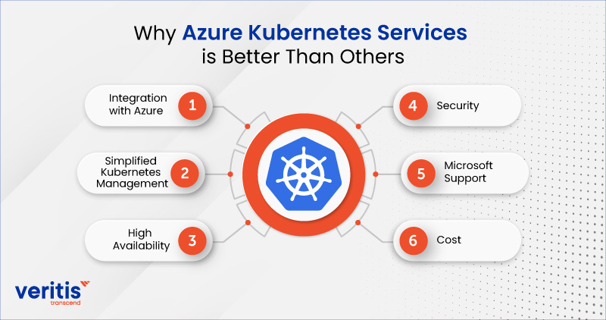

Slide 10
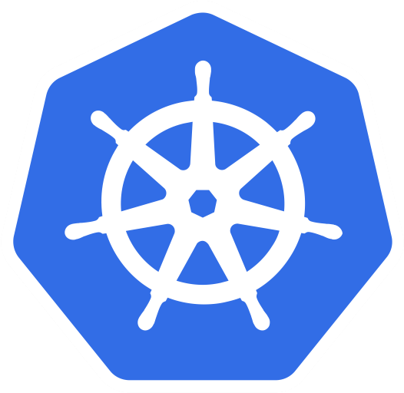
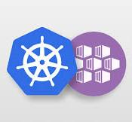
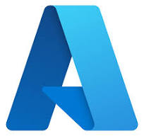
What is aks?

Slide 11
What is Kubernetes
Kubernetes has been open source since 2014.
Kubernetes is an open-source system that automates the deployment, scaling, and management of containerized applications
What it does IT DO?
Deployment: Automatically deploys applications
Scaling: Automatically scales applications up and down to meet changing needs
Monitoring: Monitors applications
Load balancing: Incorporates load balancing
Resource allocation: Tracks resource allocation
Health checks: Checks the health of individual resources
Self-healing: Enables apps to self-heal

Slide 12
What is an AKS?
Azure kubernetes service is an Microsoft Azure service that deploys a managed kubernetes cluster or it is a robust and cost-efficient container Orchestration service that helps you to deploy and manage containerized applications in seconds where additional are assigned automatically without the headache of managing additional servers.
Azure Kubernetes Service (AKS) is a managed Kubernetes service that you can use to deploy and manage containerized applications. You need minimal container orchestration expertise to use AKS. AKS reduces the complexity and operational overhead of managing Kubernetes by offloading much of that responsibility to Azure

Slide 13
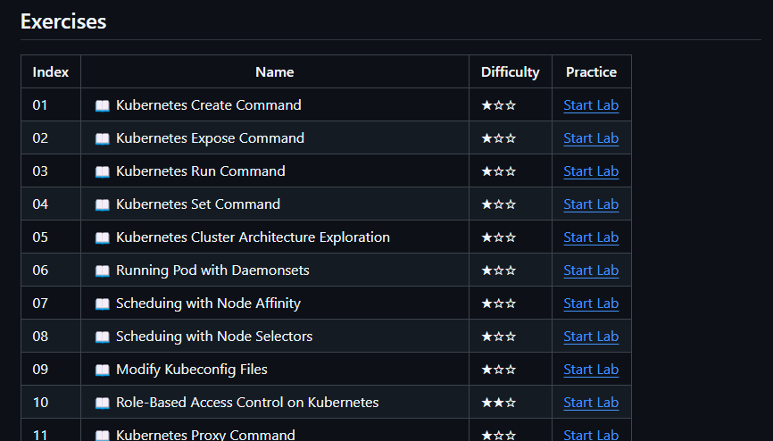
KUBENETES Practise Labs
https://github.com/labex-labs/kubernetes-practice-labs

Slide 14
Another lab
https://labex.io/login?rd=%2Flabs%2Fkubernetes-your-first-kubernetes-lab-391133

Slide 15
Industry Usecases Of Azure Kubernetes Service !
https://medium.com/@20ashisharma/industry-usecases-of-azure-kubernetes-service-8bf7f924b7d6
Next we will see awesome kubernetes architecture

Slide 16
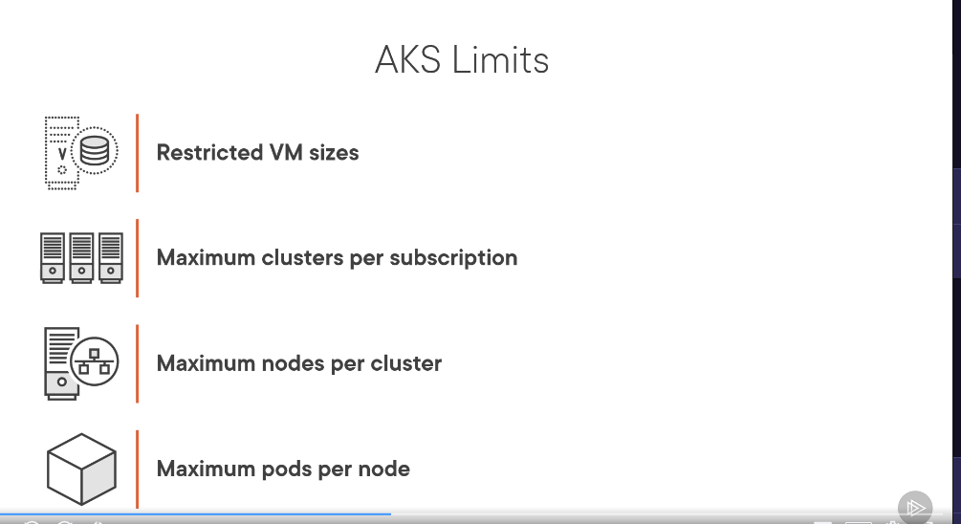
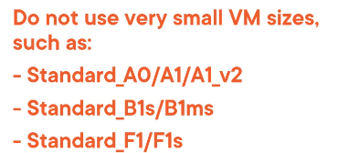





Slide 17
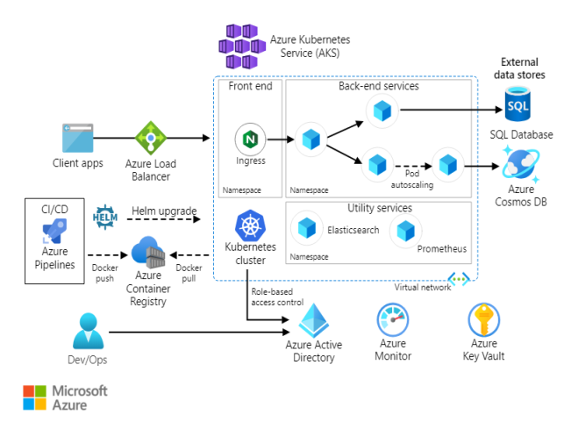

Slide 18
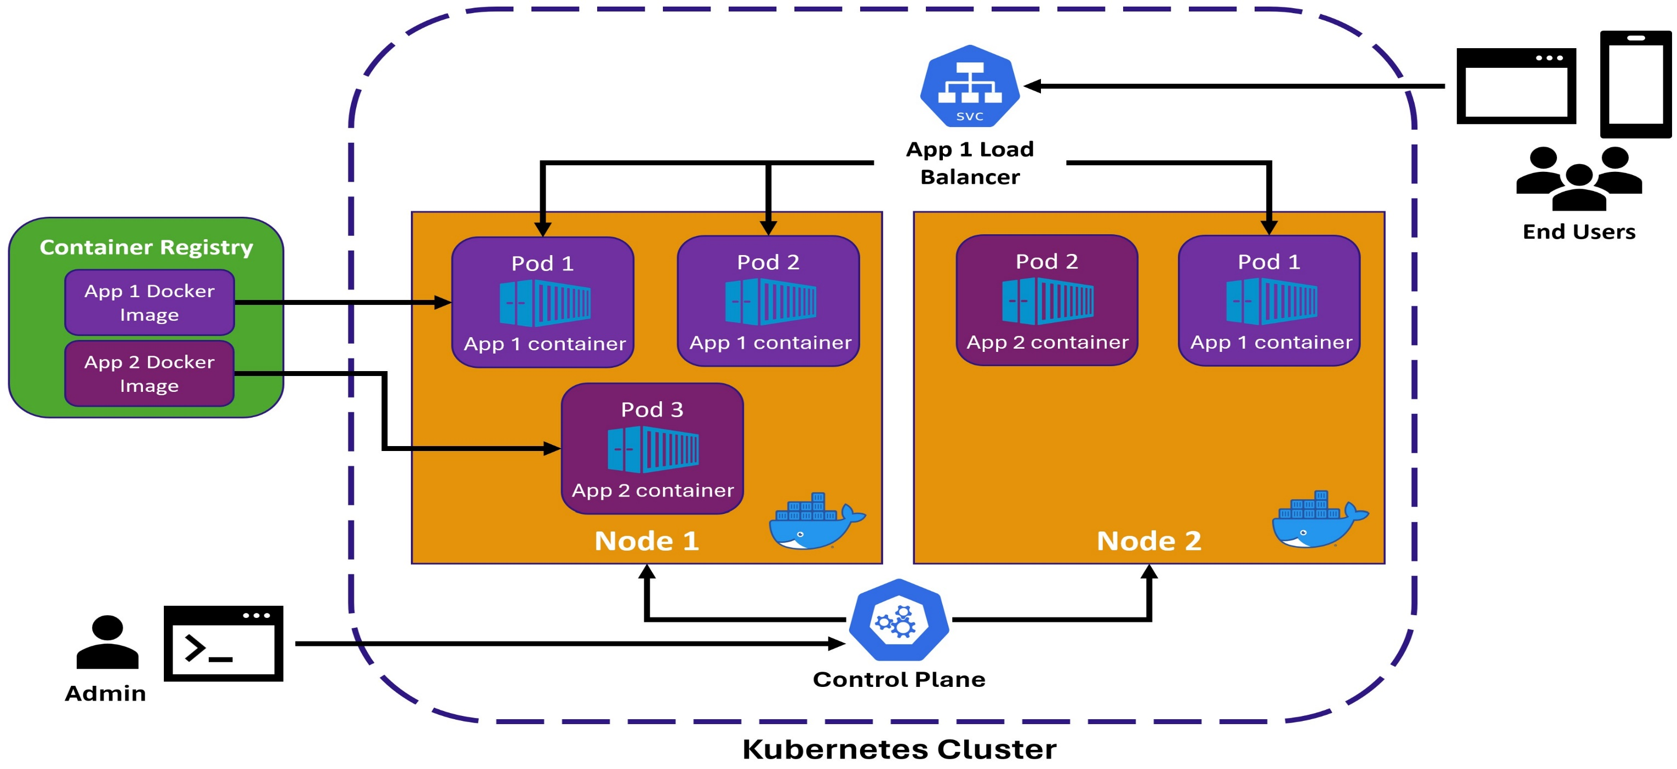

Slide 19
Components of kubernetes
Kubernetes Cluster: A set of machines, called nodes, that run containerized applications.
Node: A Docker-enabled machine that runs your pods. It can be a physical machine or a virtual machine.
Pod: The smallest deployable unit in Kubernetes. Your containers run inside these pods.
Service: An abstraction that defines how to access your pods. One type of service is a load balancer, which allows external clients to interact with your pods.
Control Plane: Takes care of managing the Kubernetes cluster. Admins use tools to interact with the cluster via the control plane.

Slide 20
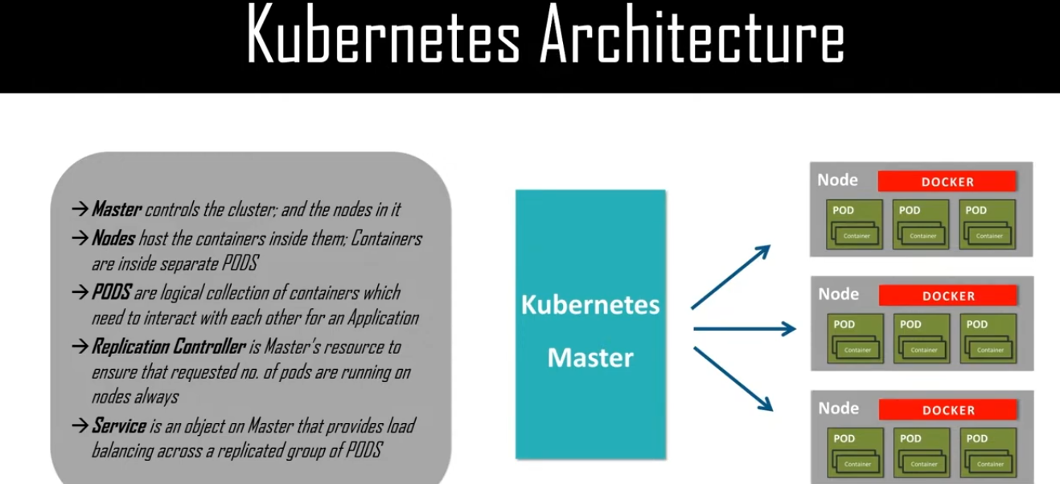

Slide 21
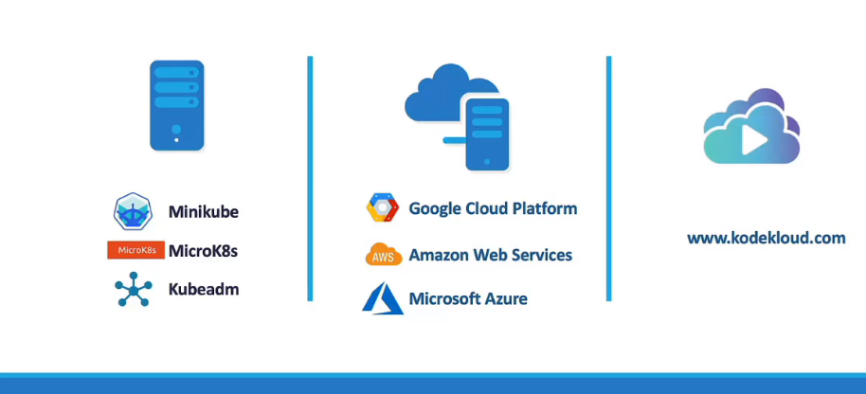
SET UP we can create kubernetes cluseter s
LAPTOPS
Cloud
Readymade step

