Slide 1

Seasonal Agriculture Performance Analysis
A Data-Driven Study of 4,000 Farm Records Across Kharif, Rabi, and Zaid Seasons
VOIS FOR TECH / AICTE DATA ANALYTICS INTERNSHIP
Major Project Submission — August Batch 2026–2027
Student Name: Krishna Kumar
College Name: Ambalika Institute of Management and Technology, Lucknow
AICTE STU ID: STU6a252b77248381780820855
Domain: Data Analytics | Platform: VOIS LMS / Edunet Foundation | Submission Date: September 2026

Slide 2

Problem Statement
Agricultural Context & Challenges
• Seasonal Environmental Disparity: Agricultural outcomes in India vary drastically across Kharif (Monsoon), Rabi (Winter), and Zaid (Summer) seasons due to marked differences in precipitation, temperature, and solar radiation.
• Information Gaps in Raw Data: Unprocessed agricultural datasets contain individual farm metrics but fail to explicitly communicate seasonal patterns, performance bottlenecks, or comparative economic viability.
• Resource Misallocation: Without analytical visibility, farmers often follow static farming practices, resulting in excessive water consumption in dry seasons and severe crop losses during pest outbreaks.
Analytical Objectives & Value
• Quantify Seasonal Performance: Examine 4,000 farm records to measure and compare average yield, total production, and net financial profitability across all three cropping seasons.
• Evaluate Irrigation & Water Use: Determine water efficiency across irrigation methods (Drip, Flood, Rainfed, Sprinkler) to establish optimal water management strategies.
• Assess Environmental & Pest Risks: Investigate correlations between seasonal climate variables (rainfall, temperature, humidity) and pest/disease outbreak vulnerabilities.
• Deliver Evidence-Based Planning: Translate analytical findings into actionable recommendations for farmers, agronomists, and policy planners to improve agricultural sustainability.

Slide 3
Project Description & Methodology
Dataset Scope & Coverage
• Sample Size: 4,000 agricultural farm records spanning 8 Indian states (AP, Gujarat, Karnataka, MP, Maharashtra, Punjab, TN, Telangana) and 10 districts.
• Seasonal Distribution: Kharif: 1,779 farms (44.5%) | Rabi: 1,627 farms (40.7%) | Zaid: 594 farms (14.8%).
• Crop Representation: 8 distinct crops analyzed across food grains, pulses, and commercial crops: Chilli, Cotton, Groundnut, Maize, Pulses, Rice, Sugarcane, Wheat.
• Variables (28 Features): Covers environmental indicators (rainfall, temp, humidity), soil nutrients (N, P, K, pH), farming inputs (fertilizer, pesticide, irrigation), and financial metrics (cost, revenue, profit).
5-Stage Analytical Framework
• 1. Data Auditing & Cleaning: Verified data types, identified zero duplicate rows, detected 120 missing values across 3 variables, and applied robust median imputation.
• 2. Exploratory Data Analysis: Conducted univariate and bivariate aggregations across seasons, crop types, and irrigation categories to evaluate production patterns.
• 3. Environmental & Risk Analysis: Evaluated temperature, sunlight, and rainfall dynamics in relation to pest risk and overall yield output.
• 4. Correlation & Economic Modeling: Computed full Pearson correlation matrix; assessed revenue, operating cost, and net profit margins per season and crop.
• 5. Insights & Recommendations: Synthesized statistical findings into 5 actionable strategic recommendation areas for stakeholders.

Slide 4

Target End Users & Stakeholder Value
Farmers & Farm Producers
Guide seasonal crop selection, manage input costs (fertilizers, pesticides), and adopt efficient irrigation scheduling to protect margins during high-risk seasons.
Agronomists & Researchers
Analyze empirical interactions between climate variables, disease/pest risk, and soil chemistry to develop resilient agricultural models.
Agricultural Policy Planners
Design evidence-based crop insurance schemes, regional subsidy allocations, and minimum support price policies calibrated to seasonal volatility.
Agribusiness & Financial Analysts
Assess seasonal revenue risks, crop-specific profitability trends, and agricultural credit viability across commercial and staple crops.
Irrigation & Water Authorities
Identify water-efficient irrigation methods (such as drip) to optimize canal water distribution during water-scarce summer (Zaid) periods.
Data Analytics Students & Educators
Serve as a comprehensive benchmark case study for applied exploratory data analysis, hypothesis validation, and multivariate agricultural modeling.

Slide 5

Technology Stack & Development Environment
Programming & Runtime
Python 3.14
• Core Language: Chosen for comprehensive scientific computing ecosystem, robust data manipulation, and wide industry adoption.
• Jupyter Notebook: Interactive computing environment used for modular step-by-step analysis, output persistence, and inline documentation.
Data Manipulation & Math
Pandas & NumPy
• Pandas (v2.x): Efficient handling of 4,000-row tabular dataset, missing value imputation, multi-column groupbys, and statistical aggregation.
• NumPy: Vectorized array calculations, numerical transformations, and foundational data structures.
Data Visualization
Matplotlib & Seaborn
• Matplotlib: Custom figure formatting, axis scaling, dual-axis plotting, and rasterization of 12 publication-quality PNG charts.
• Seaborn: High-level statistical visualization including multi-feature correlation heatmaps, categorical bar charts, and regression scatters.
Dataset Pipeline & Versioning
CSV & Git / GitHub
• Structured CSV: Clean 28-variable schema preserving original records while maintaining full portability across data workflows.
• Git & GitHub: Version-controlled project repository ensuring full reproducibility of code, dataset, charts, and documentation.

Slide 6
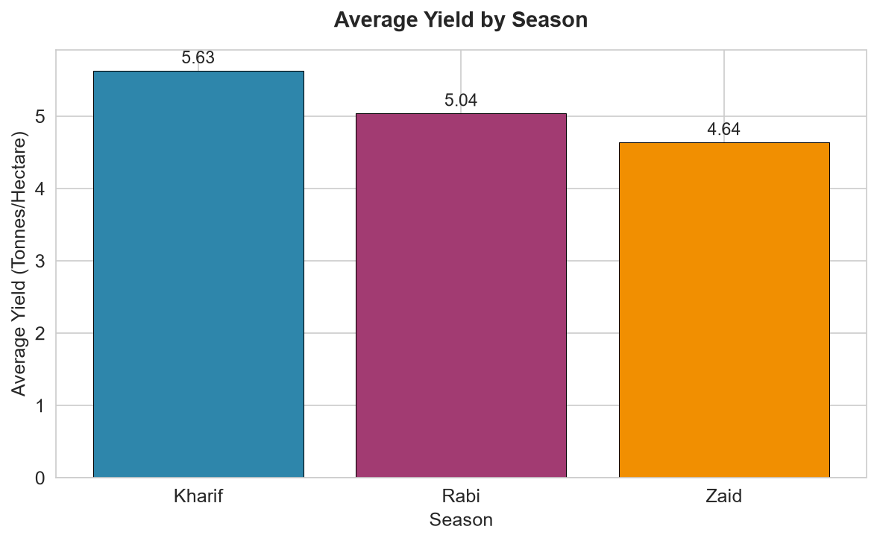
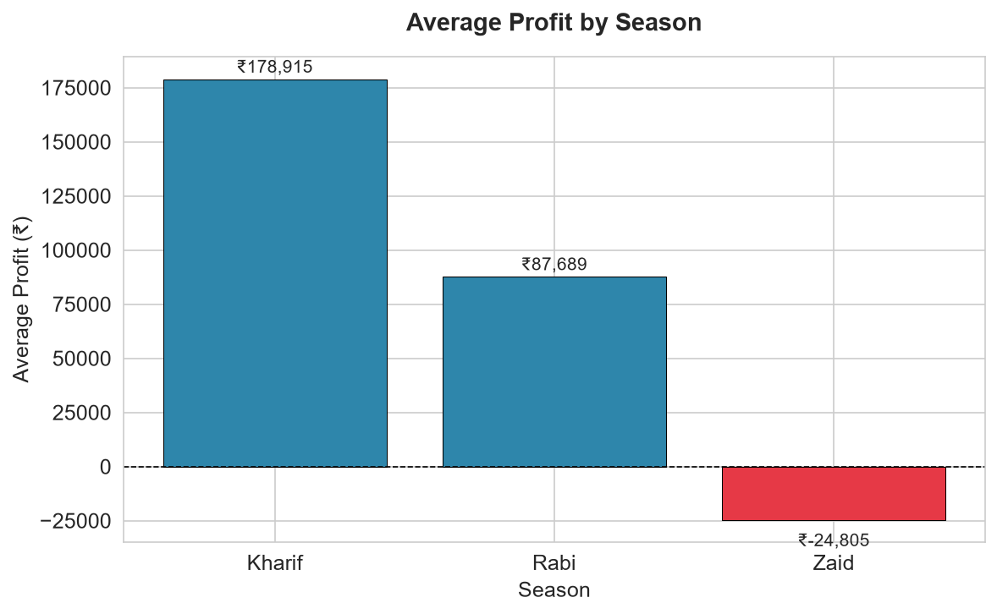
Results — Season-wise Performance Analysis
KEY METRICS COMPARISON ACROSS SEASONS (EXACT DATASET VALUES)
• Average Yield (t/ha): Kharif: 5.63 | Rabi: 5.04 | Zaid: 4.64 • Average Profit (₹): Kharif: ₹1,78,915 | Rabi: ₹87,689 | Zaid: -₹24,805 • Profitable Farms (%): Kharif: 57.8% (1,028 farms) | Rabi: 48.9% (795 farms) | Zaid: 35.5% (211 farms)
Key Insight: Kharif achieves highest yield (5.63 t/ha) & profitability due to monsoon rainfall. Zaid suffers from water deficit, yielding -₹24.8K average profit.

Slide 7
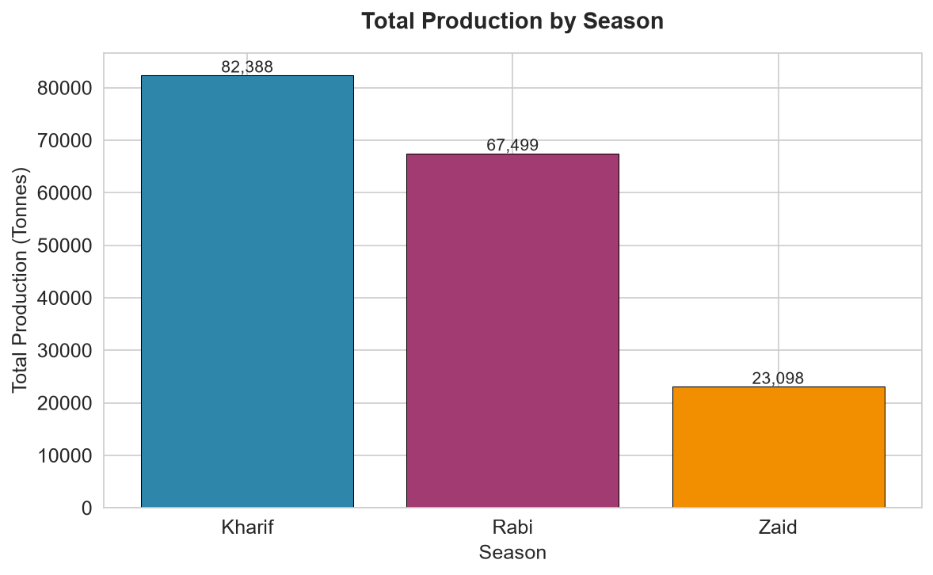
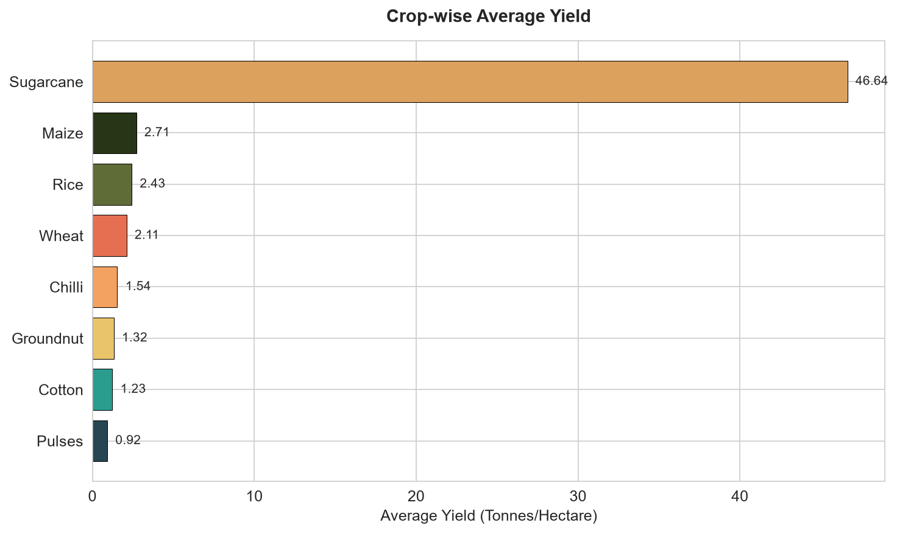
Results — Total Production & Crop-wise Yield Analysis
PRODUCTION VOLUME & TOP CROP PERFORMANCE (EXACT DATASET VALUES)
• Total Production: Kharif: 82,388 tonnes (47.6%) | Rabi: 67,499 tonnes (39.0%) | Zaid: 23,098 tonnes (13.4%) • Top Crops by Yield (t/ha): Sugarcane: 46.64 | Maize: 2.71 | Rice: 2.43 | Wheat: 2.11 | Chilli: 1.54 • Top Crops by Net Profit (₹): Sugarcane: ₹8,17,188 | Chilli: ₹7,50,878 | Cotton: ₹1,24,547
Key Insight: Sugarcane dominates biomass production (46.64 t/ha) & profit (₹8.17L). Staple cereals (Rice, Wheat) show lower yields & negative margins due to input costs.

Slide 8
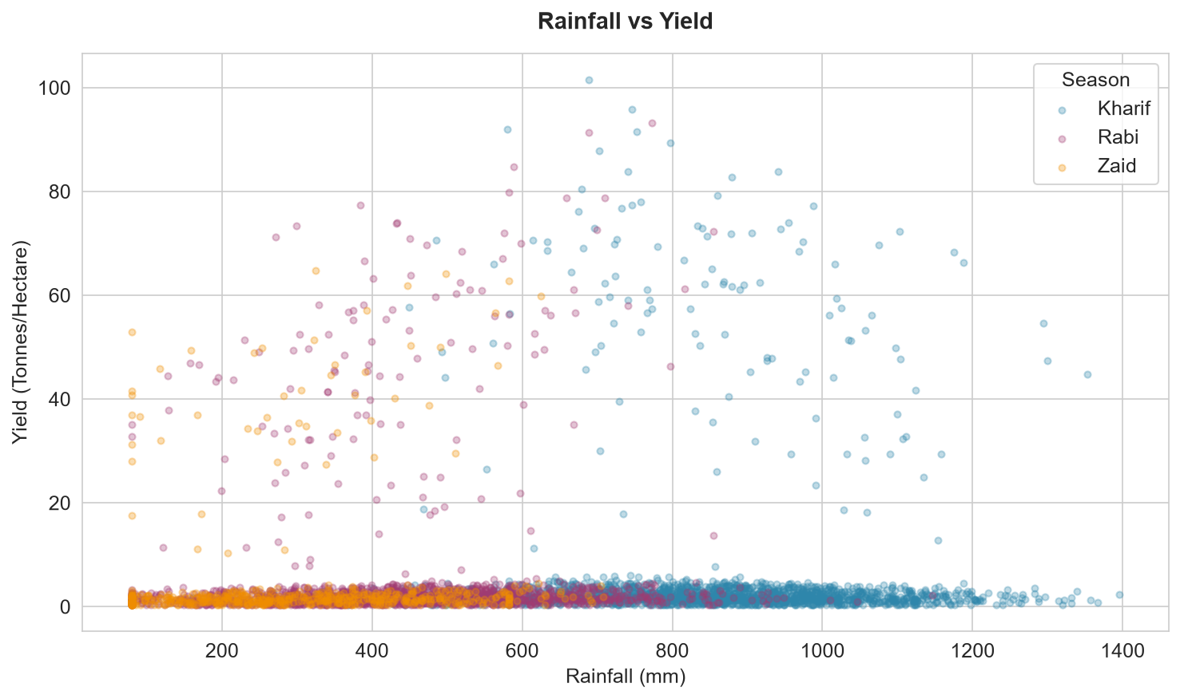
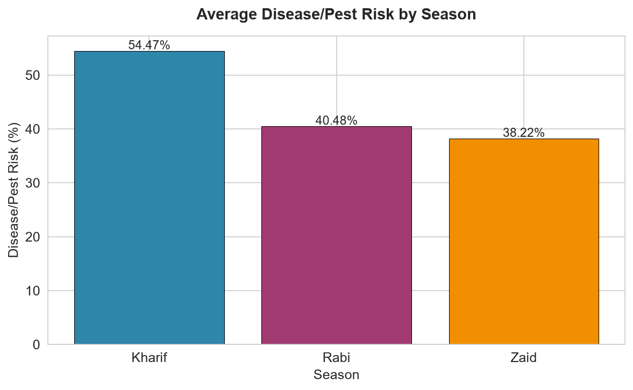
Results — Environmental Factors & Pest/Disease Risk
ENVIRONMENTAL DYNAMICS & DISEASE CORRELATIONS
• Avg Temperature (°C): Kharif: 28.5°C | Rabi: 23.5°C | Zaid: 31.0°C (Highest thermal stress) • Disease & Pest Risk (%): Kharif: 54.5% | Rabi: 40.5% | Zaid: 38.2% • Critical Correlation: Rainfall ↔ Disease Risk (r = 0.622) & Humidity ↔ Disease Risk (r = 0.545) show strong positive links.
Key Insight: Direct correlation between Rainfall/Temp and Yield is weak individually (r ≈ 0.01-0.03), but high rainfall drives severe pest outbreaks (54.5% in Kharif).

Slide 9
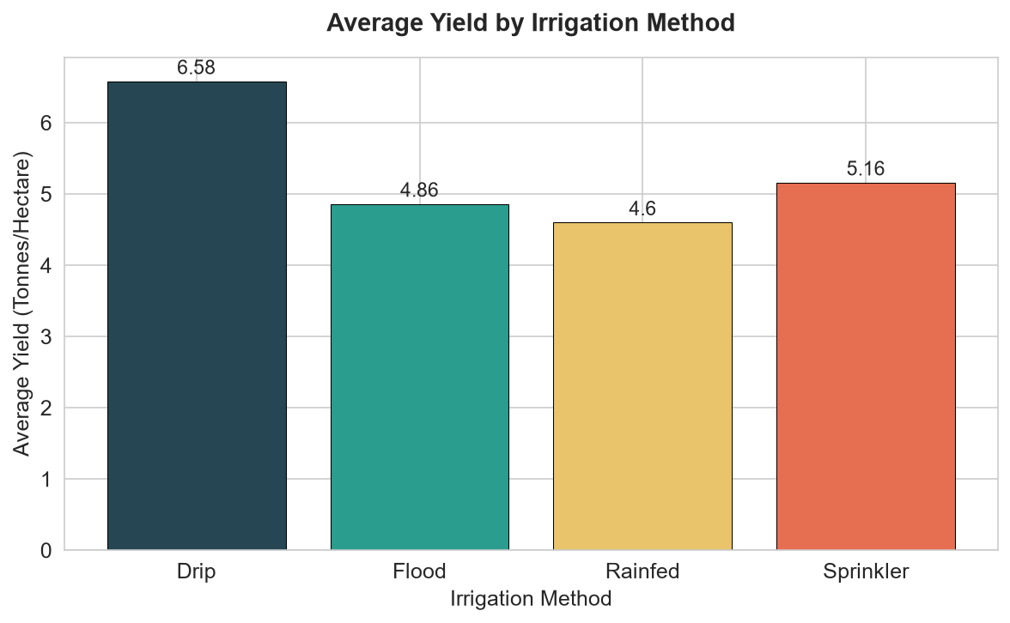
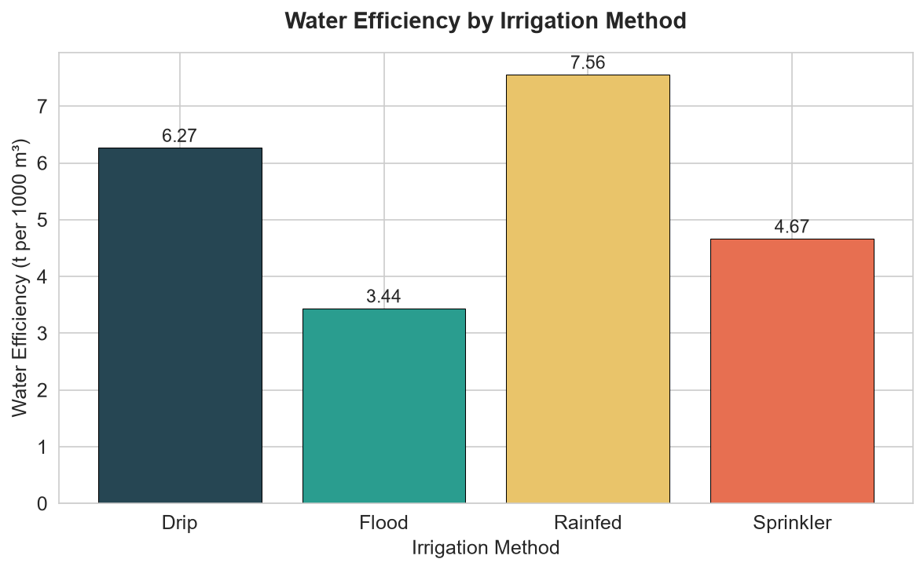
Results — Irrigation Methods & Water Efficiency
IRRIGATION EFFICIENCY & WATER PRODUCTIVITY (EXACT DATASET VALUES)
• Yield by Irrigation (t/ha): Drip: 6.58 | Sprinkler: 5.16 | Flood: 4.86 | Rainfed: 4.60 • Water Efficiency (t/1000m³): Rainfed: 7.56 | Drip: 6.27 | Sprinkler: 4.67 | Flood: 3.44 • Mean Seasonal Water Usage: Kharif: 6,102 m³ | Rabi: 5,847 m³ | Zaid: 6,420 m³ (Highest water demand)
Key Insight: Drip irrigation yields 43% higher than rainfed (6.58 vs 4.60 t/ha). Flood irrigation is least efficient (3.44 t/1000m³) and should be transitioned to micro-irrigation.

Slide 10
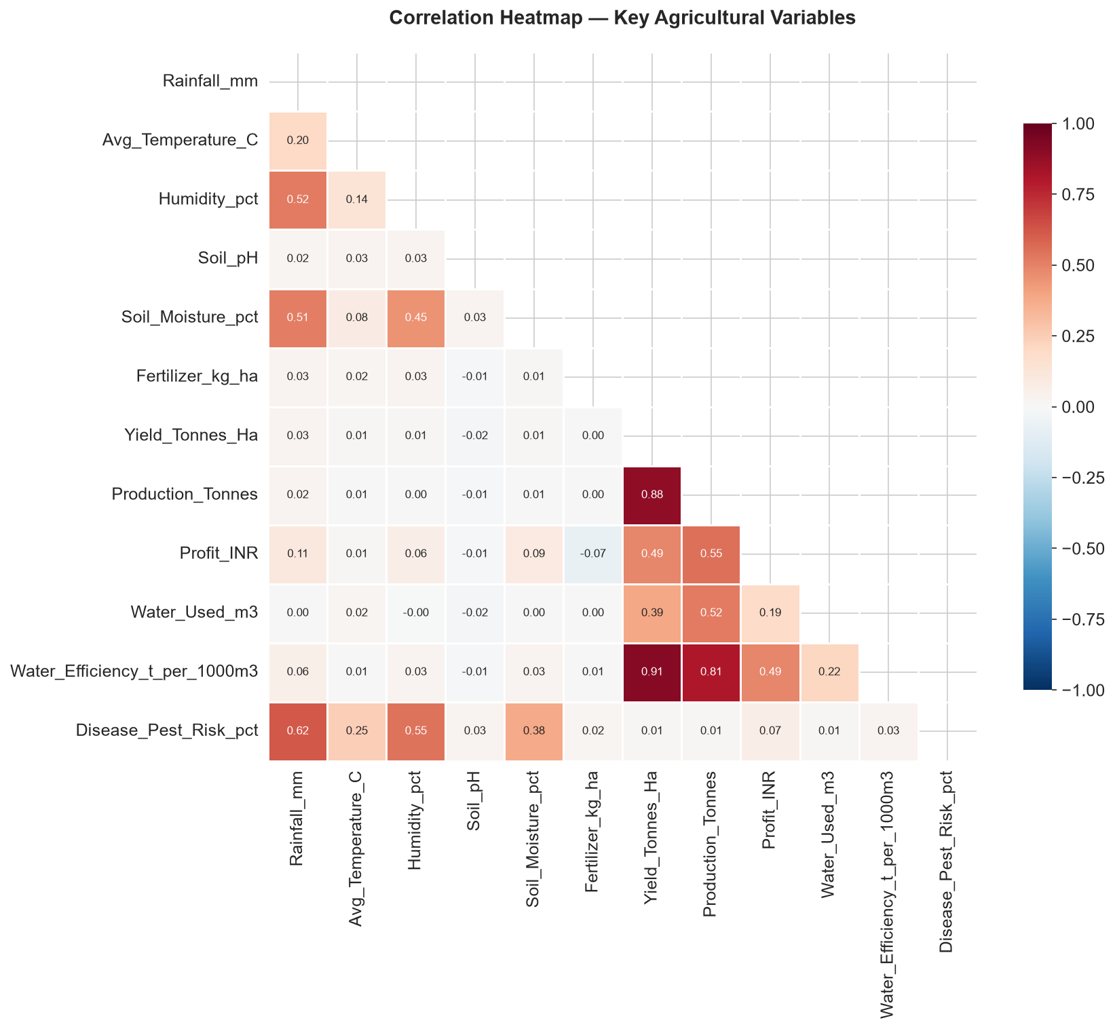
Results — Correlation Matrix & Synthesis of Findings
Key Empirical Findings
1. Kharif Outperformance: Kharif achieves peak average yield (5.63 t/ha) and highest profit (₹1,78,915), but experiences highest pest risk (54.5%).
2. Zaid Season Stress: Zaid is characterized by severe water deficit (299 mm rainfall), lowest yield (4.64 t/ha), and negative avg profit (-₹24,805). Only 35.5% of farms turn a profit.
3. High Commercial Profitability: Sugarcane (₹8.17L) and Chilli (₹7.51L) generate substantial net profits, while food grains (Wheat, Rice, Maize) averaged net negative returns.
4. Drip Irrigation Superiority: Drip irrigation generates the highest yield (6.58 t/ha) and strong water efficiency (6.27 t/1000m³), outperforming conventional flood methods.
5. Weather-Disease Linkage: Rainfall strongly correlates with pest risk (r = 0.622) and soil moisture (r = 0.509), necessitating proactive pesticide management in high monsoon seasons.
6. Strong Production Drivers: Yield shows strong positive correlation with water efficiency (r = 0.913) and total harvest production (r = 0.883).
Figure 12: Pearson Correlation Matrix across 28 Features (|r| > 0.3 labeled)

Slide 11
Future Scope & Strategic Roadmap
Predictive Yield & Risk Modeling
Train supervised machine learning models (Random Forest, XGBoost) on historical multi-season data to forecast crop yield and early-stage pest probabilities prior to planting.
Crop Diversification & Soil Management
Encourage farmers to intercrop high-margin cash crops (Chilli, Groundnut) with nitrogen-fixing pulses to offset market risks and preserve soil health.
Longitudinal Multi-Year Studies
Expand analysis across 5–10 years to distinguish macro climate change trends from regular seasonal variation and assess long-term soil nutrient degradation.
Interactive Decision Support Systems
Deploy open-access web applications (Streamlit / Power BI) enabling farmers and local extension officers to input soil/weather conditions and receive customized crop advice.
Precision Micro-Irrigation Adoption
Formulate state-level subsidy transitions from flood irrigation to drip and sprinkler systems, targeting arid regions during the vulnerable Zaid season.
IoT & Weather Station Sensor Feeds
Integrate live field sensor telemetry (soil moisture probes, local rain gauges) with automated SMS advisories for precision pesticide application.

Slide 12
GitHub Repository & Project Deliverables
PUBLIC SOURCE CODE REPOSITORY
krishna3163 / Seasonal-Agriculture-Performance-Analysis
https://github.com/krishna3163/Seasonal-Agriculture-Performance-Analysis
Jupyter Notebook
[.ipynb]
• Complete end-to-end data pipeline
• 85 cells (30 code, 55 markdown)
• Pre-executed outputs & plots
• 0 errors, fully reproducible
Project Dataset
[.csv]
• 4,000 farm records × 28 features
• Original unmodified raw dataset
• 3 seasons, 8 crops, 8 states
• Full schema documentation
Visualizations
[charts/]
• 12 high-resolution PNG plots
• Season, crop & irrigation charts
• Correlation matrix heatmap
• Official course certificate
Documentation
[.md]
• Comprehensive README.md
• Final Verification Report
• Technical verification audit
• AICTE/VOIS alignment audit

Slide 13

VOIS Course Completion Certificate — Data Visualization
Course: Data Visualization | Recipient: Krishna Kumar | Certificate ID: VFLMS26_163451 | Issued: September 6, 2026
Verified VOIS For Tech & Edunet Foundation LMS Credential | Directly Applicable to AICTE Internship Submission

Slide 14
Thank You
Questions & Discussion
Project: Seasonal Agriculture Performance Analysis
Internship: VOIS For Tech / AICTE Data Analytics Internship (Batch 2026–2027)
Student: Krishna Kumar | AICTE STU ID: STU6a252b77248381780820855
Institution: Ambalika Institute of Management and Technology, Lucknow
Repository: https://github.com/krishna3163/Seasonal-Agriculture-Performance-Analysis

