Slide 1


B.TECH COMPUTER SCIENCE & ENGINEERING • MINI PROJECT EVALUATION
SyncTube: Real-Time Synchronized Watch Party Platform
Simple Questions • Short Answers • Practical Architecture & Live Workflow
SUBMITTED BY:
Krishna Kumar (Roll No: 2303630100089)
Hareram Yadav (Roll No: 2303630100073)
B.Tech CSE – Section 4A • Batch: 2026–2027
UNDER THE GUIDANCE OF:
MRS. SHIVANGI PANDEY
Assistant Professor, Department of CSE
Ambalika Institute of Management & Technology, Lucknow

Slide 2
1. PROBLEM DEFINITION
What Problem Are We Solving?
Modern video platforms are built for 1 person alone • Shared watching is broken
THE PAIN POINTS TODAY
• Isolated Streaming: YouTube, Netflix, and OTT apps isolate every viewer into their own unicast stream.
• Manual '3-2-1 Play' Fails: Different buffer speeds, network lag, and timer drift cause friends to desynchronize within minutes.
• Mid-Roll Commercial Ads: Ads trigger at different times for each person, completely shattering synchronized movie or study sessions.
• Algorithmic Doomscrolling: Clickbait sidebars and endless Shorts constantly distract students trying to watch study lectures.
HOW SYNCTUBE FIXES IT
• Authoritative Synchronization: Sub-100ms playout alignment. Play, pause, and seek happen simultaneously for everyone.
• Zero Ad Interruptions: Videos play cleanly without disruptive commercials interrupting lectures mid-sentence.
• Pure Cinema Interface: All recommendation sidebars and algorithm feeds are removed for complete learning focus.
• Zero Barriers to Entry: No account creation, no password fatigue, and no third-party extension installations required.

Slide 3
2. TARGET AUDIENCE
Who Is This Platform Built For?
Tailored specifically for three high-demand everyday user demographics
🎓 STUDENTS & STUDY GROUPS
• Playlist Import: Paste full YouTube course playlists (OS, DBMS, Gate Smashers, NPTEL).
• Ad-Free Learning: Zero commercial ads stopping lecture flow.
• No Distractions: No Shorts or clickbait feeds.
• Discussion Pauses: Pause synchronously to discuss doubts and take group notes.
❤️ LONG-DISTANCE COUPLES
• Virtual Date Nights: Watch romantic movies, series, and vlogs together across cities.
• Emotional Sync: Laugh and cry at the exact same second with sub-100ms precision.
• Video Calling: Face-to-face WebRTC video & audio while watching.
• Floating Hearts: Send live floating reaction hearts.
🍿 FRIENDS & WATCH PARTIES
• Weekend Marathons: Anime, comedy sketches, gaming clips, and movie nights.
• Democratic Queue: Everyone adds songs/clips and upvotes their favorites.
• Live Banter: Real-time threaded chat with emojis.
• Soundboard: Trigger funny sound effects in-sync.

Slide 4
3. SYSTEM WORKFLOW
How Does SyncTube Work?
A seamless 4-step user journey from zero to watching together in under 5 seconds
STEP 1
Create a Room in 2 Seconds
Enter your display name, pick an optional anime avatar, and click 'Start Watch Party'. No signup or password needed.
STEP 2
Instant Share & Join
Share the auto-generated 6-character room code, direct invite link, or display the scannable QR code to friends.
STEP 3
Load Video or Playlist
Paste any YouTube link, import an entire lecture playlist, or search videos directly from the built-in search bar.
STEP 4
Enjoy Synchronized Media
Play, pause, seek, chat, vote on the queue, or start video calling. The server coordinates state instantly.

Slide 5
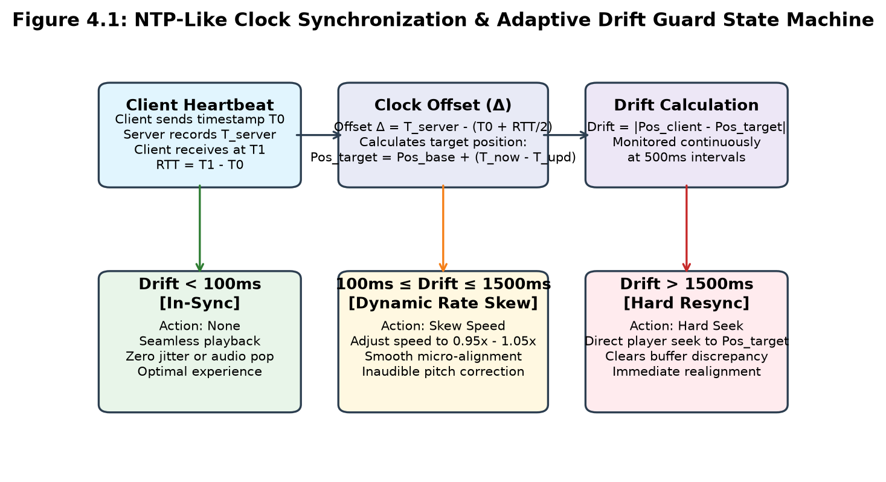
4. SYNCHRONIZATION MECHANISM
How Do We Keep Everyone in Exact Sync?
Authoritative clock offset calculation + 3-Tier Adaptive Drift Guard
CORE SYNCHRONIZATION PRINCIPLE
“SyncTube synchronizes the watch experience, not the video stream.”
• NTP Clock Offset Calculation: Clients periodically exchange timestamped probes (T0, T_server, T1) to calculate Round-Trip Time (RTT) and network latency.
• Offset Formula: Δ = T_server - (T0 + RTT / 2). Every client accurately knows the true server clock position.
• Target Playhead Formula: Pos_target = Pos_base + (T_now + Δ - lastUpdated).
• Zero Stream Proxying: Video frames are rendered natively via YouTube IFrame API; our server only sends tiny JSON timeline sync events.

Slide 6
5. ACADEMIC USE-CASE
Why Is SyncTube a Game-Changer for Students?
Eliminating distractions and commercial interruptions from group study
FOCUSED GROUP STUDY & LECTURES
• Bulk Playlist Import: Students studying for semesters can paste entire course playlists (Operating Systems, DBMS, DSA). All videos queue automatically.
• Zero Commercial Mid-Roll Ads: Commercials that normally interrupt professors mid-explanation are completely eliminated.
• Distraction-Free Cinema UI: Strips away recommended feeds, clickbait thumbnails, and addictive Shorts that cause academic procrastination.
COLLABORATIVE LEARNING TOOLS
• Synchronous Doubt Pausing: When any student pauses to understand a complex diagram, it pauses for everyone. No student gets left behind.
• In-Room Note Sharing & Chat: Students share time-stamped notes, code snippets, and questions directly in the chat panel.
• Peer Accountability: Studying together in a virtual room creates healthy study discipline similar to sitting in a college library.

Slide 7
6. SOCIAL & RELATIONSHIP USE-CASES
Why Do Couples & Friends Love It?
Recreating the warmth of physical co-presence across distance
❤️ FOR LONG-DISTANCE COUPLES
• Zero Spoilers: Sub-100ms sync ensures partners react to emotional twists and jokes at the exact same physical moment.
• Face-to-Face Video Calling: Integrated WebRTC calling lets partners see each other's live facial expressions right next to the player.
• Floating Emoji Reactions: Heart and celebration animations float over the screen to express real-time affection.
🍿 FOR FRIENDS & WATCH PARTIES
• Democratic Queue Voting: Everyone queues their favorite songs or movie clips; the community votes, and the top song plays next automatically.
• Live Chat Replies & Banter: Full threaded messaging for funny commentary and group jokes.
• Soundboard Effects & Polls: Trigger synchronized comedy sound effects and create instant group polls ('What should we watch next?').

Slide 8
7. ARCHITECTURAL SANITY
What About Installation, Privacy & Security?
Zero installation, zero DRM circumvention, and zero data harvesting
ZERO BROWSER EXTENSIONS
Runs purely in standard web browsers (Chrome, Edge, Firefox, Safari). No extension installation that scares non-technical users or gets blocked by college IT firewalls.
ZERO MANDATORY SIGN-UP
Users can spin up or join a room in seconds with only a display name and room code. Eliminates account creation fatigue and prevents email spam.
ZERO DRM VIOLATIONS
SyncTube adheres strictly to copyright law. We do not download, proxy, or re-encode video streams. Video rendering is delegated directly to the official YouTube IFrame player.
STRICT BACKEND VALIDATION
All WebSocket payloads and REST endpoints pass through runtime Zod schema validation, blocking malformed event injections and protecting room states.

Slide 9
8. COMPETITIVE MATRIX
Why Not Just Use Existing Services?
Direct comparison across key usability, technical, and feature dimensions
Feature / Dimension | SyncTube (Our System) | Teleparty (Netflix Party) | Watch2Gether | Discord Watch Together
Installation Required | Zero Install (Web Native) | Mandatory Extension | Zero Install (Web Native) | Discord App Required
Account Creation | Optional (Instant Code) | Mandatory Sign-Up | Optional | Mandatory Discord Acct
Ad-Free Cinema Stage | Yes (No Ads / No Feeds) | No (Standard UI) | No (Heavy Banner Ads) | No (Discord Overlay)
Playlist Queue & Voting | Full Import & Upvoting | No Playlist Import | Basic Manual Queue | Basic Queue Only
Playout Sync Precision | Sub-100ms (NTP + Skew) | 300ms – 1200ms | 250ms – 800ms | 150ms – 500ms
Built-in Video Calling | WebRTC Video/Audio Call | Text Chat Only | Laggy P2P Mesh | Discord Voice/Video
Mobile Phone Usability | Dedicated Touch Dock | No Mobile Support | Limited Mobile Web | Mobile App Only

Slide 10
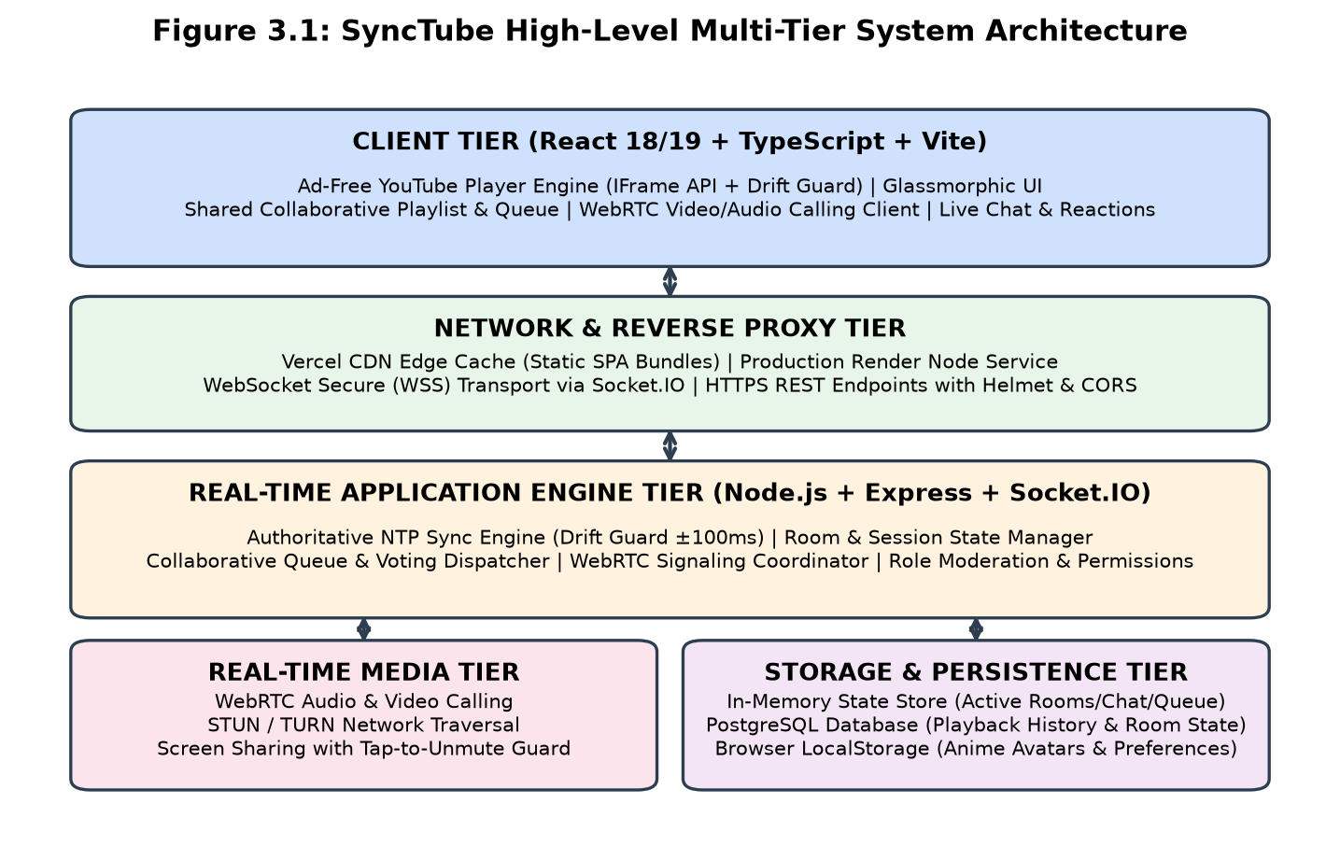
9. SYSTEM ARCHITECTURE
System Architecture & Engineering Stack
Built with modern, production-tested full-stack web technologies
CORE TECHNOLOGY STACK
• Client Frontend: React 18/19, TypeScript, Vite, Glassmorphic CSS with ambient player lighting.
• Real-Time Engine: Node.js, Express, Socket.IO v4 full-duplex WebSocket bus with Zod validation.
• Media Calling: WebRTC (RFC 8825) with Google STUN and configurable TURN traversal.
• Data Tier: In-Memory volatile store (sub-millisecond room state) + PostgreSQL history database.
• Cloud Edge: Deployed on Vercel CDN (Frontend) and Render Cloud (Backend Server).

Slide 11
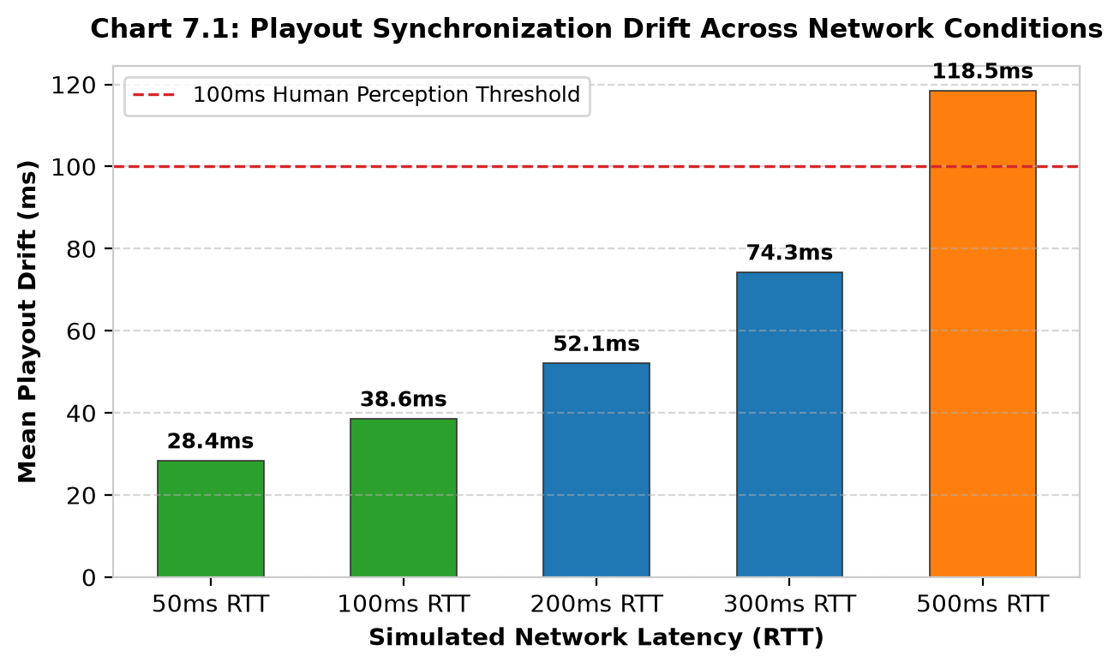
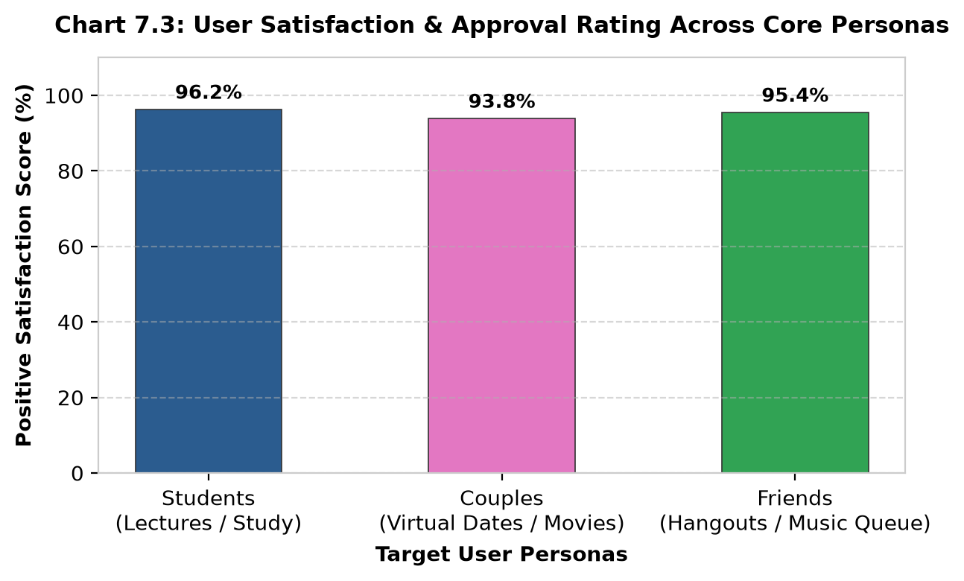
10. RESULTS & BENCHMARKS
What Makes the Project Successful?
Empirical performance testing and user satisfaction metrics

Slide 12
11. SUMMARY & ROADMAP
Our Core Pitch & Future Roadmap
Transforming isolated video watching into a shared, productive, and fun social reality
🎯 OUR CORE PITCH
“SyncTube brings people together to watch YouTube in perfect real-time sync. With zero ads, zero algorithmic distractions, instant 6-character room codes, collaborative playlist voting, and integrated video calling, it is the ultimate shared viewing platform for students, couples, and friends.”
🚀 FUTURE SCOPE & ENHANCEMENTS
• Multi-Region Redis Pub/Sub Cluster: Scale room state horizontally across global cloud servers for international watch parties.
• Progressive Web App (PWA): Enable mobile background audio and Picture-in-Picture (PiP) support for smartphones.
• AI Real-Time Subtitles: On-device speech-to-text generating real-time multilingual subtitles for educational lectures.

