Slide 1


THE G7 CONCEPT OF BUSINESS ENGLISH PRESENTED IN FOUR PARTS

Slide 2

THE G7 CONCEPT
PART 1

Slide 3
BUSINESS ENGLISH PLUS PERFORMANCE TRAINING PLUS COMMUNICATIONS SKILLS ALL TOGETHER

Slide 4
1. BUSINESS ENGLISH
Learn how to speak and write better
Enhance your language skills
Small talk and Business talk
Develop confidence to speak naturally

Slide 5
2. PERFORMANCE TRAINING
Learn how to do business with foreigners
Learn about different cultures
Understand social and behavioral styles
Sales & marketing communication skills
Develop performance business thinking

Slide 6
3. COMMUNICATION SKILLS
Develop global communication skills
Learn how to do business with …
Westerners, Easterners, ‘Resterners’
Develop country-specific business skills
Learn business-specific vocabulary

Slide 7
STARTING POINT
G7 helps businesses make more profits and grow faster through performance-based consulting, coaching and training
We start by working with clients to understand their business and their needs
What is their strategy?
What are they trying to achieve?
How can we help them?

Slide 8

IS GROWTH IMPORTANT?
If growth in sales, profits and market share is important to a client, then G7 is their best choice.
G7 has the ability to meet any client’s training needs of today and tomorrow

Slide 9
OPERATIONAL RESULTS
Future sales, profits, growth
This is where they want to be in the future
GAP
This is where the business is now
Current sales & profits

Slide 10
STAFF PERFORMANCE
Future Performance
This is what their staff performance level needs to be
GAP
This is their current staff performance level – to produce current business
Current Performance

Slide 11
FULL PICTURE
Operational
Results
On the job
people performance
4. Future
$ales,
profits, &
growth
3. Higher
performance
staff
High performance staff create best results
Staff development with harmony
Business Growth plan
Gap in $ales
results
Gap in Staff
Performance
2. Current
$ales
Current staff cause current results
1. Current staff
1 causes 2
3 will create 4

Slide 12

DYNAMIC FRAMEWORK
Normal business growth
Ambitions
Goals
G7 training:
‘the shortcut’
Current
Business
THE G7 DEVELOPMENT PLATFORM
Working in harmony with clients
Co-developed training programs
Constant performance reviews
Ongoing testing and assessments
High performance training methods
Best possible trainers
C&D
Connect & Develop

Slide 13
How we determine the best program
THREE LEVELS OF TRAINING
General Business English
Specific Business Subjects
Performance Communication skills
G7 BLENDS ALL THREE TOGETHER

Slide 14
The G7 Advantage
PROFITS $$$$$
Directors who consult, coach and train
Selected qualified trainers with business and training experience
The G7 family of training materials
Full accountability! No wasted money
Flexibility in venues, times, schedules
Full understanding of global business

Slide 15
Decision
yes
YES
We strongly recommend that clients consider the great value of the G7 Advantage
G7 programs cost about the same as others –
but only G7 offers the G7 Advantage
The G7 Advantage is 100% proven in Korea
With G7, it’s a Win-Win solution
G7 YOUR PARTNER IN SUCCESS

Slide 16
PART 2
THE G7 METHOD IS SPECIAL

Slide 17
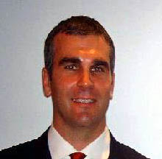

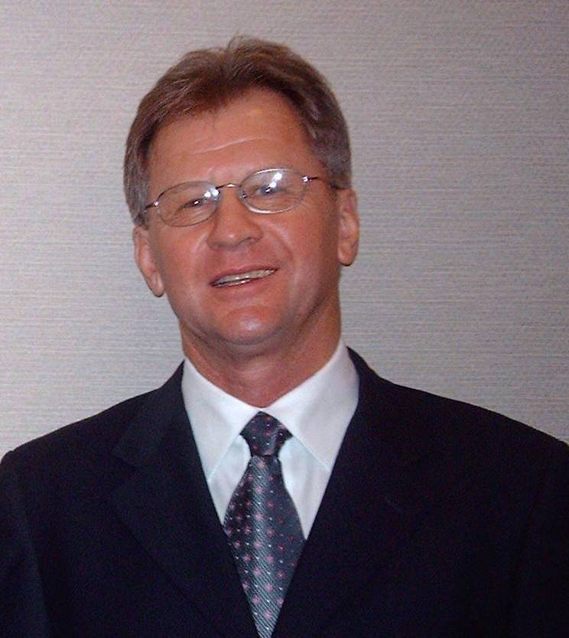
WHY IS THE G7 METHOD SPECIAL
THE G7 CONCEPT versus REGULAR BUSINESS ENGLISH
Jon Scott President
“Raising the standard of
Business English Education
in Asia”
www.g7english.com
info@g7english.com
Dr. Ian Kirkwood

Slide 18
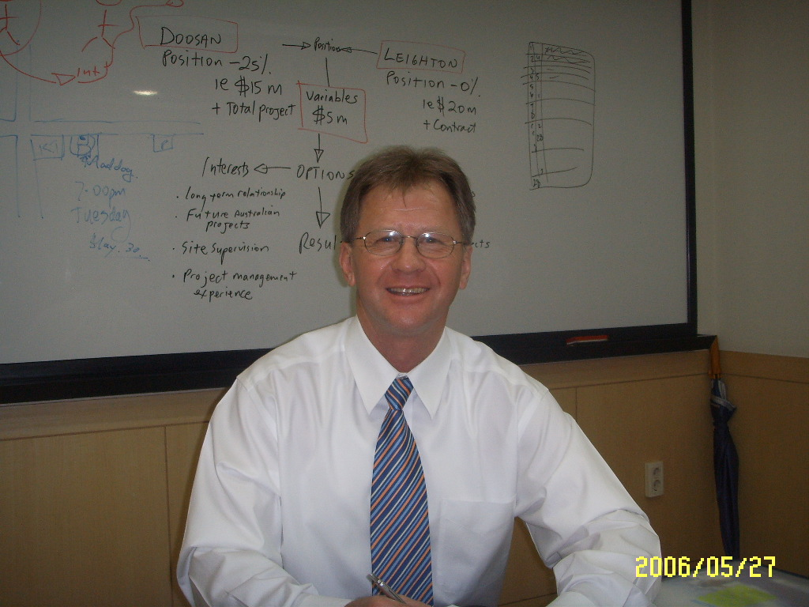
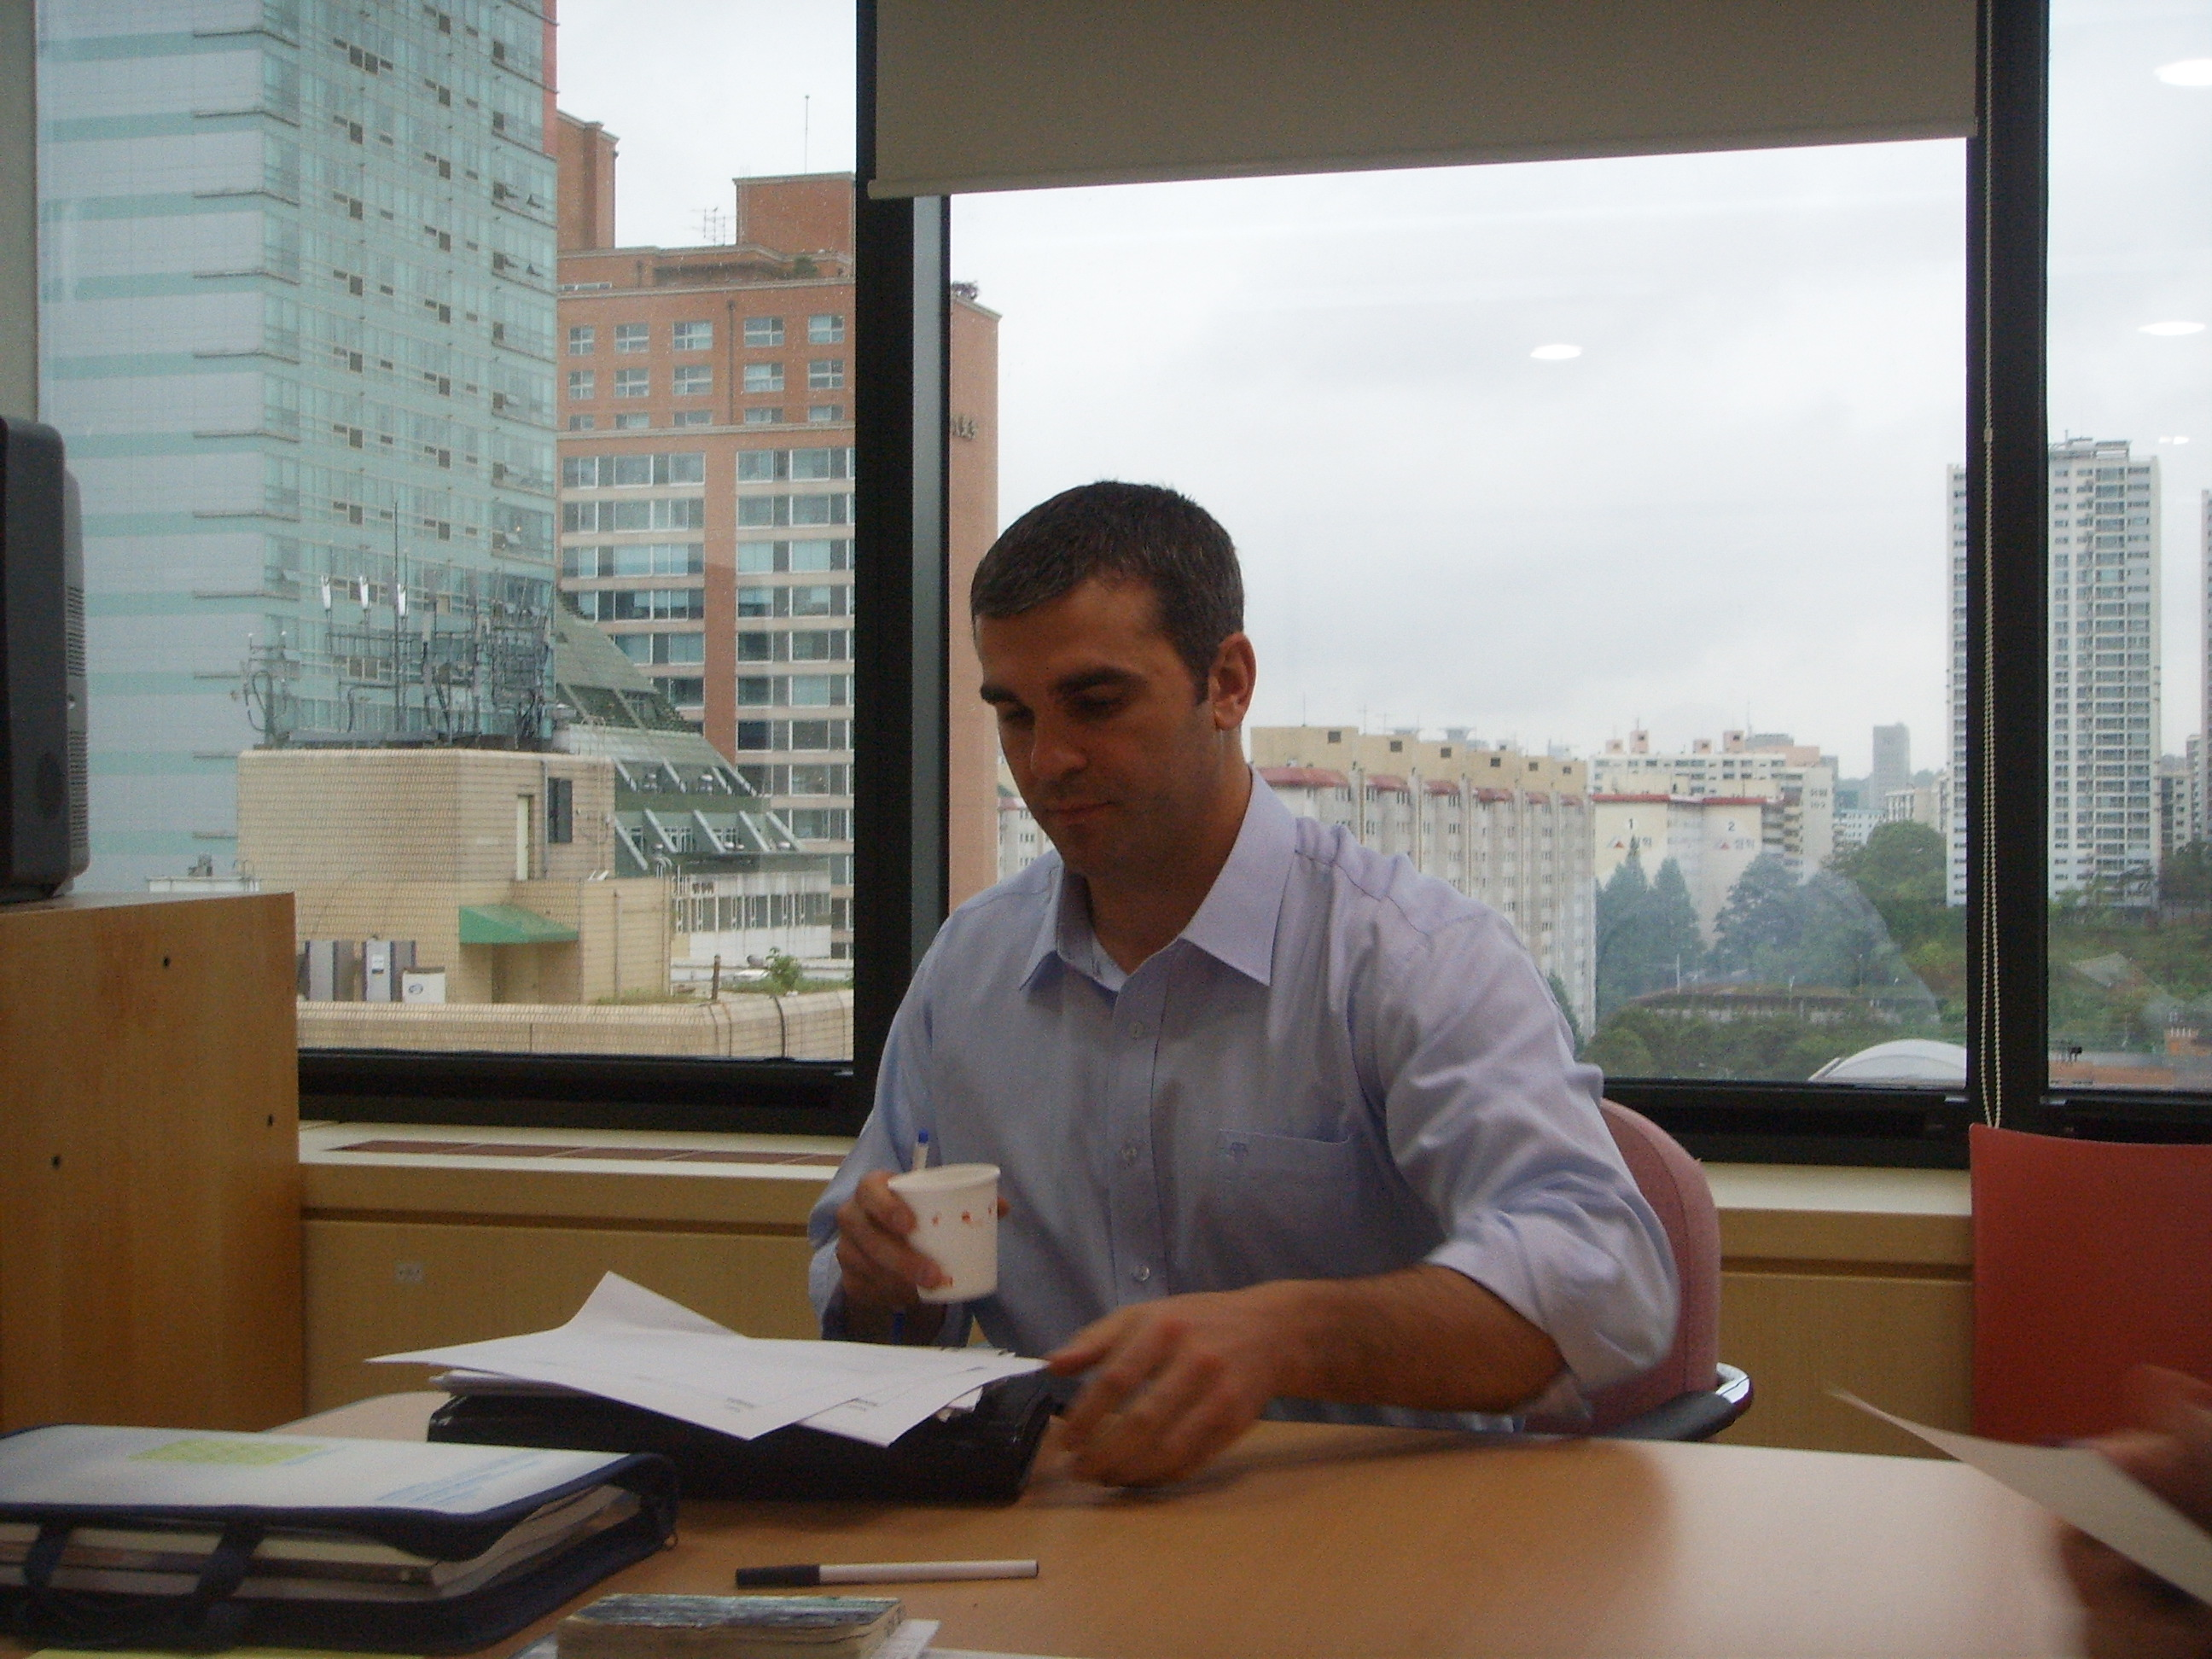
TO KNOW THE BUSINESS …
… KNOW THE CREATORS
G7 and TBC® were created by Jon Scott and Ian Kirkwood based on research undertaken on Korean students of ‘Business English’.
Ian and Jon believe that Asian students need a much better form of education if they are to be effective communicators in global business in the 21st Century.
TBC ® is 100 percent unique. No-one else can offer the same programs or the same long-lasting benefits.
All materials and workbooks used by G7 have been personally written and created by Ian and Jon.
Ian Kirkwood
Australian. Co-founder and Director. Three years in Asia. Majors in Engineering, Marketing, Business Administration and Education. Background in corporate management. Co-developed wide range of performance programs for Asian managers and executives
Jon Scott
American. Co-founder and President of G7 Korea. Six years in Asia. Majors in Psychology and Business Administration. Background in business ownership and B2B sales. Trained and coached hundreds of business managers and University students in Asia
Meet the co-founders of G7
Creators and developers of TBC® ‘Total Business Communications’ concept of Business English Education

Slide 19
DIFFERENCES IN
TEACHING METHODS
Traditional Language Academies - Regular Business-English
versus
The New and Improved Method from G7

Slide 20
TRADITIONAL EDUCATION IS FOCUSED ON INPUT
BUSINESS PERFORMANCE IS BASED ON OUTPUT
BUT
INPUT
Information
Knowledge
Data
Stuff
OUTPUT
Inert knowledge
Activated Ignorance
Activated Knowledge

Slide 21
Regular Business English
Relatively unimportant and
disconnected
information taught in
classroom
Low retention of information
due to lack of
connection to career or life
in the real world
Majority of information lost -
never used outside classroom
Inert Knowledge
Activated Ignorance

Slide 22
G7 Method
Communication structure is
organized - can be
progressively built up -
Applies to private
and business issues
Activated Knowledge
Information has a specific
purpose – and is
important to the person for
both life and career.
Language, ideas and concepts
are regularly used in life and
‘on the job’
A
B
C

Slide 23
WHAT DOES THIS MEAN
Inert Knowledge:
Things you learn just to pass an exam
Knowledge that doesn’t mean anything to you
Things you know about but never use – or can’t use
?
Activated Ignorance
When you have learned something that is not correct
When you believe something is right, but it is in fact wrong
Believing everything in the newspapers and on television
X
Activated Knowledge
Things you have learned that you can use in your job and your life
Things you know that are true and correct
Knowledge you have that can be proven correct or proven true
√

Slide 24
THE CHOICE IS YOURS
Regular
Program
X
?
G7
Program
√
G7 – Great Training, Great Coaching … Basis for future knowledge!

Slide 25
PART 3
THE G7 MODEL OF BUSINESS ENGLISH
(a technical explanation)

Slide 26
G7 BUSINESS ENGLISH MODEL
Advanced
Students
Intermediate
Students
Basic
Students
L/T 10
L/T 7.0
L/T 3.5
L/T 0.0
GBC-A
SBC-A
PBC-A
GBC-I
SBC-I
PBC-I
A Level Test score of 3.5 is average for Koreans
This places Koreans at an extreme disadvantage to most other nationalities
GBC
(General Business Communications)
Basic Level
This is the starting point for all Business English students
L/T = Verbal level test score 0.0 = Cannot speak any English 3.5 = Average for Korean business people 7.0 = Quite good 10 = Similar to a ‘native’ English speaker
GBC = General Business Communications – Regular Business English education
SBC = Specific Business Communications – English for Specific Purposes
PBC = Performance Business Communications – Business Communication Skills

Slide 27
GENERAL BUSINESS ENGLISH
GBC
GBC
General Business English
and
General Business Communication skills
WARNING!!
Most organizations only teach General Business Communications.
Why? Because they employ English Teachers – and most English teachers do not understand business
This is what is taught in the majority of Business English programs
No SBC
No PBC

Slide 28
SPECIFIC BUSINESS ENGLISH
SBC
NOTE!!
There are organizations that specialize in the teaching of specific business subjects such as Marketing, Finance, Accounting and so on…
…BUT…..
students only learn specific subject knowledge – and still cannot speak properly with foreigners when the training is over
Intermediate and Advanced
Students
SBC-A
SBC-I
The subjects are mostly taught in Universities - or as ‘vocabulary specific’ training
No teaching or training at the basic level
No GBC
No PBC
SBC is also called ‘English for Business’ or ‘Business in English’

Slide 29
PERFORMANCE BUSINESS COMMUNICATIONS
PBC
NOTE!!
There are organizations that specialize in Performance training, particularly in Presentation skills, Negotiations and Meetings …
BUT…..
These ‘performance’ subjects are mostly only General Business Communications as they are usually taught by teachers who have no experience in Sales or Business
Intermediate and Advanced
Students
L/T 10
L/T 3.5
PBC-A
PBC-I
Basic level
(cannot be properly taught to lower level students)
No GBC
No SBC

Slide 30
TOTAL BUSINESS COMMUNICATIONS
GBC PLUS SBC PLUS PBC
G7 groups GBC, SBC and PBC together as Total Business Communications
L/T 10
L/T 3.5
L/T 0.0
GBC, SBC, PBC
This is the area that G7 specializes in
Intermediate and Advanced students all working together
GBC + SBC + PBC
Lower level
Students
GBC
(General Business Communications)
GBC
SBC
G7 creates high quality programs for Intermediate and Advanced students – ‘Total Business Communications’
PBC

Slide 31
G7 TYPICAL PROPOSAL
PART 4

Slide 32
G7 Training Program
Intensive Business Program (IBP)
Program Overview
Objectives – What do we want to achieve?
Curriculum – How will we achieve it?
Syllabus – What are the programme specifics?
Measure – How will achievement be measured?

Slide 33
G7 Training Program
Program Objectives
To help students conduct and win business from non-Korean speaking customers
To help students bridge gaps between Korean and foreign business practices
3. To help students develop confidence in their abilities to conduct business in English

Slide 34
G7 Training Program
OVERVIEW
Title: Intensive Business Program (IBP)
Duration: Weekday Program
Time: 09:00 – 17:30 M-F, or 06:00 – 09:00 M-W-F
**Program duration is variable to suit individual clients.
Subjects: The program includes – Presentation skills, Sales and negotiation skills, B2B Marketing, Business small talk, Cross-cultural skills, and Interpersonal skills

Slide 35
G7 Training Program
Syllabus
Program divided into three units
Unit 1: Inter-cultural, Inter-personal skills
Unit 2: Communications & Presentations
Unit 3: Business and Management

Slide 36
G7 Training Program
Unit 1. Inter-Cultural, Inter-Personal Skills
This unit assists students to communicate with a wide variety of people – East, West, Rest (L2-L2 … L2-L1)
Areas covered include –
- biz small-talk, transactional communications, social and behavioral styles, developing cross-cultural people skills, sales-negotiation skills

Slide 37
G7 Training Program
Unit 2. Communications & Presentations
This unit assists students to actually win business from foreigners, either in Korea or overseas
Areas covered include –
- performance business communications, marketing skills, Presentations, Public speaking, Negotiation skills, Communication strategies

Slide 38
G7 Training Program
Unit 3. Business Management
This unit assists students in two ways:
Developing a clear understanding of the key areas of business – Strategic and Operational
Areas covered can include –
- Business skills in Supply Chain Management, Marketing and Finance, Growing company value, Corporate Sustainability, Innovation & Entrepreneurship, and Globalization

Slide 39
G7 Training Program
Program Expectations
To know yourself and others better - to develop your own personal communication strategy
To have a clear understanding of the key areas of global business – and how to win new business
To develop both confidence and skills in communicating with a wide range of foreigners

Slide 40
THE MOST ADVANCED BUSINESS ENGLISH EDUCATION AVAILABLE
KOREA Jon Scott
Tel: 010-8699-9821
Jon@g7english.com
www.g7english.com
AUSTRALIA Ian Kirkwood
Tel: 0400 143 063
ian@g7english.com www.g7english.com
G7 Communications
Korea & Australia
G7 Communications – Consulting, Coaching, Training, Education

