Slide 1
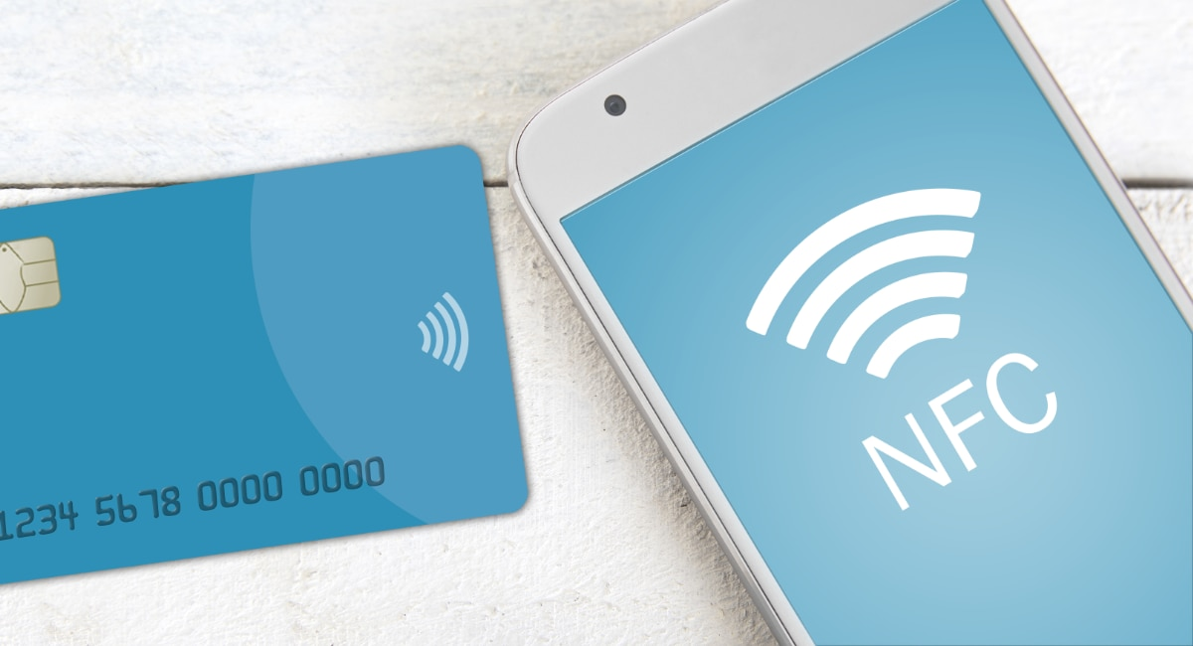
PAYEAZY
Team:
Avinash B
Sai Krishna P
Srikanth M

Slide 2
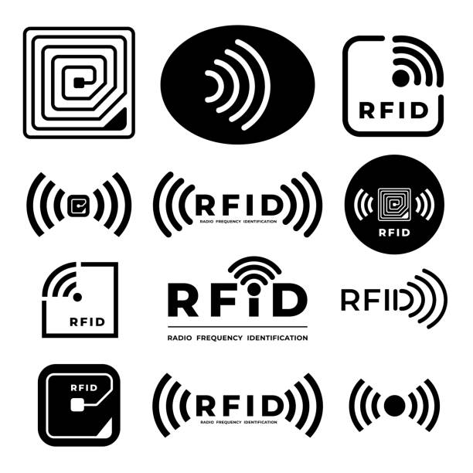
NFC Technology
Near Field communication
Short-range wireless RFID technology which used low speed signals to allow two devices to automatically start communicating when they are close to one another.
RFID:
A mobile phone with a RFID tag is a mobile device that includes a RFID chip with some identification information programmed on it. Besides a cell phone antenna used for connection to the network operator, the phone contains a RF antenna for communication with RFID readers.

Slide 3
USE OF PAYEAZY – THE IDEA AND THE APPLICATION
Novel, but Realistic & Implementable idea – Technology Feasible, Economically Viable
Frictionless, Easy Acceptability by end-users, as customers are used to making tap-payments.
Cost Savings for Merchants.
Increased Revenue for the bank & reduced dependency on Vendor for mobile devices.
Should be good enough to go with Responsive UI.
Should be able to integrated with Backend.

Slide 4
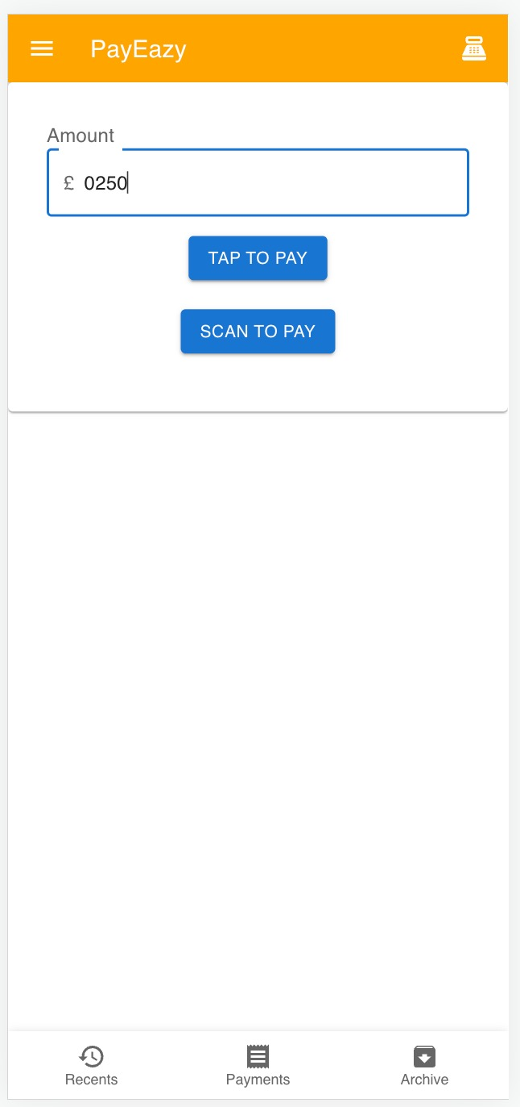
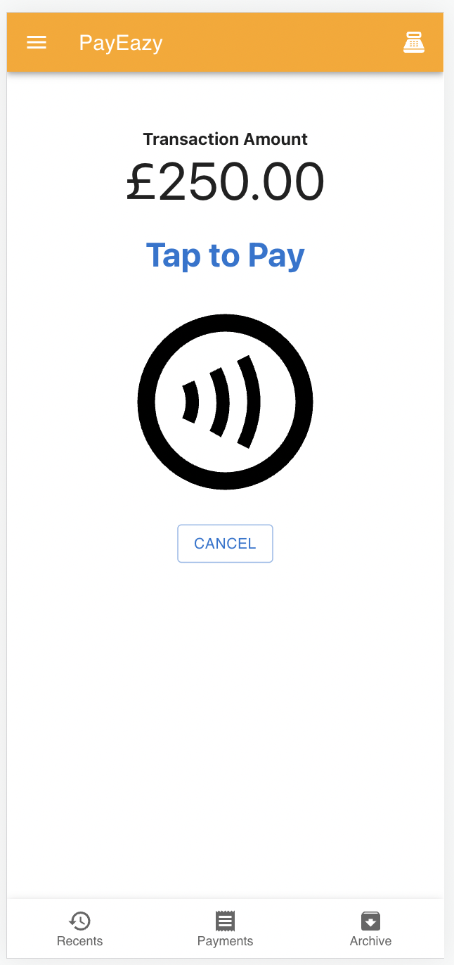
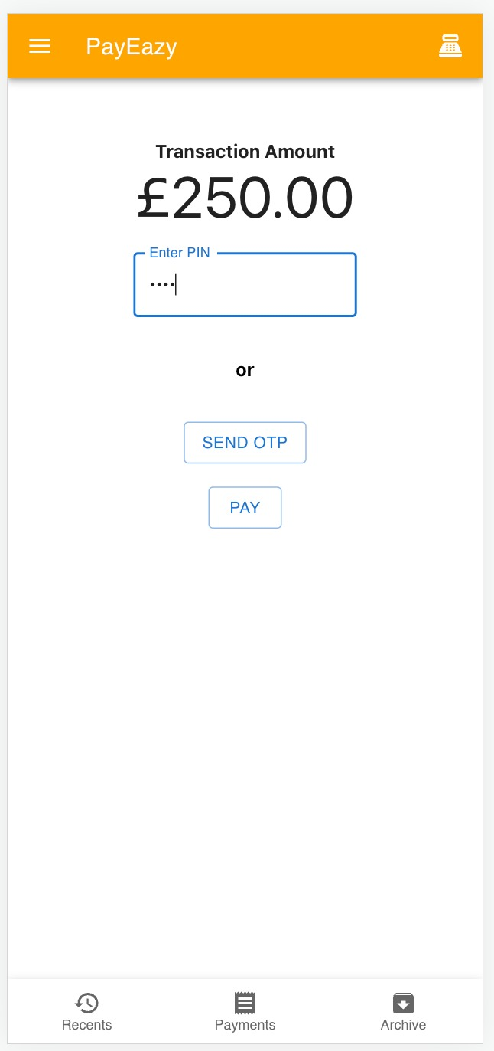
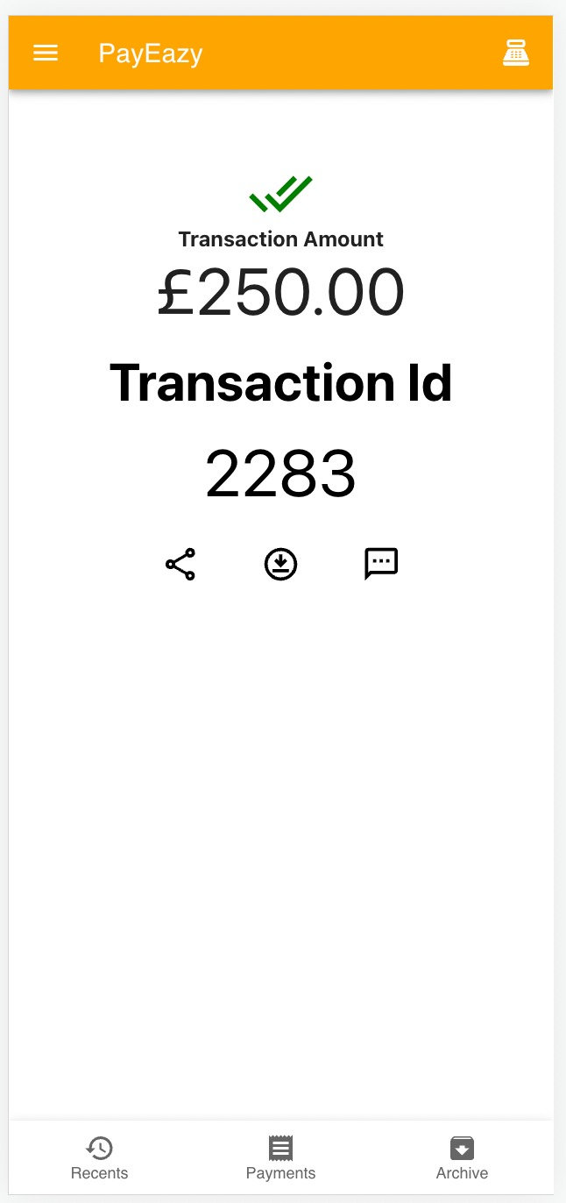
APP SCREENSHOTS – TAP TO PAY FEATURE

Slide 5
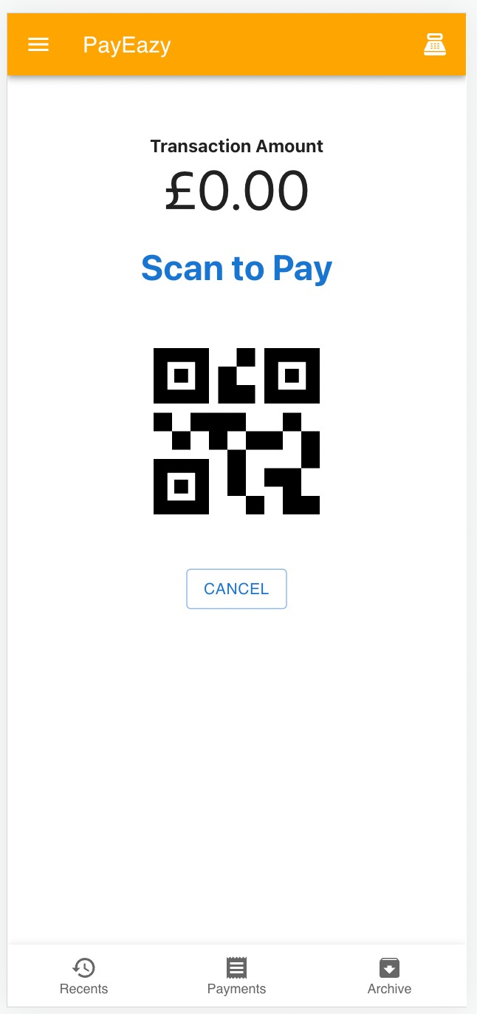
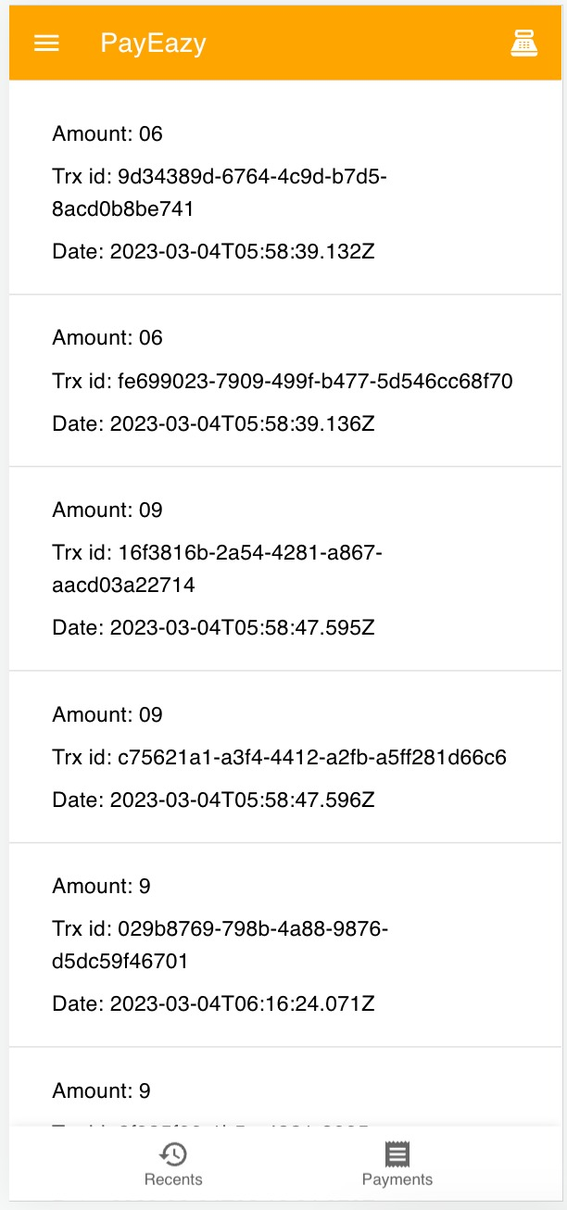
APP SCREENSHOTS – SCAN TO PAY FEATURE

Slide 6
Solution Benefits
$$$avings for Merchants – No specialized & expensive hardware.
Improved Customer experience for Merchants.
Any phone - Works on any NFC enabled Android/IOS phone.
Any where - Convenience fee for On-the-go workers / Popup stores.
Any time- Instant setup, no waiting for shipping of physical devices. Start accepting payments from day-one!
Multiple payment methods – NFC, QR-code based payments like UPI
Value added service – Can integrate with other business applications, such as scanning the product b barcodes using
camera, managing the inventory of items sold, tracking Sales etc.
Revenue Opportunities for the Product owner.
New merchants can be onboarded in digital payments ecosystem, resulting in increased revenue from Transaction fees.
Increased Monthly fee (for app subscription and other services)

Slide 7
Product Features
Enhancements
MVP
Accept Payment through NFC (Tap to Pay)
Accept Payment through QR code (Scan to Pay)
Share transaction receipt through email, SMS and Print
View & export Transaction Reports
Checkouts – Scan product Barcode using mobile cameras
Inventory Management – Integrate with ERP software to adjust the inventory sold through barcode scanning
Sales Reporting

Slide 8
Problem Statement & Market Research
Market
Digital Payment = $5.44T in 2020, $11.29T by 2026, CAGR = 11.21%
Proximity mobile payments penetration = 43.2% with CAGR = 15%(2021-2028)
130mn SMB merchants do not accept card payments
For Merchants
1 of 3 merchants quotes the cost of a payment solution
Lead / Set up time of 10 – 15 days, preventing a merchant from accepting card payments and the device is ready to use.
For the Product owner:
Dependency on 3rd party vendor for hardware: E.g., stock out due to semiconductor chip shortage, Volatile device prices regarding effort for updating

Slide 9
Customer personas / segments
Small Business
A small business owner with < $500k annual sales
New business, multiple payment counters, needs to accept card payments
Pain point:
High set-up Cost – expensive POS devices(upto $665 per device)
High set-up Time – Upto 10 days for shipping the device
Popup stores & On-the-go workers
A temporaty / semi-permanent pop-up store with limited counter space e.g.m Foodtrucks, Farmer’s market.
On-to-g0 / gig worker without physical address e.g., Delivery persons, Taxi Drivers
Pain point:
No permanent physical business address to order device
No infra / counters to manage devices.

Slide 10
THANK YOU

