Slide 1

MODEL PREDICTIVE CONTROL BASED TRAJECTORY GENERATION FOR LOW SPEED SCENARIOS
Author : Krishna Satish Deshkulkarni Shankaranarayana
Supervisor_1 : Alexander SCHNELLE
Supervisor_2 : Dhruv Chad
Professor : Dr. Armin Arnold
November 2021

Slide 2
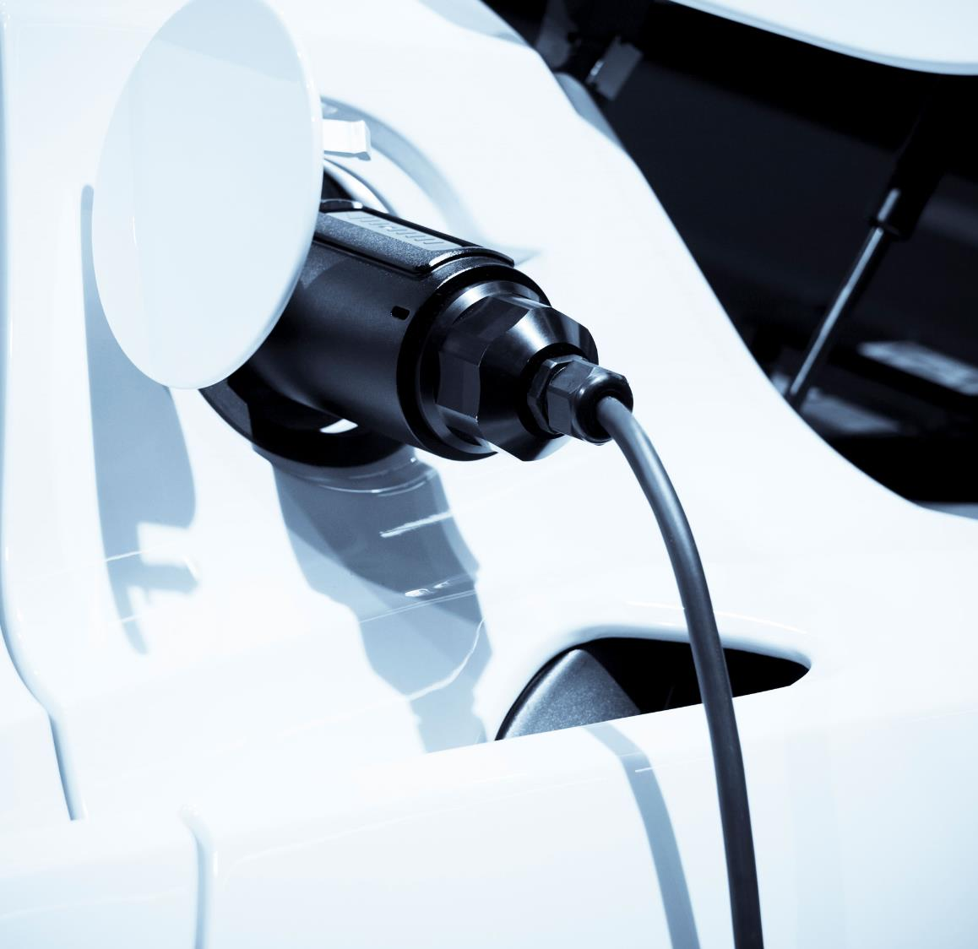
Agenda
Motivation
Potential Solutions
Model Predictive Control
Motion Models
Constraints
Current and Future Steps
Implementation Process
Expected Results
Thesis Timeline

Slide 3
Motivation
Path planning in autonomous driving-
Path planning, also Motion planning is a computational problem to find a sequence of valid configurations that moves the object from the source to destination.
Types of planning methods,
Global Planners
Dijkstra Algorithm
A*
Local Planners
RRT
RRT*
Lattice planners

Slide 4
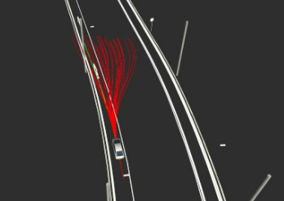
Motivation
Issues with the current approach in our project (Lattice planner)
Generation of many trajectories at once
Choosing best trajectory based on some cost
Discarding all remaining trajectories
Wasting the computation on generating
non feasible trajectories

Slide 5
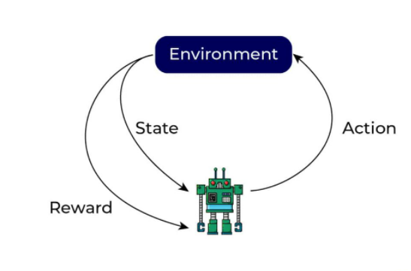
Potential Solutions
Reinforcement based learning approaches
Pros :
Self learning algorithm
No special data set required
Cons :
Requires many episodes to get acceptable performance
Inherently a black box approach
Requires a lot of computation
Can’t be deployed on real hardware during learning

Slide 6
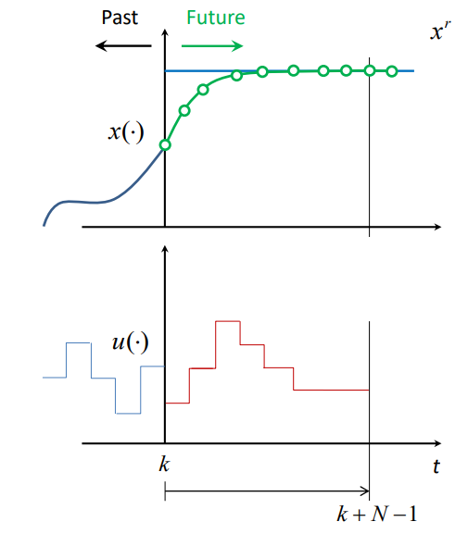
Potential Solutions
Model Predictive Control approaches
Pros :
Easy to specify constraints for states and controls
Prediction can be done not only for immediate next state unlike
other predictions but for a many steps ahead in time
Can handle MIMO unlike PID which is SISO
Cons :
Accuracy depends on the model system dynamics
Requires fairly decent computation power
(Not a limitation any more with fast CPUs)

Slide 7
Model predictive control
Idea here is to use MPC to generate only one optimal trajectory which satisfies all the constraints

Slide 8
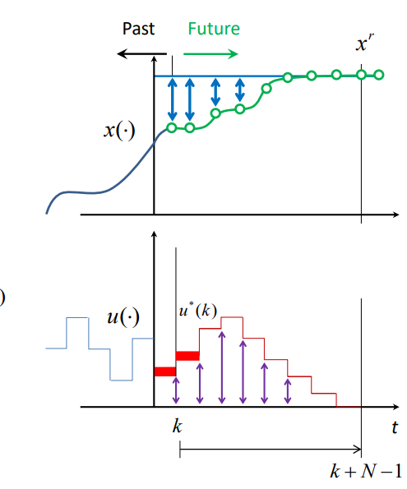
Model predictive control
The basic idea of MPC is to predict the future behavior of the controlled system over a finite time horizon and compute an optimal control input that, while ensuring satisfaction of given system constraints, minimizes an a priori defined cost function.
Types of MPC
Linear Time Invarient MPC
Linear Time Varying MPC
And Many More

Slide 9
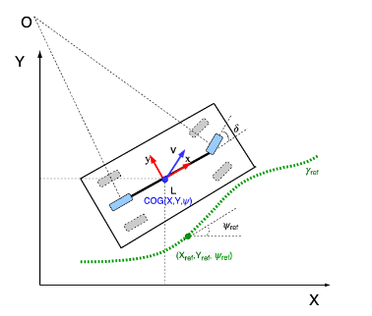
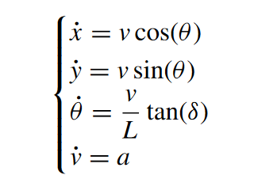
Motion Models
Kinematic Bicycle Model
Small angle consideration
No load transfers
Dynamic Two Track Model
(possible future step)

Slide 10
Constraints
Motion Model
Input state [x, y, v, theta]
Output control action [acceleration, steering_angle]
Map boundaries
Obstacle avoidance [Static, Dynamic]

Slide 11
Current progress and future steps
Matlab implementation of MPC with Kinematic bicycle model with CasADi modeling language
Python implementation
Object oriented deign
Table of Content Creation
Vizualization of generated trajectories
Carla integration and Validation
Scenario Definition
Scenario Validation and Tuning
Comparision between different Motion Models*
Case study on solver parameters*
Documentation
* → if time permits

Slide 12
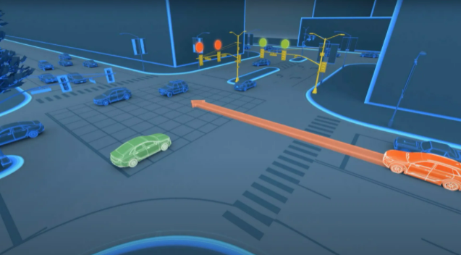
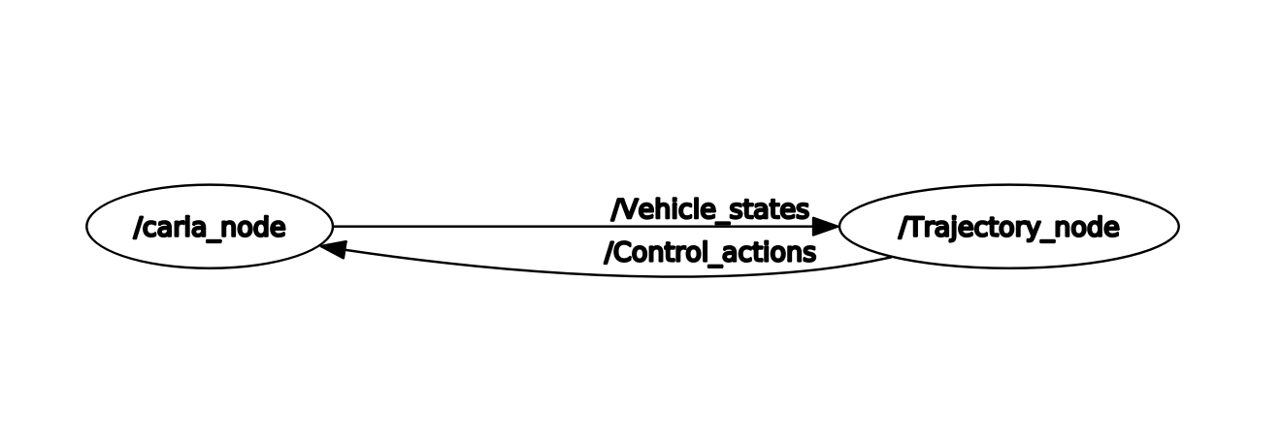
Expected results
Generation of only one optimal trajectory respecting all the required constraints
Implementation in ROS2 and Carla
Compare Lattice and MPC*

Slide 13
Timeline of thesis

Slide 14
Thank You

