Slide 1

MODEL PREDICTIVE CONTROL BASED TRAJECTORY GENERATION FOR LOW SPEED SCENARIOS
Author : Krishna Satish Deshkulkarni Shankaranarayana
Supervisor_1 : Alexander SCHNELLE
Supervisor_2 : Dhruv Chad
Professor : Dr. Armin Arnold
December 2021

Slide 2
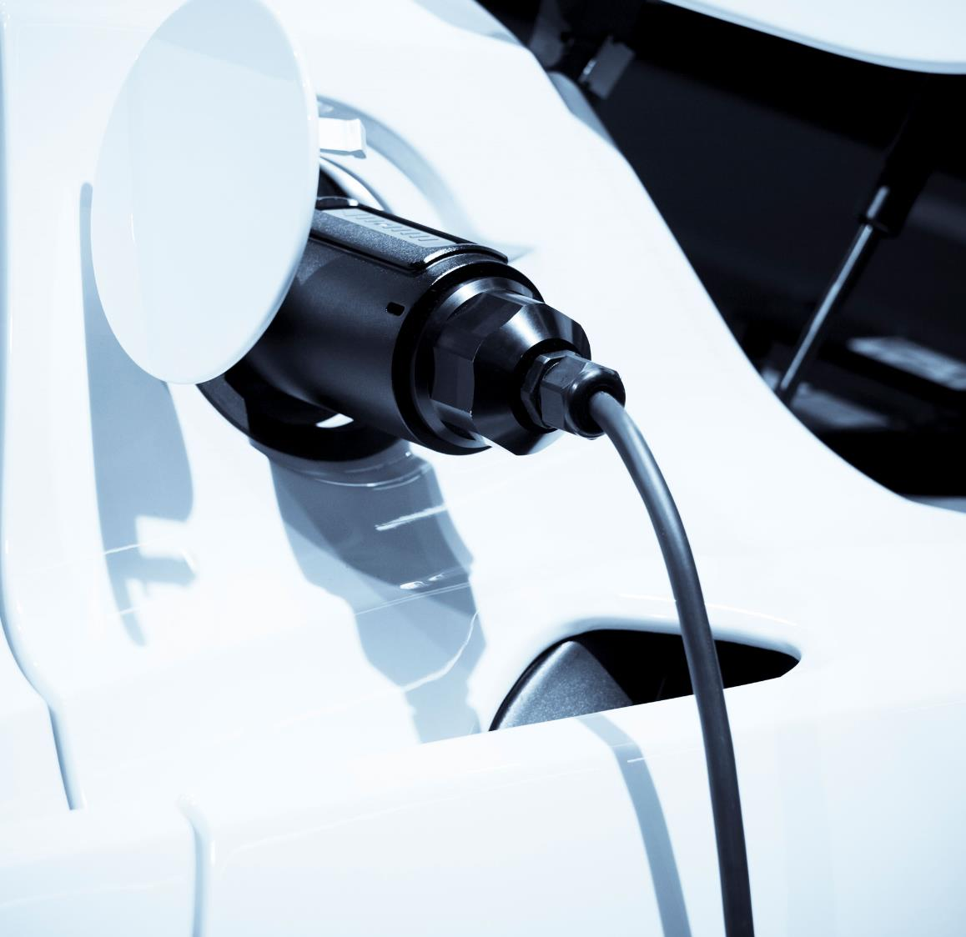
Agenda
Recap about the previous meeting
Past work
Current work
Planned future work
Expected Results
Thesis Timeline

Slide 3
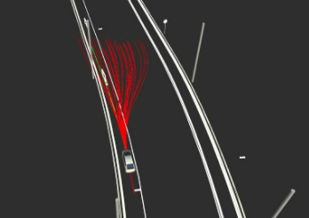
Recap
Problem statement : Efficient and Robust trajectory planning for autonomous vehicles,
Proposed approach : Model Predictive Control(MPC) with single track model as a plant model.

Slide 4
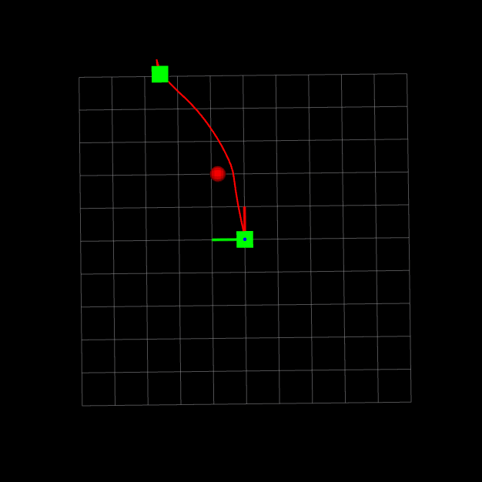
Past work and achievements
Matlab implementation of MPC with Kinematic bicycle model with CasADi modeling language.
Python implementation.
Object oriented deign.
Vizualization of generated trajectories.

Slide 5
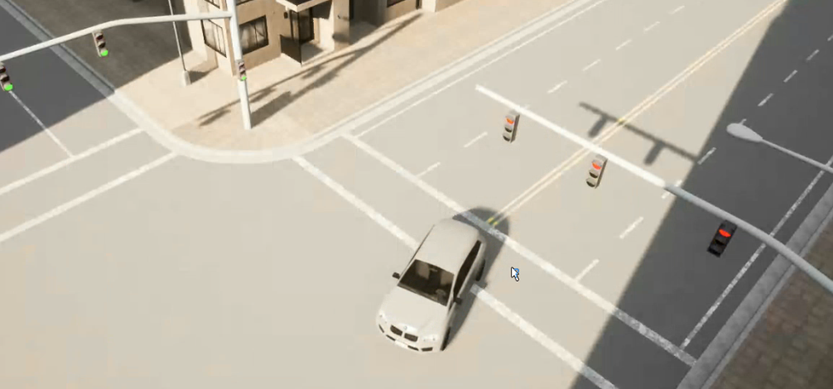
Current work
Carla integration and Validation
Scenario Definition
1. Straight line driving
2. Right turn
3. Left turn
4. Static obstacle overtaking
New feature requests:
1. Dymapically updating Map boundaries
2. Dynamic obstacle overtaking

Slide 6
Future work
New requirements and features (if any)
Documentation

Slide 7
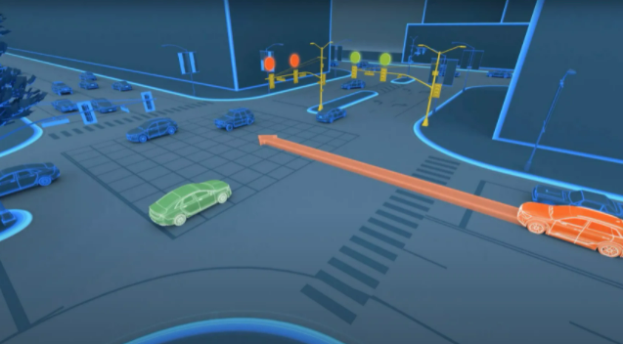
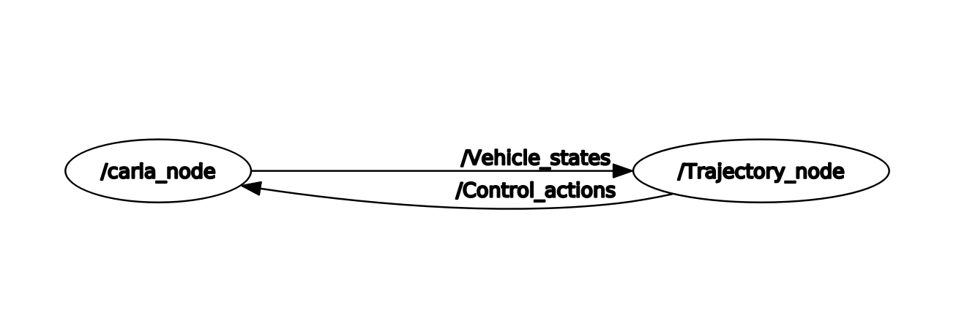
Expected results
Generation of only one optimal trajectory respecting all the required constraints
Implementation in ROS2 and Carla (finished)
Compare Lattice and MPC*

Slide 8
Timeline of thesis

Slide 9
Thank You

