Slide 1
Word Embedding
Project By – Krishna Adatrao

Slide 2
Natural Language processing
Nlu + NLG = NLP

Slide 3
Natural language Processing ?
Before knowing about Word Embedding, we must get familiar with the concept of Natural Language Processing (NLP) Natural Language Processing: NLP is the concept based on two main sectors they are 1. Natural Language Understanding – NLU 2. Natural Language Generation – NLG

Slide 4
Natural Language Processing ?
In general, both NLU and NLG tasks must work together to process the textual data and get the outcome from an agent. The interactive nature between human and an agent can be processed using NLP
As system can not progress the textual data, NLU is the task-oriented vector building concept which process the textual data into numerical form which can be understood by the system to process the user instances
The vectorization can be based on any word embedding model likely NLTK, Word2Vec, One Hot, TF-IDF (Term Frequency Inverse Document Frequency), BM-25 and so on
However, in general the concept here is passing the information to the system in its understandable language to make the task complete and to revert the information back to the user
Furthermore, at the other end of the system NLG is also vectorized task which generates the information or data retrieved by an agent in the way of human perception
Further, deep drive through the concept includes the Conversational Search, Information Retrieval, Recommender Systems, Dialogue Management System, Dialogue Flow, and so on. These concepts are emerging now-a-days with the support of NLP
Though NLP base concept is interchanging the data between user and the system, Natural Language Processing also amalgamates English words based on the n-gram concepts which can be included in prediction concepts where the concept of ML and DL Jump into. The neural networks can be applied to NLP document retrieval task to make the tasks more optimal and efficient

Slide 5
NLP - Preprocessing
Before preprocessing the textual data, we need to use normalization techniques to protect the algorithm from inadequate data
One of the popular technique of normalization in python is Regular Expressions which is a basic text processing module

Slide 6

NLP - Overview
N-Grams and Language Models
Vector Semantics and Word Embeddings
Text Classification
Sentiment Analysis
Modeling Text – Named Entity Recognition
Supervised Machine Learning
Neural Nets and Neural Language Model

Slide 7
Word Embedding ?
Text Analysis in Natural Language Processing - NLP

Slide 8
Word Embedding ?
Word Embedding is a concept of text analysis in Natural Language Processing
Word Embedding is a vectorized task which deals with the words in the data, each word has its unique meaning which are encoded into a unique real-valued vector
Which leads to getting more feature extractions likely, the vector encoded words which are closer in the vector space are treated as having similar textual meaning
Word Embedding relies on the techniques likely, Language Modeling, and Feature Learning where words or phrases are mapped to the specific vectors (real-numbers)

Slide 9
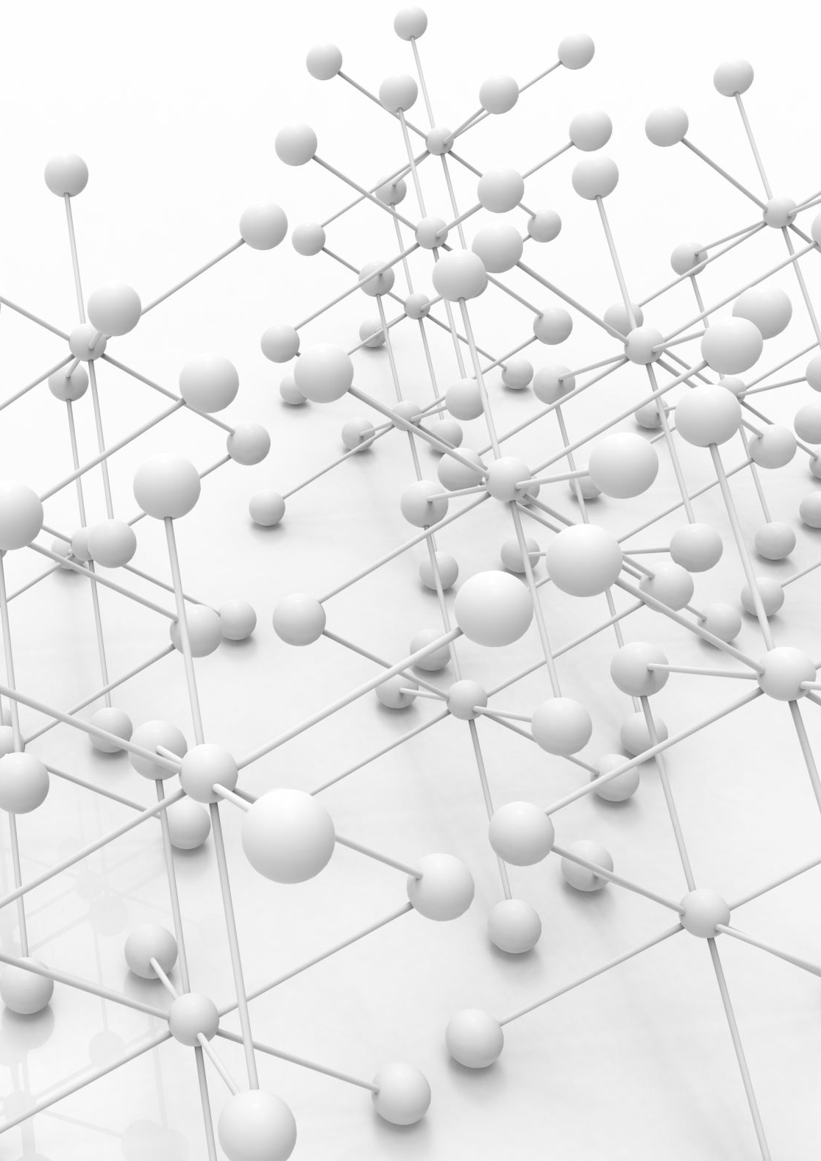
Word Embedding - Methods
Neural Networks
Neural Networks is a continuous space language model (continuous embedding of phrases)
Dimensionality Reduction
Is the change of information from high-dimensional space to low-dimensional space without change in meaning
Co-occurrence Matrix
Is a matrix format that is illustrated over an image to be the distribution of co-occurrence pixel representations. Especially used in medical image analysis
Probabilistic Models
Probability based approach

Slide 10
Contextualized word embedding
Contextualized Word Embedding:
Representing the phrases or terms in a sentence according to their context
The meaning of a word or phrase in a sentence can be almost predicted depending on the terms that are frequently occurring with the targeted word. This kind of methodology of predicting the weightage and meaning of a term is called Distributional Semantics
Example:
I went to office to do the pending work which is so tough to complete everything at a time.
She is been doing that work since day one, but she still could not figure it out.
Context
Words

Slide 11
Language Models
Language Model is a benchmark task that helps us measure our progress on understanding language
Language Model is one of the key component in NLP, especially in the task of generating text or estimating e probability of words
Language Models:
Unigram Language Model
Bigram Language Model
N-gram Language Model

Slide 12
Language Model – N gram
Goal: Compute the probability of a sentence or sequence of words P(w) = P(w₁, w₂, w₃, w₄, ......, w_{n}) → Probability of an upcoming word: P(w₅ | w₁, w₂, w₃, w₄, .......) → A model that computes P(w) or P(w_{n} | w₁, w₂, w₃, w₄, ......, w_{n-1}) is called a Language Model

Slide 13
Word Embedding – training
Words or Phrases can be trained as vectors by various training models likely,
Word2Vec
GloVe (Global Vectors – Distributed Word Representations)
GN - GloVe (Gender Neutral variant of GloVe)
BERT (Bidirectional Encoder Representations from Transformers)
NLTK (Natural Language Tool Kit)
Keras / TensorFlow
Gensim (unsupervised topic modeling)
PyTorch

Slide 14
Word2vec
Word2Vec is a concept of Natural Language Processing where the textual phrases is been transformed to unique real-valued vectors.
Word2Vec was published by Thomas Mikolov in 2013
doi - https://doi.org/10.48550/arXiv.1301.3781
doi - https://doi.org/10.48550/arXiv.1310.4546
The algorithm behind Word2Vec utilizes neural network model to illustrate the phrase associations from a huge corpus of information.
Word2Vec is has features of extracting semantically similar words, suggest more recommended words for the following sequence of terms
These features happens with the clustering of vectors represented by an algorithm of Word2Vec. Furthermore, it depends on a simple mathematical function called cosine similarity between the vectors which identifies the words under the same vector space

Slide 15
Word2Vec – computing
Probability Function of Word2Vec
P(context | T_{k}) → P(T_{k ± i} | T_{k})
Example:
Skip-gram
. . . . . the pending work which is . . . . .
- {the, pending, which, is} are context words
Context Words | Probability
the | P(T_{k-2} | T_{k})
Pending | P(T_{k-1} | T_{k})
which | P(T_{k+1} | T_{k})
is | P(T_{k+2} | T_{k})
Targeted Word (k)

Slide 16
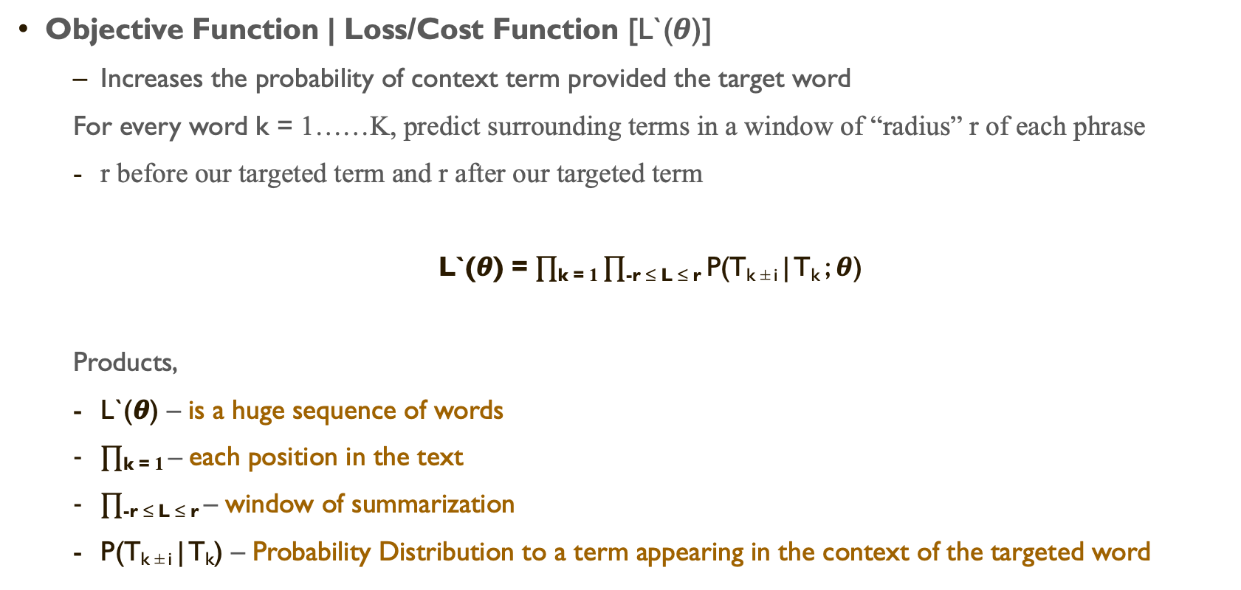
Word2vec – objective function
Objective Function | Loss/Cost Function [L`(𝜽)]
Increases the probability of context term provided the target word
For every word k = 1……K, predict surrounding terms in a window of “radius” r of each phrase
r before our targeted term and r after our targeted term
L`(𝜽) = $∏$_{k = 1} $∏$_{-r ≤ L ≤ r} P(T_{k ± i} | T_{k} ; 𝜽)
Products,
L`(𝜽) – is a huge sequence of words
$∏$_{k = 1} – each position in the text
$∏$_{-r ≤ L ≤ r} – window of summarization
P(T_{k ± i} | T_{k}) – Probability Distribution to a term appearing in the context of the targeted word
Vector
Representations

Slide 17
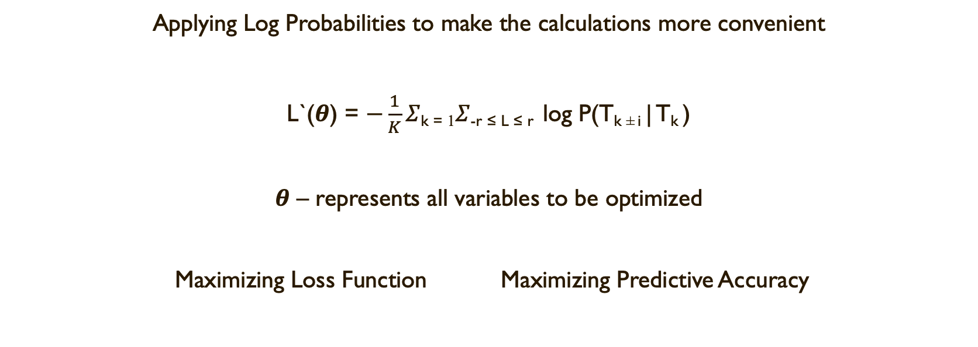
Negative Log Likelihood (AVG)
Applying Log Probabilities to make the calculations more convenient
L`(𝜽) = $−\frac{1}{K}Σ$_{k = 1}$Σ$_{-r ≤ L ≤ r} log P(T_{k ± i} | T_{k} )
𝜽 – represents all variables to be optimized
Maximizing Loss Function Maximizing Predictive Accuracy

Slide 18
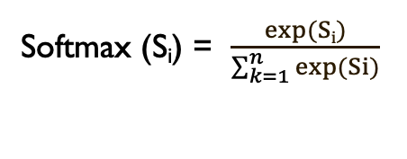
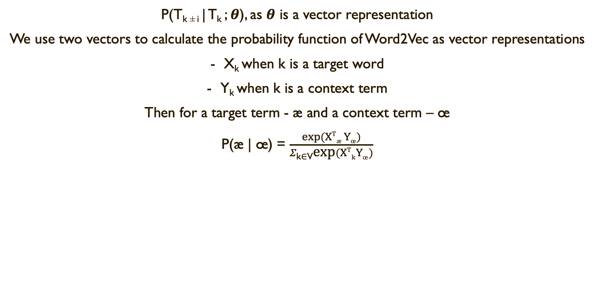
Probability calculation
P(T_{k ± i} | T_{k} ; 𝜽), as 𝜽 is a vector representation
We use two vectors to calculate the probability function of Word2Vec as vector representations
X_{k} when k is a target word
Y_{k} when k is a context term
Then for a target term - æ and a context term – œ
P(æ | œ) = $\frac{exp(XTæ Yœ)}{Σ\text{k}\text{∈}\text{V}\text{exp}(XTkYœ)}$
Dot product compares similarity of æ and œ
Lager Dot Product = Lager Probability
Normalize over entire context
to give Probability Distribution
Softmax (S_{i}) = $\frac{exp(Si)}{\sum_{k=1}^{n}{exp(Si)}}$
Maximizes the probability of S_{i},
However, it assigns some probability to smaller S_{i}
When we calculate dot product, they are real numbers
Hence, to turn numbers into a Probability Distribution,
Exponentiate Method keeps the distribution in positive values

Slide 19
Word2Vec - Snippet
Training Word2Vec Model:
cola_model_build = Word2Vec(cola_split, min_count = 1)
summarizing all the words in one list → unique words:
cola_words = list(cola_model_build.wv.vocab)
Semantic Similar Words Analysis:
cola_model_build.most_similar("chalice")

Slide 20
Keras – Word Embedding
Keras is been providing an Embedding Layer that can be used for neural networks on textual information
The vectorization of a phrase can be performed using he Tokenizer API
Embedding Layer can be adjustable by a user according to the weights that we wanted to act as vectors for a specific division of words

Slide 21
Keras – Embedding Arguments
input_dim – size of vocab in the information provided
output_dim – size of the vector space in which words will be embedded
input_length – length of input sequence
For instance,
Layer = Embedding(5000, 100, input_length = 50) → which represents, 5000 words, 100 dimensionality of embeddings, length of input sequence is 50 The output of embedding layer is a 2D vector with 1 embedding for each term in the input sequence of information provided

Slide 22
PyTorch - Embedding
While using embeddings we need to define an index for every phrase like one-hot vectors which act like keys.
Hence, embeddings are stored as a ∣Vec∣×Dim matrix, where Dim is the dimensionality of the embeddings
The term assigned an index (k) which has its embedding preserved in the k^{th} row of the matrix.
In the implementation of PyTorch Embedding, the mapping of words to indices stored in a word_to_ix dictionary
PyTorch Embedding Syntax
torch.nn.Embedding
which takes two arguments: the vocabulary size, and the dimensionality of the embeddings.

Slide 23
Graph embeddings
General Idea
Embedding: Mapping words to vectors and performing some similarity metrics
WORD VECTOR
Graph Embedding: Constructing these vector representations into graph structure
and mapping these nodes to vectors
NODE VECTOR

Slide 24

Applications
Word Embeddings

Slide 25
Applications
Semantic Relatedness
Synonym Detection
Concept Categorization
Selection Preferences
Analogy

Slide 26

Biological Word Embedding
Recently, word embedding techniques are implemented in biological term sequences to analyze the data according to the language modeling
For instance, DNA, RNA, Blood Streams data is been processing on N-gram Language Model of embeddings for bioinformatics applications
This research and applications proposed by Asgari and Mofrad
doi - 10.1371/journal.pone.0141287
The vectorization of bio terminology is been implemented as Bio-Vectors for general biological sequential terms, Protein-Vectors for protein terms, and Gene-Vectors for gene building terms.
Further, the applications is been emerging with the collaboration of Deep Learning algorithms likely, Proteomics and Genomics

Slide 27
Implementation
Word Embedding

Slide 28
Hugging Face Datasets !
For the implementation of Word2Vec semantic similar terms, I have used hugging face datasets
Hugging Face Datasets are built by Wikipedia information (https://dumps.wikimedia.org/)
We can directly import these datasets into the environment we have been using and then apply these datasets on top of our program to analyze results
In the field of Artificial Intelligence and Data Science hugging face datasets is been taking a crucial part in developing various digital technologies
The recent article on hugging face datasets for more explanation and details
https://www.linkedin.com/pulse/hugging-face-going-become-ed-tech-ai-company-michael-spencer/

Slide 29

Code
Word2Vec Implementation
https://colab.research.google.com/drive/18s2ulh5QJOeMGIsLjAqHLEEU-RftRqV1#scrollTo=4_y8fNLlGPRF
Keras – Word Embedding
https://colab.research.google.com/drive/1SMDF-pAQ-9t3Wgay6OF3U_YM3WXF8X-g#scrollTo=524a0136
PyTorch – Word Embedding
https://colab.research.google.com/drive/1kNrj2sRXBtJOKVj3gK00rm0EhHv7GNje#scrollTo=CYnH53fX6Icr

Slide 30
References
Mikolov, Tomas et al. “Efficient Estimation of Word Representations in Vector Space.” ICLR(2013).
Mikolov, Tomas et al. “Distributed Representations of Words and Phrases and their Compositionality.” NIPS (2013).
Asgari, Ehsaneddin et al. “Continuous Distributed Representation of Biological Sequences for Deep Proteomics and Genomics.” PLoS ONE 10 (2015): n. pag.

Slide 31
Thank You

