Slide 1

Gokaraju Rangaraju Institute of Engineering and Technology (Autonomous)
Department of Artificial Intelligence and Machine Learning Engineering
TEAM-A6
Under the Guidance of:
Dr. Kiran Kumar,
Presented by:
Krishna Kalyan (20241A6638)
Abhinav (20241A6605)
Samuel (20241A6647)

Slide 2
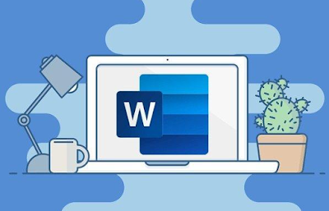
Automated Word Formatter

Slide 3
Our Approach
Creating a streamlined solution to correct formatting in Word documents using AI-assisted methods. This project involves developing an application that leverages JSON-based instructions to identify and highlight formatting discrepancies in paragraphs and runs within the document. By parsing provided instructions and applying the specified formatting attributes, the system enables efficient detection of incorrect font styles, sizes, and other attributes. The tool empowers users to enhance document consistency and adherence to predefined formatting standards, improving the quality and visual coherence of written content.

Slide 4
Existing Approaches Drawbacks
Paid service
Lack of free demo

Slide 5
NOVELTY OF THE PROJECT
Saves a lot of time by automating the tedious manual work.
Improves Productivity
Free of Cost

Slide 6

Digital Balance (A chrome Extension for productivity)

Slide 7
EXISTING APPROACHES
Many extensions solve small problems

Slide 8
NOVELTY OF THE PROJECT
Provides an all in one productivity solution.
Addition of new ideas such as providing motivational quotes and showing Surf history and the usage time on a new tab.
Addition of the idea of inclusion of writing the purpose of using a blacklisted extension
Blocking of given extensions

Slide 9
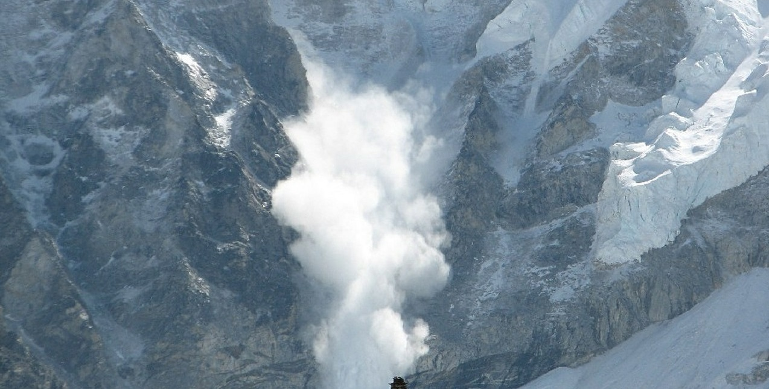
Avalanche Hazard Reduction and Recovery

Slide 10
EXISTING APPROACHES
Many Approaches are based on using sensors

Slide 11
NOVELTY OF THE PROJECT
Open CV based Avalanches Detection
Sends Alert to both rescue forces and the all the people near Avalanches.

