Slide 1

Gokaraju Rangaraju Institute of Engineering and Technology (Autonomous) Department of Artificial Intelligence and Machine Learning Engineering
Under the Guidance of:
Dr. Kiran Kumar,
Presented by:
Krishna Kalyan (20241A6638)
Abhinav (20241A6605)
Samuel (20241A6647)

Slide 2

Automated Word Formatter

Slide 3
Our Approach
Creating a streamlined solution to highlight incorrect formatting in Word documents using AI-assisted methods. This project involves developing an application that leverages JSON-based instructions to identify and highlight formatting discrepancies in paragraphs and runs within the document. By parsing provided instructions and applying the specified formatting attributes, the system enables efficient detection of incorrect font styles, sizes, and other attributes. The tool empowers users to enhance document consistency and adherence to predefined formatting standards, improving the quality and visual coherence of written content.

Slide 4

MindfulSurf (Digital Balance)

Slide 5
ABSTRACT
In today's digital age, the constant influx of information, notifications, and digital distractions can take a toll on our mental well-being and productivity. The "DigitalBalance" Chrome extension is designed to empower users to regain control over their online lives and find a healthier balance between screen time and real-life experiences.
With "DigitalBalance," users can effortlessly track and manage their online activities, gaining valuable insights into their digital habits. The extension provides real-time data on website usage, app engagement, and screen time, enabling users to make informed decisions about their online interactions.

Slide 6
DigitalBalance also features a customizable website blocker and productivity timer. Users can set limits on access to time-consuming or distracting websites and utilize focused work intervals to enhance their productivity. The extension gently nudges users toward healthier online behaviors without sacrificing convenience.

Slide 7
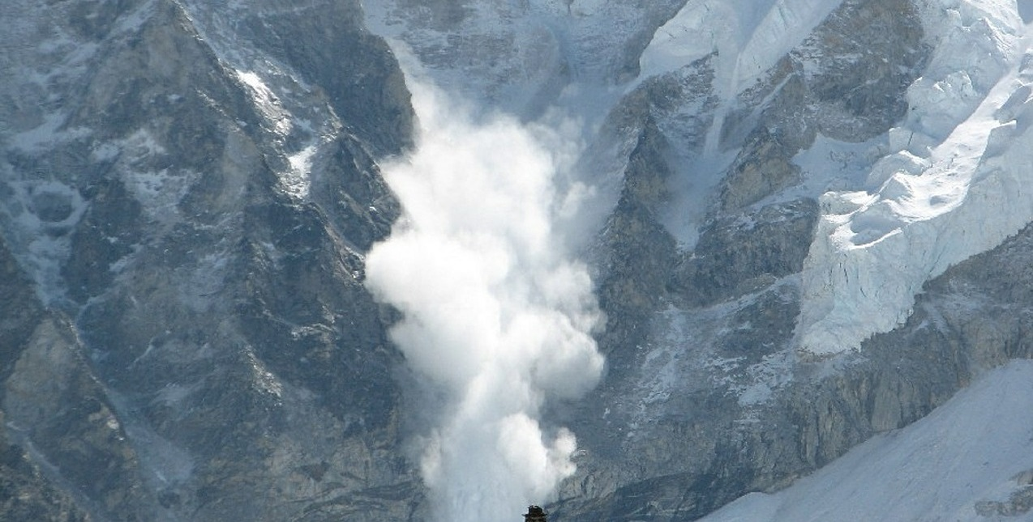
Avalanche Hazard Reduction and Recovery

Slide 8
ABSTRACT
Avalanches bring danger, especially for buried victims. Rapid response is vital, but rugged conditions complicate matters. This study suggests an effective strategy merging OpenCV and AI. OpenCV detects potential victims using visual clues, while AI adds intelligence to predict avalanches. By combining these technologies, a proactive rescue system is developed, alerting authorities when people and avalanches coincide. This research exploits OpenCV's capabilities to revolutionize avalanche rescue, offering a proactive approach to save lives in challenging scenarios.

