Slide 1

Insect Classification
Guide - Professor Ozgur Ozturk
Team Members:
Dishnat Fapot
Krishna Sai Biradar
Akhil Kumar

Slide 2
Introduction
Agriculture, which is considered the backbone of the economy, contributes to the country’s economic growth and determines the standard of life.
Insect pests are known to be a major cause of damage to commercially important agricultural crops. Categorization of insect pests plays a crucial role in agricultural pest forecasting, which is vital for food security.
This study aims to classify and detect the insects in rice, wheat, etc. using different Approaches and insect pest detection algorithms.

Slide 3
Research Question
Does the Hybrid (Resnet50 and VGG16) model approach help in the classification of Hierarchical Classes?
What is the best method of data augmentation for improving the overall accuracy?
Which of the Approach (Noise, Gaussian, Cascade) fits best to gain a higher Accuracy in our Model?

Slide 4
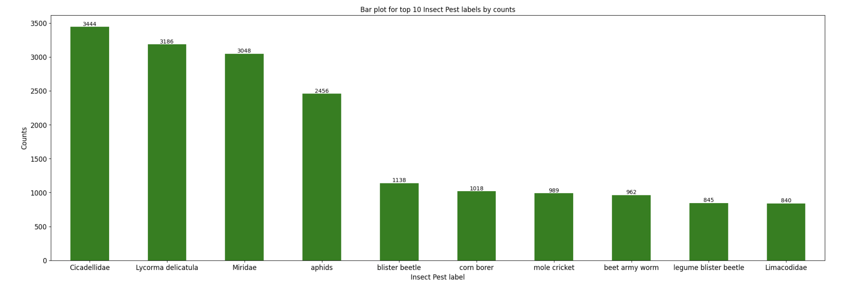
Top 10 Labels by counts
Cicadellidae stands on top of the list with highest number of datapoints in the train dataset while Limacodidae stands at 10th position.

Slide 5
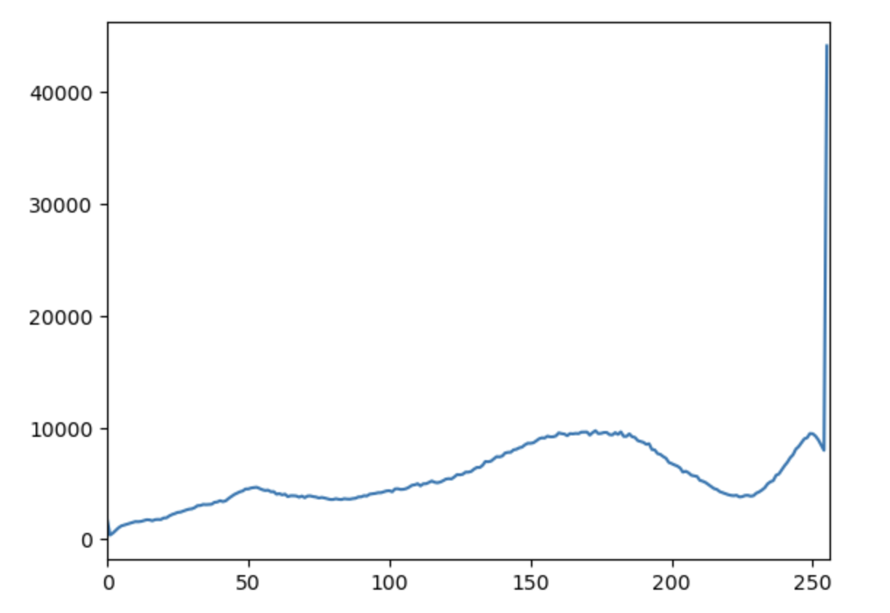
Pixel Distribution
Pixel distribution refers to the distribution of pixel values across all images in the dataset.
A pixel with red, green, and blue values all between 150 and 200 would represent a medium-bright color with no dominant hue
pixel distribution

Slide 6
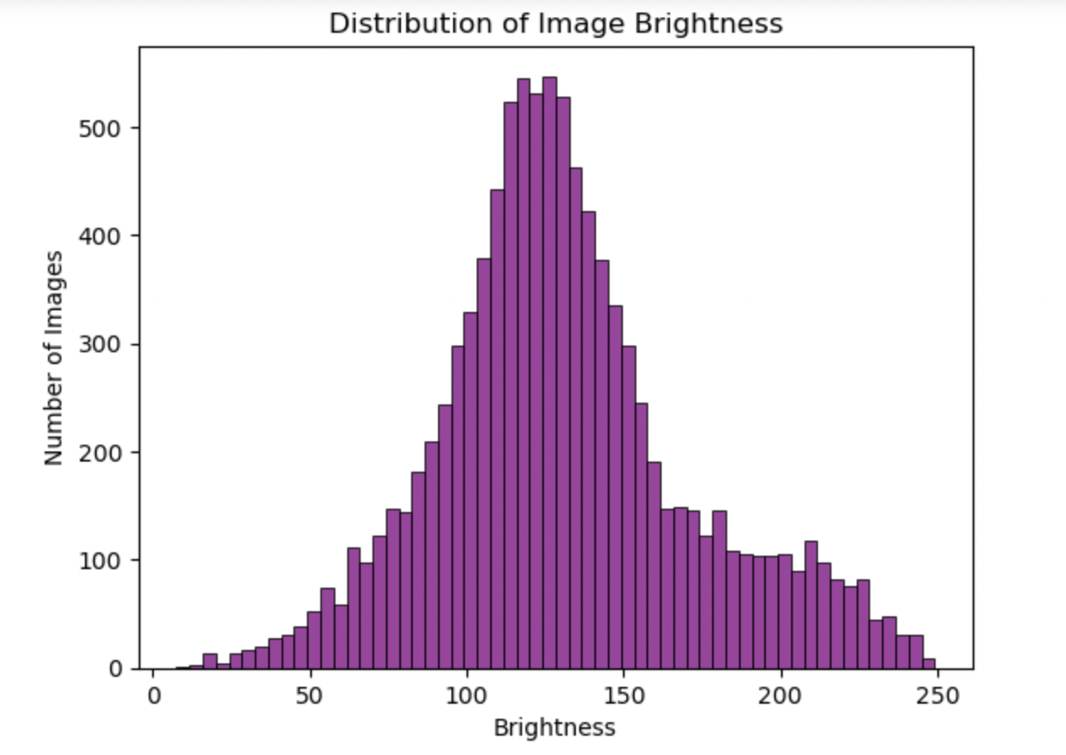
Histogram of Image Brightness Values
If the histogram shows a normal distribution, it indicates that the majority of images have an average brightness level, and the dataset is balanced.

Slide 7
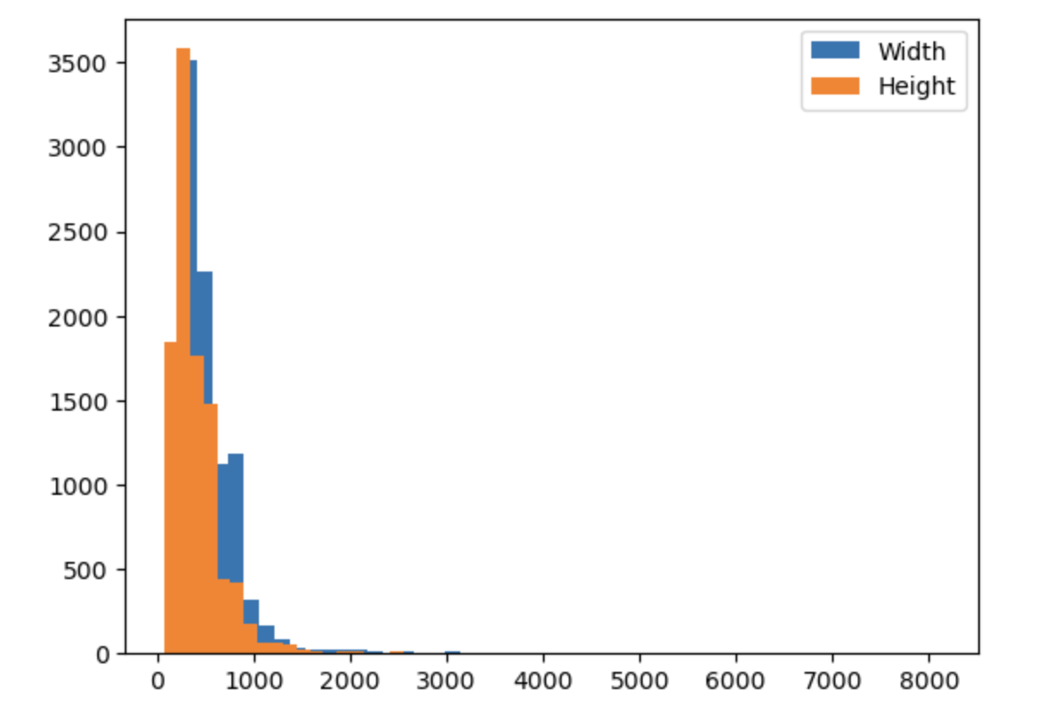
Image size Distribution
This plot provide the image size distribution in the dataset.
It can help to identify outliers i.e., presence of extreme large or extreme small images.
Image Size Distribution

Slide 8
Model
The ResNet50 was trained on the ImageNet dataset, achieving state-of-the-art performance on several image classification benchmarks. The ResNet architecture has been used in a variety of computer vision tasks, including image classification, object detection, and semantic segmentation. Its architecture has also been adapted for other computer vision tasks, such as object detection and semantic segmentation. ResNet50 has become a popular choice for transfer learning, where the pre-trained weights on ImageNet can be fine-tuned on a new dataset for a specific image classification task.​
VGG16 has achieved state-of-the-art performance on several image classification benchmarks, including the ImageNet Large Scale Visual Recognition Challenge (ILSVRC) in 2014, where it achieved a top-5 error rate of 7.3%. Its simplicity and uniformity have also made it a popular choice for transfer learning, where the pre-trained weights on ImageNet can be fine-tuned on a new dataset for a specific image classification task.

Slide 9
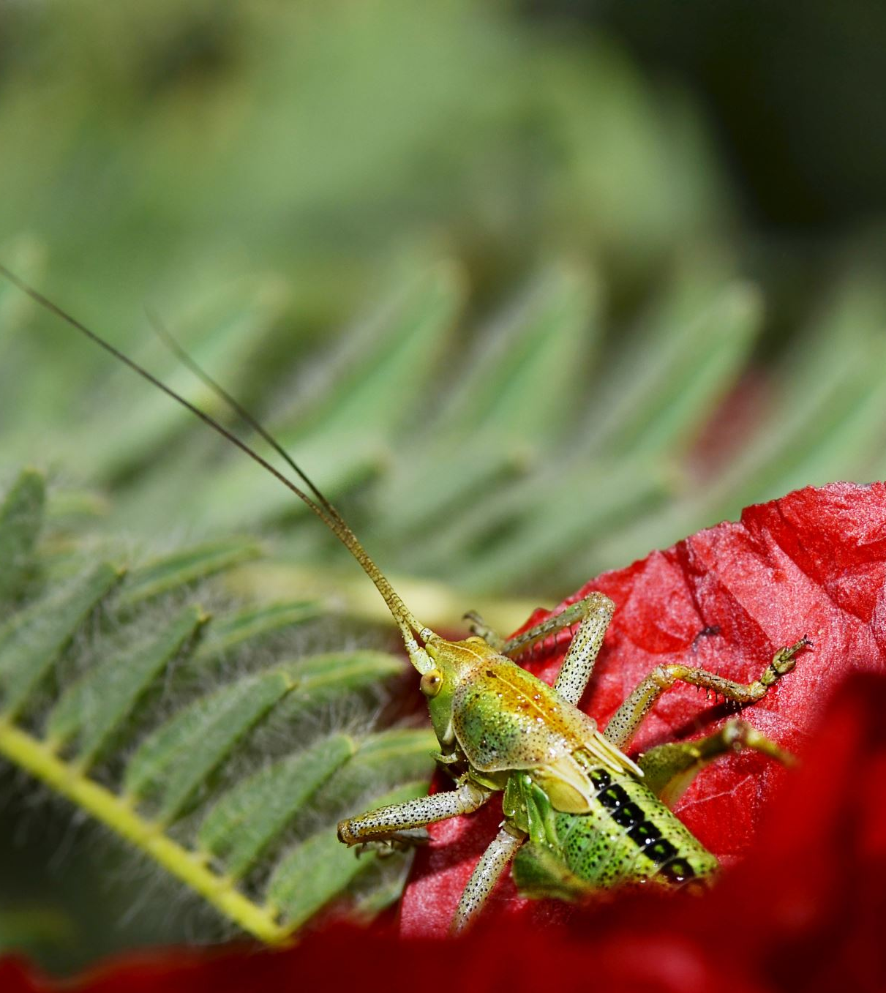
Approach
Noise refers to any unwanted variation or distortion in the image signal that can reduce its quality or make it difficult to interpret. Noise can have a variety of negative effects on image analysis tasks, such as reducing accuracy, introducing errors, and making it difficult to extract meaningful information from the image. Techniques such as noise reduction, filtering, and image enhancement can be used to mitigate the effects of noise and improve image quality.
Cascade would use a separate classifier to recognize different features of the image that are relevant for the current level of categorization. The outputs of each stage would be combined to generate the final classification result.
The Gaussian noise can have a significant impact on image quality, making it harder to discern fine details and reducing the accuracy of image classification algorithms. Gaussian smoothing can also help to reduce the impact of other types of noise or image artifacts that may be present in the image, such as motion blur or camera shake. By improving the quality of the input image, the accuracy of the classification algorithm can be improved as well.

Slide 10
References
https://github.com/xpwu95/IP102
Li, Yanfen & Wang, Hanxiang & Dang, L. Minh & Sadeghi-Niaraki, Abolghasem & Moon, Hyeonjoon. (2020). Crop pest recognition in natural scenes using convolutional neural networks. Computers and Electronics in Agriculture. 169. 10.1016/j.compag.2019.105174.
Nanni, Loris & Manfè, Alessandro & Maguolo, Gianluca & Lumini, Alessandra & Brahnam, Sheryl. (2021). High performing ensemble of convolutional neural networks for insect pest image detection. Ecological Informatics. 67. 101515. 10.1016/j.ecoinf.2021.101515.
W. Dawei, D. Limiao, N. Jiangong, G. Ji-yue, Z. Hongfei, and H. Zhongzhi, "Recognition pest by image-based transfer learning," Journal of the science of food and agriculture, vol. 99, no. 10, pp. 4524-4531, 2019.

